Slide 1
ACR Overview
Bill Herrington MD FACR
Chair Commission on Membership
And Communication
Member Board of Chancellors
Official ACR Photo Above

Slide 2
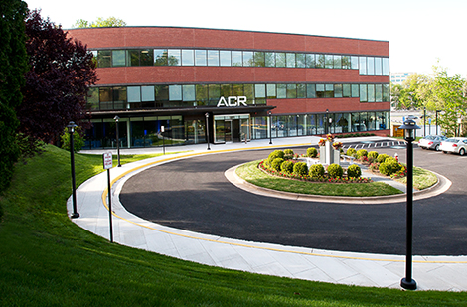
ACR Key Facts
Founded 1923
450+ staff in four locations
ACR Headquarters — Reston, VA
ACR Government Relations — Washington, DC
ACR Center for Research and Innovation™ — Philadelphia, PA
ACR’s American Institute for Radiologic Pathology — Silver Spring, MD
ACR Headquarters | Reston, VA

Slide 3
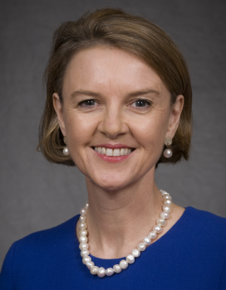
ACR Is Led by Members
1,850 members volunteer their time and talents together on commissions and committees to promote excellent patient care and professionalism in radiology
James A. Brink, MD, FACR, of Boston, MA, was elected by the ACR Board of Chancellors to serve as Chair from May 2016 to May 2018
Geraldine B. McGinty, MD, MBA, FACR, of New York, NY, was elected by the ACR Board of Chancellors to serve as Vice Chair from May 2016 to May 2018
Timothy L. Swan, MD, FACR, of Marshfield, WI, was elected by the ACR Council to serve as Council Speaker from May 2017 to May 2019
Richard Duszak Jr., MD, FACR, of Atlanta, GA, was elected by the ACR Council to serve as Council Vice Speaker from May 2017 to May 2019

Slide 4
ACR Core Purpose and Values
Core Purpose of the ACR
To serve patients and society by empowering members to advance the practice, science and professions of radiological care
ACR Core Values
Leadership
Integrity
Quality
Innovation

Slide 5
ACR Core Areas
Membership: acr.org/membership
Advocacy: acr.org/advocacy
Economics: acr.org/advocacy-and-economics
Quality and Safety: acr.org/quality-safety
Education: acr.org/education
Research: acr.org/research
Informatics: acr.org search Informatics

Slide 6
ACR ― The Voice of Radiology
The leader in advancing the practice, science and professions of radiology
ACR is recognized within the House of Medicine, and by patient advocacy groups, as a groundbreaker in shaping the future of health care
The established global voice of radiologic quality and safety and best practices — providing solutions to government decision makers that ensure radiology remains a vital part of the health care community
ACR fosters a sense of community among radiologists both locally and nationally

Slide 7
ACR Supports Members and Patients
Helping you to participate in new practice and payment models that promote high value, patient-centered radiologic care
Providing you with the necessary tools to adapt, succeed and thrive in the changing world of health care
Protecting and supporting the work you do through advocacy, economics, leadership, quality and safety, and innovation initiatives
Connecting you directly with a dedicated community of professionals who are shaping radiology to ensure it remains integral to the future of health care

Slide 8
ACR Is The Voice of Radiology
ACR Advocacy:
Works for you and the radiology community at the local, state and federal levels
Advocates for positive change in regulations and legislation
Supports important changes, such as physician payment reform, imaging utilization research and patient access to diagnostic screening services
Shapes our medical specialty, working with members, to ensure that radiology remains integral to the future of health care

Slide 9
ACR Advocacy
Takes a proactive approach in representing and advancing radiology before U.S. Congress, state legislatures and federal agencies
Supports important issues, including:
Transition to value-based models
Imaging appropriateness
Patient- and family-centered care
Quality Payment Program (APMs/MIPS)
Regulatory affairs and research policy
Evidence-based justification for covered services
Learn more at acr.org search Advocacy

Slide 10
ACR Advocacy Communication
Legislative and regulatory communication goals
Ongoing, frequent and concise updates
Inform and engage members
Maintain ACR as the clear Voice of Radiology
Tactics
Weekly e-newsletter: ACR Advocacy in Action
Practice management tools
Webinars & podcasts
Voice of Radiology Blog & web content
Social media
Capitol Hill meetings/events

Slide 11
ACR Advocacy: Recent Victories
H.R. 2029: Consolidated Appropriations Act of 2016
Delays 2015 draft United States Preventive Services Task Force (USPSTF) mammography screening recommendations for 2 years
Lowered multiple procedure payment reduction from 25% to 5%, effective January 2017
USPSTF assigns CT colonography and other colorectal cancer screening exams an “A” grade for use in adults ages 50−75, mandating private insurance coverage with no patient cost-sharing under the Affordable Care Act
Unfortunately, Medicare is still not required to cover CTC
Introduction of HR 1298, CT Colonography Screening for Colorectal Cancer Act of 2017, to mandate Medicare coverage of CTC

Slide 12
115th Congress Legislative Forecast
Results of the 2016 election have altered the political landscape
Republicans retained control of the House and Senate, as well as captured the White House
A few new faces in Senate leadership and on key House Committees:
New Senate Minority Leader: Charles Schumer (D-NY)
New Energy and Commerce Committee Chair: Rep. Greg Walden (R-OR)
New Energy and Commerce Health Subcommittee Chair: Rep. Michael Burgess, MD (R-TX)
New Ways and Means Committee Ranking Member: Rep. Richie Neal (D-MA)
New Ways and Means Health Subcommittee Ranking Member: Sander Levin (D-MI)
New Ways and Means Health Subcommittee Chairman: Peter Roskam (R-IL)
2017 — Repeal and replace of the Affordable Care Act (ACA) was a major priority for incoming Republicans and Trump administration
Didn’t turn out as the Republicans had planned
ACA has been weakened by other legislative and regulatory efforts

Slide 13
Failure of AHCA Illustrates Many Things
Despite Republican control of Congress and White House, GOP lawmakers wouldn’t support AHCA Why?
1
Independence of individual members of Congress
Individual members of Congress have become more willing to act independently of their party’s leadership
4
Polarized sources of money in politics
It is now easier than ever for members of Congress to connect with small donors throughout the country. Small and individual donors tend to be the most ideologically polarized, which further empowers extreme wings of the parties
2
Heightened influence of well-funded outside groups
There has been a transfer of influence from political parties to well-funded outside groups that are willing to support Republican representatives who take stances on issues that align with the group
5
Reduced importance of congressional committee assignments
Committees did not play a central role in crafting the AHCA. Now, committee assignments are less necessary for PR and fundraising purposes, meaning less leverage for leadership
3
Less reliance on party infrastructure
Many members of Congress now depend less on the party’s financial assistance and support. An example of this was the Koch network’s willingness to support those who buck party leadership
6
Impact of elimination of earmarks
The elimination of earmarks has stripped a tool that party leaders could have used to entice members to support certain legislation

Slide 14
TRUMP ADMINISTRATION POTENTIAL ACA ACTIONS
Five Ways the Trump Administration May Undermine the Affordable Care Act in 2018
Congress may not be able to repeal the law, but there are several actions Trump could take to weaken the ACA
ACA executive order
Trump signed an executive order to ease ACA regulations in October 2017, but health agencies have not yet issued regulations to bring the order into effect
Expanding short-term health insurance plans and association health plans could siphon healthy people away from ACA plans
Cuts to ACA outreach programs
In 2017, the Trump administration cut ACA outreach funding by 90%. The administration could cut funding further for the next open enrollment period
Despite the funding cut, 8.7 million people signed up during the 2018 open enrollment period, down just slightly from 9.2 million in 2017
Targeting essential health benefits
Without congressional action, Trump cannot repeal the ACA’s essential health benefits, which require insurance plans to cover a wide range of services such as mental health care and prescription drugs
Trump could, however, take steps to loosen definitions and give states flexibility to change the requirements
Allowing counties to have zero on-exchange insurers
In previous years, officials have had to take active measures to prevent some counties from having zero insurers that provide ACA plans
Earlier in 2017 Trump administration officials declined to comment about whether they would encourage insurers to participate in the ACA marketplaces
Rejecting plans to stabilize ACA marketplaces
Two bipartisan bills have been announced to help stabilize the ACA insurance markets
House Republicans have resisted the bills, saying they are “just throwing more money at ObamaCare”
Passing the bill in the House may require Trump to put pressure on House conservatives, but it is unclear if he will do so
January 2, 2018 | Maansi Vasan
Sources: Peter Sullivan, “Five ways Trump can undermine ObamaCare in 2018,” The Hill, December 30, 2017.

Slide 15
So What’s Congress Been Doing Since the ACA Repeal Effort?
Tax Reform
Repealed the ACA Individual Mandate
January Continuing Resolution (CR)
Funded and extend the Children's Health Insurance Program (CHIP) for six years
February Continuing Resolution (CR)
Funded and extend the Children's Health Insurance Program (CHIP) for an additional four years
Reauthorized funding for community health centers for two years
Permanently repealed the ACA’s Independent Payment Advisory Board (IPAB)

Slide 16
What’s Next for Health Care?
Will there be any more serious attempts to replace the ACA?
Maybe. Any serious attempt would likely be a more minor, bipartisan, legislative fix to the ACA
Will Trump’s administration undermine the ACA?
Possibly. However, if Trump’s administration does cause the law to collapse, there will likely be significant political consequences
What about entitlement reform and drug pricing legislation?
Entitlement reform is unlikely to occur in the next two years
Drug pricing legislation is possible, but unlikely in the short term due to a number of other legislative priorities (e.g. tax reform, infrastructure)

Slide 17
Other Key Issues in 115th Congress
ACR will also be working to:
Continue to put legislative pressure on CMS to properly implement the imaging appropriate use criteria policy
Stop any retrospective site neutral payment policies (i.e. Medicare reimbursing hospitals at the same rate as physician offices)
Promote legislation to mandate Medicare coverage of CTC
Extend the moratorium on implementing the 2016 USPSTF mammography screening recommendations
Pursue changes to USPSTF within the context of broader ACA reforms
Opposing private insurers that exclude specific imaging sites of service (Anthem)

Slide 18
www.acrdsi.org
Physicians
Technologists
Industry
Data Scientists
Informaticists
Health Care Executives
Patients
Notes:
The The ACR Data Science Institute.
The ACR Data Science Institute was created by the ACR Board of Chancellors in May 2017 to establish the ACR’s and radiology professionals’ leadership role in bringing the advances in data science and artificial intelligence for medical imaging to clinical practice. While we cannot tell the entire ACR DSI story in just a few slides please visit acrdsi.org for more information and updates.
AI will ultimately be an incredibly important tool to help radiology professionals better serve our patients. The applications of AI to the radiological sciences will be almost unlimited. We foresee applications where AI is automatically run on our modalities to flag potentially time-sensitive, critical cases so that we can bump those patients to the top of our worklists. AI will almost certainly improve disease detection and classification. AI will also enhance patient throughput and the overall productivity of our departments. We may even be able to use AI to predict which patients are most likely to skip their MRI appointment and then take steps to prevent that situation.
Although the initial work on AI for radiology is happening mostly at our academic institutions, the value of AI is not going to just be for academic radiologists. To help our patients the most, AI algorithms must be integrated in community practices as well. Our goal is to make AI an indispensable tool for all radiology professionals, our referring physicians and our patients.
The DSI is designed to support every stakeholder involved in applying AI to imaging: industry developers, data scientists, radiologists and other physicians, informaticists, patient advocates, healthcare executives, and ultimately (and most importantly) our patients!

Slide 19
ACR DSI Mission
Establish industry relationships by providing credible use cases, help with FDA and other government agencies, and pathways for clinical integration
Ensure the value of radiologists as AI evolves through the development of appropriate use cases and workflow integration
Protect patients through leadership roles in the regulatory process with government agencies and validation of algorithms
Educate radiologists, other physicians and all stakeholders about AI and the ACR’s role in data science for the good of our patients
Notes:
The DSI has a four-part mission to help guide the implementation of AI in medical imaging and the radiological sciences:
Ensure the value of radiologists as AI evolves through the development of appropriate use cases and workflow integration
Protect patients through leadership roles in the regulatory process with government agencies and validation of AI algorithms
Establish industry relationships by providing credible use cases, help with FDA and other government agencies, and pathways for clinical integration
Educate radiologists, other physicians and all stakeholders about AI and the ACR’s role in data science for the good of our patients

Slide 20
ACR Data Science Institute: Initial Focus
Use cases | Content | Compute | Implementation | Regulatory | Validation
Economics | Standards | Education | Commercialization | Legal | Ethical
The biggest DSI initiative right now centers around creating clinical Use Cases for applying AI to radiology.
The DSI is:
Defining clinical AI use cases for imaging that intersect high clinical value with problems solvable by AI
Using the data elements from these use cases to develop methodologies for creating annotated data sets for training
Ensuring patient safety with use cases that have data elements for algorithm validation pre-FDA approval and after clinical deployment
Ensuring use cases have data elements that will allow effective clinical integration using our workflow tools such as our reporting software, the modalities, PACS and HER
Creating validation data sets to test algorithms trying to tackle these use cases
Notes:
AI use cases are the way software developers specify how an AI algorithm will take in information, run the AI model and provide an output for end user and the top DSI initiative is creating clinical Use Cases for applying AI to radiology and radiological sciences.
We are focusing on the activities where the ACR and DSI are uniquely positioned to do the things that need to happen to advance that missions of the ACR and our professions: patient safety, regulatory process and government relations and promoting and ensuring the value of radiology professionals to our patients and health systems These are key areas where other players will be unlikely to take on or less successful if they do.
Using a wide range of input from radiology specialty societies, academic practices and industry developers, ACR DSI Use Cases will be developed by expert DSI Data Science Subspecialty Panels to prioritize the AI use cases that will be most valuable to our patients, our practices and our health systems. The ACR is developing a very agile but structured way to tap into the volunteer energy of our members to help the developers be successful in creating AI that gets broad adoption because it solves real problems.
-DSI Use Case data elements will specify standardized ways for creating annotated data sets for algorithm training and testing that recognize the technical, geographic and patient diversity in our practices.
-DSI Use Case data elements will ensure patient safety by specifying how algorithms will be validated prior to FDA approval and the ACR DSI will provide validation services for developers using DSI use cases to facilitate FDA review
-DSI Use Case data elements will specify pathways for clinical integration into our existing workflow tools such as our reporting software, the modalities, PACS and EHR and finally
-DSI Uses Cases will have data elements that provide post-market feedback about the algorithm’s effectiveness in clinical practice from radiologists through an AI Registry
This process has broad appeal among many stakeholders including the FDA, and DSI Lung Cancer Screening Use Case has been selected by the FDA for a demonstration project illustrating DSI tools for algorithm validation of algorithms and monitoring algorithm performance in clinical practice.

Slide 21
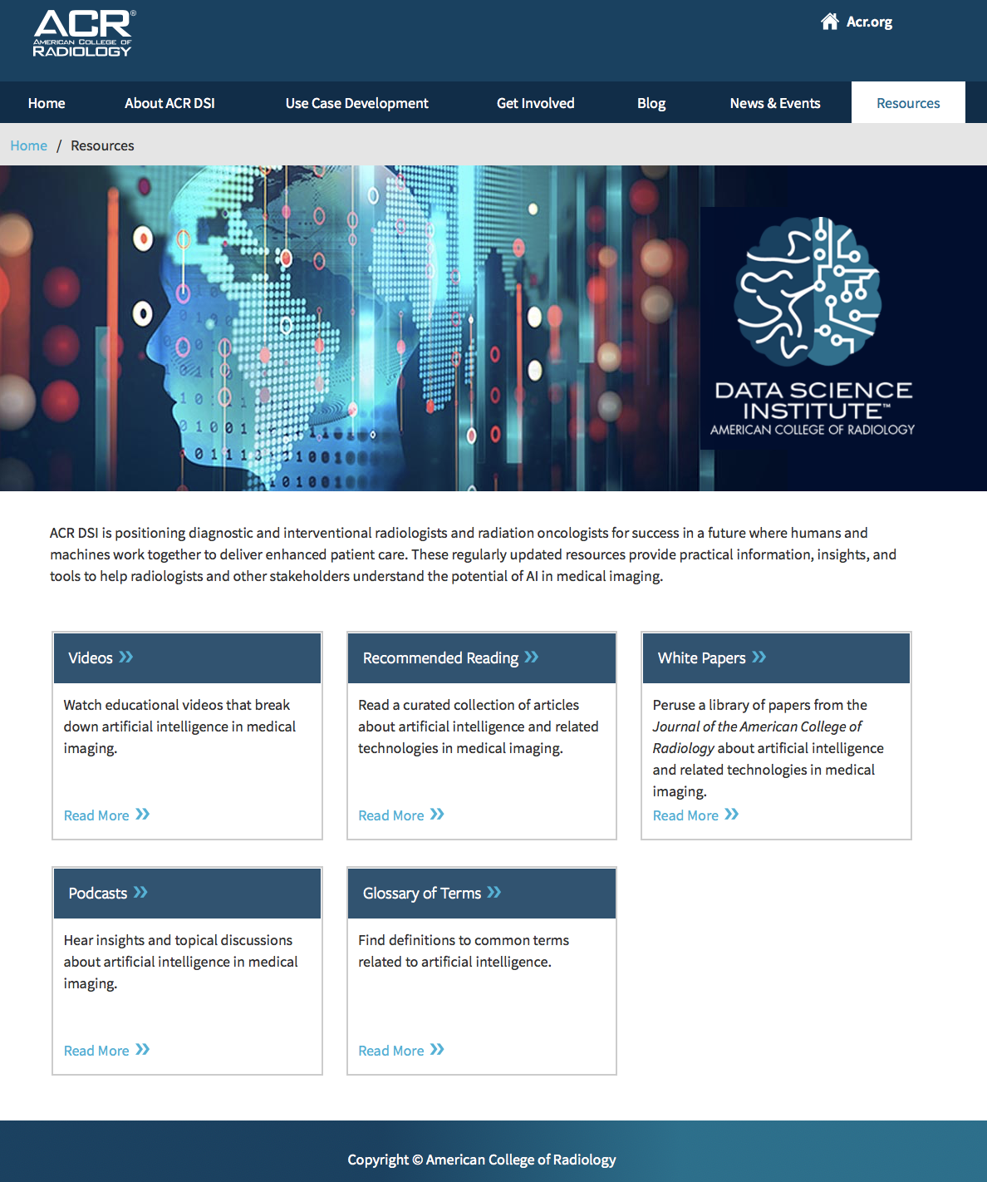
Education
Member And Stakeholder Education
Separating the hype from the reality
Understand the applications AI in the radiological professions and how AI will improve our practices
How AI will be implemented in our practices
Legal and ethical issues
Understanding the regulatory process and economics of AI
ACR DSI website: acrdsi.org
JACR AI resources – bimonthly column “Data Science and Radiological Practice” to keep members informed of the latest in AI
Notes:
Finally, the ACR DSI has the mission of member and other stakeholder education about AI in the radiological professions. Separating the hype of AI taking away radiologists’ jobs from the real benefits AI will bring to our practices and patients is paramount. Additionally, we are discussing all aspects of AI in medical imaging including implementation, legal and ethical issues and the regulatory and economic aspects of bringing AI to practice. Please visit the ACR DSI website at acrdsi.org for more resources including blogs, videos and webinars. Also, the JACR has established a bimonthly Data Science And Radiological Practice co-edited by the DSI Chief Science Officer, Keith Dreyer and the DSI Chief Medical Officer, Bibb Allen to keep members up to date on the developments in Ai and the activities of the Data Science Institute.

Slide 22
ACR Economics and Health Policy
Focusing on coding, payment policy, national and local coverage policy, regulation, as well as private and public payer relations, the ACR:
Provides evidence for communications with Centers for Medicare and Medicaid Services (CMS), policy makers and medical insurers
Fights against CMS edits that place incorrect payment restrictions on particular CPT® codes
Works to ensure ACR members are reimbursed fairly by government and private payers
Aims for successful implementation of clinical decision support systems
Helps to adopt value-based payments and alternative payment models

Slide 23
CDS Update
Starting Jan. 1, 2020 -- CMS will require referring providers to consult the Appropriate Use Criteria (AUC) when ordering advanced medical imaging (CT, MR, NucMed/PET) for Medicare Part B patients
Providers must access imaging AUC via stand-alone electronic clinical decision support (CDS) systems or CDS software embedded in electronic health record (EHR) systems
The software must be qualified by CMS for this function
CareSelect Imaging™ is qualified by CMS and can be accessed in a no-fee website version or through EMR integration
If no consultation information is included in the claim (technical and professional), the claim will not be paid

Slide 24
Important CDS Points
Let me repeat: No imaging provider who furnishes Medicare Part B advanced imaging — radiologist or otherwise — will receive Medicare reimbursement for these studies if the referring provider does not verify that imaging AUC were consulted
Imaging AUC is available through a free, ACR web portal
The law does not provide for proxy access. Furnishing providers cannot consult AUC on behalf of the referring provider
Imaging providers may refuse Medicare referrals lacking the Unique Consultation Identifier
Exams performed in the emergency department are considered outpatient imaging and, therefore, covered by PAMA — except for the most emergent of cases.
CMS has defined exceptions for rural providers with limited internet connectivity

Slide 25
CDS/AUC opportunities for radiologists
By promoting CDS/AUC use, ACR member radiologists will position themselves as leaders in driving savings and improving quality for hospital/health system administrators, referring providers, and patients
Use CareSelect Imaging™ (ACR Select)
Drive savings in common areas of overutilization
Ensure compliance with PAMA
Participate in R-SCAN™
Take part in the Radiology Support, Communication, and Alignment Network (R-SCAN) with your referring providers to become familiar with CDS/AUC
CareSelect Imaging integrates with the R-SCAN registry to automate data capture
By participating in R-SCAN, you and referring providers can fulfill Improvement Activity credit under MIPS, obtain CME Credit, and earn MOC Part 4 Credit (ABR and ABIM Diplomates). R-SCAN is administered by ACR.

Slide 26
CPT Editorial Panel
2018 cycle ― completed Oct. 2016 to include new Category 1 codes (20), deleted codes (32) and revised codes (17)
Majority of work at Current Procedural Terminology (CPT®) Editorial Panel for all specialties related to “bundling” (combining existing CPT component codes into new bundled CPT codes)
Extensive coding education for ACR members
Clinical Examples in Radiology
ACR Radiology Coding Source™ newsletter
Coding guides ― Ultrasound, Nuclear Medicine
Coding update ― Interventional Radiology
Learn more at search acr.org Coding Source

Slide 27
Medicare Access and CHIP Reauthorization Act
Key Payment Policy Provisions
MACRA repeals Sustainable Growth Rate formula but in return sets up 2-track payment system to encourage physicians into risk-based payment models
Merit-Based Incentive Payment System (MIPS)
Alternative Payment Models (APMs)
June 2015 − December 2019: All physicians get 0.5% annual update
January 2020 − December 2025: Reimbursement rates frozen at 2019 levels with possibility of earning additional reimbursement through participation in MIPS or APMs
27

Slide 28
Imaging 3.0
Raising awareness and communicating change
Grassroots ACR members: Case studies
ACR Bulletin, JACR®
Medical imaging community and health care partners
Develop, deploy and promote Imaging 3.0 tools
Most Valuable Radiology Practice: living document to help you advance Imaging 3.0 solutions in your practice
ACR Diagnostic Imaging Center of Excellence™ (DICOE)
National Radiology Database Registry (NRDR®)
Radiology Support, Communication and Alignment Network (R-SCAN™)
ACR Select® and Patient Portal
Actionable reporting and image sharing
Learn more at acr.org search Imaging 3.0

Slide 29
Quality and Safety
Accreditation in 10 modalities
ACR Practice Parameters and Technical Standards
ACR Appropriateness Criteria®
ACR Diagnostic Imaging Center of Excellence™
Breast Imaging Center of Excellence
ACR Designated Lung Cancer Screening Center™
Image Wisely® and Image Gently®
ACR BI-RADS® Atlas Fifth Edition
RADPEER® and e-RADPEER®
Learn more at acr.org/Quality-Safety

Slide 30
ACR Quality and Safety Tools for Patient Care
Provide quality patient care with ACR quality and safety tools:
ACR accreditation — 10 modalities
Diagnostic Imaging Center of Excellence™ (DICOE)
Breast Imaging Center of Excellence (BICOE)
ACR Designated Lung Cancer Screening Center™
Breast Imaging Reporting and Data Systems (BI-RADS®)
Lung Imaging Reporting and Data System (Lung-RADS™)

Slide 31
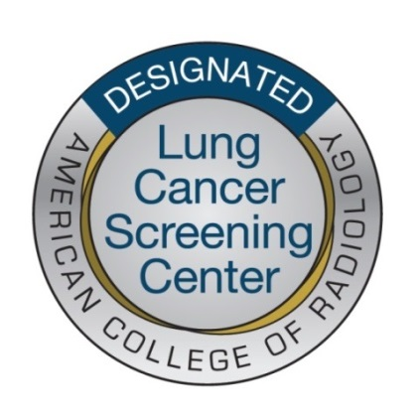
Lung Cancer Screening Activities
ACR Lung Cancer Screening Center designation Search acr.org Lung Cancer Center
Currently 1,792 centers designated LCSC
Reporting and management system based on BI-RADS® ― Lung-RADS™ Version 1.0 Search acr.org Lung Rads
ACR Lung Cancer Screening Registry Search acr.org Lung Cancer Registry
Appropriateness Criterion under development

Slide 32
CMS Quality Payment Program
Authorized under the physician payment reform legislation (MACRA), in Jan. 2017 CMS began implementation of Quality Payment Program (QPP)
Two QPP pathways:
Merit-based Incentive Payment System (MIPS); consolidates three programs (PQRS, Value Modifier, Meaningful Use); adds a fourth: Improvement Activities
Alternative Payment Model (APM) Qualified Participant

Slide 33
ACR QPP Resources
ACR National Radiology Data Registry (NRDR®) has been a PQRS Qualified Clinical Data Registry (QCDR) since 2014
NRDR approved as MIPS QCDR 2017
Key facts, multiple resources available at acr.org: Be MACRA Ready and QPP
Interactive ACR QPP and MIPS Measure Calculator tool available at qpp.acr.org
CMS QPP webpage: qpp.cms.gov

Slide 34
Radiology Support, Communication and Alignment Network (R-SCAN)
ACR received ~$3M over 4 years from CMS to support practices transition from volume-driven to value-based payment systems
Now in year three of the grant: Over 160 practices have signed on to participate
All the tools are available on the R-SCAN website — sign on at rscan.org … participation is free!

Slide 35
What Is R-SCAN?
An Improvement Activity that engages radiologists and referring clinicians to optimize imaging care
Demonstrates radiology’s value to patients, referring clinicians and hospital administration
Features imaging exams of Choosing Wisely® initiative
Highlights benefits of clinical decision support systems

Slide 36
Why Participate?
Fulfills all Improvement Activity credit requirements under MIPS
Demonstrates the impact radiologists can have on management of patient care and the utilization of health care resources
Essential under advanced alternative payment models
Provides an easy (and free) way to try out clinical decision support (CDS)
In preparation for Protecting Access to Medicare Act (PAMA) implementation

Slide 37
Interventional Radiology Toolkit
Video: Interventional Radiology Is Modern Medicine
PowerPoint and Talking Points:
The Clinical and Economic Value of an IR Practice
Customizable brochure
Imaging 3.0 IR case studies
Scientific articles on IR efficacy and cost
IR data tools (Medicare IR spending and volume)
And other helpful resources
Access toolkit at acr.org/ir

Slide 38
Radiation Oncology Resources
Radiation Oncology Practice Accreditation (ROPA)
600+ Accredited sites in the United States
Provide discounted fees for ACR members for Performance Quality Improvement (PQI) projects when participating in ROPA
R-O PEER™ for radiation oncologists
ACR M-P PEER™ for medical physicists
Appropriate Use
Guides for making initial decisions about techniques
ACR Appropriateness Criteria®
Notes:
ACR ROPA is a voluntary process and ACR has recommended to Legislators mandatory accreditation of all facilities

Slide 39
Radiation Oncology Resources
Practice Parameters & Technical Standards
Radiation Oncology Practice Parameters
Medical Physics Technical Standards
Practice Quality Improvement
R-O PEER™ Program
ACR M-P PEER™ Program
Research
IROC Imaging and Radiation Oncology Core
Radiation Therapy Oncology Group
NRG Oncology
ACR Journal Advisor

Slide 40
Radiation Oncology Resources
ACR Member Resources
Online Community for Radiation Oncology (Engage)
CARROS ― RO chapter
Represents members on the ACR Council
Provides information and resources
Offers a pathway to ACR Fellowship
CARROS Connection ― e-newsletter
ACR Bulletin: Radiation Oncology Is Alive and Well Represented Within the College
Search acr.org Radiation Oncology

Slide 41
Helping Improve the Patient Experience
Patient- and Family-Centered Care:
Helps radiologists better understand the value of patient- and family-centered radiologic care and apply such principles to their practices
Supports radiology participation in emerging alternative payment models
Search acr.org Patient Centered Care
JACR® Special Issue: Patient- and Family-Centered Care
Original articles provide valuable insights to help radiologists provide more patient-centered care
Focuses on increasing patient involvement in their own health and health care

Slide 42
Education
Your one-stop education, training and leadership shop
ACR Education Center — state-of-the-art education, combining faculty lectures and one-on-one interaction, with intensive, self-paced case review
Radiology Leadership Institute® — radiology-specific leadership training that will helps you stay at the forefront of the most important issues in health care
American Institute for Radiologic Pathology — radiologic-pathologic correlation courses from residency to practice
Continuous Professional Improvement (CPI) — one of ACR’s most popular self-assessment programs providing current, quality clinical content
Case in Point — challenging cases delivered daily to your email inbox offering up to 65 CME per years at no cost to ACR members
Learn more at acr.org/education
Notes:
The ACR Education Department offers a comprehensive array of instructional options to best meet the learning needs and diverse styles of its members in the field of radiology and its subspecialties.

Slide 43
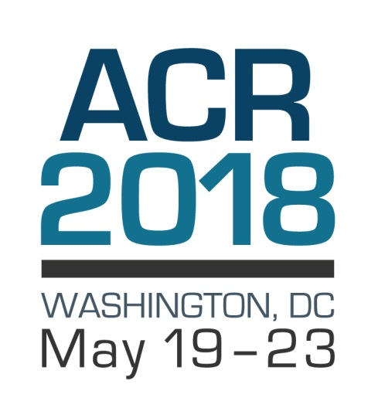
Annual Meeting of the American College of Radiology SAVE THE DATE! May 19−23, 2018 Marriott Wardman Park Hotel Washington, DC Governance ● Advocacy ● Economics ● Education Search acr.org ACR 2018
43

Slide 44
ACR Center for Research and Innovation
State-of-the-art facility in central Philadelphia
World-class core laboratory: Advanced imaging processing tools and workstations; cloud-based image management, quality assessment and interpretation; site and modality qualification; reader study training
Expert clinical trial support: Protocol design; data management; statistical analysis and results reporting
Network of research leaders: Experts in specific diseases, modalities, trial design
Network of qualified sites: Demonstrated competence to perform advanced imaging
Fully regulatory-compliant research environment

Slide 45
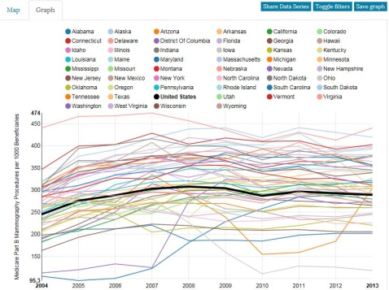
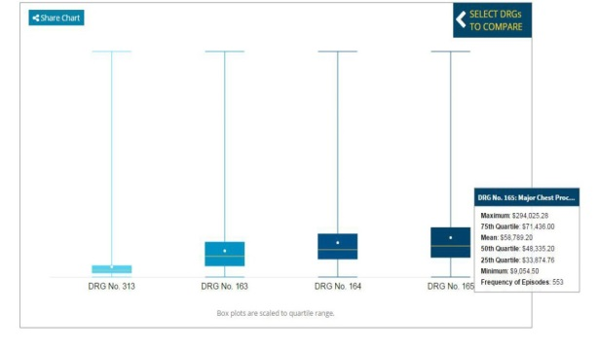
Harvey L. Neiman Health Policy Institute®
Studies value and role of radiology and radiologists in evolving health care payment and delivery models
Scientific deliverables
48 scientific papers since 2013
2015 Impact Factor: 4.66
Provides web-based data tools to help practices succeed!
Neiman Almanac
ICE-T
Learn more at neimanhpi.org

Slide 46
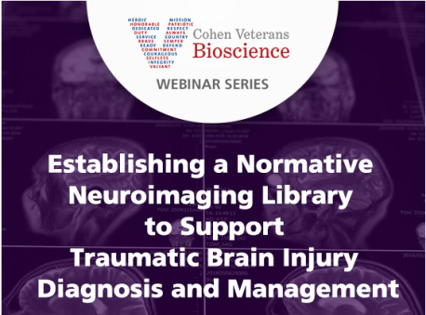
Advancing the treatment of traumatic brain injury (TBI) through the application of diagnostic imaging.
Research: Facilitating and organizing research efforts that will lead to improvements in care for patients with TBI
Awarded $1 million funding to create a Normative Neuroimaging Library
Awarded funding from U.S. Navy for neuroimaging of breachers ― people trained to use explosives for entering buildings and exposed to repeated blasts

Slide 47
ACR Informatics Systems and Tools
ACR is at the forefront of advancing imaging informatics, applying technological advances to practical medical use:
ACR Assist™: Structured clinical guidance framework that incorporates content into radiology workflow
ACR Common™: Compilation of radiology terms and semantic structures to facilitate interaction with ACR
ACR Connect™: Communication platform that manages flow of information between ACR and health care community
TRIAD®: Software application providing secure and efficient transmission of electronic images and data
DART: Data warehouse and analytic platform
Search acr.org Informatics

Slide 48
ACR Foundation (ACRF)
The mission of the ACR Foundation (ACRF) is to advance the profession and practice of radiology to benefit patients through specific emphasis on health policy research
The vision of the ACR Foundation is to advance human health through radiology innovation

Slide 49
ACRF Update
October 2016 — Board of Chancellors approve Health Policy Research as Foundation focus
Second Challenge Grant from Advanced Radiology Services Foundation (ARS) offered if $100,000 raised from other practices for Health Policy Research by December 2017
Will generate $100,000 from ARS
If match reached ACR will match with additional $100,000
To support ACRF, visit: donate.acrfoundation.org
To learn more, visit acr.org/ACR-Foundation or search acr.org ACR Foundation

Slide 50
Member Services
The ACR supports more than 38,000 members by:
Ensuring that radiology's voice is heard on Capitol Hill
Maintaining the highest standards while pushing the frontiers of education and clinical research
Offering complimentary membership to residents and discounted rates to young and early career physicians
Providing career resources and tools for skill development
Watch ACR membership video
about ACR member benefits and how the College works for you
Learn more at: acr.org/membership

Slide 51
ACR Member Benefits
Complimentary subscriptions to leading publications:
Journal of the American College of Radiology®
ACR Bulletin
ACR Radiology Coding Source™
Free CME/MOC activities covering subspecialties across the radiologic spectrum:
Daily Case in Point
Image Wisely Radiation Safety Cases
JACR® journal-based CME activities
Discounts on premier lifelong learning, including the ACR Education Center (CME credits), Continuous Professional Improvement (SA-CME credits) and Radiology Leadership Institute® (RLI credits)

Slide 52
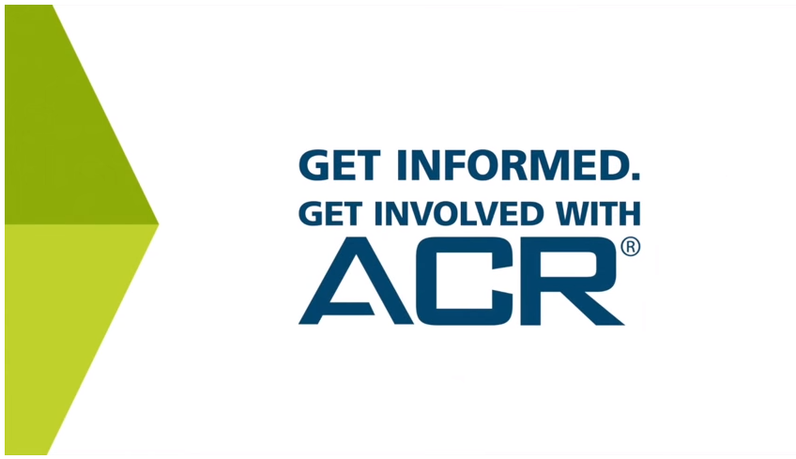
Join ACR or Renew Today
Watch the ACR membership video
Learn more about ACR member benefits, renew or join today at acr.org/membership

