Slide 1
Seaside and Maritime Injuries
Russell Chapin
Medical University of South Carolina
May 6, 2018

Slide 2
Objectives
Understand the management of maritime injuries including treatment and prevention of infections from Aeromonas, Vibrio, and Mycobacterium species
Recognize the findings of turf toe and mimics on MRI
Know the findings and treatment of atypical femur fractures

Slide 3
24 year old Female
An umbrella from the group next to her was blown into her leg.
Hemorrhage control is a part of the primary survey of ATLS.
The secondary survey of ATLS includes evaluation for neurovascular compromise, imaging, and history taking including tetanus.
Patients with an open wound should receive a tetanus booster if prior vaccination was > 10 years.
Those who did not complete tetanus vaccination and have a contaminated wound should be treated with tetanus immune globulin.

Slide 4
Orthopedic Emergency/Urgency
-Fractures with vascular compromise
-Compartment syndrome
-Open fractures
-Dislocations
-Long bone fractures
-Hand and foot injuries
-Periarticular fractures

Slide 5
Fish Injury
45 year old caught a stingray and then himself on shark bait.
In addition to Staph and Strep, patients exposed to saltwater injuries should receive antibiotics for aquatic gram negative bacteria (Aeromonas and Pseudomonas) as well as Vibrio species
Aeromonas is a gram-negative rod found in fresh and brackish water environments including fish tanks. Symptoms are similar to Staph soft tissue infection but progress more rapidly
Wounds in water should be treated to prevent infections associated with Aeromonas hydrophila, using fluoroquinolones (ciprofloxacin/levofloxacin) or 3rd or 4th generation cephalosporin, such as ceftriaxone
Notes:
TEMPLATE

Slide 6
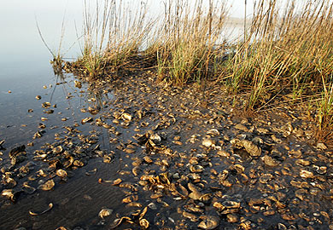
Oyster Bed Laceration
A 13 year old boy was waterskiing when he was towed into an oyster bed.
Left leg radiographs show a deep soft tissue laceration with multiple foreign bodies without fracture.
Irrigation and debridement was performed in the OR hours later after antibiotic treatment
Vibrio bacteria are prevalent in salt and brackish water and can survive in fresh water. They can produce extremely virulent cellulitis, necrotizing fasciitis, and septicemia. Skin manifestations of infection include vesicle and bulla formation. Aggressive surgical debridement is necessary in cases of vibrio infection.
Antibiotic treatment for Vibrio vulnificus consists of doxycycline PLUS a 3rd or 4th generation cephalosporin such as ceftriaxone OR fluoroquinolones, such as cipro- or levofloxacin
Courtesy: SC DNR - SC.gov
Notes:
TEMPLATE

Slide 7
34 yo M with shark bite
Shark, moray eel, and barracuda bites are the most common.
Approximately 80 shark bites/year worldwide
25 Florida
5-10 South Carolina
5 CA and HI
Australia: 15
8 fatal attacks worldwide/year
1 fatal attack in US every other year
Most attacks in FL and SC are due to blacktip sharks
Great white, tiger, and bull sharks are most commonly responsible for fatal attacks
Notes:
TEMPLATE

Slide 8
Mycobacterium marinum infection
68 year old male with a fish hook injury to his thumb 3 weeks ago. Presented with decreased ability to flex his hand and fingers.
At surgery, the flexor tendons were encased in thick gelatinous granulomatous appearing material confirmed to represent M. marinum
Typically, the tendon and bursal involvement is gelatinous rather than pure fluid. Classically, there is horseshoe shaped 1st and 5th tendon bursa with extension into the carpal tunnel bursal.
A high level of suspicion is required for prompt diagnosis with biopsy often required. This should not to be confused with trigger finger in order to avoid steroid injection
Treatment for Mycobacterium marinum infection generally includes clarithromycin with either ethambutol or rifampin. For mild disease, single-drug therapy with clarithromycin or doxycycline may suffice.
B, post contrast T1
A, Axial STIR
C, Axial STIR

Slide 9
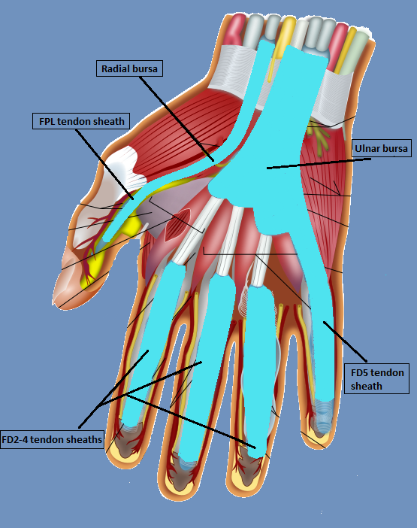
Palmar bursa anatomy
Two palmar bursae encase the flexor tendons within the carpal tunnel, originating proximal to the carpal tunnel and ending within the mid palm
Ulnar bursa encases the flexor digitorum (FD) tendons and communicates with the 5th flexor digitorum (FD5) tendon sheath
Radial bursa encases the flexor pollicis longus (FPL) tendon and communicates with the FPL tendon sheath.
Individual synovial tendon sheaths surround the 2nd-4th flexor digitorum tendons, which do not communicate with the palmar bursa

Slide 10
Sting Ray Injury
Stingrays are not generally aggressive but if stepped on, may whip their tail which contains a barb covered with sharp flat spines and venom
The most common injury is soft tissue laceration without radiographic findings. However, the barb does frequently break off.
Venom may cause systemic neurotoxicity or myotoxicity with local pain, nausea, vomiting, diarrhea, weakness, fasciculations, hypotension, and arrhythmias
Injury from stingrays, stinging fish, sea urchins, and coral require neutralization of the heat-labile toxin with immersion in non-scalding water for 30-90 minutes
Pain control with local anesthetics and oral medications is helpful
Allergic reactions can occur

Slide 11
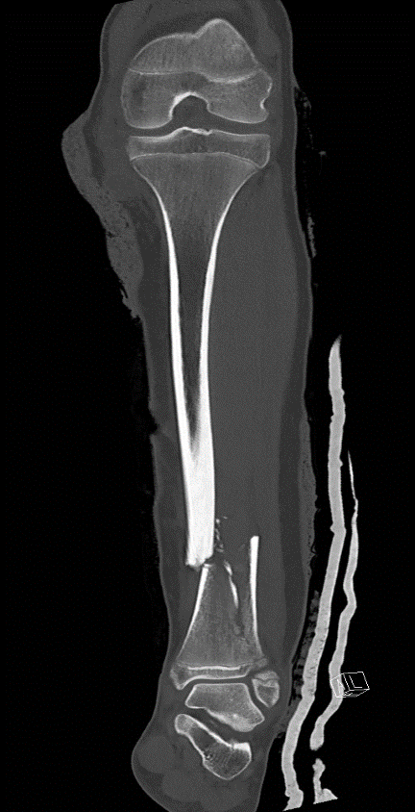
Motorboat Propeller Injury
A 14 year old injured by the propeller after a wave pushed her into the boat prop while swimming
Open tibial fracture with extensive anterior and medial soft tissue injury. Disruption of the medial joint capsule
Type 3A open tibial fracture with traumatic knee arthrotomy and extension to the tibial physis
Notes:
TEMPLATE

Slide 12
Gustilo and Anderson Classification of Open Fractures
-Grading depends on mechanism of injury, soft tissue damage, and degree of skeletal involvement
-Type 1: wound < 1 cm
-Type 2: wound 1-10 cm
-Type 3: > 10cm, high energy

Slide 13
Propeller Injury
There is significant potential for loss of bony structures and soft tissues:
Death in 20% of the reviewed patients
Amputation in 19% of patients
Recovery with deficits in 20% of patients
Full functional recovery in 20% of patients
Lavage and Debridement for removal of contamination and devitalized tissue
Stabilization of bone fragments, usually by external fixation
Reconstruction of neurovascular injuries
Soft tissue closure and reconstruction: Early primary closure vs free flap reconstruction
Infection prevention and antibiotic treatment

Slide 14
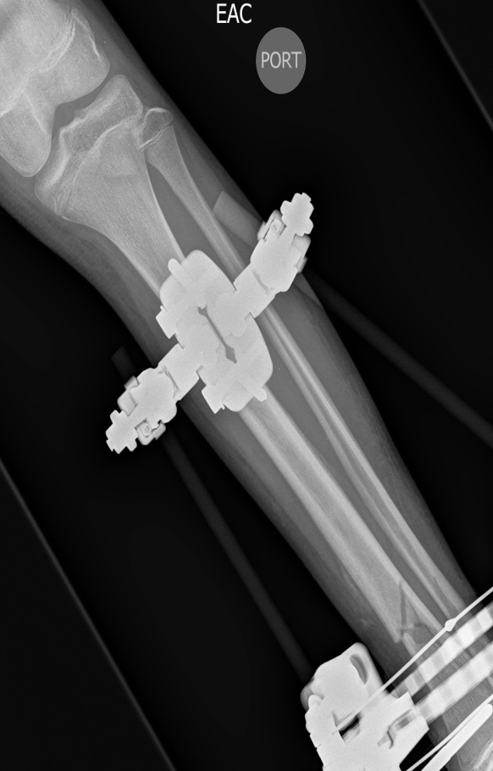
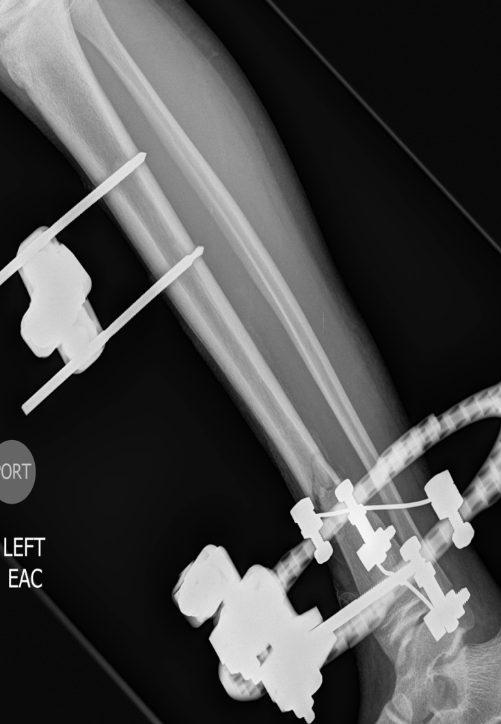
Propeller Injury
The patient underwent extensive wound debridement with washout within 4 hours of arrival.
External fixator was placed
6 total washouts with debridement
Wound vac on day 8, DermaClose device for wound approximation on day 16, and delayed primary closure on day 25
Notes:
TEMPLATE

Slide 15
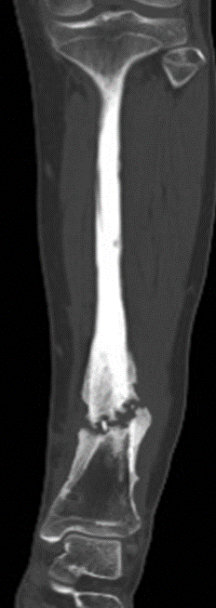
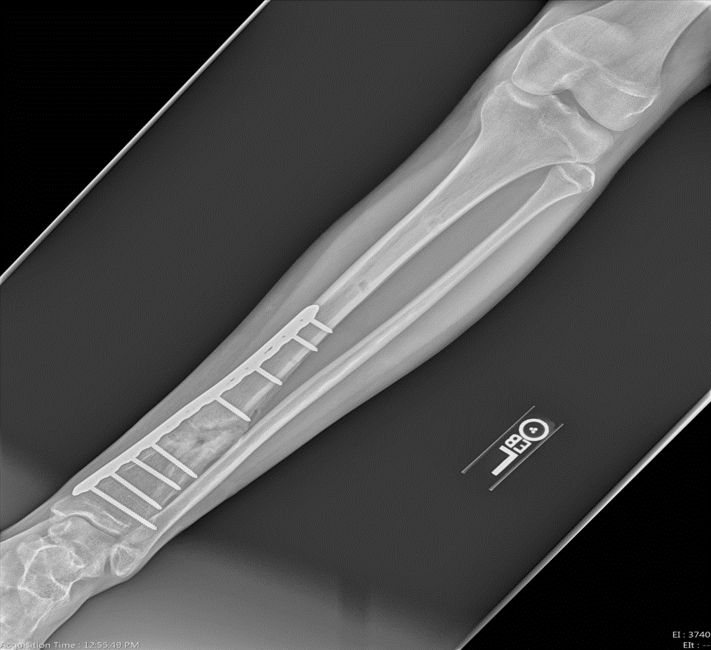
Propeller Injury
External fixator removed after 4 months
10 months after injury, radiographs and CT showed non-union (left images)
Internal fixation with placement of bone graft for nonunion. Radiographs show healing 13 months after injury.
Notes:
TEMPLATE

Slide 16
Managing Maritime Injuries
Although specific more unusual organisms are present in salt and freshwater, the most common cause of infection from maritime injuries are Staphylococcus aureus and Streptococcus pyogenes
Freshwater injuries (including aquariums) should provide coverage for Aeromonas hydrophila with a fluoroquinolone (ciprofloxacin/levofloxacin) OR a 3rd/4th generation cephalosporin.
Saltwater injuries should provide coverage for Vibrio vulnificus with doxycycline and a 3rd/4th generation cephalosporin OR a fluoroquinolone.
Treatment for Mycobacterium marinum infection generally includes clarithromycin with either ethambutol or rifampin. For mild disease, single-drug therapy with clarithromycin or doxycycline may suffice.
Toxin effects should be mitigated with immersion in hot non-scalding water for 30-90 minutes.
Irrigation and debridement may be performed in the ED or OR
External fixation with delayed reconstruction is necessary for severe contaminated injuries

Slide 17
Beachwalker
69 yo with 4 months of thigh pain and history of breast cancer.
Loss of balance while walking dog followed by leg pain and fall
Meds
Palbociclib – CDK 4 and CDK 6 inhibitors
Denosumab
Ranitidine
Levothyroxine
PPI Calcium carbonate and vitamin D

Slide 18
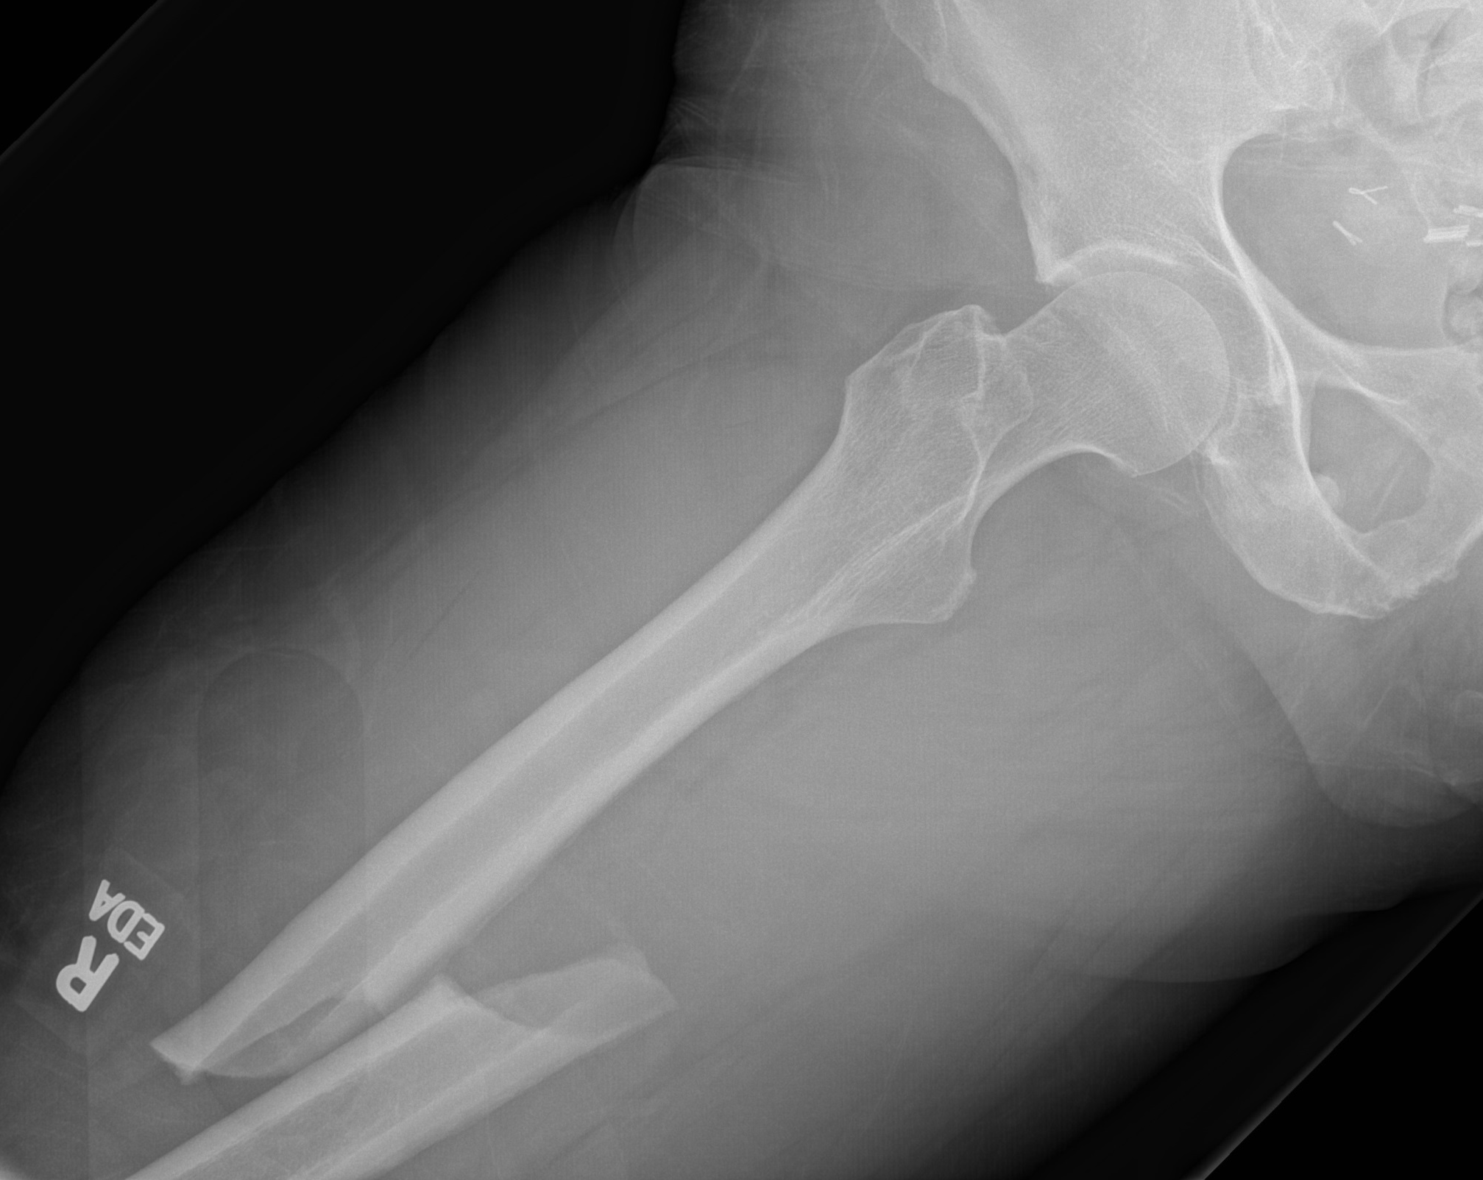

Slide 19
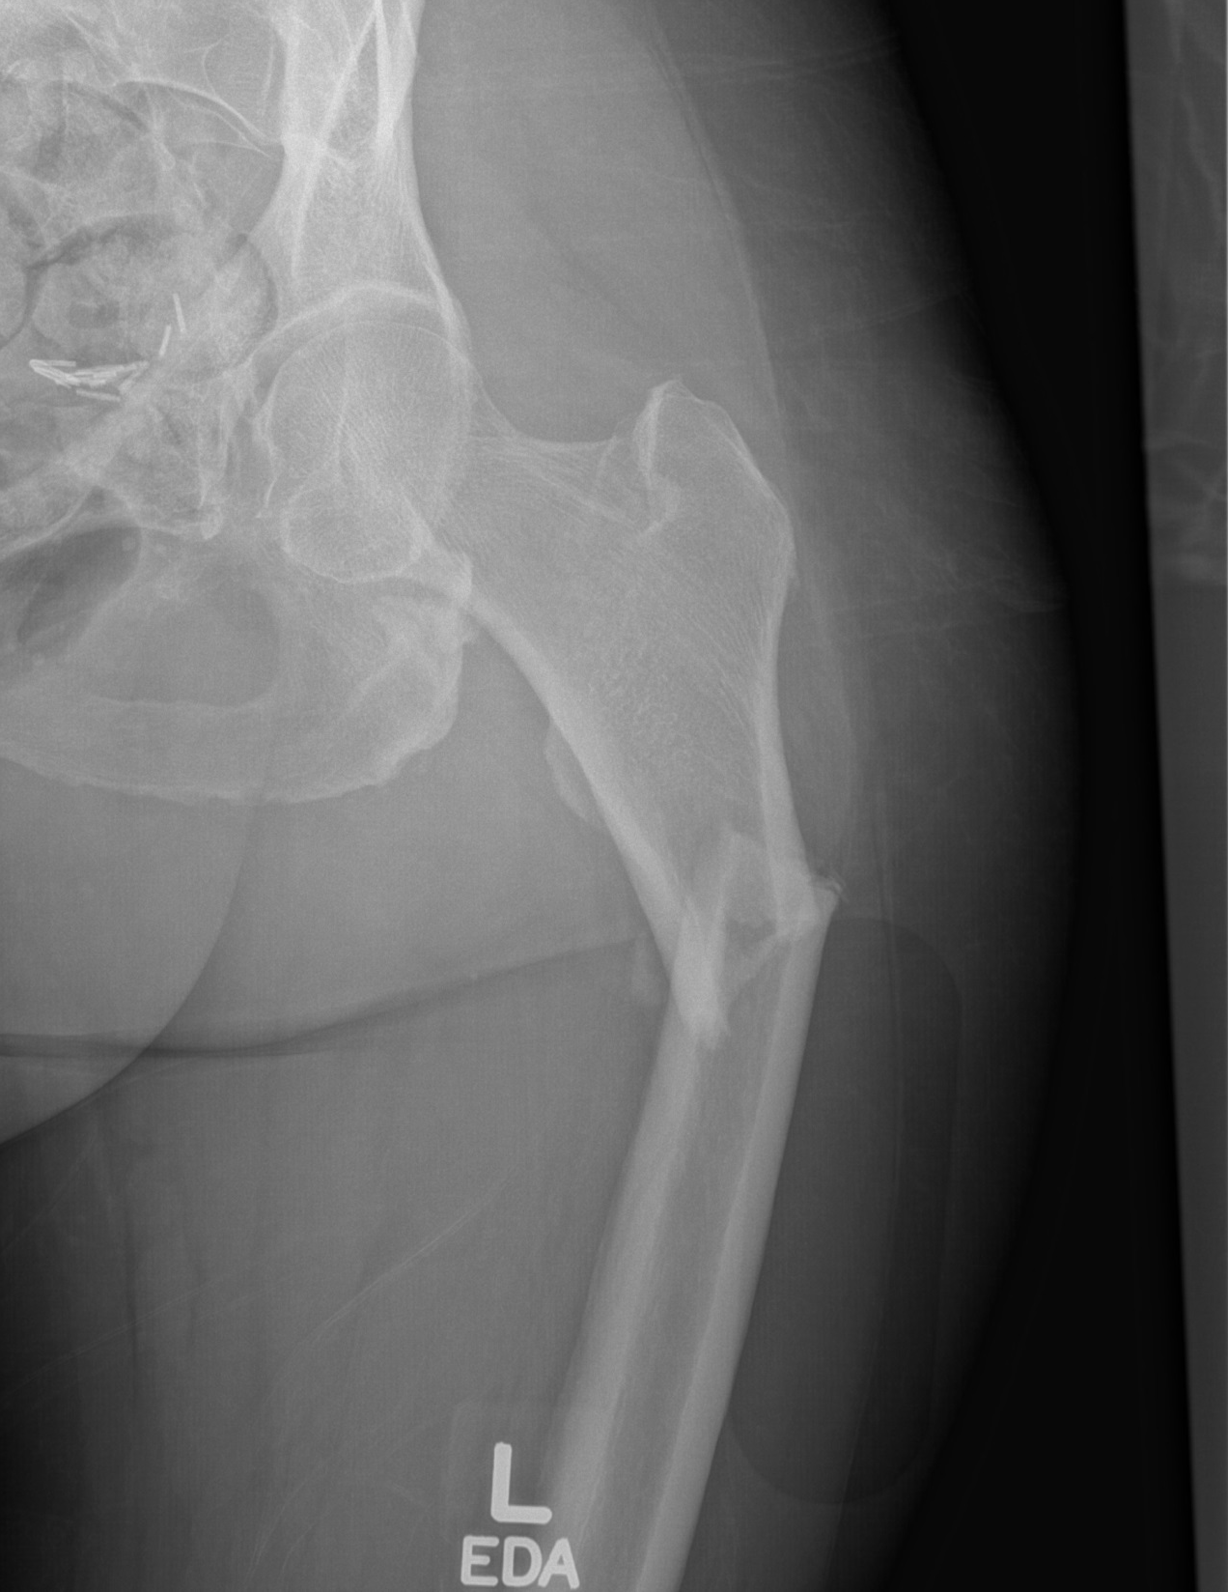

Slide 20
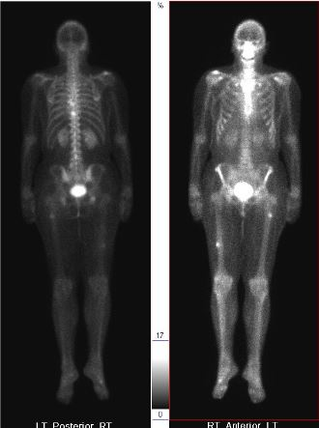
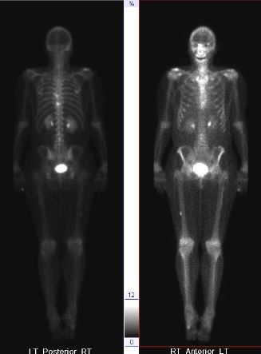
Sept 17
Nov 16

Slide 21
Atypical Femur Fractures
Transverse orientation
Lateral cortical thickening
Medial spike
Lack of Comminution
Subtrochanteric
Low energy mechanism, prodromal pain, bilateral involvement

Slide 22
AFF additional features
Rate increases to 100/100K after bisphosphonate use of 8yrs duration
Also associated with VitD deficiency, RA, PPI meds, Corticosteroids, and HRT
Up to 60% bilateral
-Szolomayer et al. Skeletal Radiology, 2017

Slide 23
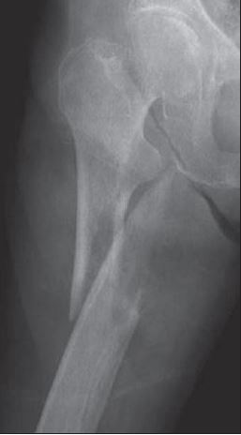
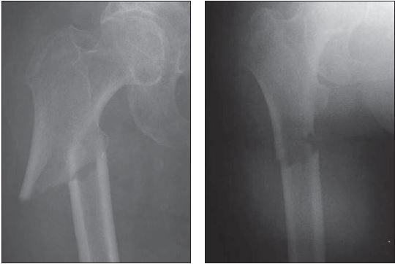
Typical femur fracture
False Positive
Rosenberg et al AJR 2011

Slide 24
How accurate is radiographic characterization?
Rosenberg et al AJR 2011
Imaging findings predictive of bisphosphonate use in 19pts and controls
Lateral cortical thickening: 76, 90%, 92%
Transverse orientation: 10, 79%, 87%
Medial spike and lack of comminution are helpful, but less so
[OR, SP, Accuracy]

Slide 25
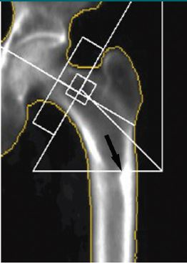
May be seen on DXA
Kim et al Radiology 2014
33 patients with serial DXA and AFF
Detection rate of 60% and SN/SP 52/58% for DXA

Slide 26
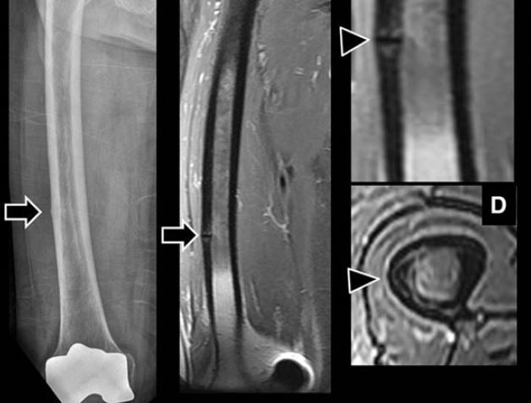
MRI for Problem Solving Cheon et al. J Orthop Sci. 2013

Slide 27
Outcomes
30-40% functional/painful limitation
8 months mean healing time
5-10% nonunion
20-30% delayed union
Surgical revision rate of 10-20%
Egol et al. CORR, 2014.
Kon et al. Bone and Joint Journal, 2017

Slide 28
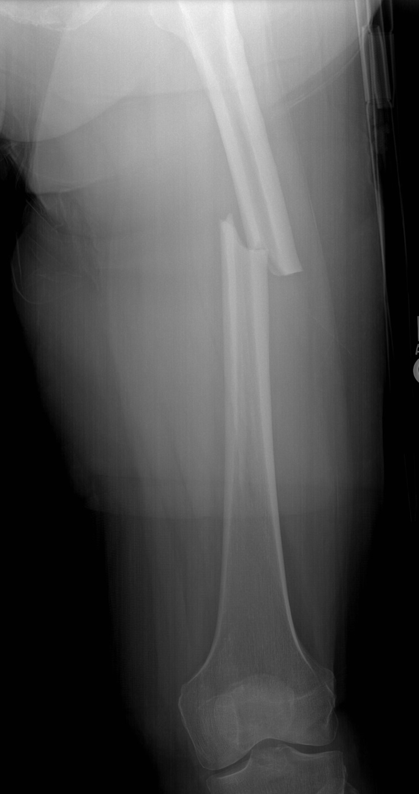
Another patient: Mar 15

Slide 29
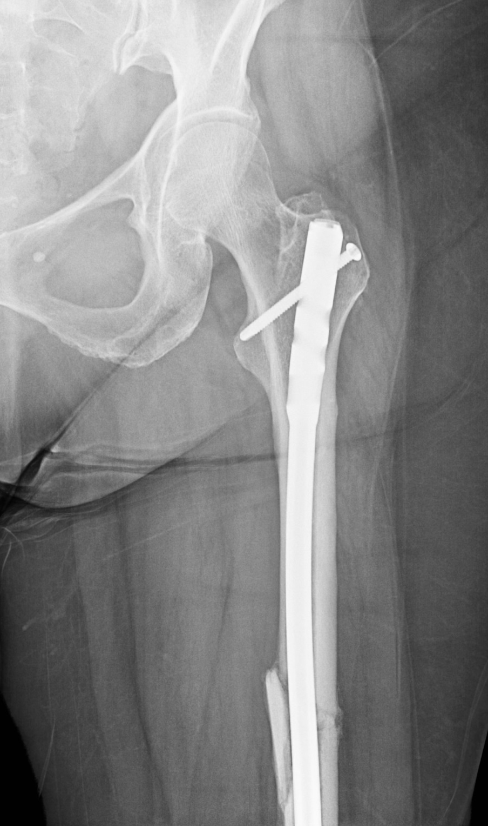
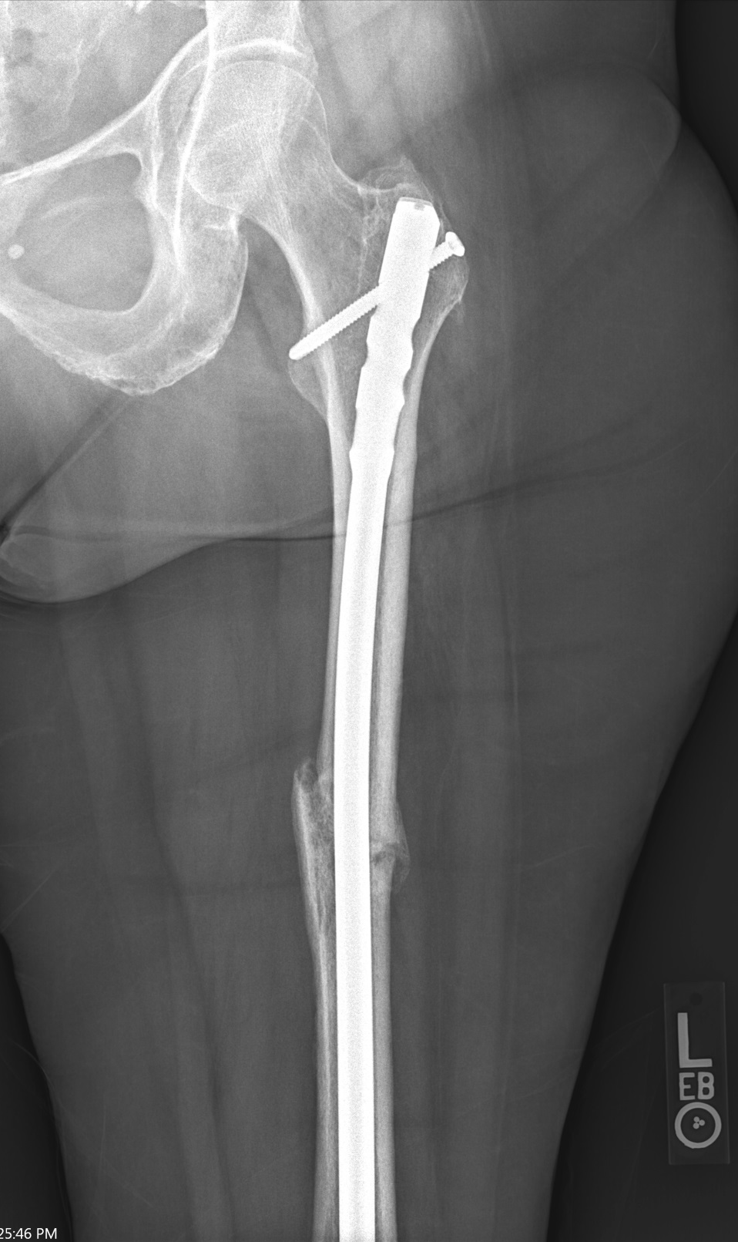
June 15
Aug 2017 – 26 months

Slide 30
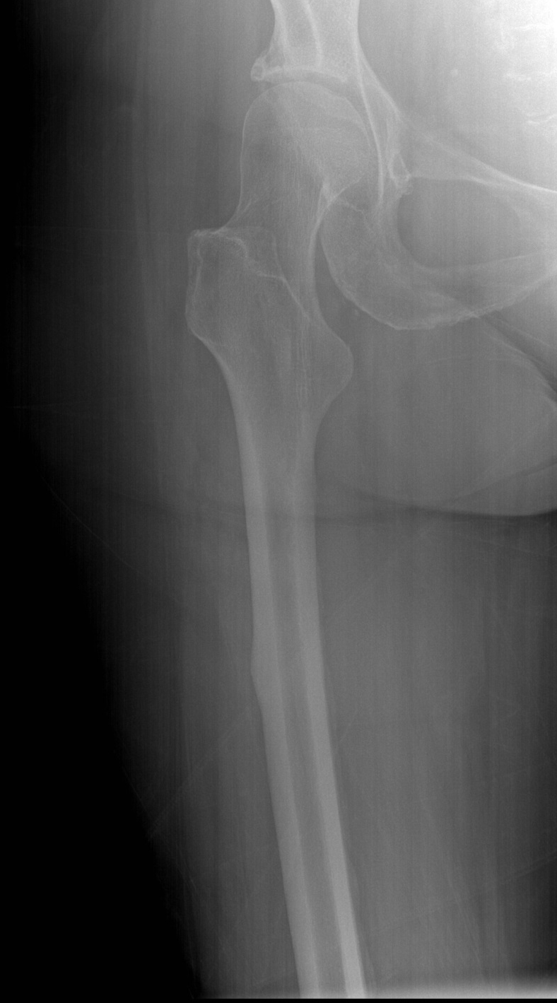
Mar 15 contralateral

Slide 31
Prophylactic Treatment
Surveillance of contralateral limb is recommended because contralateral fractures are not infrequent and an incipient fracture may propagate with changes in weight bearing
Recommend radiographs of the contralateral femur and consideration of bone scan or MRI.
If the patient has minimal pain and no clear fracture line, conservative management is reasonable.
Prophylactic intramedullary nail fixation should be considered when there is a moderate to severe pain, or persistence or progression after conservative management
Donnelly et al. Curr Opin Support Palliative Care. 2014.

Slide 32
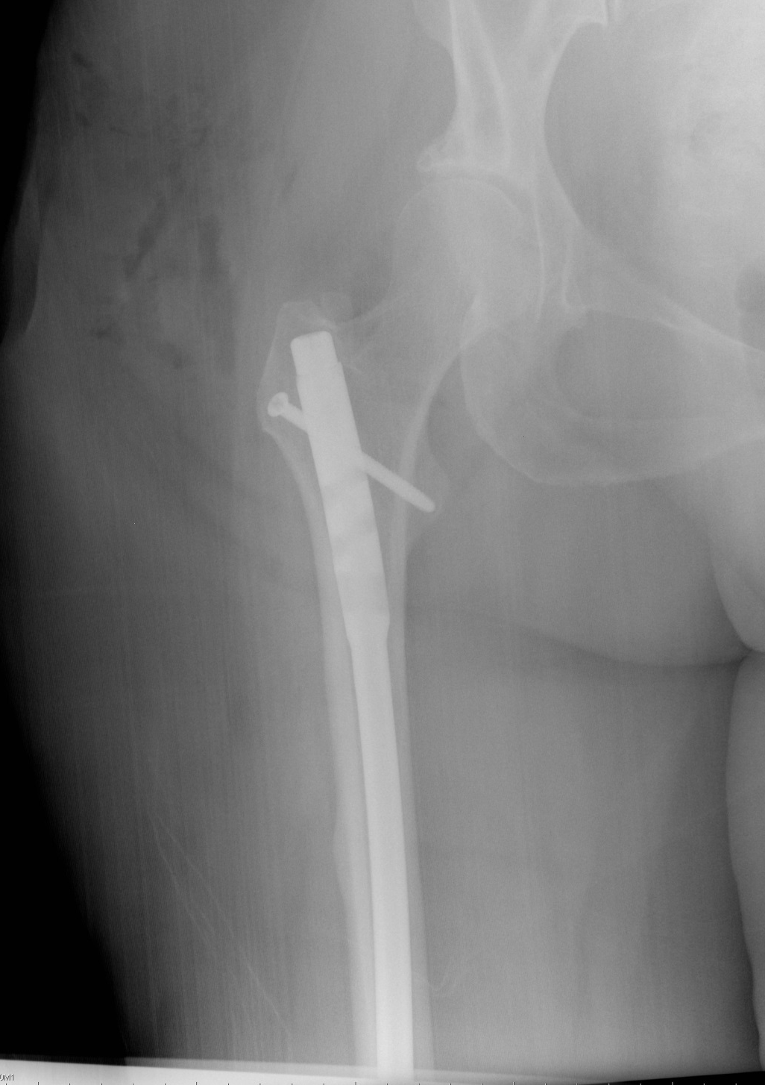
Aug 15 Contralateral

Slide 33
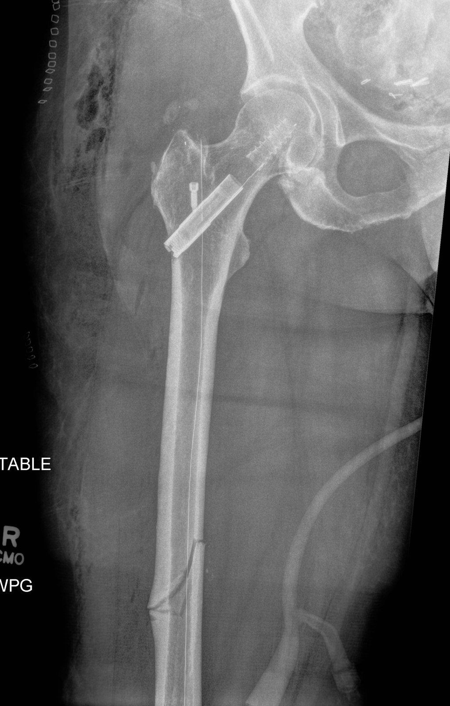
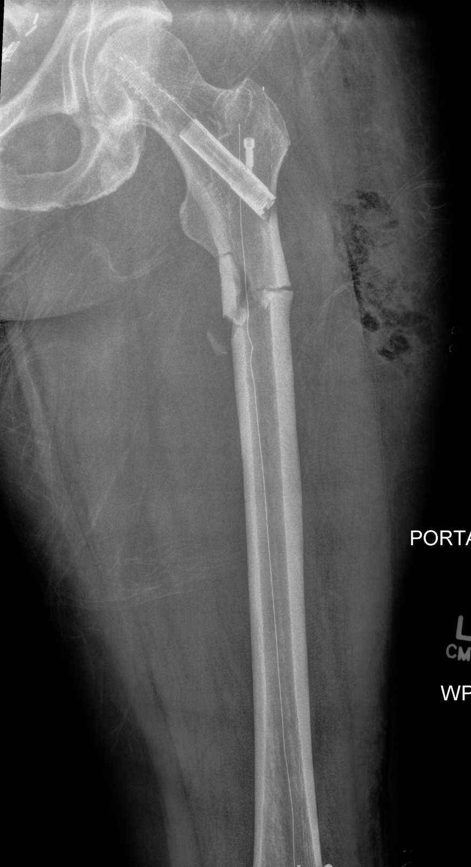
Beachwalker Patient
Summary
Look closely for them
Treat early
Check the contralateral side
Don’t have to be on a Bisphosphonate

Slide 34
Beach Volleyball Injuries
Ankle injuries are the most common, followed by shoulder and finger

Slide 35
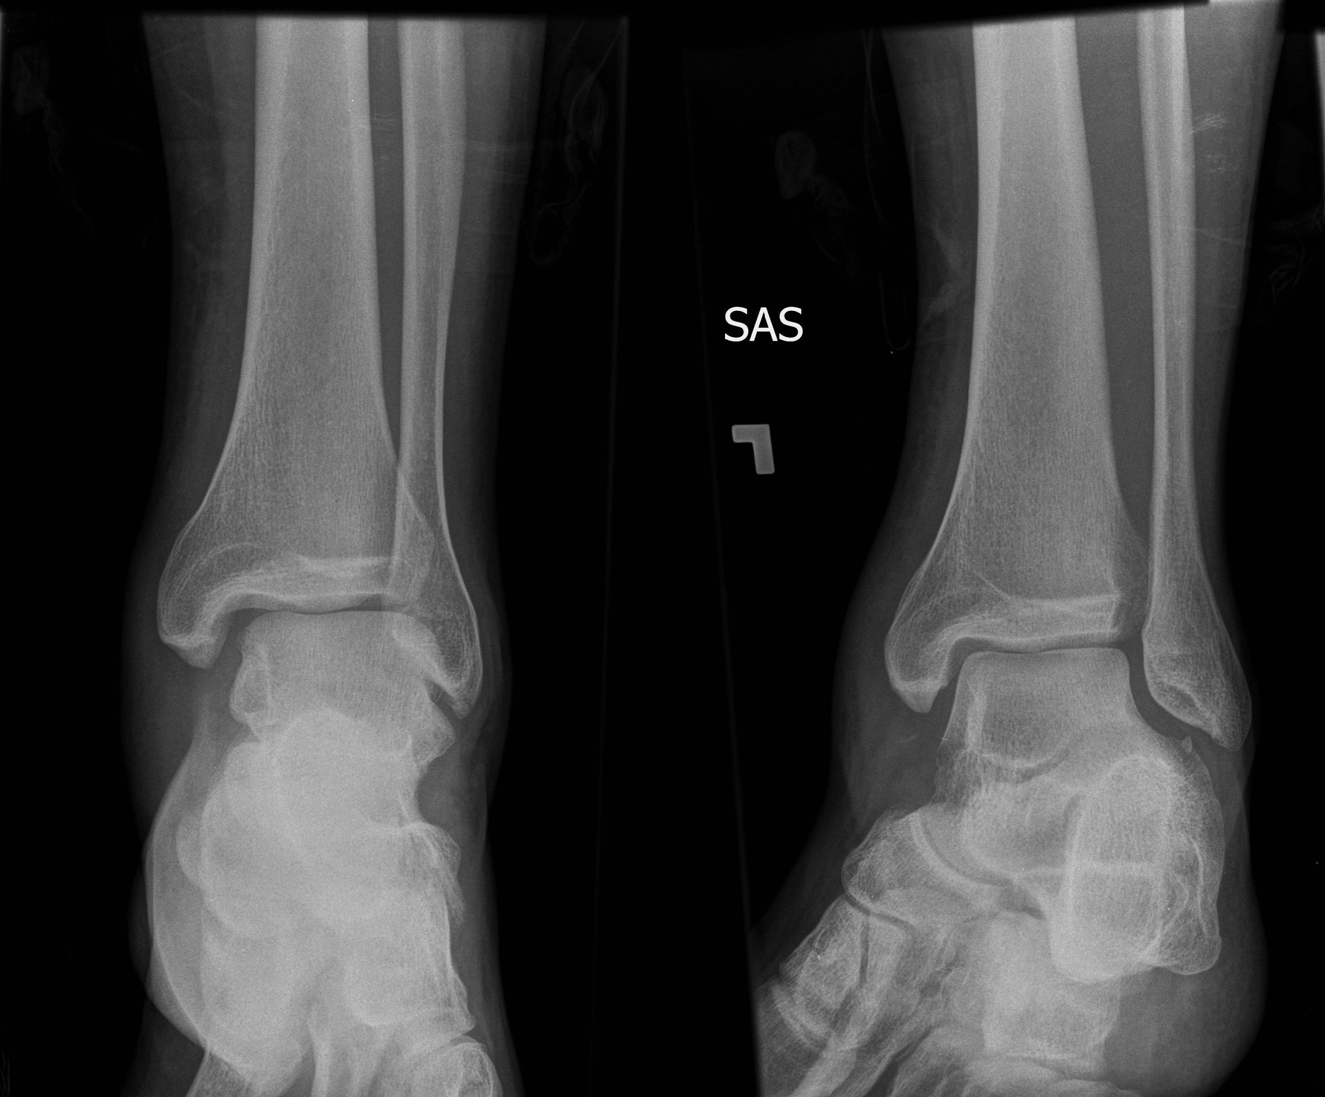

Slide 36
Maisonneuve fracture
Suspect when fibula fracture does NOT accompany
medial mortise widening
medial malleolus fracture
posterior tibial “malleolus” fracture
Force transmitted proximally through syndesmotic membrane
May be overlooked because patients may ignore pain in the proximal fibula when more painful ankle injuries exist

Slide 37
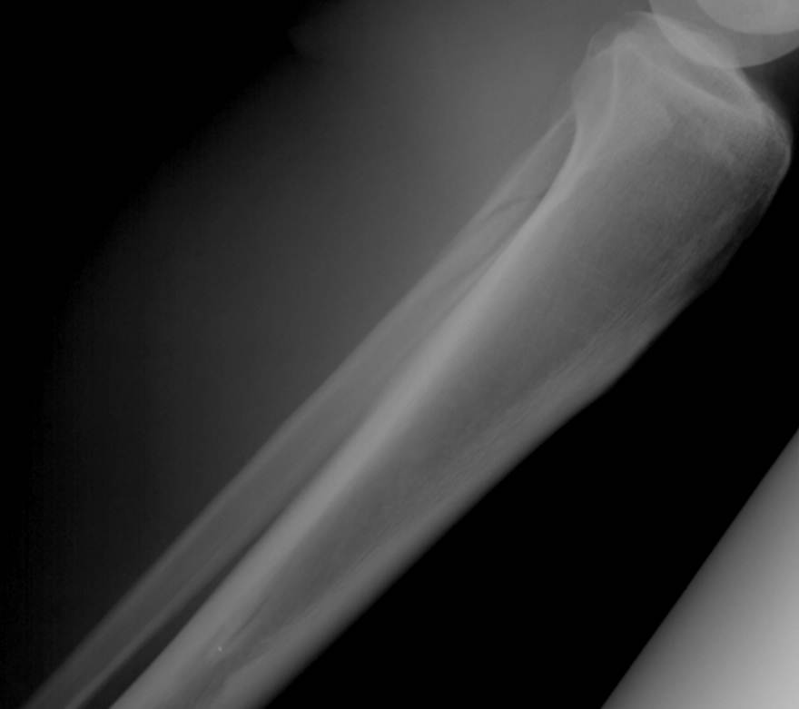
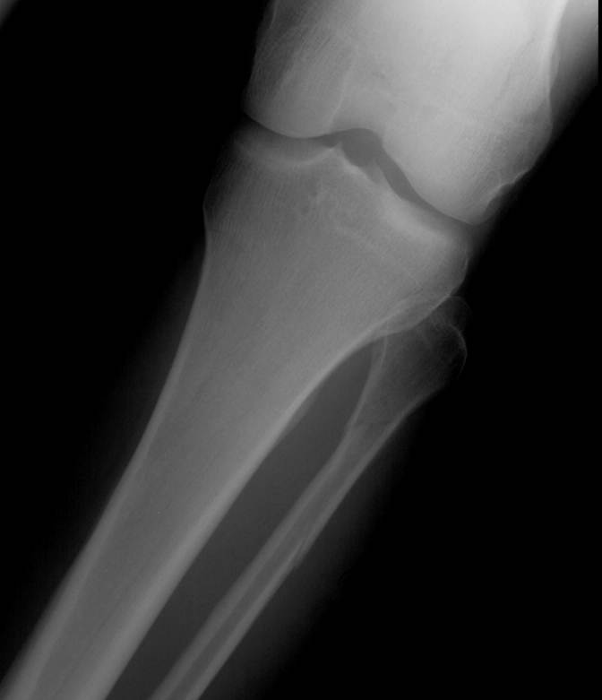

Slide 38
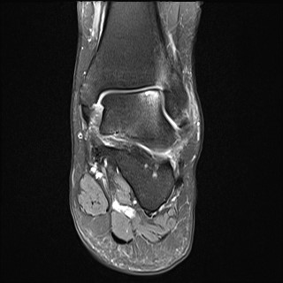
Missed Unstable Ankle Sprain

Slide 39
Low vs. High Ankle Sprain
Classic “low” ankle sprain treated by up to 1 week immobilization in boot (CAM) followed by mobilization and rehab.
Surgery for persistent instability or poor clinical response
High Ankle Sprain: Notoriously prolonged and variable recovery
Nonoperative treatment in cast for 2-4 weeks
Surgery for evidence of instability with stress

Slide 40
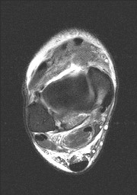
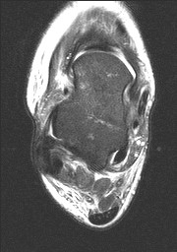
High Ankle Sprain: AITFL

Slide 41
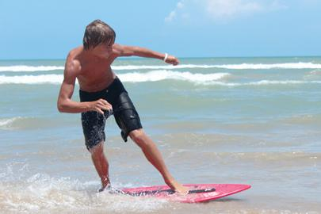
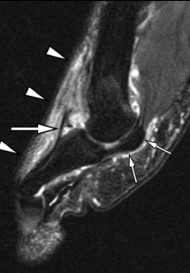
Skimboarder’s Toe
-Forced dorsiflexion of bare foot
-Disruption of extensor hood around EHL tendon
Donnelly, LF et al. Skimboarder’s Toe. AJR 2005

Slide 42
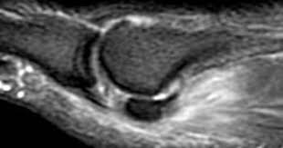
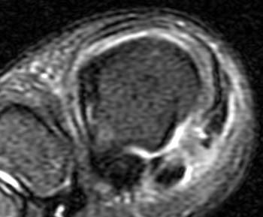
“Turf toe”
Also a forced dorsiflexion injury
Common in American football on artificial turf with soft-soled shoes
Plantar plate, medial metatarso-phalangeal ligament, or MCL injury
Primary repair may be performed
Radsource.us

Slide 43
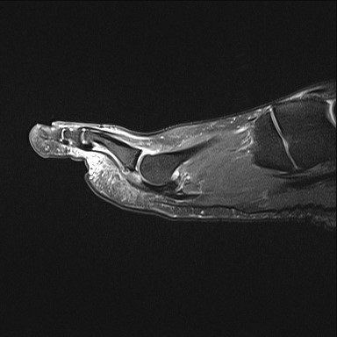
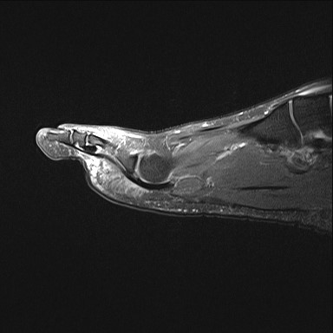
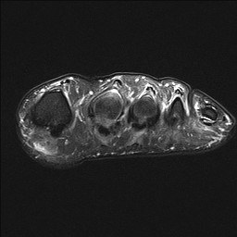
Lesser Planar Plate Injury
- 90% 2nd MTP and lateral
- >50 yo F
- May be repaired, generally along with osteotomy

Slide 44
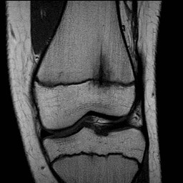
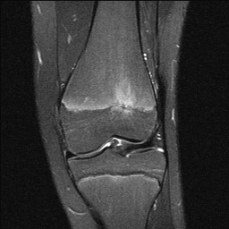
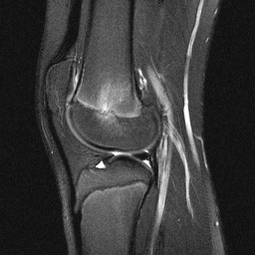
FOPE:Focal Periphyseal Edema
Painful but benign transient tethering at the physis
Distal femur and proximal tibia
11-12 yo females and 13-14 yo males

Slide 45
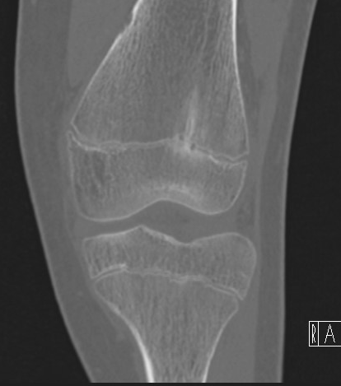
FOPE

Slide 46
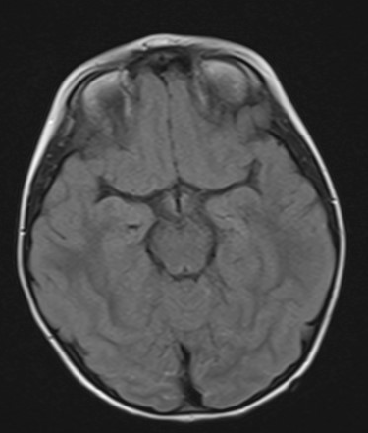
9 yo F
Presented March 2017 with rapidly progressive weakness followed by difficulty breathing hours later
2 prior days of not feeling well

Slide 47
Tick Paralysis
Ascending motor weakness progresses over hours (vs GBS)
Prodrome but no fever
Spring and early summer, young female, at neckline
Dermacentor andersoni or variabilis, Rocky Mountain wood tick or American dog tick

