Slide 1
Breast MRI
As taught by a guy who also reads wrist arthrograms and does liver biopsies
David Dolinsky, MD
Eastern Radiological Society Annual Meeting
May 2018

Slide 2
Objectives
To learn the basics of breast MRI, including protocols, the lexicon, basics of image interpretation, indications, and pitfalls, with example cases.
To learn about the potential for expanded indications for screening breast MRI in the near future.

Slide 3
Disclosures
None

Slide 4
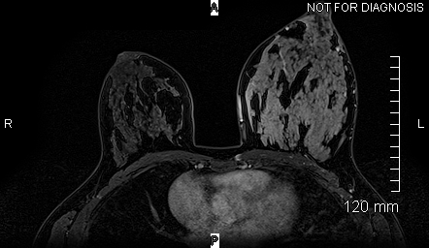

Slide 5
A bit of history
J Comput Assist Tomogr. 1983 Apr;7(2):215-8.
Initial experience with nuclear magnetic resonance (NMR) imaging of the human breast.
El Yousef SJ, Alfidi RJ, Duchesneau RH, Hubay CA, Haaga JR, Bryan PJ, LiPuma JP, Ament AE.
Abstract: Two patients with breast abnormalities, one malignant and one benign, were studied with nuclear magnetic resonance (NMR) imaging utilizing a cryogenic superconducting magnet. Three-dimensional NMR images were obtained in one case and single slice planar images were obtained in the other. The NMR images correlated well with the corresponding mammograms. Although both conditions exhibited a different signal intensity for the area of abnormality compared to adjacent ductal and fatty tissue, the configuration of the abnormal areas allowed distinction between benign and malignant process.

Slide 6
A little more history
J Comput Assist Tomogr. 1986 Mar-Apr;10(2):199-204.
MR imaging of the breast using gadolinium-DTPA.
Heywang SH, Hahn D, Schmidt H, Krischke I, Eiermann W, Bassermann R, Lissner J.
Abstract: In a preliminary study 20 patients underwent breast examinations by magnetic resonance (MR) imaging without and with Gd-DTPA as contrast medium. All carcinomas enhanced, whereas dysplastic tissue enhanced slightly or not at all. Significant additional diagnostic information was available on the Gd-DTPA examinations in at least four of 20 cases compared with MR without contrast medium and X-ray mammography. Our preliminary results indicate that MR imaging of breast using Gd-DTPA may be helpful for the evaluation of dense breasts and the differentiation of dysplasia and scar tissue from carcinoma.

Slide 7
Protocols
Obviously there’s variation, but most protocols include:
Axial T1
Axial fluid-sensitive (T2, T2 fat-sat or STIR)
Dynamic contrast-enhanced (typically a fast spoiled-gradient T1 fat-sat) – axial or sagittal
Scan performed prone
In my practice, we get an axial T1, axial T2-fat, axial dynamic, and sagittal delay.
Timing for the dynamic is four 90 second acquisitions

Slide 8
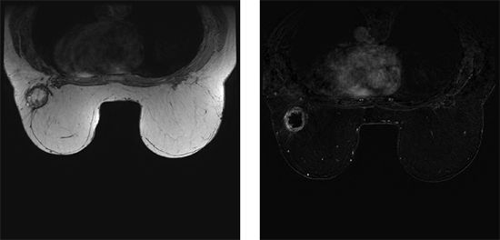
T1
Why? Shows fat-containing tissues, can be used to assess morphology
From https://radiologykey.com/diagnostic-breast-imaging-breast-pathology-and-breast-imaging-findings/

Slide 9
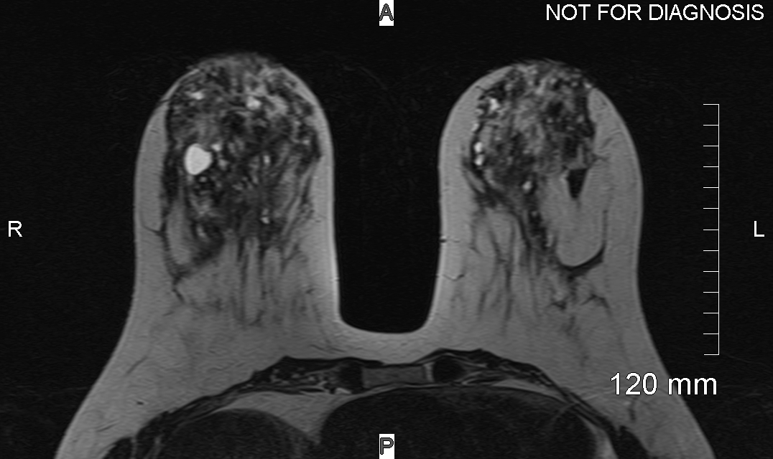
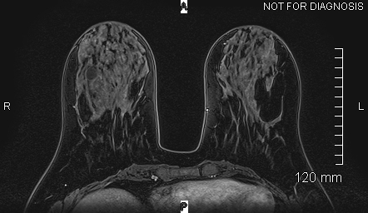
Fluid-sensitive
Why? Shows cysts, and other masses, but cysts don’t enhance

Slide 10
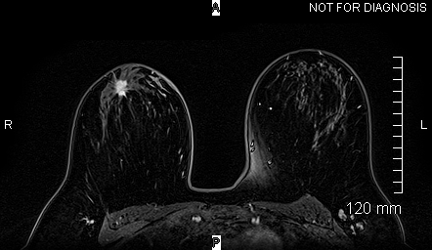
Dynamic contrast-enhanced
This is the “key” set of images. Why? Because cancers enhance, typically more so than normal fibroglandular tissue.
But benign masses can enhance just like a cancer
So how do we distinguish them?

Slide 11
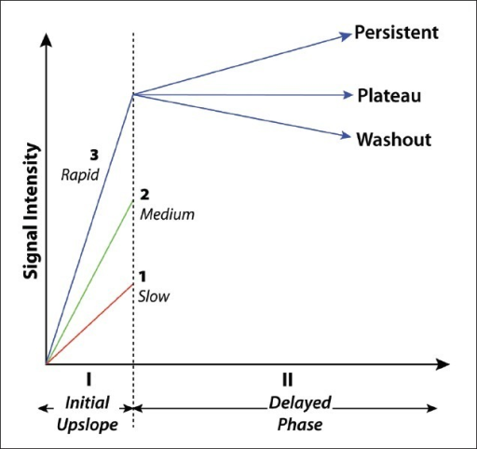
Enhancement kinetics
One method for distinguishing benign v. malignant is to assess enhancement curves
Cancers tend to rapidly enhance, and washout or show plateau kinetics
Benign masses tend to more
slowly enhance. Or if they do
rapidly enhance, they tend to
show progressive
enhancement kinetics.
So do I use kinetics? Not that
much.
Image from: Breast MR Imaging: What the Radiologist Needs to Know. Dhillon et al. J Clin Imaging Sci (2011).

Slide 12
The classics
Size
Shape
Margin
Multiplicity
Distribution
Stability
And findings on mammo and US
If I can still can’t decide what to do based on the above, I’ll consider the kinetics.

Slide 13
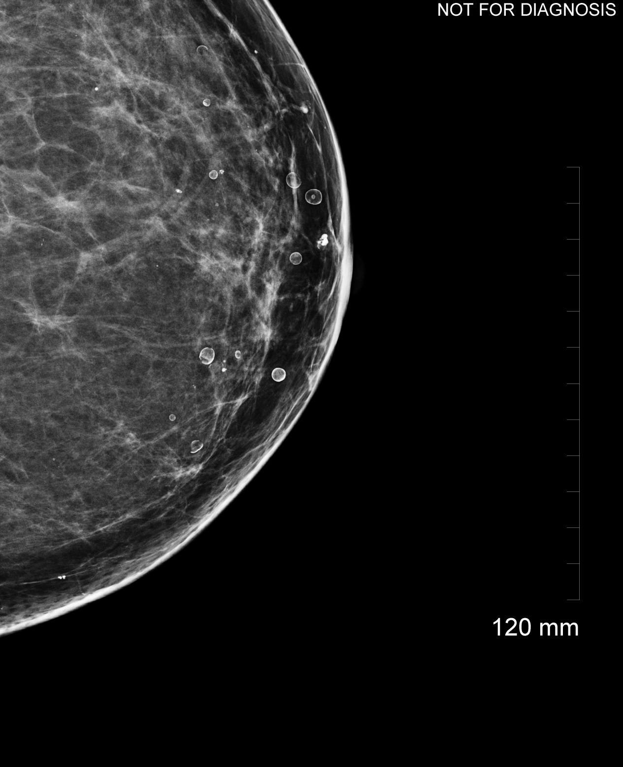
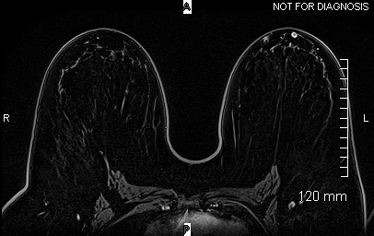
Correlate with mammo and US

Slide 14
The lexicon
Mass
Non-mass
Focus

Slide 15
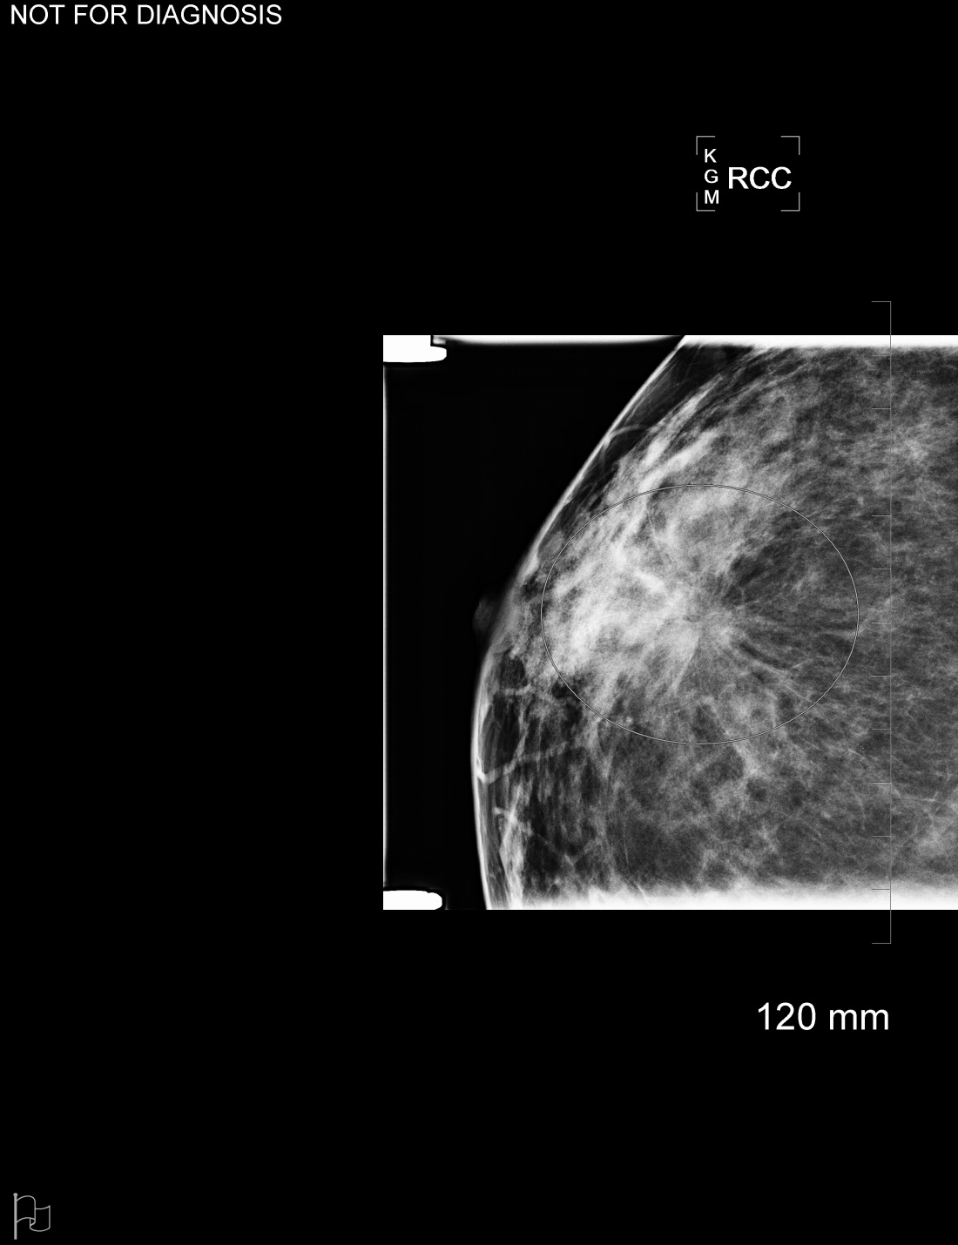
Mass

Slide 16
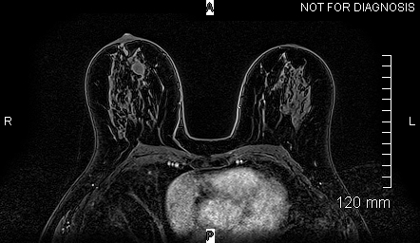
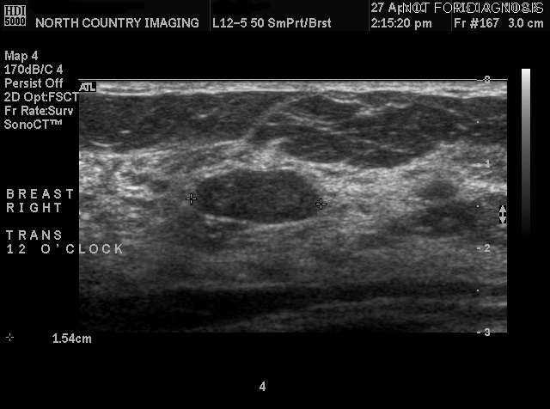
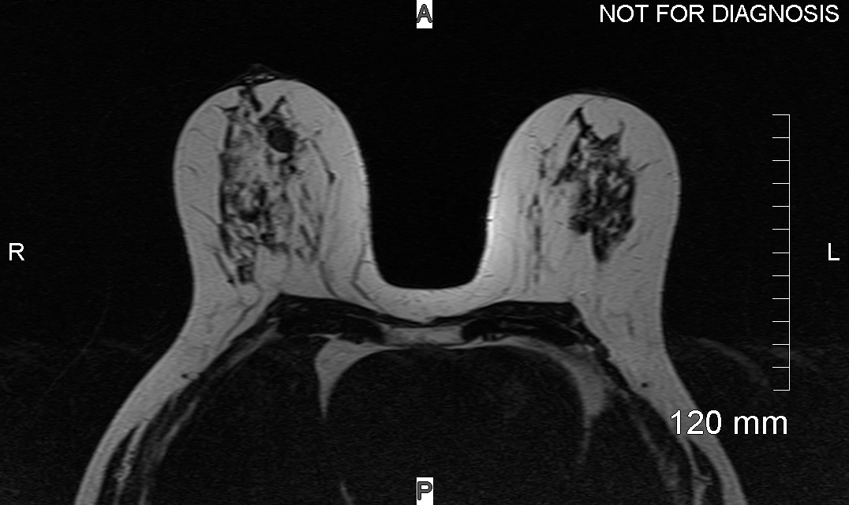
Mass

Slide 17
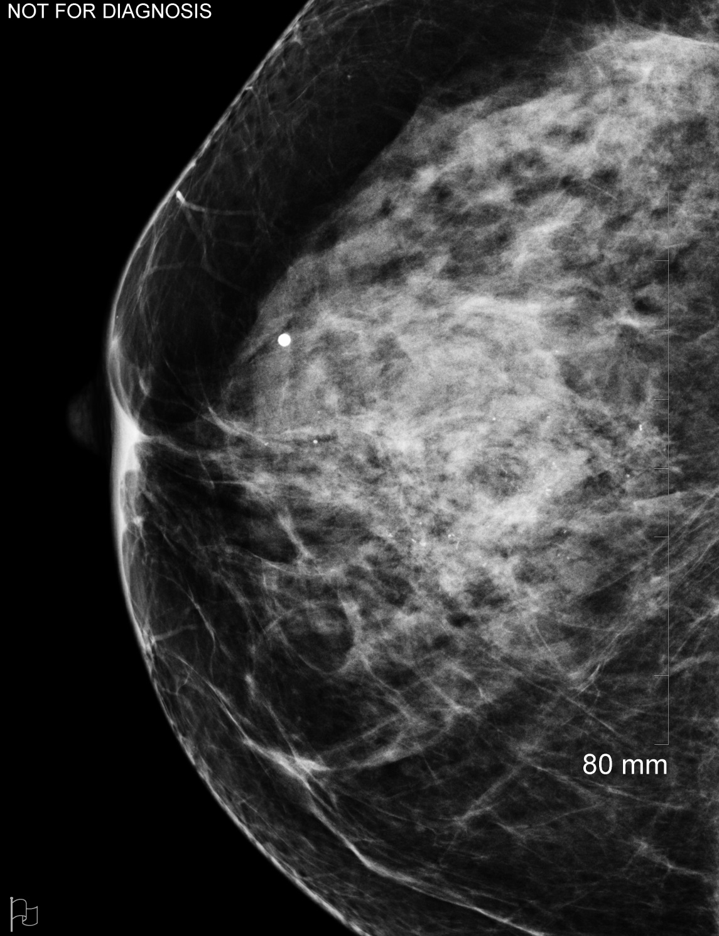
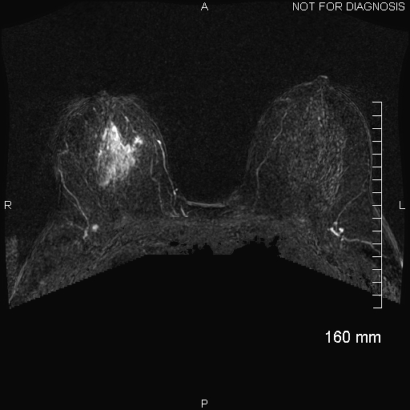
Non-mass

Slide 18
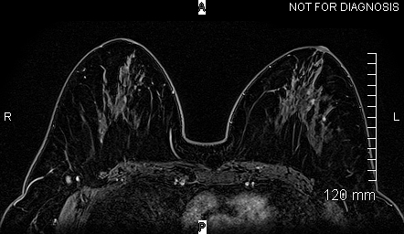
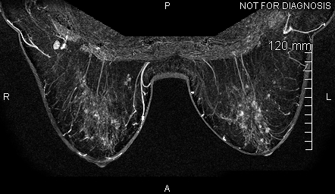
Focus

Slide 19
Indications
Screening
Problem solving
Pre-op planning
(Implant integrity)

Slide 20
Screening
Conventional digital mammo screening should detect around 5 cancers per 1000 screened
Add tomosynthesis, you get to around 7 per 1000
Add whole breast ultrasound, maybe 1 or 2 more
Breast MRI is closer to 15 per 1000 screened

Slide 21
Screening
So who should be screened? Traditional criteria are:
BRCA gene mutation carriers
1st degree relative of BRCA carriers who haven’t been tested
Women with an estimated >20% lifetime risk of developing breast cancer
History of chest wall XRT between age 10 and 30
Li-Fraumeni, Cowden syndromes

Slide 22
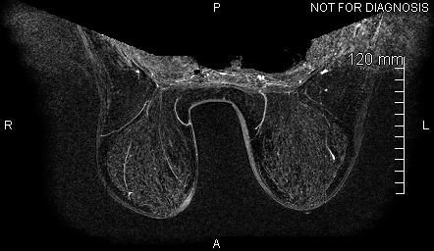
Screening in a BRCA1 mutation carrier

Slide 23
What about everyone else?
Should we be screening women with a life-time risk of 15-20%?
How about women with a personal history of breast cancer?
Or all women?
And how does breast density fit into this?
The future is faster, cheaper MRI. More on this later.

Slide 24
Problem solving
Too many scenarios to list them all
But what they all have in common is: Mammo and ultrasound aren’t answering the question, and short-term follow-up seems too risky.

Slide 25
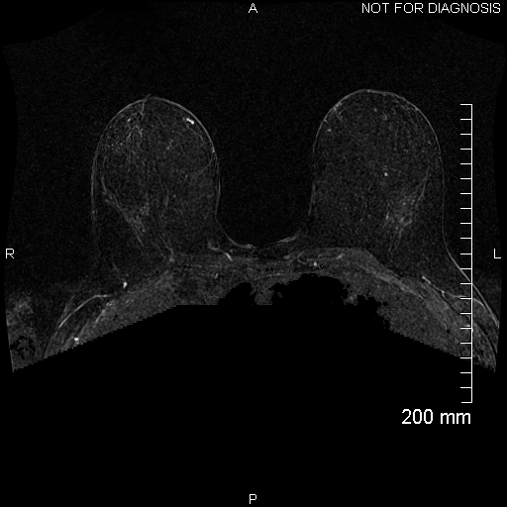
Problem solving
Palpable lump right
breast
Negative work-up with
mammo and ultrasound
Remains clinically
suspicious

Slide 26
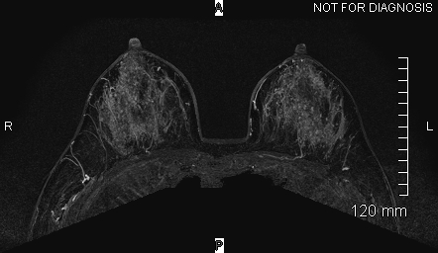
Problem solving
Right nipple discharge
Negative work-up with mammo and ultrasound

Slide 27
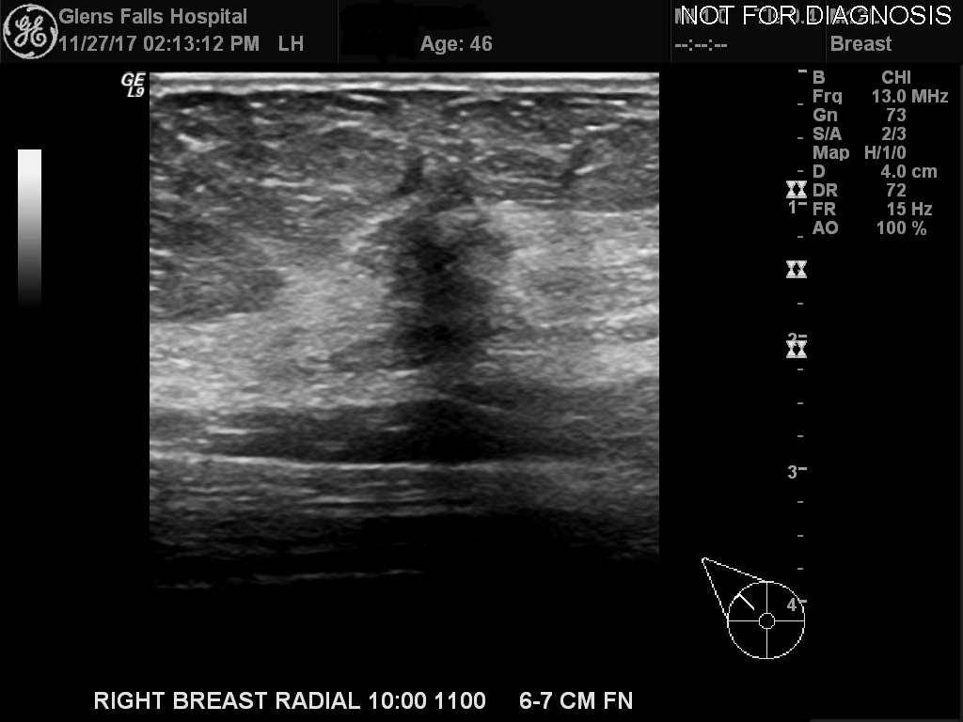
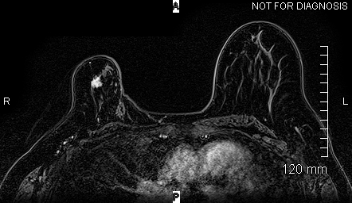
Problem solving
Personal history of right breast cancer
Palpable lump in the region of the lumpectomy scar
Ultrasound guided biopsy showed fibrosis, no cancer
Seemed it may be discordant

Slide 28
Pre-operative planning
How big is the tumor?
Are there satellite lesions?
Does it involve the chest wall, or skin, or nipple?
Are there other potential primaries?
What do the lymph nodes look like?

Slide 29
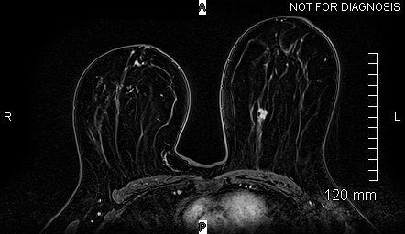
Pre-op routine

Slide 30
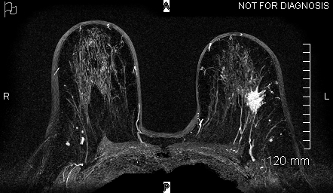
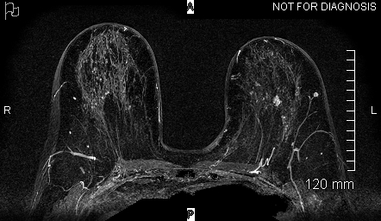
Pre-op ipsilateral tumor (probable satellite)

Slide 31
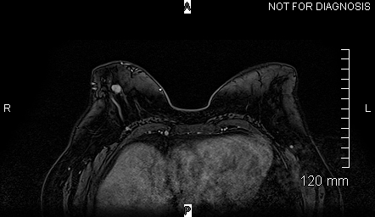
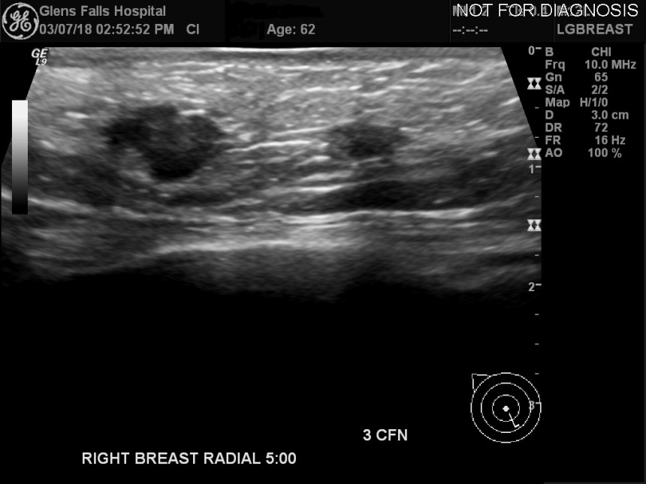
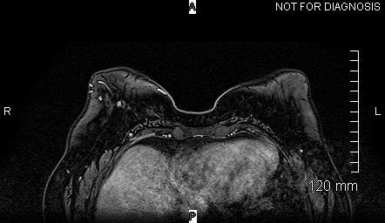
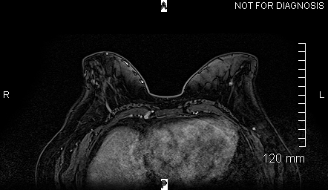
Pre-op contralateral malignancy

Slide 32
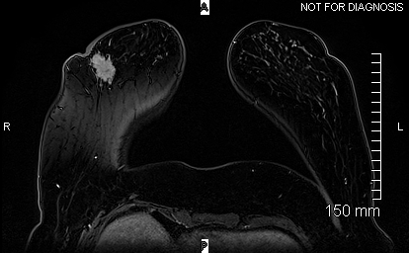
Pre-op skin thickening

Slide 33
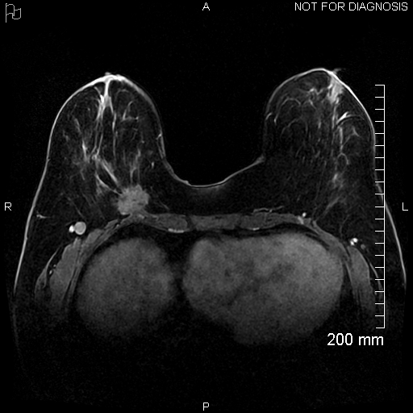
Pectoralis invasion

Slide 34
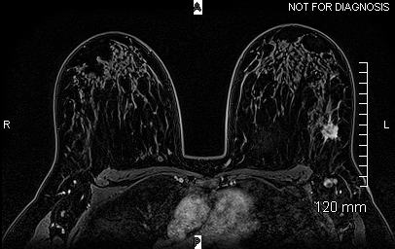
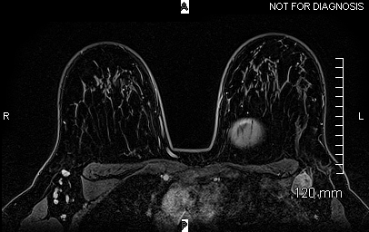
Lymph nodes

Slide 35
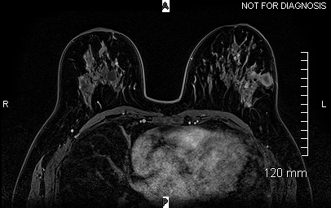
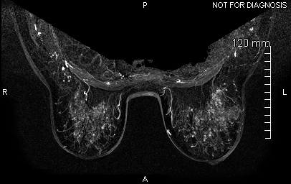
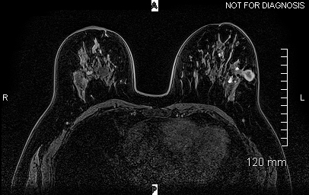
Subtractions

Slide 36
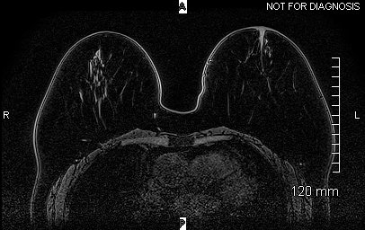
Pitfalls
“Post-contrast” image

Slide 37
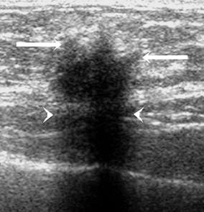
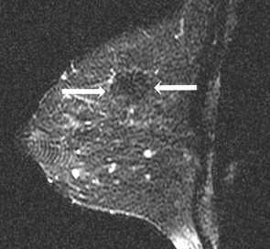
“Non-enhancing” cancer
From: Nonenhancing Breast Malignancies on MRI: Sonographic and Pathologic Correlation. Ghai et al. AJR August 2005.

Slide 38
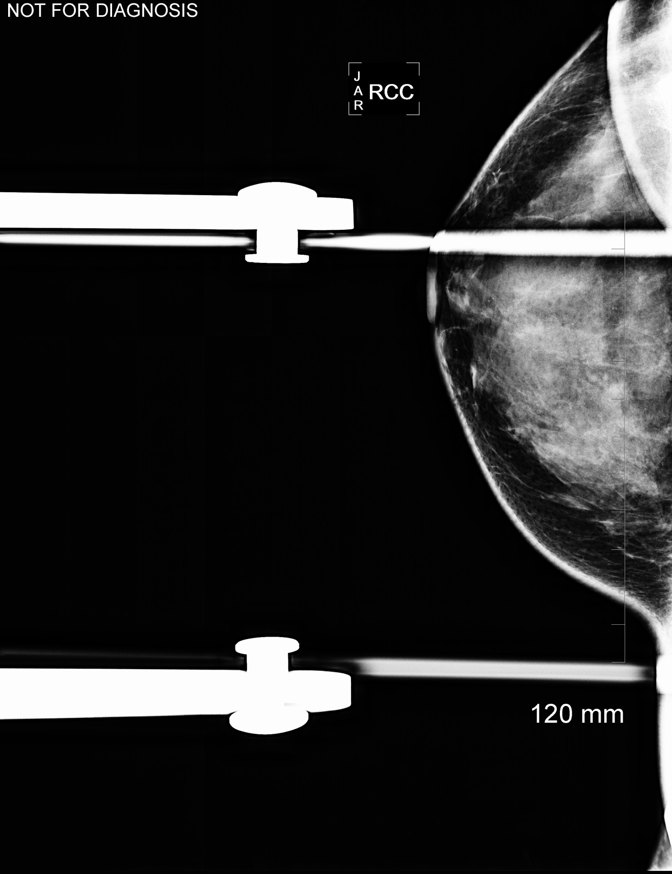
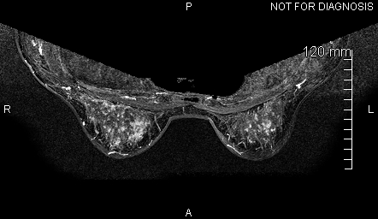
Low specificity of MRI

Slide 39
The future
J Clin Oncol. 2014 Aug 1;32(22):2304-10. doi: 10.1200/JCO.2013.52.5386. Epub 2014 Jun 23.
Abbreviated breast magnetic resonance imaging (MRI): first postcontrast subtracted images and maximum-intensity projection-a novel approach to breast cancer screening with MRI.
Kuhl CK, Schrading S, Strobel K, Schild HH, Hilgers RD, Bieling HB.
AJR Am J Roentgenol. 2017 Feb;208(2):284-289. doi: 10.2214/AJR.16.17205. Epub 2016 Nov 3.
Abbreviated MRI Protocols: Wave of the Future for Breast Cancer Screening.
Chhor CM, Mercado CL.

Slide 40
Abbreviated (cheaper) breast MRI
We know MRI is more sensitive for detecting breast cancer than mammography or ultrasound (or the two combined), but MRI isn’t considered cost effective for screening women who are at low or moderate risk for developing breast cancer.
But what if it’s cheaper?
Faster protocols are being developed. The JCO article, and multiple since then show abbreviated protocols have similar very high NPV as full protocols, and specificity and PPV are minimally impacted with the abbreviated protocols (which implies kinetics aren’t important).

Slide 41
The future
Make a shorter breast MRI protocol.
Charge less for it.
Hopefully read it faster than a full protocol.
Use this to screen women at intermediate risk, maybe even low risk. Or possibly restrict it to women with dense breasts.
And we’ll find more cancers, which tend to be early stage, and there should be a morbidity/mortality benefit.

Slide 43
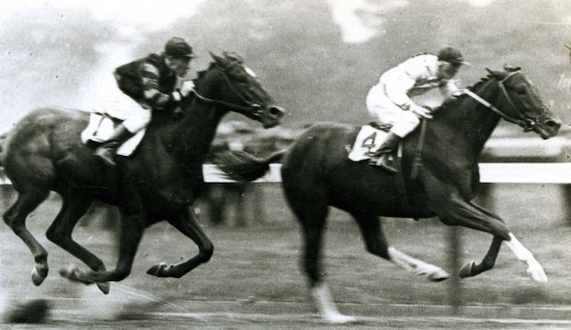

Slide 44
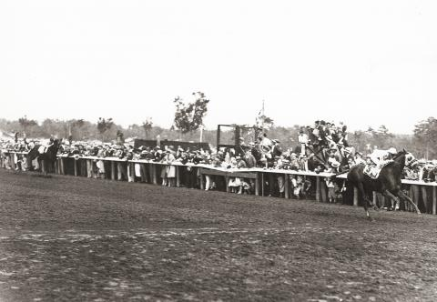

Slide 45
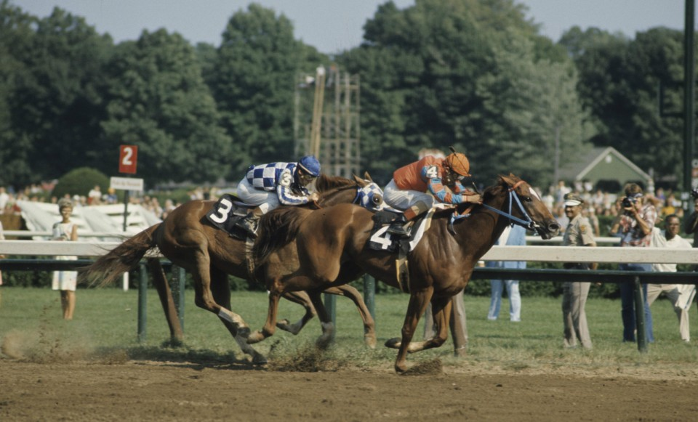

Slide 48
Thanks!

