Slide 1
Tuberculosis
The Captain of All These Men of Death

Slide 2
Nature is that lovely lady to whom we owe polio, leprosy, smallpox, syphilis, tuberculosis, cancer.

Slide 3


Slide 4
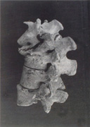
References to “TB” as far back as 3400 BC
Drawings of Hunchbacks
Recovery from Mummified Remains

Slide 5
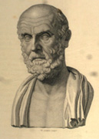
A Little History
Hippocrates
Phthisis
  To Consume
  To Spit
  To Waste Away

Slide 6
Aphorisms
Autumn is a bad season for persons in consumption
In persons affected with phthisis, if the sputa which they cough up have a heavy smell when put upon coals, and if the hairs of the head fall off, the disease will prove fatal

Slide 7
A Little History
Aristotle-Observance of spread by close contact
1500’s theory of contagion widely accepted
Hereditary Disease?
1865 Jean Villemin
  TB is a specific infection
  Can be readily inoculated
1882 Robert Koch
  Able to establish adherence to Koch’s Postulates

Slide 8
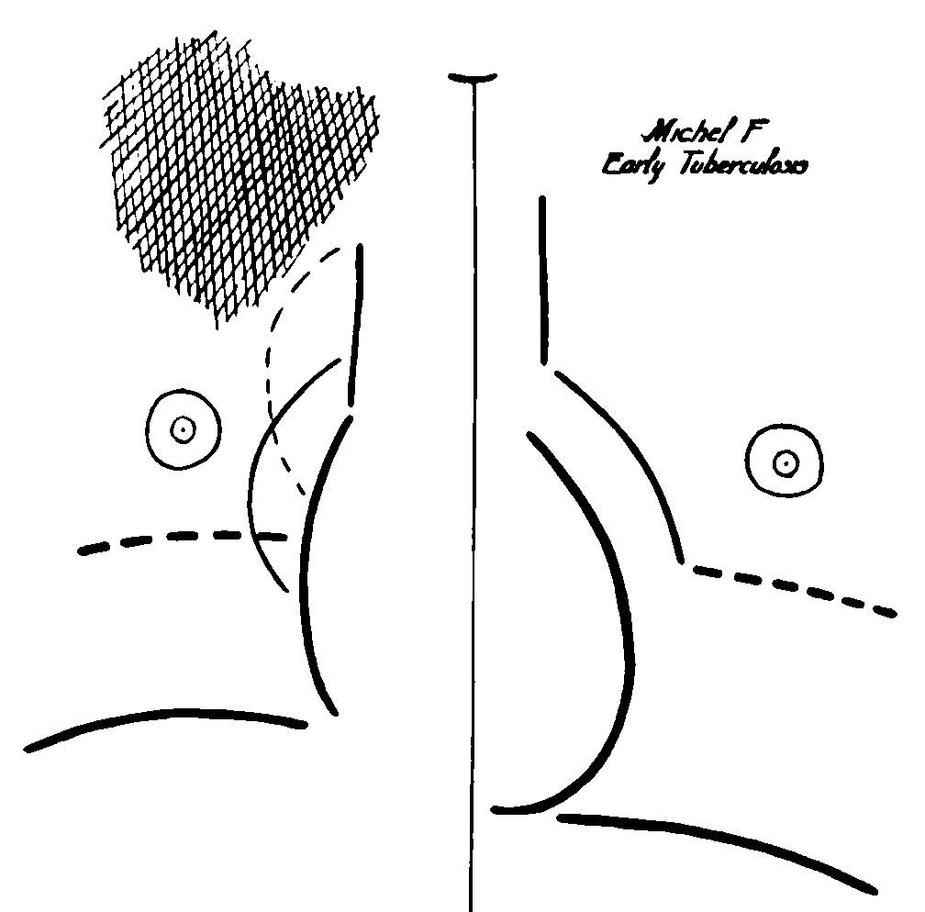
A Little History
Francis Williams 1900
  Fluoroscopy
  Radiographic findings worse than Physical Findings
  Diagnosis before symptoms
  Follow-up of Disease

Slide 9
Epidemiology
Worldwide
  9 million cases/year
  1.5 million deaths
  Leading cause of death due to infection

Slide 10
Reported TB Cases
United States, 1982–2013*
No. of Cases
Year
*Updated as of June 11, 2014.

Slide 11
TB Morbidity
United States, 2008–2013
Year | No. | Rate*
2008 | 12,893 | 4.2
2009 | 11,519 | 3.8
2010 | 11,164 | 3.6
2011 | 10,509 | 3.4
2012 | 9,940 | 3.2
2013 | 9,582 | 3.0
*Cases per 100,000. Updated as of June 11, 2014.

Slide 12
TB Case Rates,* United States, 2013
D.C.
< 3.0 (2013 national average)
>3.0
*Cases per 100,000.

Slide 13
TB Case Rates* by Age Group
United States, 1993–2013
Cases per 100,000
Age Group (years)
* Updated as of June 11, 2014.

Slide 14
TB Case Rates by Age Group and Sex,
United States, 2013
Cases per 100,000

Slide 15
Trends in TB Cases in Foreign-born Persons,
United States, 1993 – 2013*
No. of Cases
Percentage
*Updated as of June 11, 2014.

Slide 16
TB Cases by Residence in Correctional Facilities, Age ≥15, United States, 1993-2013*
No. of Cases
Percentage
*Updated as of June 11, 2014.
Note: Resident of correctional facility at time of TB diagnosis.

Slide 17
TB Cases Reported as Homeless in the
12 Months Prior to Diagnosis,
Age ≥15, United States, 1993-2013*
No. of Cases
Percentage
*Updated as of June 11, 2014.
Note: Homeless within past 12 months of TB diagnosis.

Slide 18
Whatever happened to the good old days: you know, dirty attics, tuberculosis and general all-round suffering?
Arnold Wesker

Slide 19
Pathophysiology
Inhalation of organism
Normal phagocytosis unable to eradicate
Extension to local lymph nodes
  May enter blood stream (bacillemia)
Cell-mediated immunity/caseous necrosis
PPD + around 3 weeks following exposure

Slide 20
Pathophysiology
Dystrophic calcification common at site of initial infection
  “Granuloma”
  “Ghon Focus”
Dystrophic calcification in lymph nodes
  “Ranke Complex”
Viable Organisms May Be Present
  20% at Autopsy

Slide 21
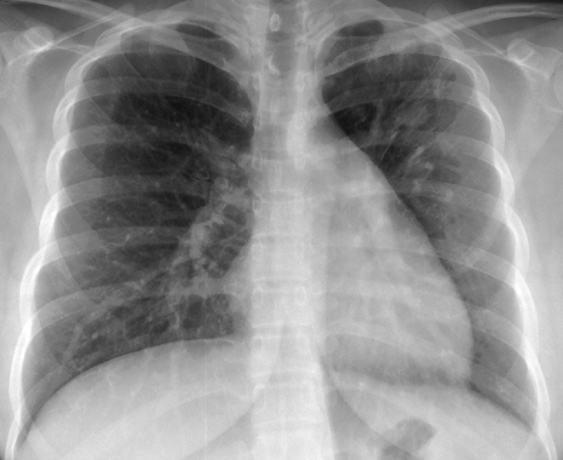

Slide 22
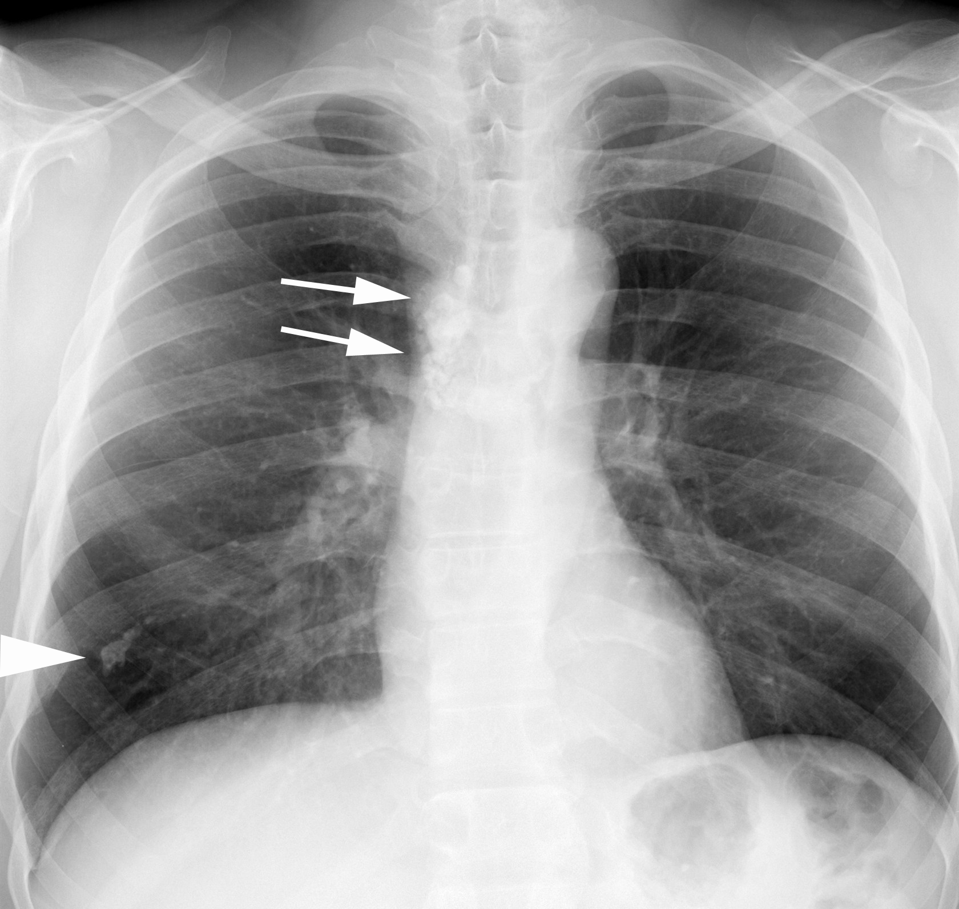
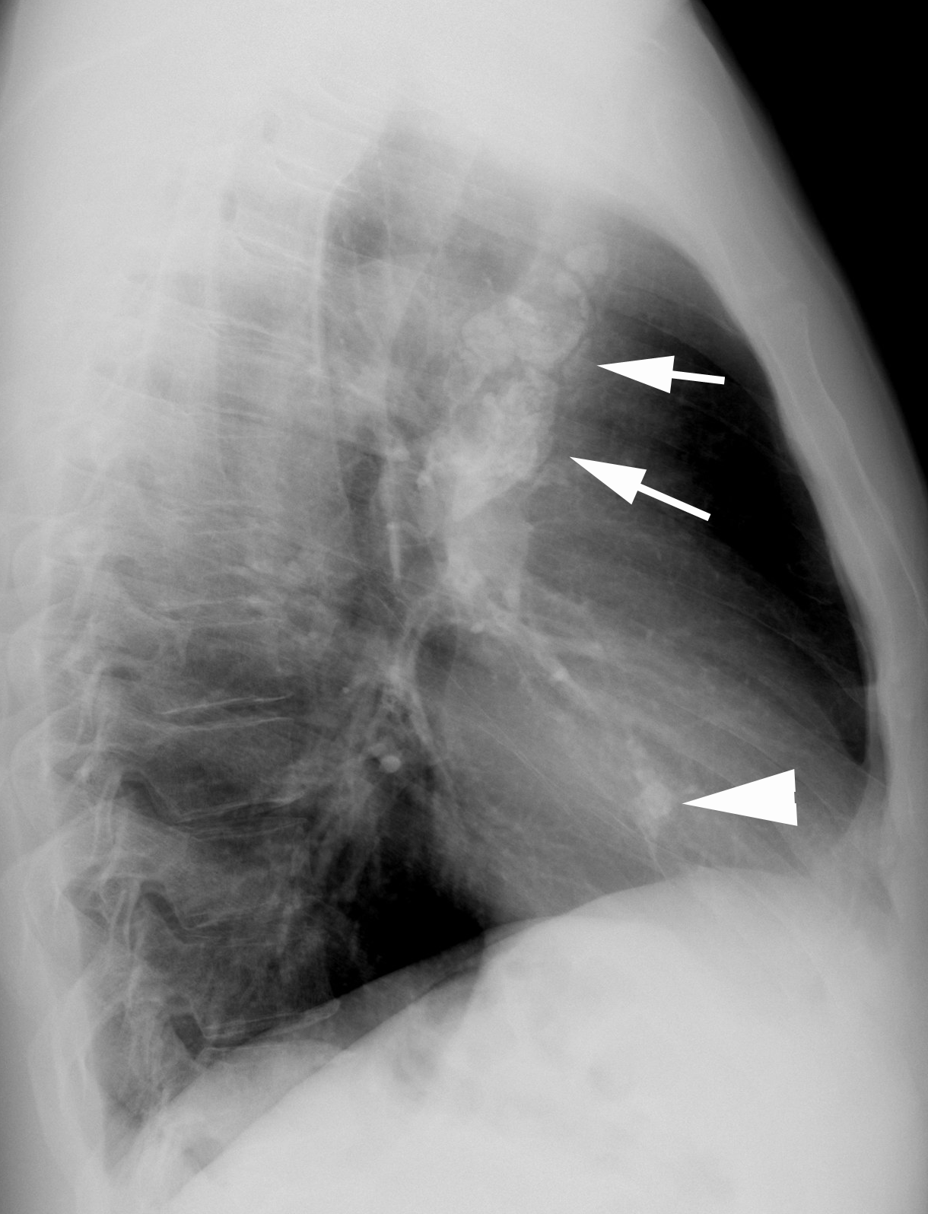

Slide 23
Signs and Symptoms
Initial exposure often asymptomatic
“Active” Infection
  Cough
  Hemoptysis
  Fever
  Night Sweats
  **May be relatively indolent (weeks/months)
  **5% asymptomatic

Slide 24
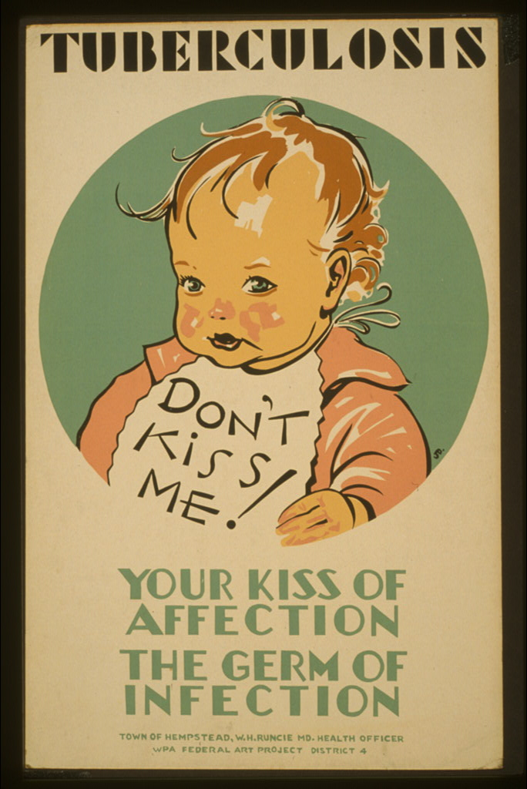

Slide 25
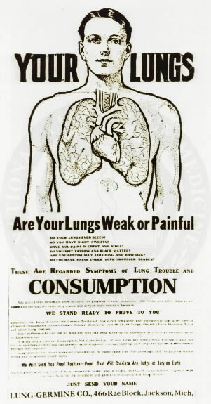
Diagnosis
Recent PPD Conversion
Typical Radiographic Appearance
  Suggestive, NOT Diagnostic
Sputum Cultures
  At least three good samples
  May take weeks to months to culture

Slide 26
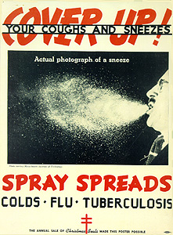

Slide 27
Sir Samuel Garth
Whilst meagre phthisis deals the silent blow.
Her stroaks are sure, but her advance is slow;
No loud alarms nor fierce assaults are shown;
She starves the fortress first, then takes the town

Slide 28
Primary Tuberculosis
More common in children
  ~25% adult
Unilateral Adenopathy (Uncommon-Adults)
Air-space Disease (More common-Adults)
  No Lobar Predilection
  +/- Cavitation/Satellite Nodules
Pleural Effusion Alone-5%
Miliary Disease-5%

Slide 29
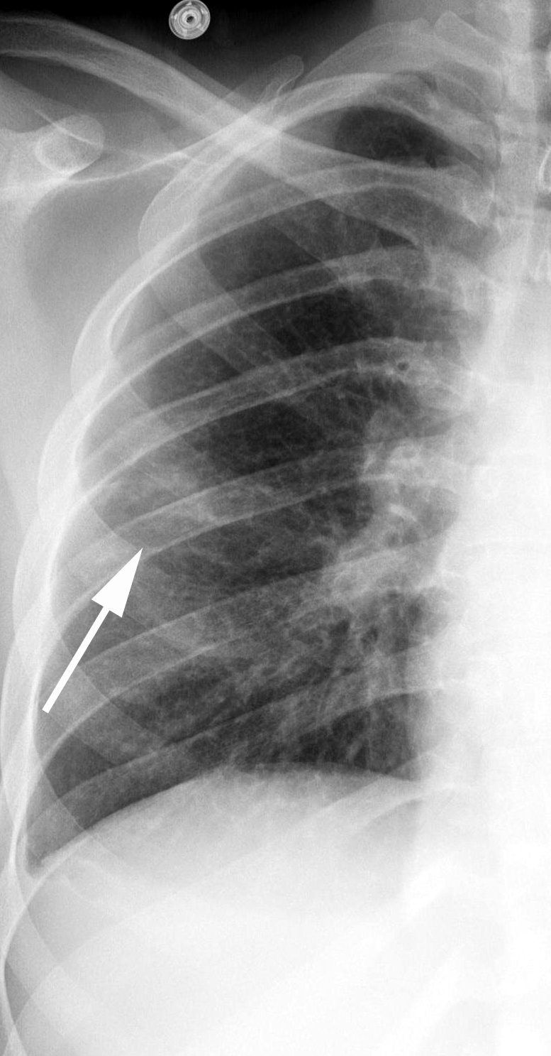
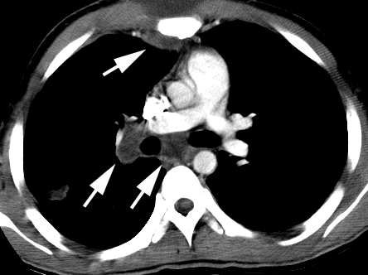

Slide 30
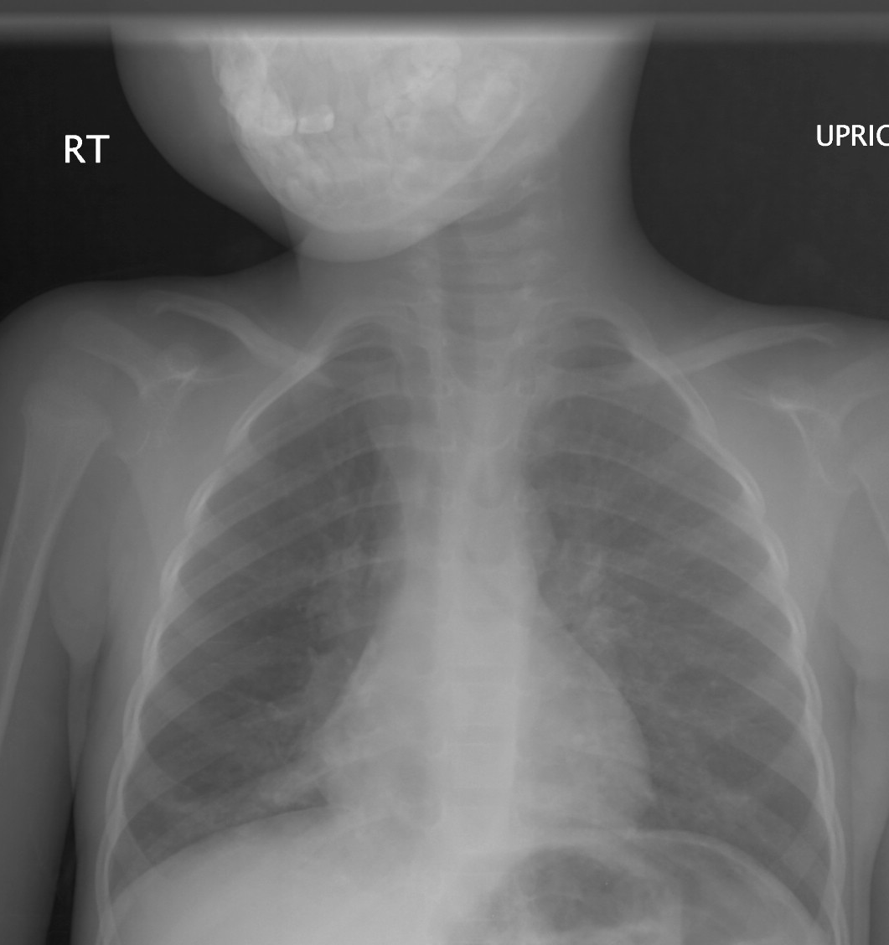
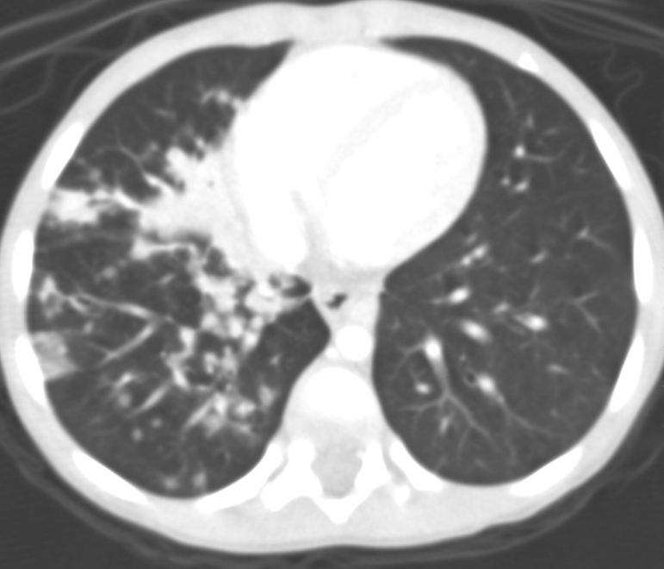
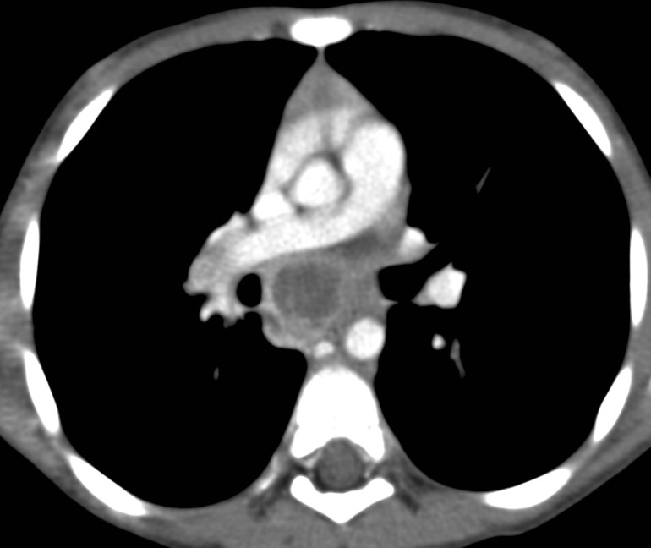

Slide 31
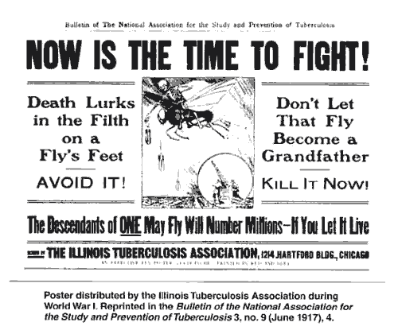

Slide 32
Progressive Primary TB
Continuum of Primary Disease
  ~5% of Primary Disease
Resembles Post-Primary TB
Recent PPD Conversion

Slide 33
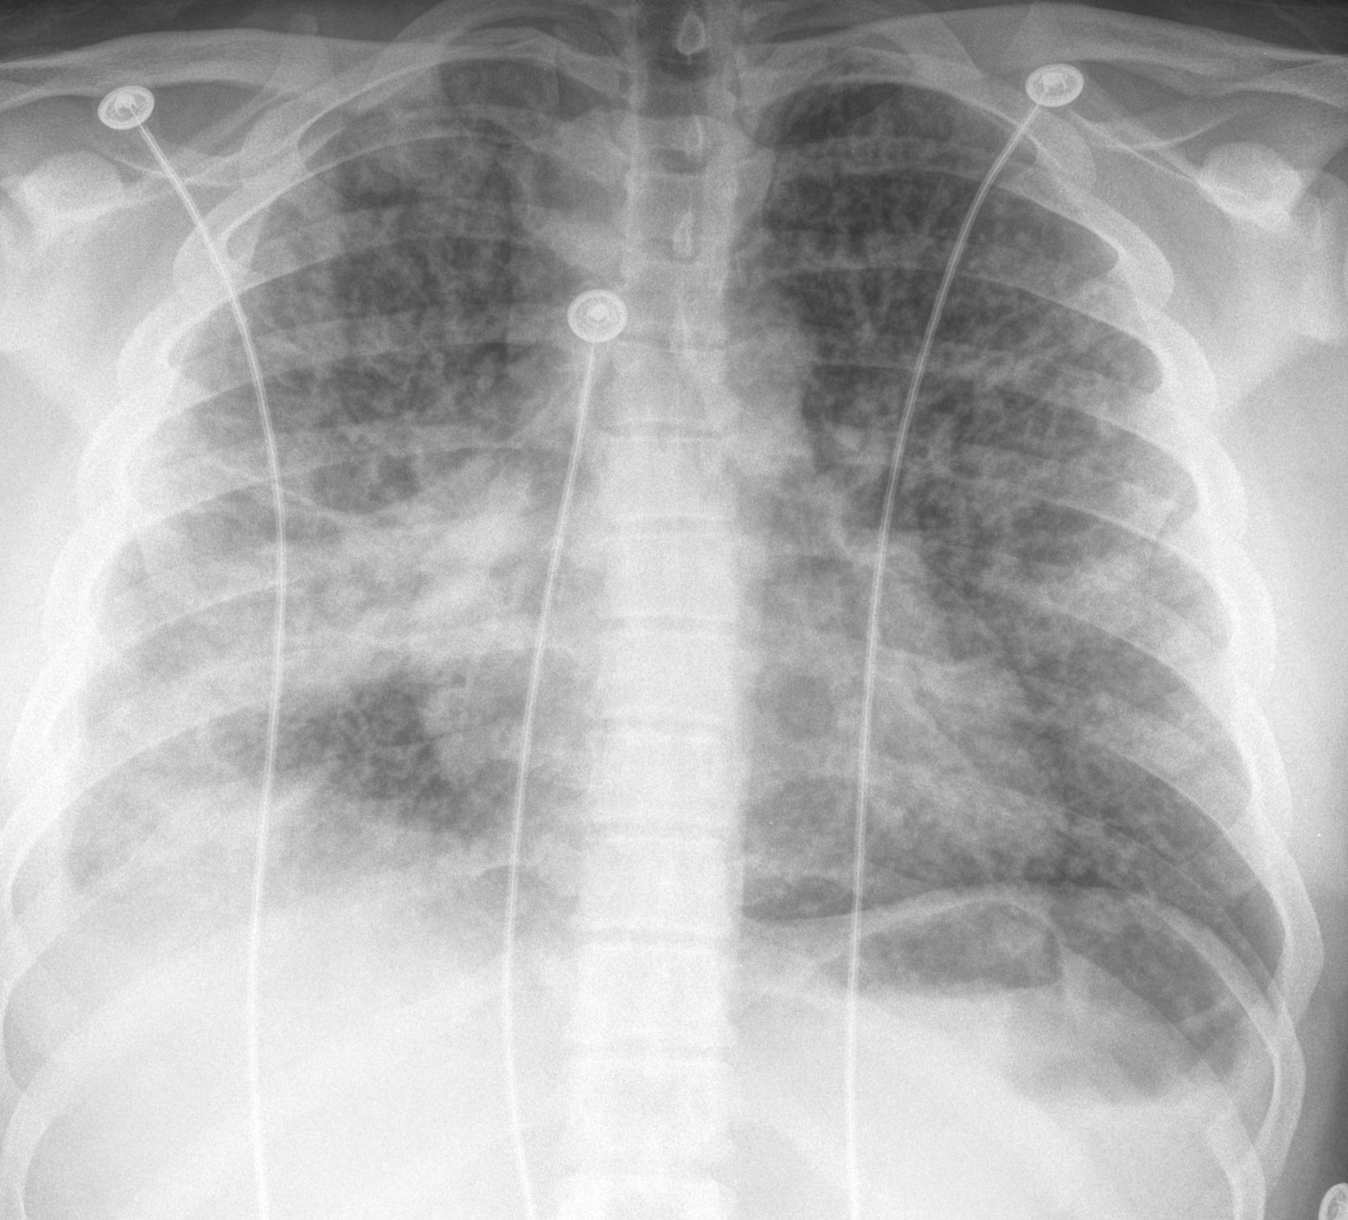

Slide 34
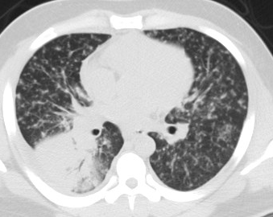
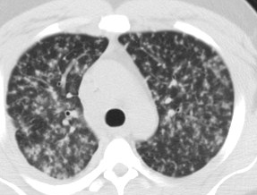

Slide 35
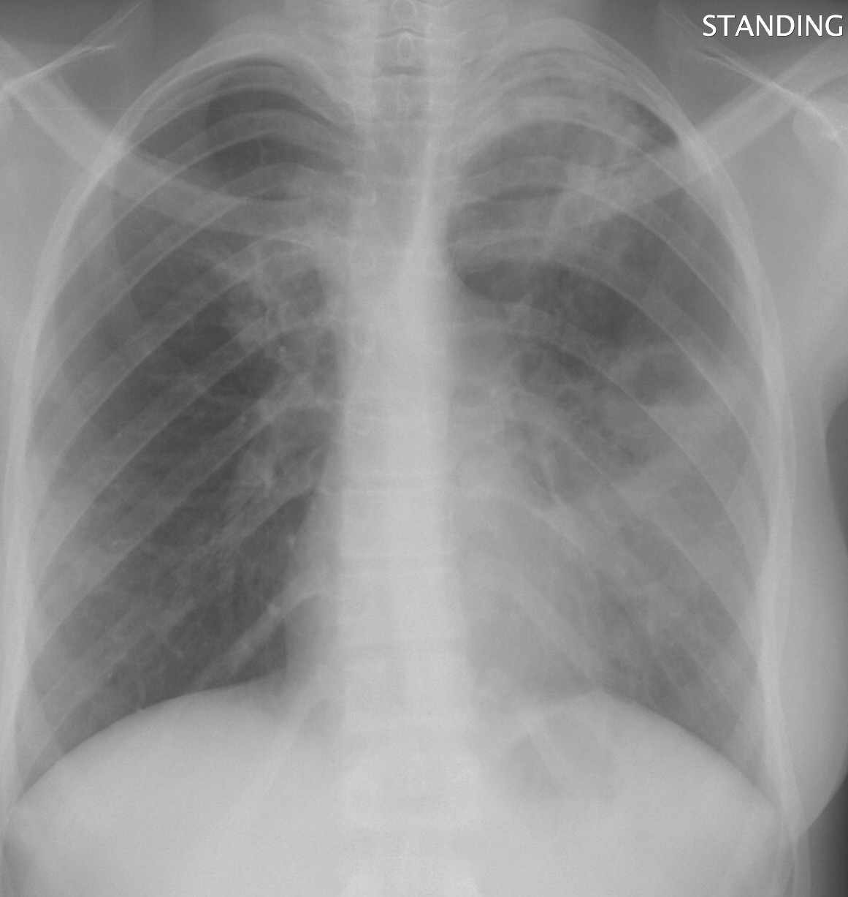
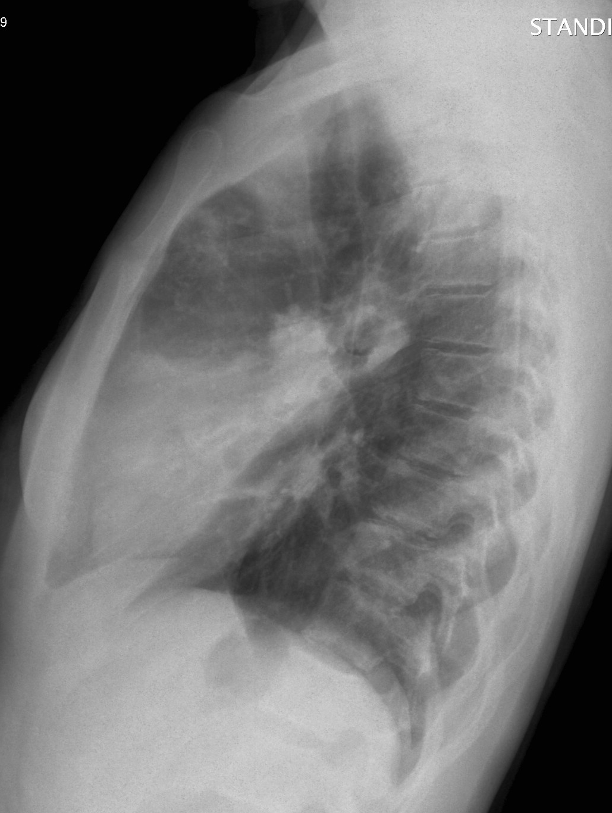

Slide 36
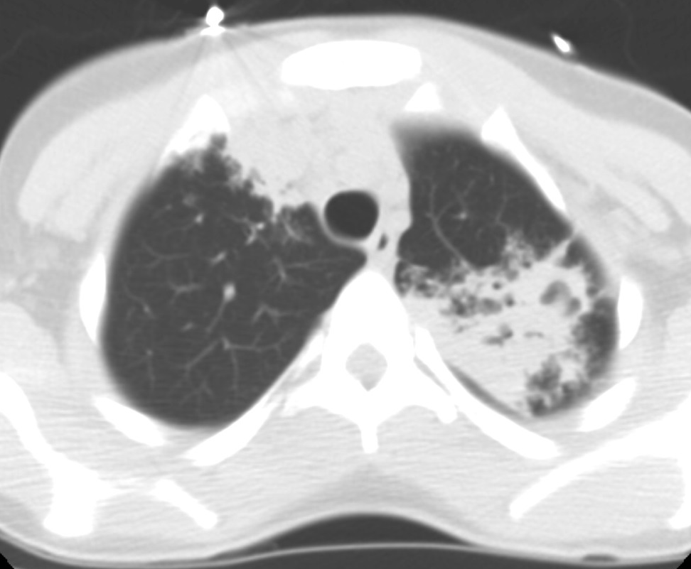
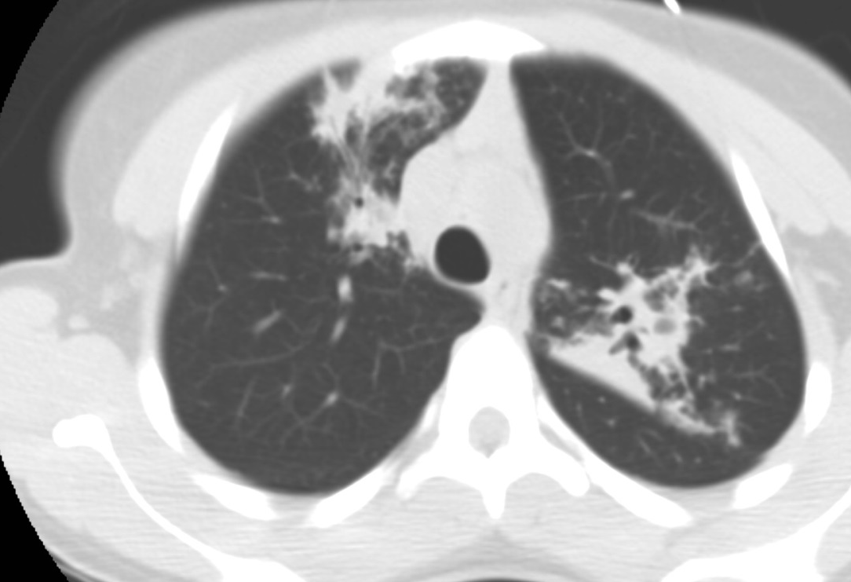
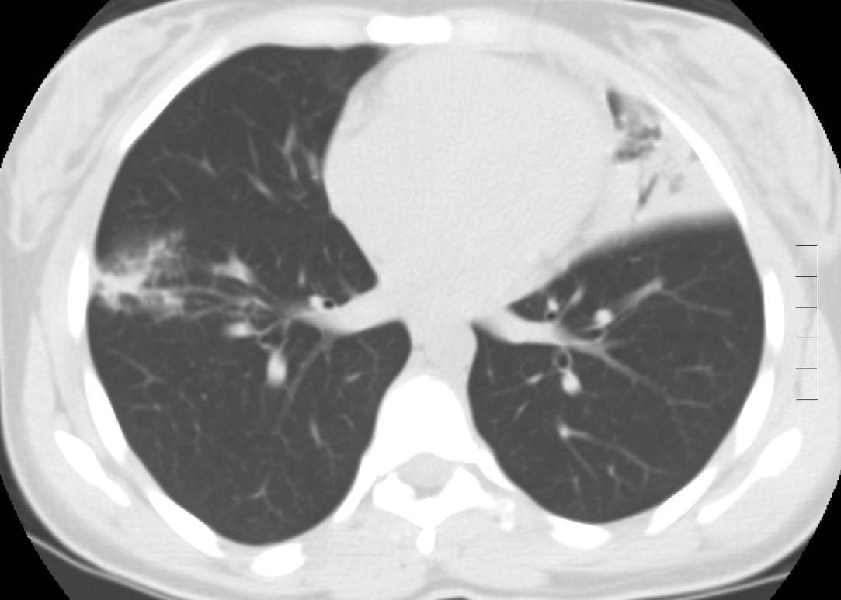
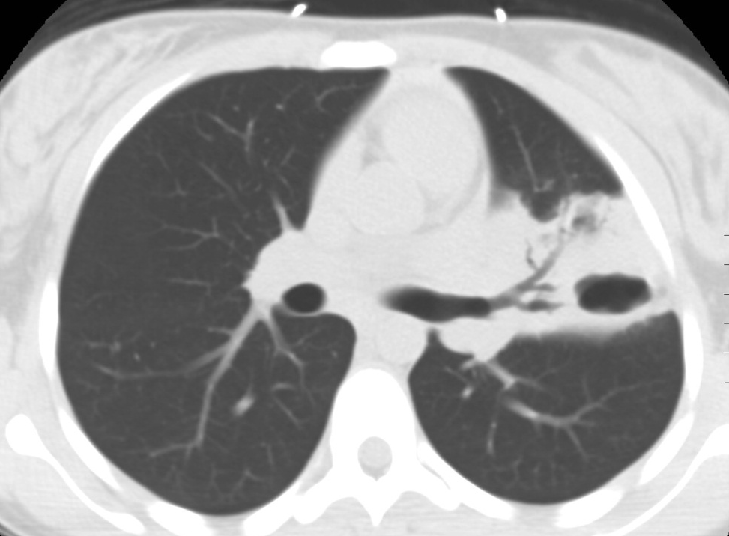

Slide 37
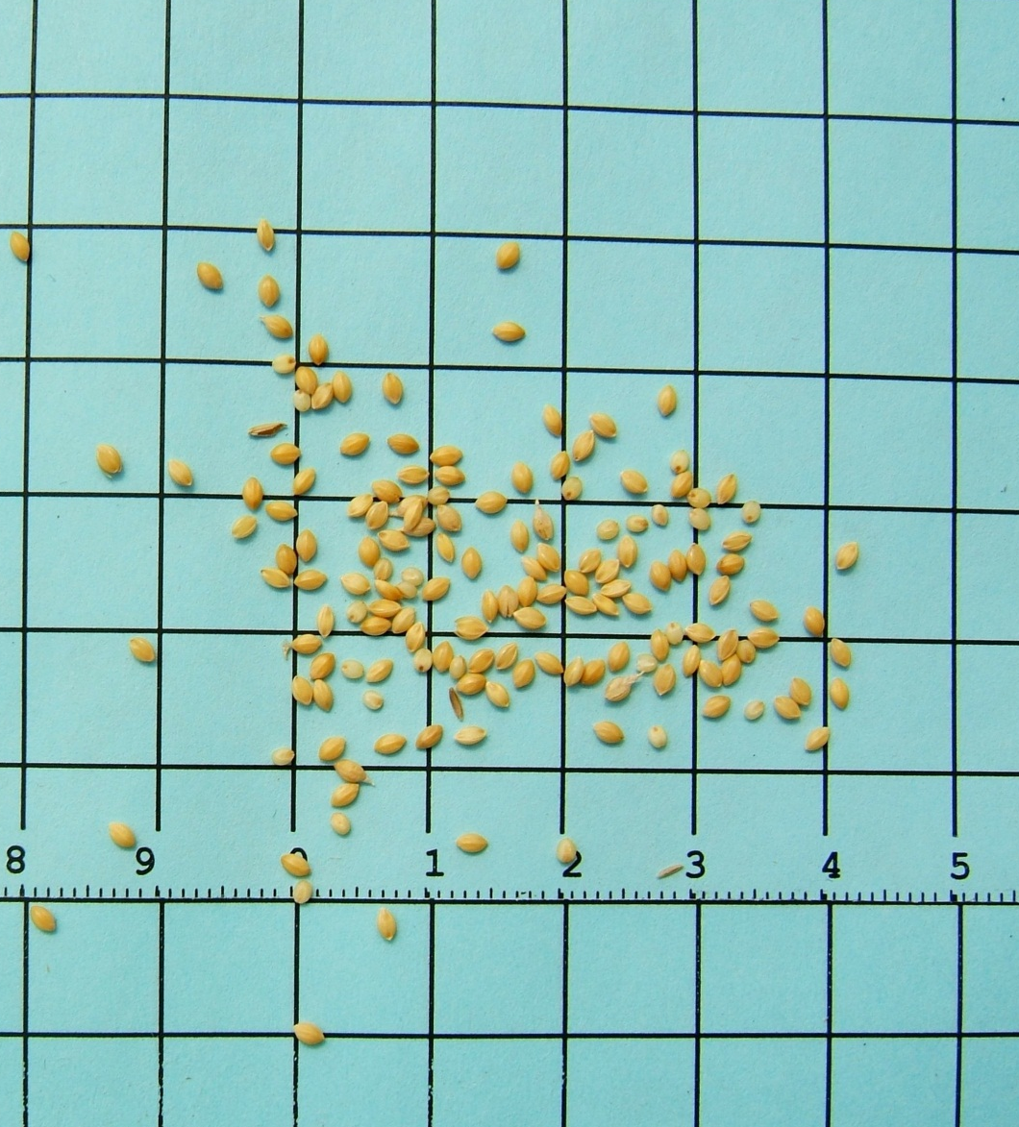
Miliary TB
Hematogenous Dissemination
1-4 mm Interstitial Nodules
Upper lobe Predominant
  May Be Coalescent in Upper Lobes

Slide 38
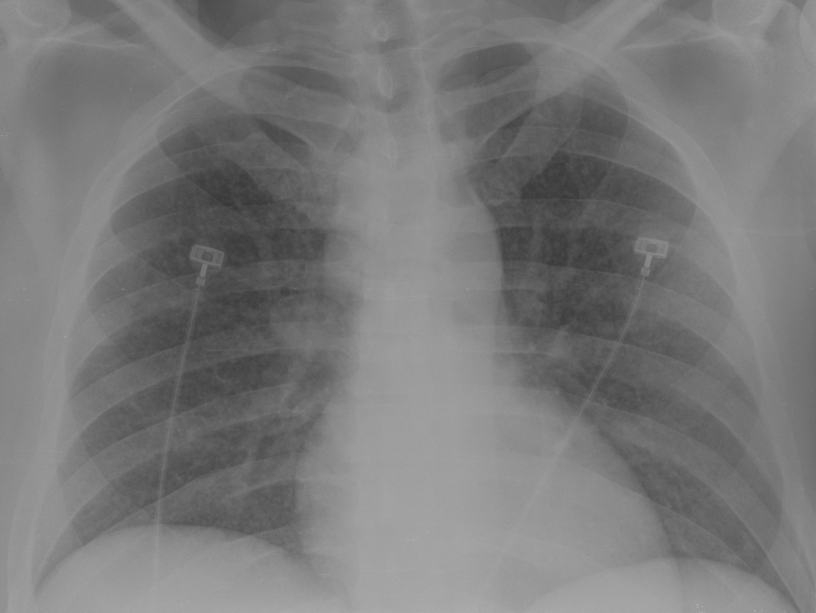

Slide 39
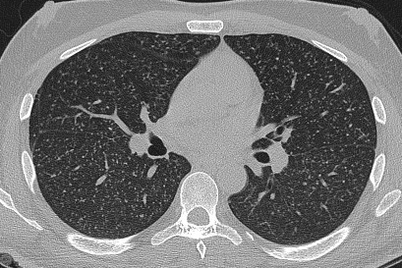

Slide 40
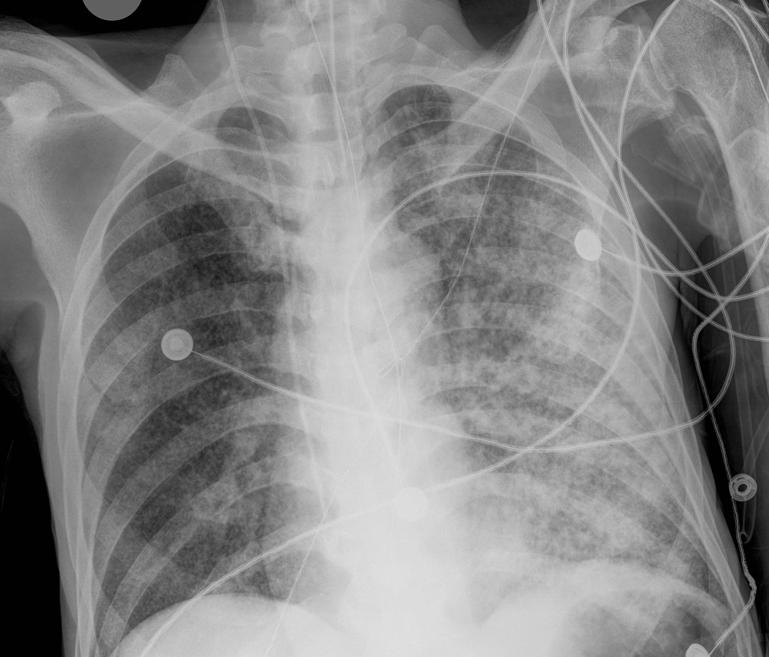

Slide 41
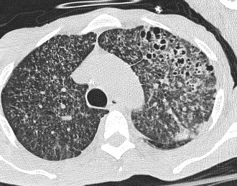

Slide 42
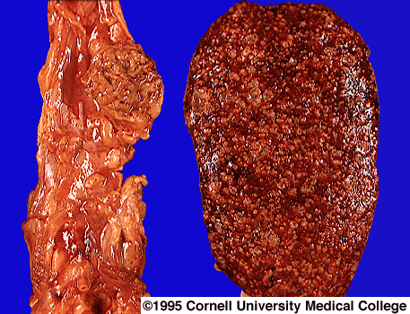

Slide 43
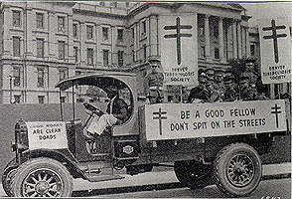

Slide 44
Fredrick Chopin (1810-1849)
Mallorca 1838
One sniffed at what I spat, the second tapped where I spat it from, the third poked about and listened how I spat it. One said I already had died, the second that I am dying, the third that I shall die…I can scarcely keep them from bleeding me…

Slide 45
Post-Primary TB
5-10% of cases
Delayed Manifestation
  Alcohol
  Malnutrition
  Elderly
  Immunodeficiency
Apical/Posterior Segment Upper Lobes-80-85%
Superior Segment Lower Lobes-10-15%
  Poor Lymphatic Drainage
  High Oxygen Tension

Slide 46
Post-Primary TB
Chest Radiograph
Course Reticulonodular Opacities
Cavitation-45%
Endobronchial Spread-20%
Architectural Distortion
Volume Loss
Typical Distribution
~5% SPN

Slide 47
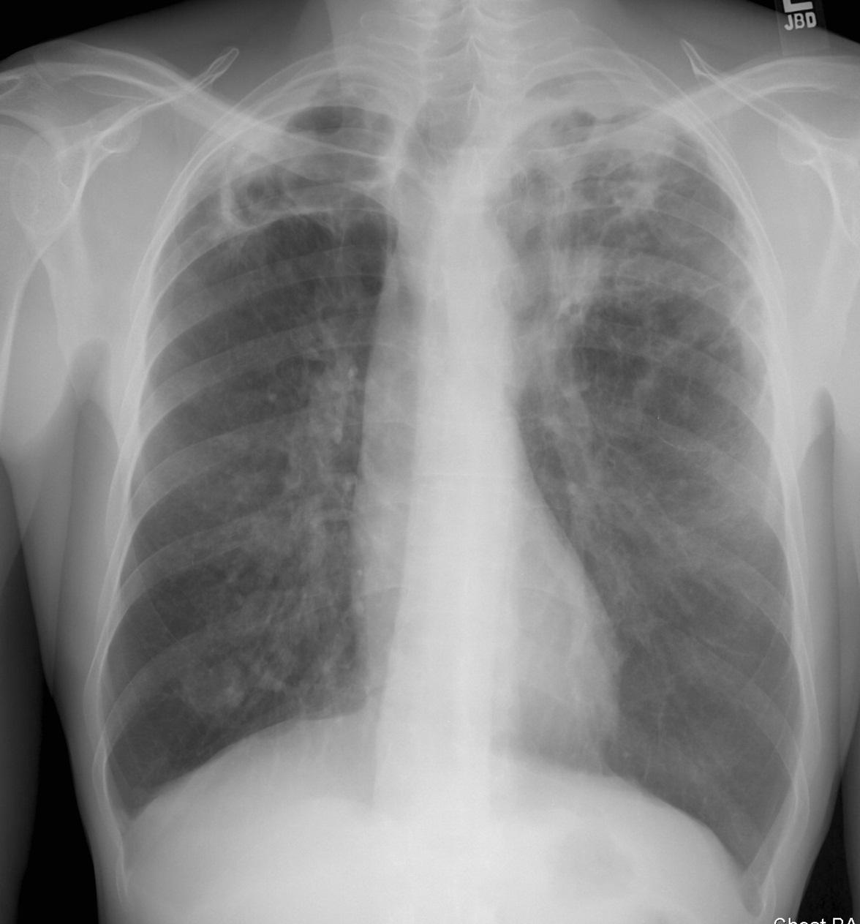
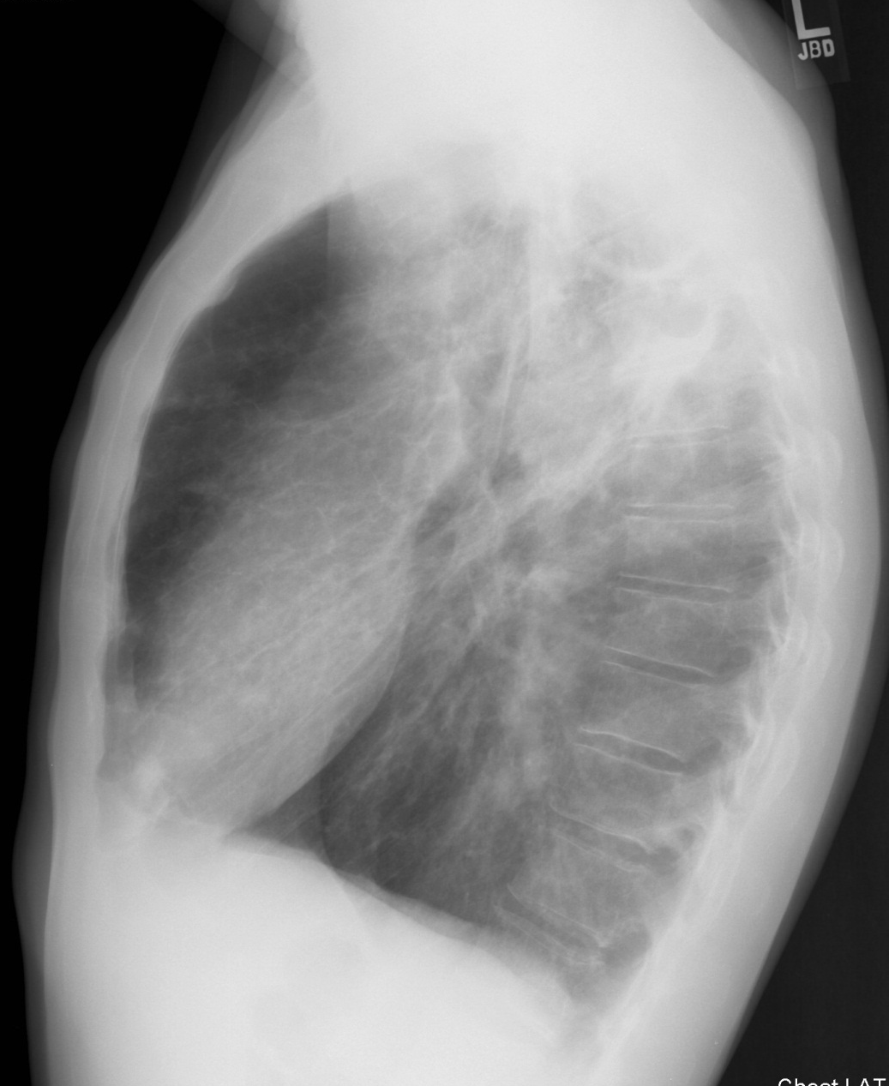

Slide 48
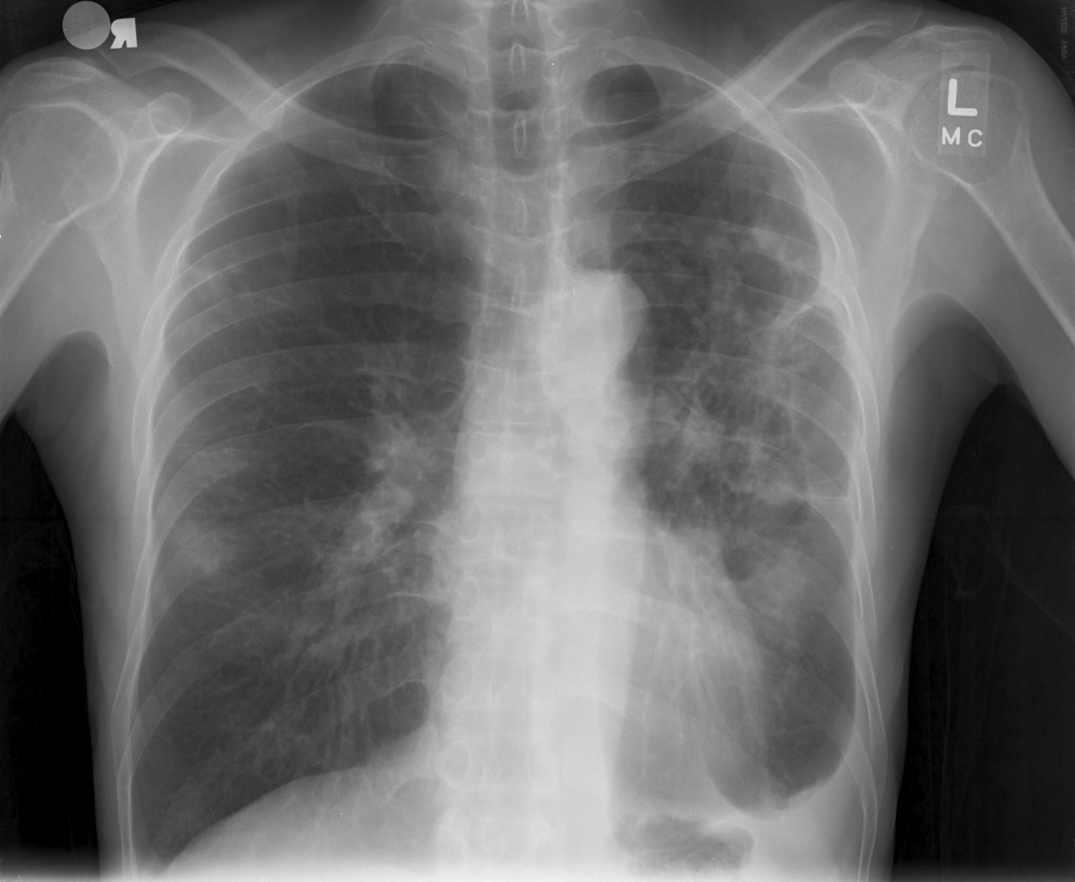
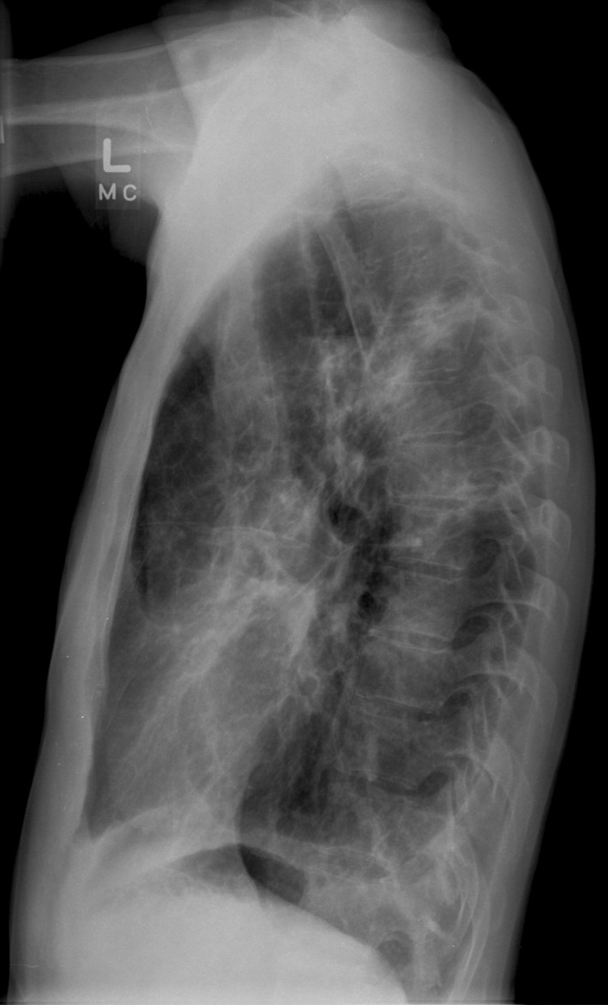

Slide 49
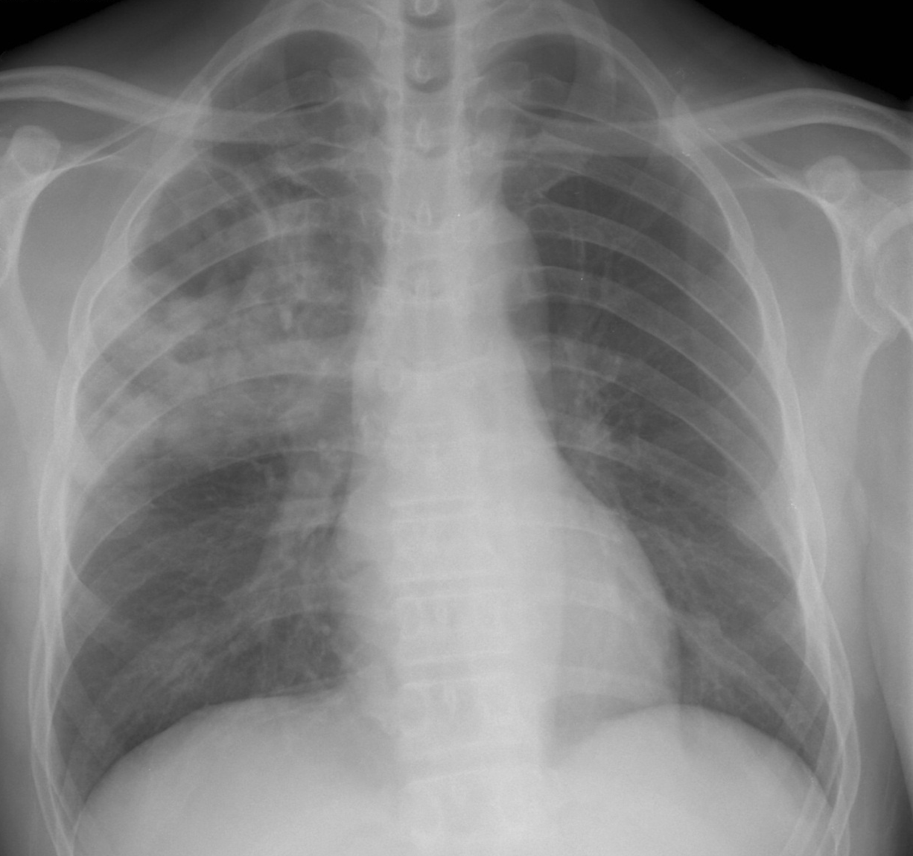
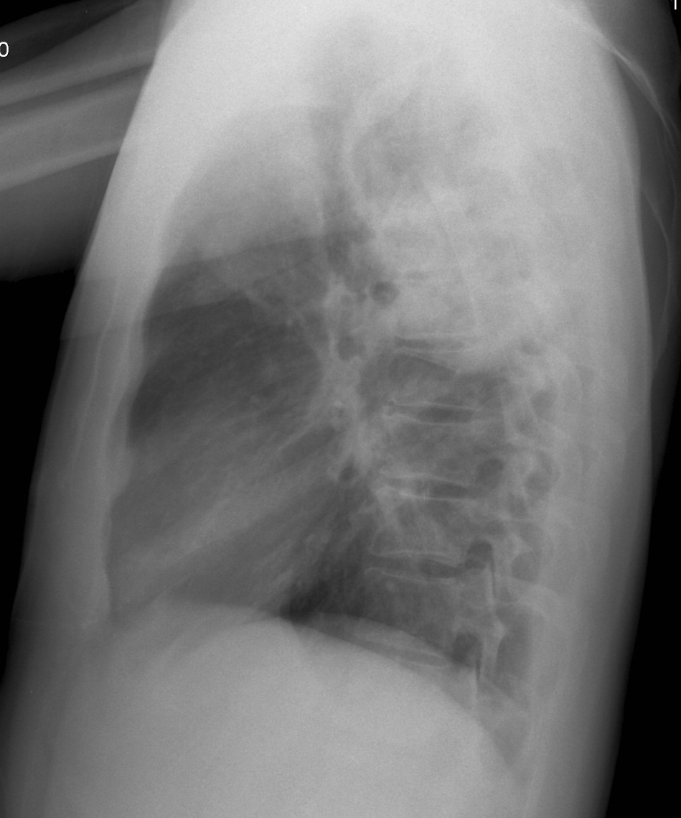

Slide 50
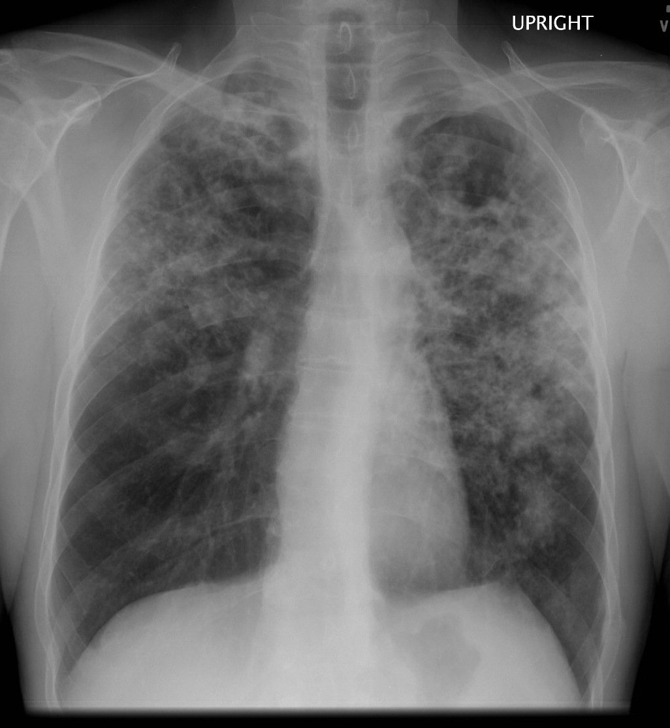
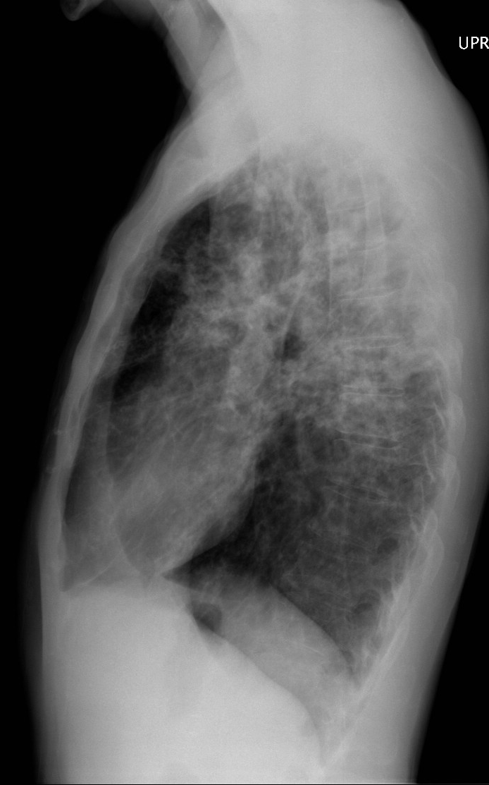

Slide 51
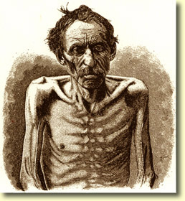

Slide 52
The Cry of the Poor Consumptive
But the end for you, it is not in sight
For death by bacillus has slow degrees
A cough by day and a sweat by night
And the lung turned leisurely into cheese

Slide 53
Post-Primary Tuberculosis
CT
Course Reticulonodular Opacities
Cavitation
Endobronchial Spread-95%
  Tree-in-bud Opacities
  Centrilobular Nodules
Adenopathy Uncommon
20-40% Evidence of Primary Infection

Slide 54
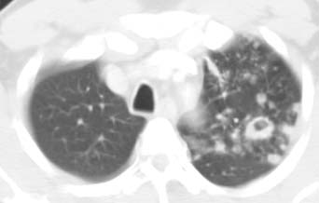
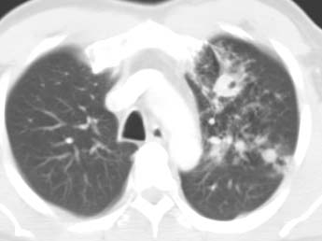

Slide 55
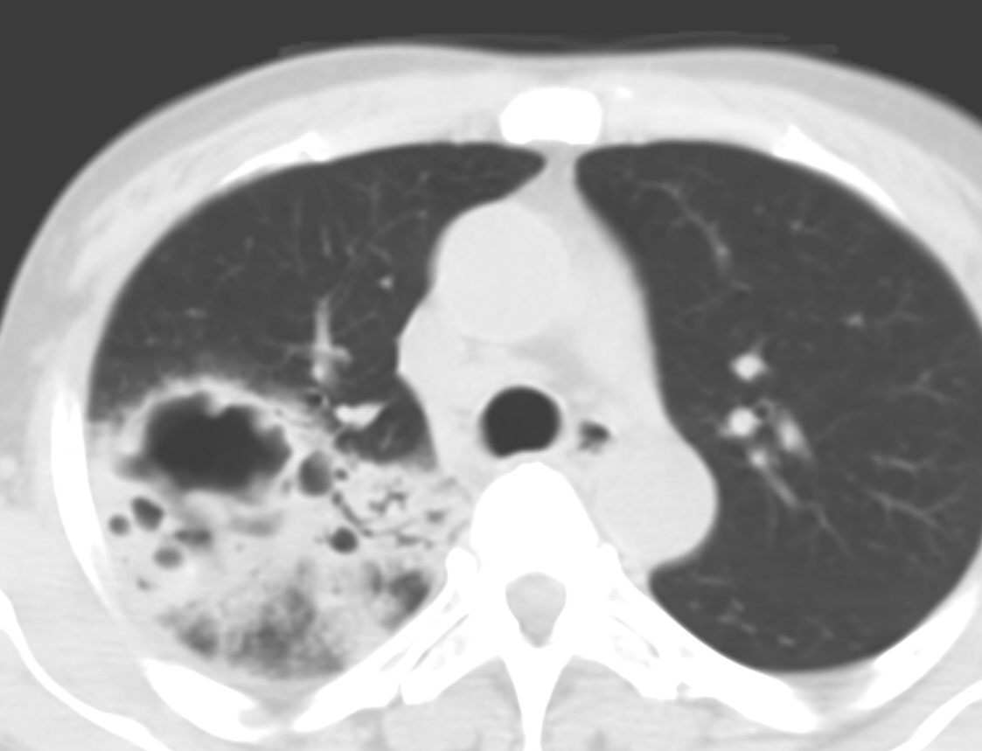
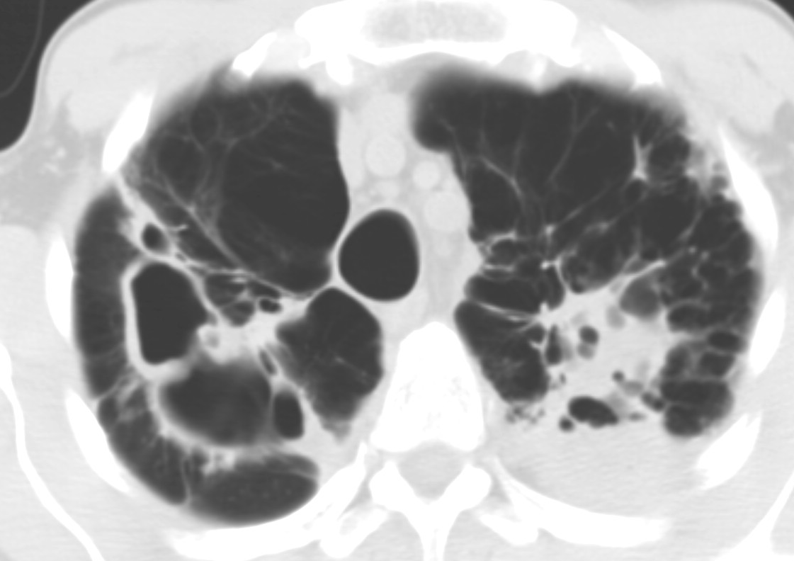

Slide 56
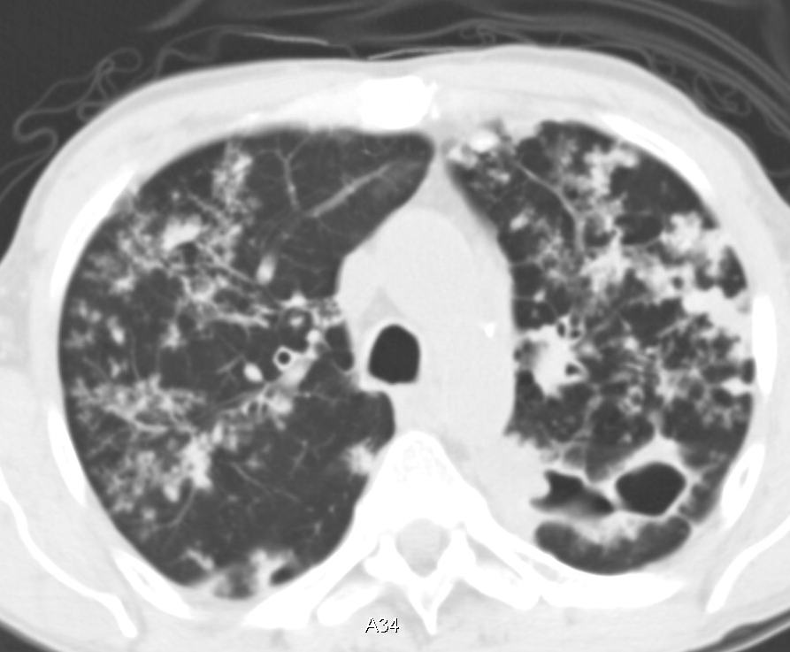
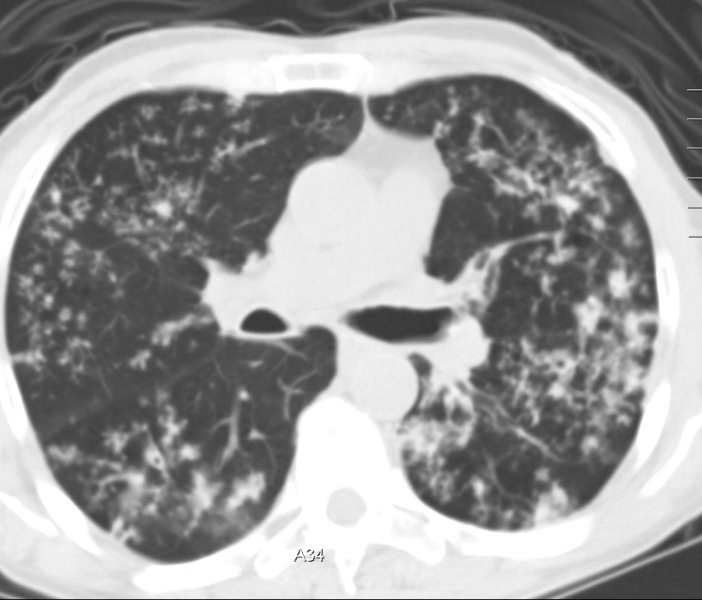
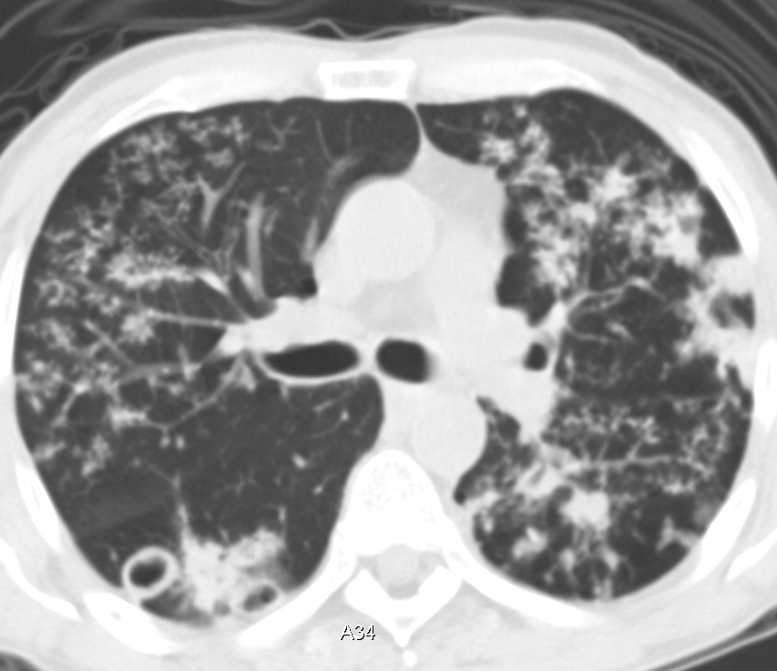
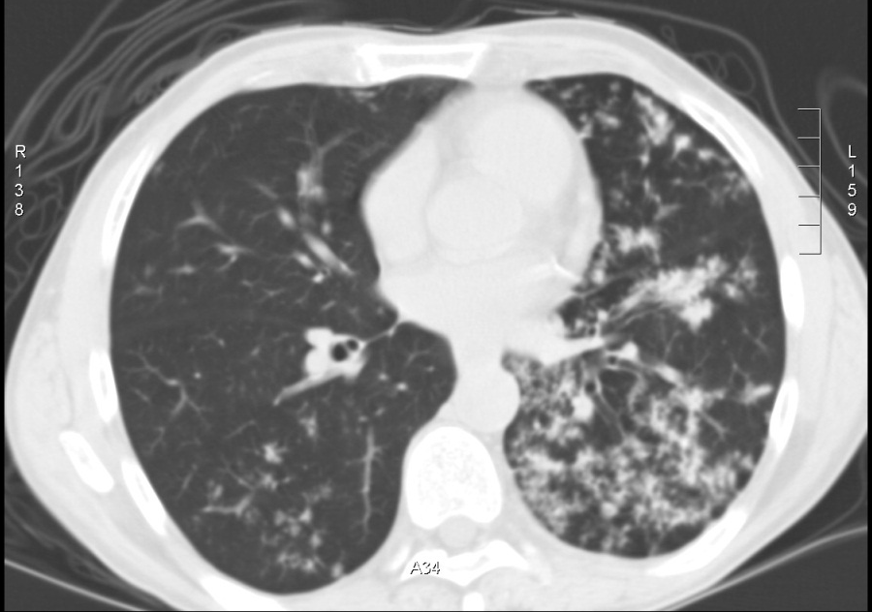

Slide 57
Jimmy Rogers 1931
TB Blues
I’m fighting like a lion; looks like I’m going to lose
Cause there ain’t nobody ever whipped the TB blues

Slide 58
Active vs. Inactive
6 Month Stability
Overlap of Findings
Presence of Endobronchial Spread-Active
Sputum Culture Needed for Definitive Diagnosis

Slide 59
TB-Pleura
Effusion Rare in Children
1/3 Adults
Ipsilateral 80%/Bilateral 20%
Only Manifestation-5%
Air-Fluid Level=Bronchopleural Fistula

Slide 60
Primary Pleura Disease
6-12 weeks following infection
Rupture of Subpleural Caseous Necrosis
Delayed Hypersensitivity Reaction
Sanguinous or Serosanguinous Fluid
Few Tubercle Bacilli in Fluid

Slide 61
Post-Primary Pleura Disease
Usually Small
Setting of Active Disease

Slide 62
Tuberculous Empyema
May have Subacute or Indolent Course
Thick White Cloudy Fluid (Pseudochylous) or Pus
Pleural Thickening +/- Calcification
Lymphocyte Predominant
Low Glucose/Triglycerides
Extension into Chest Wall-Empyema Necessitatis (Bronchopleuralcutaneous fistula)

Slide 63
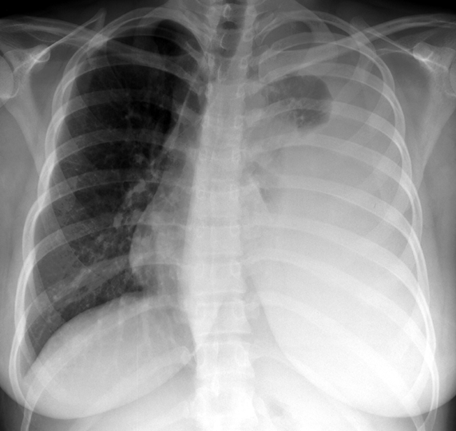

Slide 64
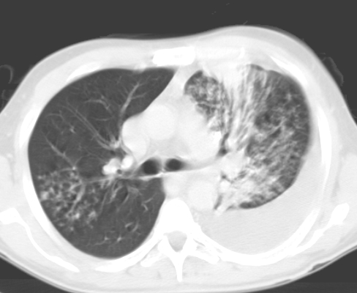



Slide 65



Slide 66



Slide 67




Slide 68


Empyema Necessitatis

Slide 69
TB-Endobronchial Disease
Primary or Post-Primary
2-4%
Irregular or smooth narrowing
Mural Thickening
Adenopathy

Slide 70




Slide 71



Slide 72



Slide 73
TB Pericardium
Direct Spread from Mediastinal Nodes
Hematogenous Dissemination
Thickening With or Without Effusion

Slide 74



Slide 75
TB Complications
Aspergilloma
  Prevalence 10% Chronic Cavitary TB
    20-50% Aspergilloma in setting of TB
  Hemoptyis Common
Hypertrophied Bronchial Arteries
  May Protrude Through Cavity Wall
Rasmussen Aneurysm
  Pseudoaneurysm of Pulmonary Artery
  5% at autopsy

Slide 76



Slide 77


Slide 78



Slide 79



Slide 80
"It is arterial blood. I cannot be deceived. That drop of blood is my death warrant. I must die."
1820, the poet John Keats died 1 year later at age 25

Slide 81


Slide 82

TB and HIV

Slide 83
Estimated HIV Coinfection in Persons
Reported with TB, United States, 1993 – 2013*
% Coinfection
*Updated as of June 11, 2014.
Note: Minimum estimates based on reported HIV-positive status among all TB cases in the age group.

Slide 84
HIV and TB
Manifestation Depends on CD4 Count
>200-Post-Primary Disease
<200
  10-20% Normal Chest Radiograph
  Low Prevalence of Cavitation
  Adenopathy Common
  Miliary Disease
May Transiently “Worsen” with HAART

Slide 85



Slide 86





Slide 87



Slide 88


Slide 89
Early Cures
Cato of Rome
  Lukewarm bath of human urine from a person who had eaten cabbage
Pliny the Elder
  Wolf lung boiled in wine
  Bear’s blood mixed with honey
Petrus Forestus
  Nurse from a young woman placed so they can suckle continuously

Slide 90
Broussais (1772-1838)
Strong Pulse, Strong Patient-Bleed
Strong Pulse, Weak Patient-Bleed
Weak Pulse, Strong Patient-Prefer to Bleed
Weak Pulse, Weak Patient-Bleeding Containdicated
50 Leeches

Slide 91



TB Surgical Therapy
Incision/Drainage
Collapse Therapy
  Pneumothorax
Resection

Slide 92


Slide 93


Slide 94
TB Therapy-Current
1940’s-Streptomycin
1952-Isoniazid
1970’s-Isoniazid + Rifampin Shortens Duration 18 to 9 Months
1980’s-Pyrozinamide-3 drugs, 6 Months
Ethambutol
Multi-drug Resistance
  Resistance to Isoniazid and Rifampin

Slide 95
“Dad always thought laughter was the best medicine, which I guess is why several of us died of tuberculosis”
  Deep Thoughts with Jack Handy

Slide 96
Treatment Response
Sputum Culture
Radiographs Poor Predictor
May Transiently Worsen over First 3 Months
Failure to Regress After 3 Months Suggests Drug Resistance (or Non-Compliance)
May take up to 2 Years to Resolve Completely
Residual Cavities/Bronchiectasis 70%

Slide 97


Slide 98
Conclusion
When to suspect TB
  Cavitary Disease Apical Posterior Segment
    Endobronchial Spread
  Upper Lobe Pneumonia in Debilitated, Alcoholic, Prisoner, etc.
  Unilateral Adenopathy in Child
  Adenopathy in HIV
If You Suspect TB, You MUST Call

Slide 99


Slide 100

is

