Slide 1
Developing a Multidisciplinary Prostate MRI Program:
Essential Initial Activities and Clinical Outcomes
Grand Rapids Medical Education Partners/MSU Radiology Residency, Grand Rapids, MI
Spectrum Health, Grand Rapids, MI
Advanced Radiology Services, PC, Grand Rapids, MI
Michigan State University College of Human Medicine, Grand Rapids, MI

Slide 2
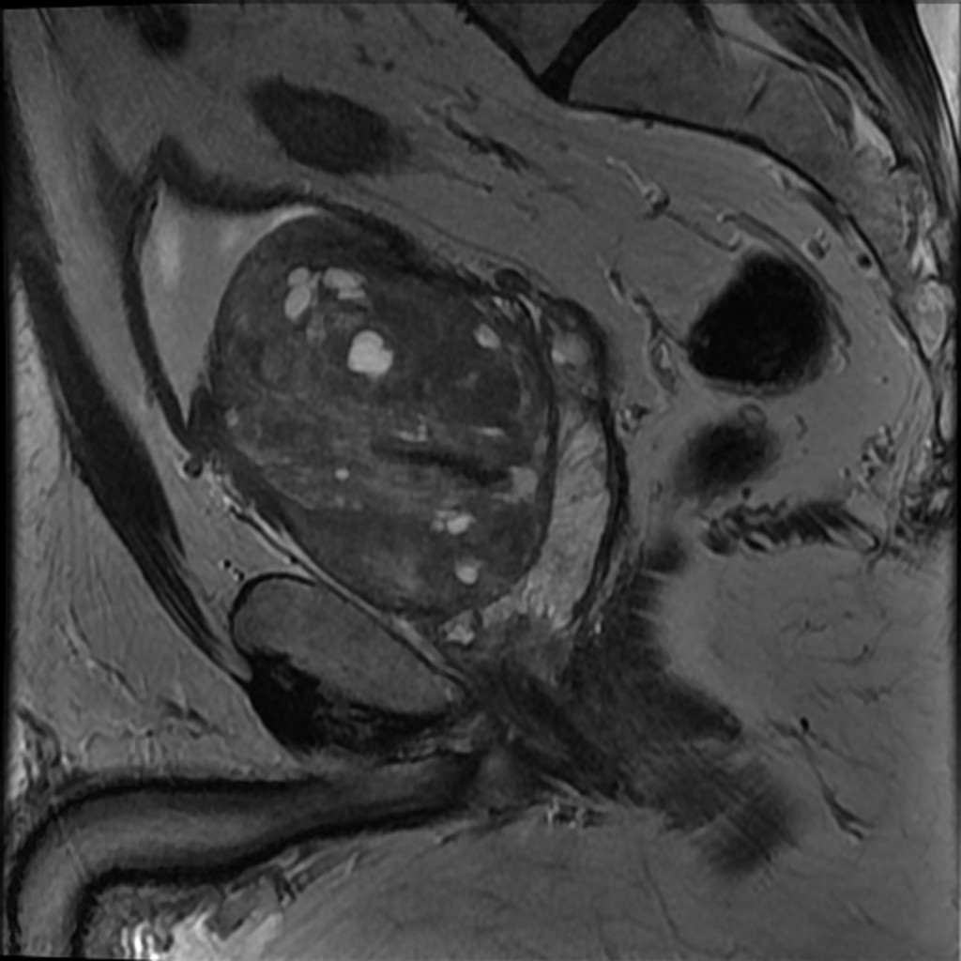
No conflicts of interest
Notes:
The prostate gland measures 80 mm transverse x 78 mm AP x 110 mm craniocaudal. Calculated gland volume: 357 mL (normal 15-30cc).

Slide 3
Prostate Cancer (PCa) Background
PCa is the second most common cancer (after skin cancer) in American men
2nd leading cause of cancer death for men in the U.S¹
~180,890 new PCa cases each year
5-year PCa-specific survival rates is nearly 100%
10-year survival ~99% for all stages of PCa¹
High survival rates due to
early detection and successful treatment
variable course and relatively long natural history
high prevalence of low-grade, slow-growing tumors that do not shorten life expectancy
¹ American Cancer Society (2016)
Notes:
Prostate cancer (PCa) is the second leading cause of cancer (behind skin cancer) and the second leading cause of cancer death (behind lung cancer) for men in the United States
While these high survival rates can be attributed at least in part to early detection and successful treatment, they also illustrate the variable course and relatively long natural history of the disease, with a high prevalence of low-grade, slow-growing tumors that do not shorten life expectancy.
1/7 men will be diagnosed with PCa in their lifetime
~26,120 deaths from PCa
1/39 men will die from it

Slide 4
PCa Screening Controversy
Risks of over-diagnosis and over-treatment
Increased morbidity without mortality benefit for treating “dormant malignancies”
Grade D recommendation for routine PSA testing by the USPSTF² in 2012
Differentiation between clinically-significant and indolent PCa is becoming recognized to be of paramount importance
Screening increases Dx and Rx w/o decreasing PCa specific or all-cause mortality
New approaches to risk stratification needed
²Moyer VA et al. Ann Intern Med 157(2): 120-134, 2012
Notes:
Randomized trials showed increased diagnosis of PCa in screened populations, leading to increased interventions but no difference in prostate cancer mortality or all-cause mortality. Lack of survival benefit and increased morbidity associated with intervention led to Grade D recommendation.

Slide 5
The PROMIS of MRI
MP-MRI triage initial biopsy
27% fewer primary biopsies
5% less clinically insig. PCa
TRUS directed by MP-MRI
18% more clinically significant cancer than primary biopsy
Sensitivity (p<0·0001)
MP-MRI: 93% (95% CI 88–96%)
TRUS: 48% (42–55%)
Specificity
MRI: 41% (36–46%)
TRUS: 96% (94–98%
TRUS: 6% (44/740) serious adverse events (8 sepsis)
Notes:
Randomized trials showed increased diagnosis of PCa in screened populations, leading to increased interventions but no difference in prostate cancer mortality or all-cause mortality. Lack of survival benefit and increased morbidity associated with intervention led to Grade D recommendation.

Slide 6
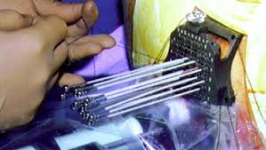
The PROMIS of MRI
Notes:
Randomized trials showed increased diagnosis of PCa in screened populations, leading to increased interventions but no difference in prostate cancer mortality or all-cause mortality. Lack of survival benefit and increased morbidity associated with intervention led to Grade D recommendation.

Slide 7
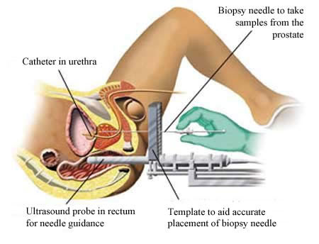
The PROMIS of MRI
Notes:
Randomized trials showed increased diagnosis of PCa in screened populations, leading to increased interventions but no difference in prostate cancer mortality or all-cause mortality. Lack of survival benefit and increased morbidity associated with intervention led to Grade D recommendation.

Slide 8
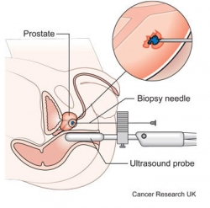
The PROMIS of MRI
Notes:
Randomized trials showed increased diagnosis of PCa in screened populations, leading to increased interventions but no difference in prostate cancer mortality or all-cause mortality. Lack of survival benefit and increased morbidity associated with intervention led to Grade D recommendation.

Slide 9
Prostate Magnetic Resonance Imaging
Initially T1 and T2 weighted sequences only
Locoregional staging
Multiparametric PMR now includes:
Diffusion Weighted Imaging (DWI)/ Apparent Diffusion Coefficient (ADC)
Dynamic Contrast Enhancement (DCE)
Expansion of clinical applications
Lesion detection and localization
Risk stratification
Active surveillance
Evaluation for disease recurrence
Image guidance for biopsy, surgical planning, and focal therapy
Notes:
Improving detection of clinically significant cancer, which is critical for reducing mortality; and 2) Increasing confidence in benign diseases and dormant malignancies, which are not likely to cause problems in a man’s lifetime, in order to reduce unnecessary biopsies and treatment.

Slide 10
Prostate Magnetic Resonance Imaging
Excessive variability in the use and application of PMR is a significant barrier to adoption, particularly in non-academic settings
Interpretation subjective, complex, low reproducibility
Prostate Imaging Reporting and Data System (PI-RADS) in 2012³ and PI-RADS v2 in 2015⁴
Increased standardization of acquisition protocols, interpretation methods, and reporting systems worldwide
³Barentsz JO et al. Eur Radiol. 22(4): 746-757, 2012
⁴Weinreb JC et al. Eur Urol 69(1): 16-40, 2016

Slide 11
Current State of PMR Programs
Growing experience at academic centers, but delayed implementation in community settings
89% of the academic institutions performed PMR
60% of large private practice groups
30% of small/medium non-academic groups⁵
38% of groups have been performing PMR <5 years
41% between 6 and 10 years⁵
No current literature on outcomes of PMR programs in community settings
Results from “mature” academic programs may not reflect the “learning curve” of program development
⁵Leake et al . J. Am Coll. Radiol. 11(2): 156-160, 2014
Notes:
Leake et al also reported that 38% of groups have been performing PMR for less than 5 years and 41% between 6 and 10 years

Slide 12
Advanced Radiology Services
Retrospective review of all PMR performed between August 2010 and December 2015
Diagnostic and staging accuracy of PMR over time
Clinical impact of multidisciplinary PMR meetings
Data recorded and analyzed included:
Patient demographic information
Clinical history
PMR interpretations
Available biopsy/surgical pathology results
Patient specific management plans

Slide 13
Evolution of PMRI Program
The overall lesion suspicion level on PMR was correlated with patient pathology results
Suspicion level assigned as low, medium, or high
Outcomes were compared across three different reporting experience eras:
Early: August 2010 – May 2014
Presence or absence of suspicious nodules reported
Mid: June 2014 – February 2015
Standardized reporting system- suspicion level based on number of positive parameters out of: T2W, DCE, and DWI
PIRADSv2: March 2015 – December 2015
Implementation of the PI-RADSv2 system

Slide 14
Patient outcomes
Primary:
How did the relative proportion of low/med/high suspicion PMR studies compare with the number of positive PCa biopsies over time?
Secondary:
How did staging information on PMR correlate with prostatectomy outcomes over time?
Extra-prostatic extension (EPE), seminal vesicle invasion (SVI), lymph node metastasis (LN), or other metastasis

Slide 15
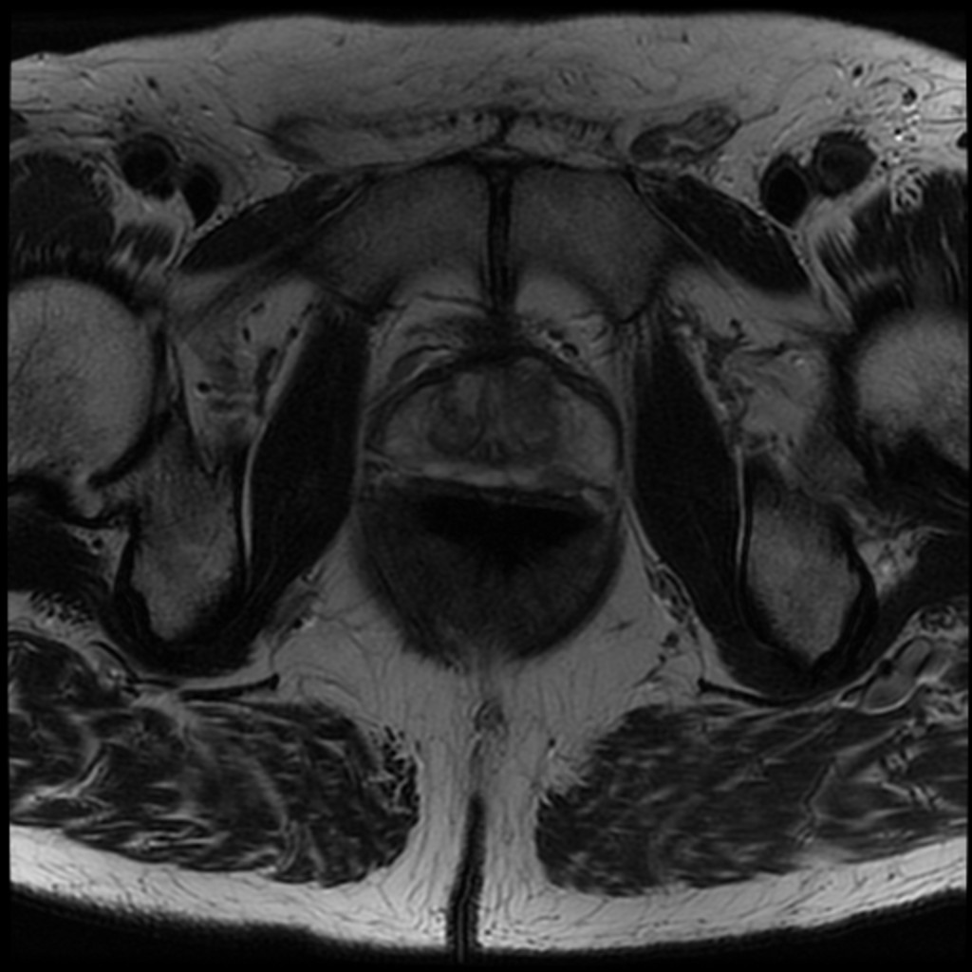
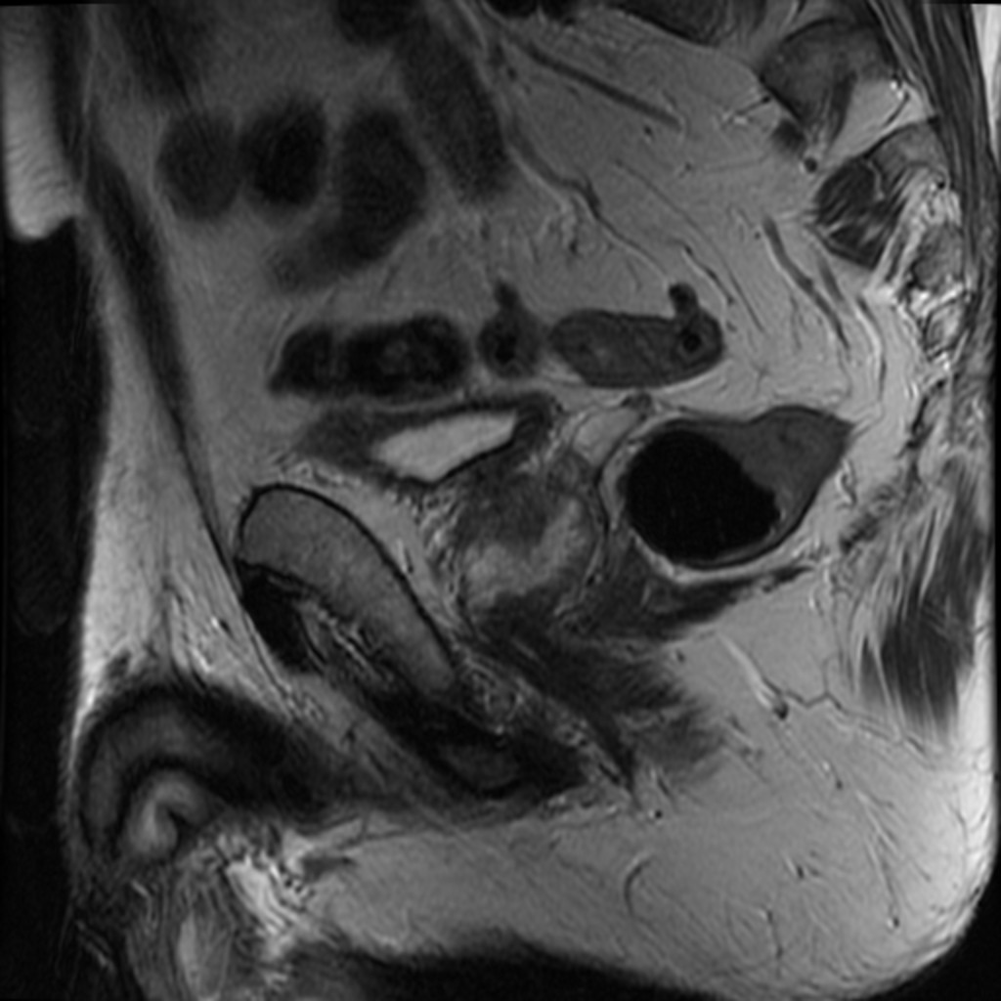
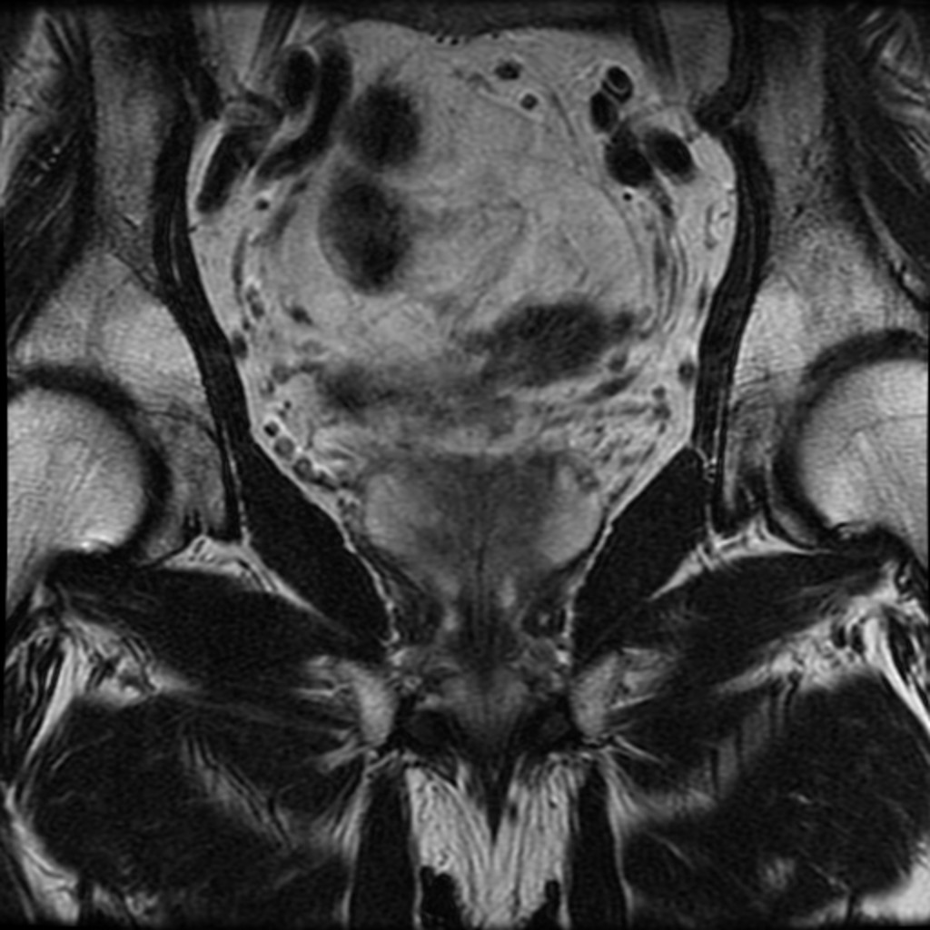
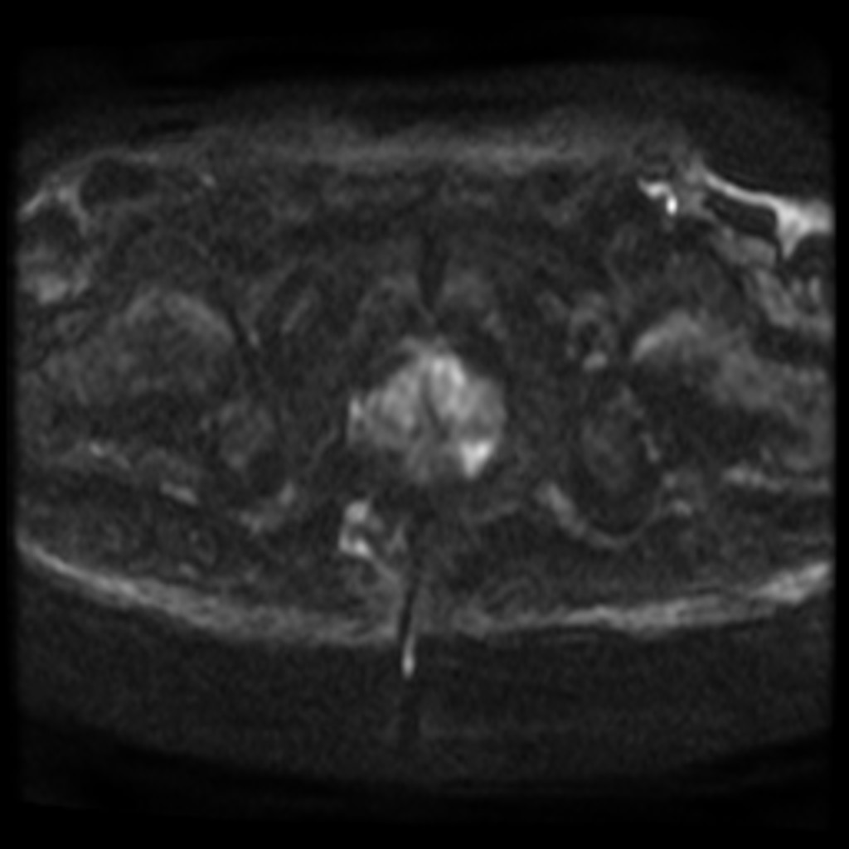
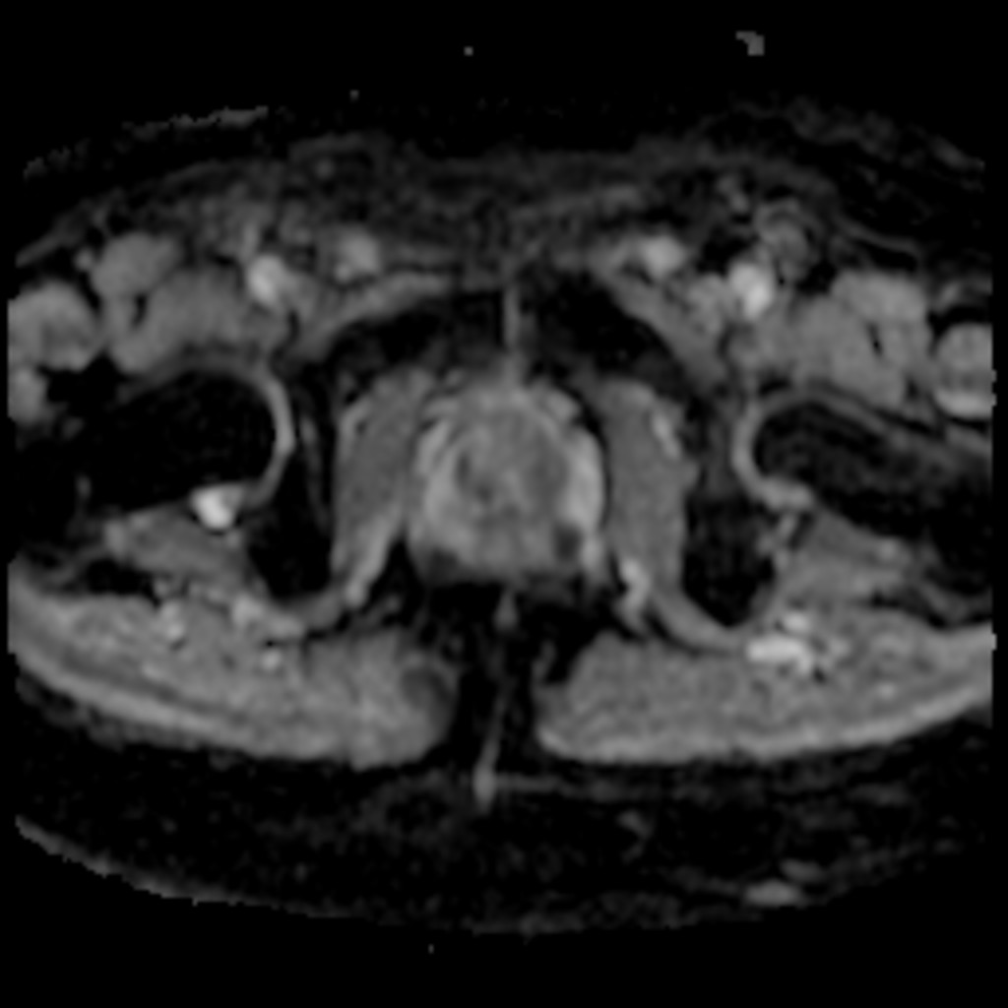
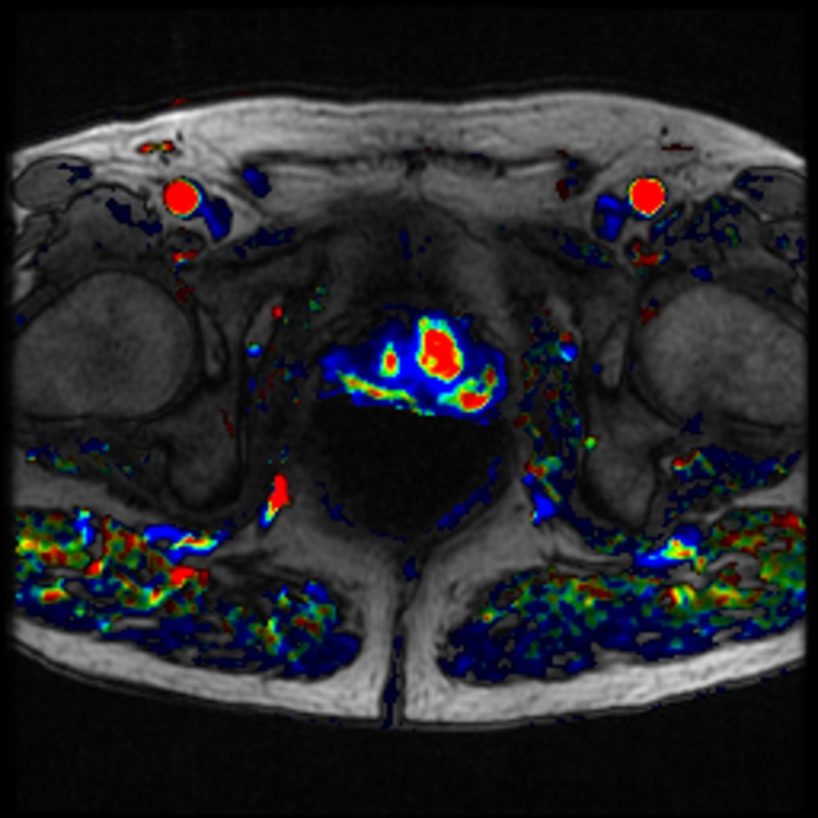
Figure 1

Slide 16
Results
Timeframe: 8/2010 and 12/2015
537 PMR studies, increasing in volume every year
Patient demographics:
Median age: 65 years (IQR: 59, 69)
93% of patients were Caucasian
21% had a positive family history of PCa
Median PSA prior to PMR was 6.1 ng/ml (IQR: 4.0, 10.0)

Slide 17
PMR Studies
Figure 1. Number of PMR studies by diagnosis by year
Notes:
Figure 1. Number of PMR by diagnosis by year

Slide 18
Results
Indications:
PCa evaluation/staging (60%, n=324)
PCa screening (37%, n=198)
Other prostatic/pelvic disease (2.8%, n=15)
Percentage of screening patientss:9.5% to 41% over 5 years (4X)
Significant increase in the number of ordering physicians occurred in both Mid and PiRADSv2 eras
Additional urologists, radiation oncologists, and medical oncologists ordering PMR exams once the program became more established

Slide 19
Ordering Physicians
Figure 2. Number of PMR by ordering physician by year
Notes:
Figure 2. Number of PMRI by ordering physician by year

Slide 20
Multispecialty Meetings
Multispecialty meetings initiated in July 2014
Radiologic- pathologic correlation
Technical improvements in image quality
Selected cases reviewed in detail
PMR
Radiologists
Application Specialists
Urologists

Slide 21
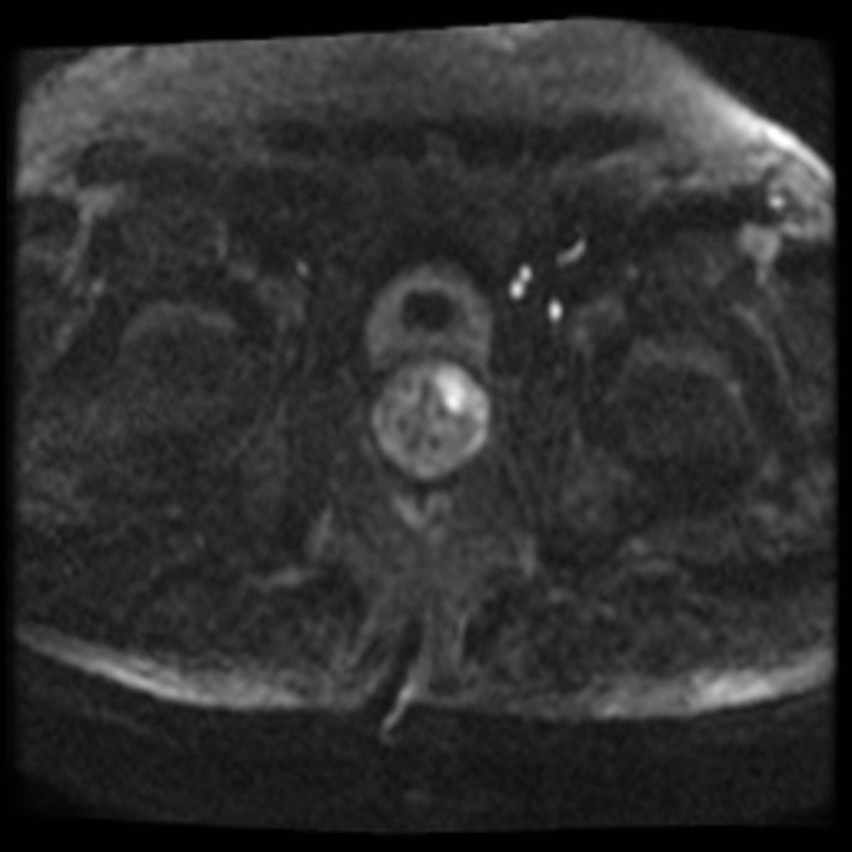
Image Quality: 2012 vs. 2015
DWI, same patient 2012 vs. 2015

Slide 22
Impact of Multispecialty Review
67 patients reviewed (14%) for clinical, radiographic, and pathologic information
51% of reviewed cases had change in management
Different PI-RADSv2 score assigned (n=6)
Treatment advised rather than continue on active surveillance (AS) (n= 5)
AS without an immediate biopsy (n= 4)
Approach to biopsy selected for difficult scenarios (anterior lesions, patients without a rectum) (n=4)
Surgical technique changed based on PMR findings (n= 3)

Slide 23
Suspicion Level by Era
Figure 3. Suspicion level on PMR by era.
Notes:
Figure 3. Suspicion level of mpMRI by era.

Slide 24
Suspicion Level by Era
All Patients
PCa Screening Pts
PCa Patients
Figure 3. Suspicion level on PMR by era.

Slide 25
Suspicion Level by Era
As the number of low suspicion studies increased, the rate of cancer detection following biopsy also increased
Patients that underwent biopsy for suspicious lesions had cancer or atypia by era:
Early: 26 of 53 (49%)
Mid:9 of 19 (47%)
PI-RADSv2: 14 of 20 (70%) (p=0.13)

Slide 26
Biopsy Results
% PCa at biopsy
Figure 4. Percentage of biopsies positive for PCa across eras.
Notes:
Published Sensitivities/Specificities for PCa evaluation in literature: 76-78% and 79-82%
Loch R, Fowler K, Schmidt R, et al. Prostate magnetic resonance imaging: challenges of implementation. Current problems in diagnostic radiology. 2015;44(1):26-37.
Yoo S, Kim JK, Jeong IG. Multiparametric magnetic resonance imaging for prostate cancer: A review and update for urologists. Korean journal of urology. 2015;56(7):487-97.
Moyer VA, U.S. Preventative Services Task Force. (2012) Screening for prostate cancer: U.S. Preventive Services Task Force recommendation statement. Ann Intern Med 157(2):120-134.

Slide 27
PMR Staging: All Patients
All Patients | Overall (n=535) | Early (n=253) | Mid (n=92) | PI-RADSv2 (n=190) | P value
Extraprostatic extension (EPE)* | 17% (87) | 18% (43) | 17% (15) | 16% (29) | 0.87
Seminal vesical invasion (SVI)* | 7.3% (37) | 7.9% (19) | 8.0% (7) | 6.1% (11) | 0.74
Lymph node involvement | 6.9% (37) | 7.9% (20) | 7.6% (7) | 5.3% (10) | 0.53
Other metastasis | 4.1% (22) | 3.6% (9) | 6.5% (6) | 3.7% (7) | 0.44
*Of the 537 PMR, EPE and SVI were not evaluable in 26 patients s/p prostatectomy, 1 with hemorrhage from biopsy 3 weeks prior, and 2 with claustrophobia, leaving 508 for analysis. LN involvement and metastasis was assessed in 535 patients (all but the 2 with claustrophobia).
Table 1. Percentages of all patients with locally-advanced or metastatic PCa based on PMR findings.
Notes:
Table 1. Reported percentages of patients with locally-advanced or metastatic PCa based on PMR findings.

Slide 28
PMR Staging: PCa Patients
There were no statistically significant differences in staging information across eras.
As expected, there were slightly higher rates metastatic disease in known PCa patients.
Pca Patients | Overall (n= 325) | Early (n= 163) | Mid (n= 51) | PI-RADSv2 (n= 111) | P value
EPE* | 24% (73) | 24% (36) | 28% (13) | 24% (24) | 0.87
SVI* | 10% (30) | 9.9% (15) | 11% (5) | 10% (10) | 0.74
LN | 8% (26) | 9.8% (16) | 8.7% (4) | 5.4% (6) | 0.53
Other mets | 5.6% (18) | 4.3% (7) | 9.8% (5) | 5.4% (6) | 0.4
Table 2. Percentages of PCa patients with locally-advanced or metastatic PCa based on PMR findings.

Slide 29
Staging Accuracy at Prostatectomy
 | EPE (n=77) | SVI (n=77) | LN (n=78)
Sensitivity | 56.3% | 58.3% | 75.0%
Specificity | 77.8% | 90.8% | 98.5%
Positive predictive value | 64.3% | 53.4% | 90.0%
Negative predictive value | 71.4% | 92.2% | 95.6%
EPE, extraprostatic extension; SVI, seminal vesicle invasion; LN, lymph node metastasis
Based on 78 patients who underwent prostatectomy and lymph node dissection after PMR; 1 study was indeterminate for EPE and SVI and thus excluded.
Table 3. Diagnostic accuracy of PMR in patients with pathologic confirmation at prostatectomy.
Notes:
Table 2. Measures of diagnostic performance of PMR in patients with pathologic confirmation at prostatectomy.
Literature sensitivity/specificity
EPE: 13-95%, 49-97%
SVI: 23-80%, 81-99%
Bonekamp D, Jacobs MA, El-Khouli R, Stoianovici D, Macura KJ (2011) Advancements in MR imaging of the prostate: from diagnosis to interventions. Radiographics 31(3):677-703

Slide 30
Discussion
Staging information was consistent throughout all eras, even early in the program
Sensitivities/Specificities within range of published literature⁶
There was a high false positive rate for lesion characterization and risk stratification in the Early and Mid eras
Cancer detection rate increased during the PI-RADSv2 era to 70%
Improved image quality
Standardized interpretation and reporting methods
Multidisciplinary collaboration
⁶Bonekamp D et al . Radiographics 31(3): 677-703, 2011
Notes:
Literature sensitivity/specificity
EPE: 13-95%, 49-97%
SVI: 23-80%, 81-99%
Bonekamp D, Jacobs MA, El-Khouli R, Stoianovici D, Macura KJ (2011) Advancements in MR imaging of the prostate: from diagnosis to interventions. Radiographics 31(3):677-703

Slide 31
Limitations
PI-RADS not adopted until version 2 published
Early and mid eras not based on validated scoring system
Biases
Only selected cases discussed at Multidisciplinary meetings
Image quality progressively improved over time
Pathologic correlation
Many patients (predictably) did not undergo biopsy or surgery after PMR
Rad-Path correlation not performed on a per nodule basis
Sample size
24 patients managed by an outside physician and/or lost to follow-up
Subset to determine sensitivity and specificity for PCa detection was smaller than the overall cohort

Slide 32
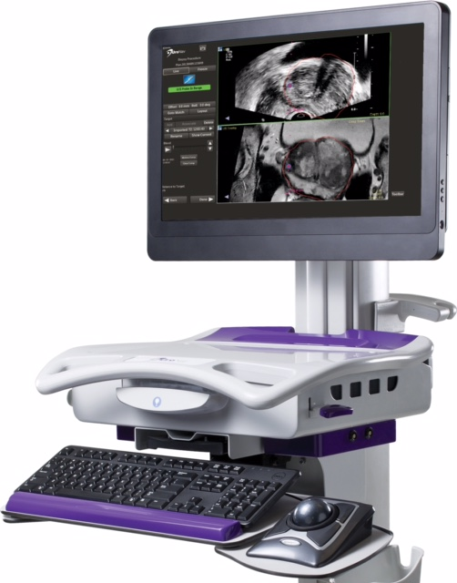
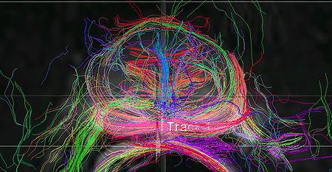
Future Directions
UroNav results on first 42 patients:
Prostate cancer detected:
30 of 42 patients (71%)
Cancer in target lesion:
PIRADS 4/5: 19 of 31 (61%)
PIRADS 3: 2 of 10 (20%)
73% were high-grade cancer
Gleason 4 +4 (2), 4+3 (1), 3+4 (13), 3+3 (6)
Notes:
Of 6 pts without cancer in target, 50% had low-grade cancer (3+3 in 1-3 of 12 systematic cores) in other parts of the prostate

Slide 33
Conclusion
PMR is a powerful up and coming tool for prostate disease evaluation and management
Staging information is accurate, even early in the program
There is a “learning curve” for identifying and characterizing clinically significant PCa lesions
Improved with PI-RADSv2 criteria and reader experience
Aided by regular multidisciplinary meetings with radiologic/pathologic correlation

Slide 34
Conclusion
Regular multidisciplinary meetings
Increase PMR reliability and reputation
Maximize clinical impact and patient outcomes
Foster interdepartmental collegiality and cooperation
A successful PMR program depends on:
Strong interdisciplinary communication
Cooperation
Trust
All of which require time and effort to build

Slide 35
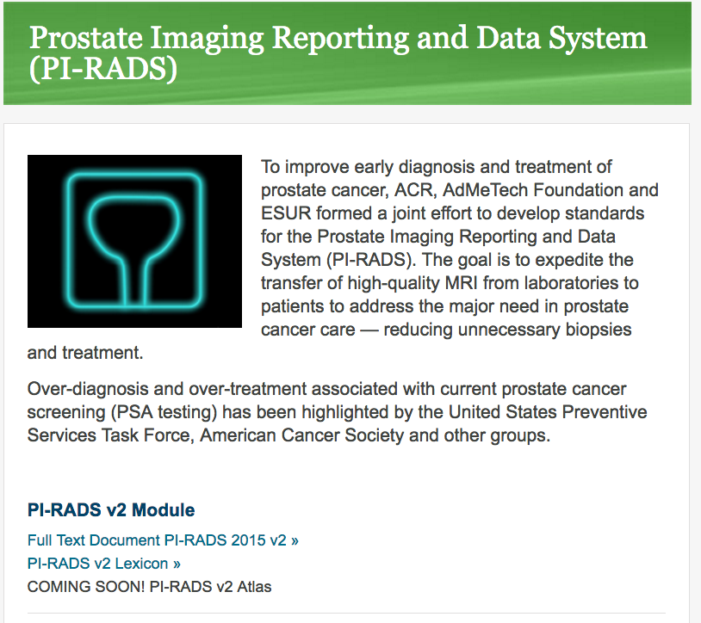

Slide 36
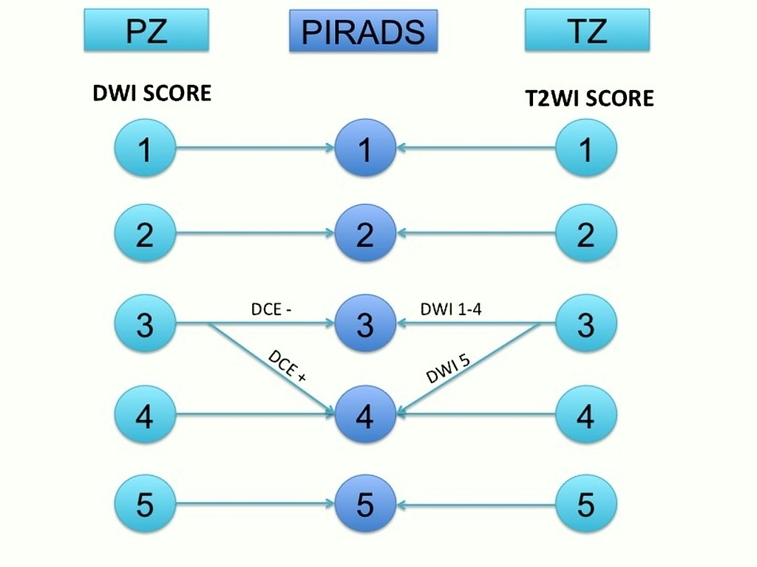

Slide 38
Pitfalls of Prostate MRI
Normal anatomic structures
Normal central zone
Surgical capsule
Venous plexus & Neurovascular bundle
Noncancerous abnormalities
Postbiopsy hemorrhage
Stromal BPH nodules
Acute/Chronic prostatitis (incl. graunlomatous)
Technical artifacts
http://www.ajronline.org/doi/abs/10.2214/AJR.13.10699

Slide 39
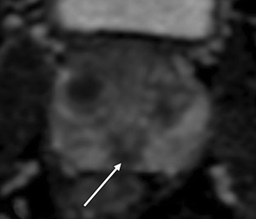
Pitfalls of Prostate MRI

Slide 40
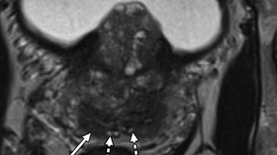
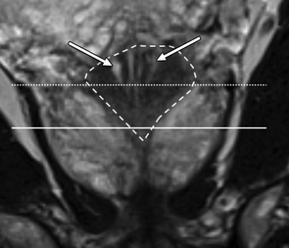
Pitfalls of Prostate MRI
Pitfall I (central zone): Normal central zone mimicking peripheral zone lesion in 67-year-old man on active surveillance after prostate biopsy showing small focus of Gleason 3 + 3 tumor in one core from right apical peripheral zone.
Central zone

Slide 41
Pitfalls of Prostate MRI
Normal Central Zone

Slide 42
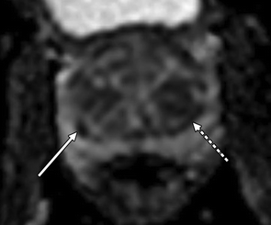
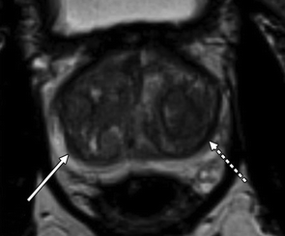
Pitfalls of Prostate MRI
Thickening of the Surgical Capsule

Slide 43
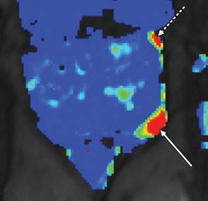
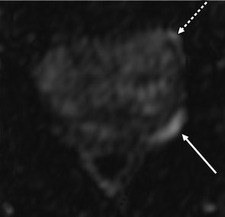
Pitfalls of Prostate MRI

Slide 44
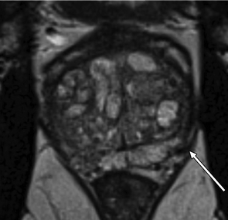
Pitfalls of Prostate MRI
Periprostatic vein mimicking peripheral zone lesion

Slide 45
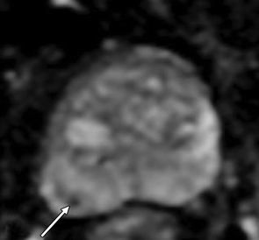
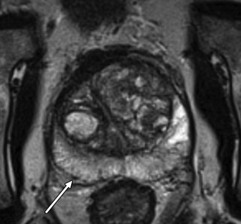
Pitfalls of Prostate MRI
Neurovascular bundle mimicking peripheral zone lesion

Slide 46
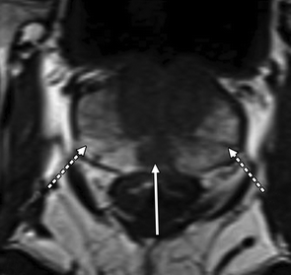
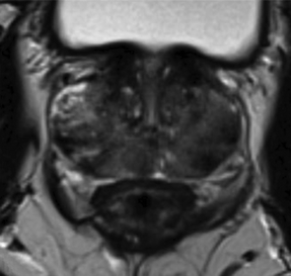
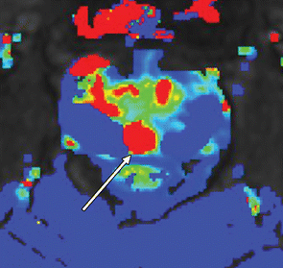
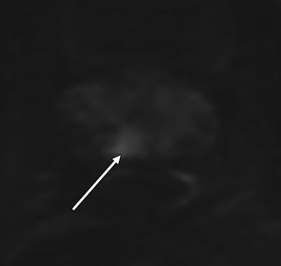
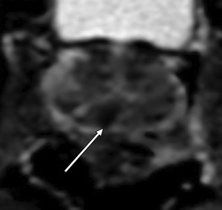
Pitfalls of Prostate MRI
Post biopsy hemorrhage

Slide 47
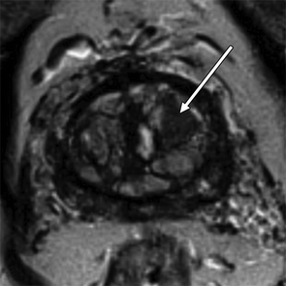
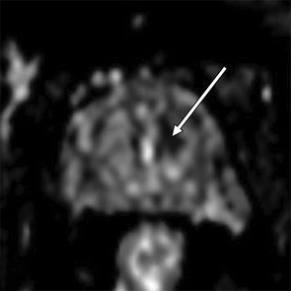
Pitfalls of Prostate MRI
BPH Nodule

Slide 48
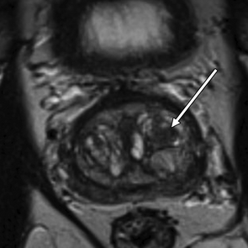
Pitfalls of Prostate MRI
BPH Nodule

Slide 49
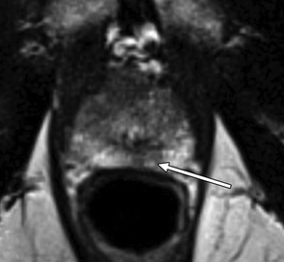
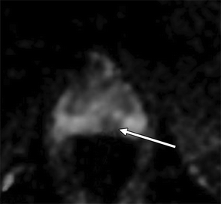
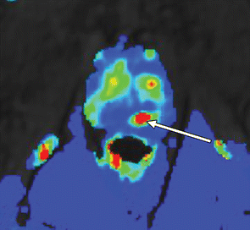
Pitfalls of Prostate MRI

Slide 50
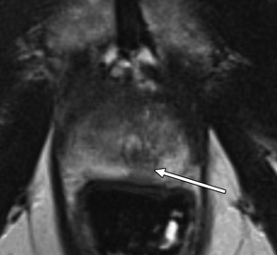
Pitfalls of Prostate MRI
Prostatitis

Slide 51
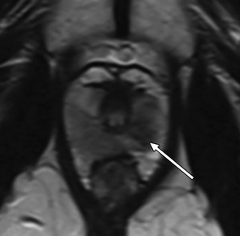
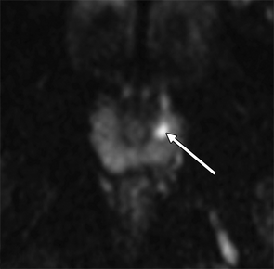
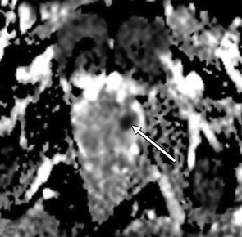
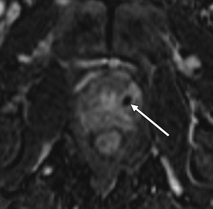
Pitfalls of Prostate MRI
Granulomatous disease
-BCG for previous bladder Ca

Slide 52
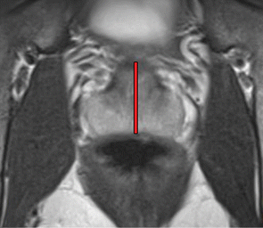
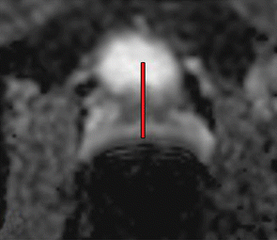
Pitfalls of Prostate MRI
Diffusion distortion

Slide 53
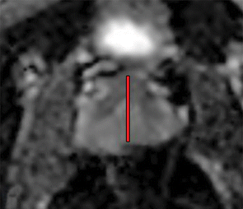
Pitfalls of Prostate MRI
Diffusion distortion

Slide 54
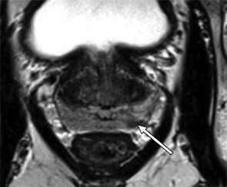
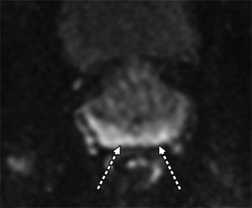
Pitfalls of Prostate MRI
Value of high-B-value imaging

Slide 55
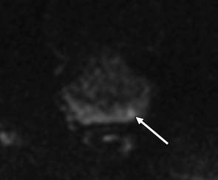
Pitfalls of Prostate MRI
Value of high-B-value imaging

Slide 56
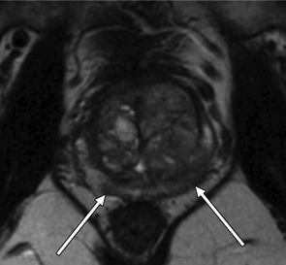
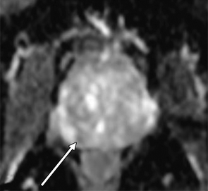
Pitfalls of Prostate MRI
ADC Windowing

Slide 57
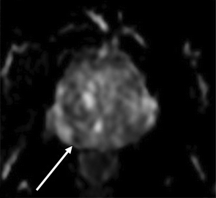
Pitfalls of Prostate MRI
ADC Windowing

Slide 58
References
American Cancer Society. (2016) Cancer Facts & Figures 2016. Atlanta.
Moyer VA, U.S. Preventative Services Task Force. (2012) Screening for prostate cancer: U.S. Preventive Services Task Force recommendation statement. Ann Intern Med 157(2):120-134.
Barentsz JO, Richenberg J, Clements R, et al. (2012) ESUR prostate MR guidelines 2012. Eur Radiol 22(4):746-757.
Weinreb JC, Barentsz JO, Choyke PL, et al. (2016) PI-RADS Prostate Imaging - Reporting and Data System: 2015, Version 2. Eur Urol 69(1):16-40.
Leake JL, Hardman R, Ojili V, et al. (2014) Prostate MRI: access to and current practice of PMRI in the United States. J Am Coll Radiol 11(2):156-160.
Bonekamp D, Jacobs MA, El-Khouli R, et al. (2011) Advancements in MR imaging of the prostate: from diagnosis to interventions. Radiographics 31(3):677-703.
Rosenkrantz AB, Taneja2 SS. Radiologist, Be Aware: Ten Pitfalls That Confound the Interpretation of Multiparametric Prostate MRI. Am. J. Radio. 2014;202: 109-120.

