Slide 1
Musculoskeletal Infection
Eastern Radiological Society 2017
Russell Chapin
Medical University of South Carolina

Slide 5
Outline
Bone, joint, and soft tissue infection
Acute vs Subacute or Chronic bone infection
Permeative changes, Brodie’s abscess, sequestrum
Septic vs direct inoculation
Diabetic foot
Necrotizing fasciitis
Joint infection
Imaging arthroplasties

Slide 6
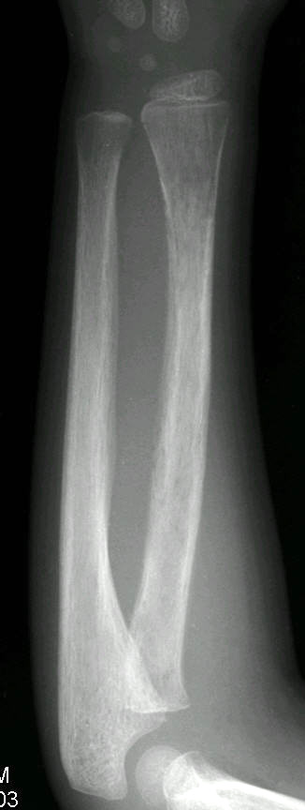
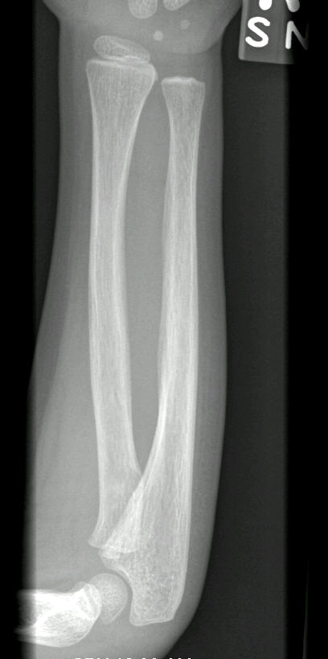
3 yo w/ pain & fever
10 days prior

Slide 7
Acute osteomyelitis radiograph
7-10 days to become apparent
30% bone loss
Permeative osteopenia, cortical irregularity, and periostitis
Metaphyseal < 18yo
Staph aureus is most common
Salmonella in sickle cell

Slide 9
Polyostotic lucent lesion DDX – “FEEHMI”
Fibrous Dysplasia
LCH/EG
Enchondromas
Brown tumors (Hyperparathyroidism)
Lymphangiomas/Hemangiomas
Mets
Infection
NOF’s
Jaffe-Campanecci or
Neurofibromatosis

Slide 10
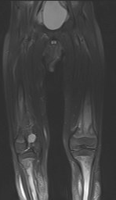

Slide 11
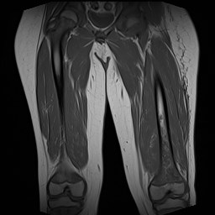
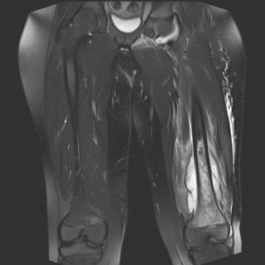
MRI of septic osteomyelitis
Permeative edema, soft tissue changes, subperiosteal collection

Slide 12
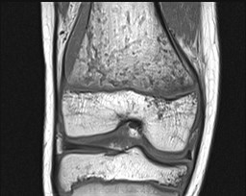
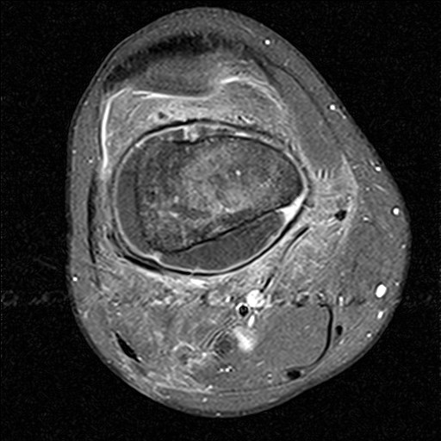
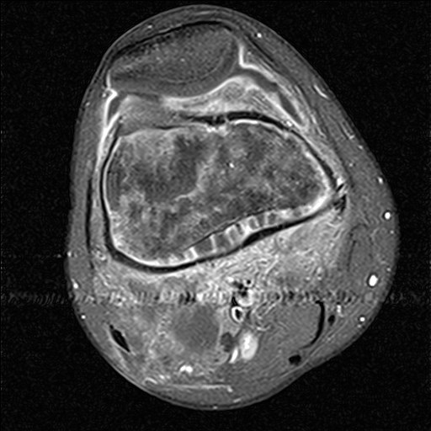

Slide 13
July
August
30 yo male MRSA

Slide 14
T1 penumbra sign
Relatively bright t1 signal
Granulation tissue
Subacute infection = Brodie’s abscess

Slide 16
Blood Supply
Infant
Child
Adult
Modified from: Resnick D, Bone and Joint Imaging, 1989

Slide 17
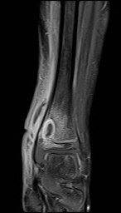
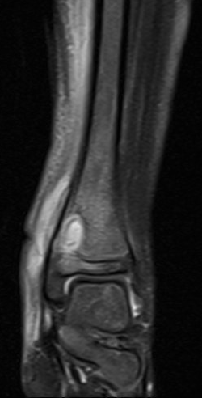

Slide 18
Special Terms
Sequestrum
Sequestered nonviable (dead) bone
Medullary and/or Cortical
Small or large
Involucrum
Enveloping periosteal new bone
Cloaca
Path
From metaphysis..to cortex..to periosteum..to ST
Extraperiosteal channel for expulsion from skin

Slide 19
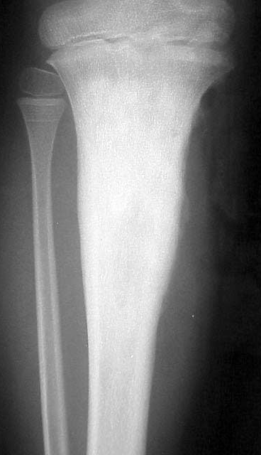
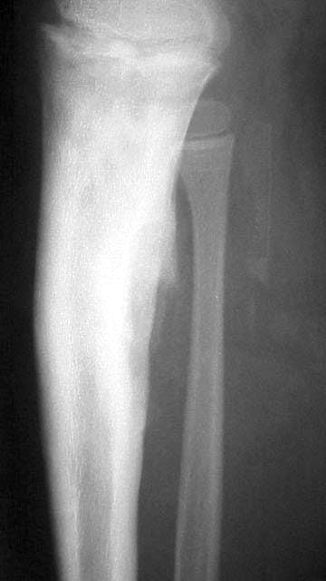
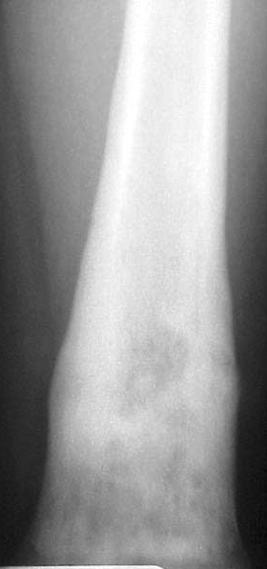

Slide 20
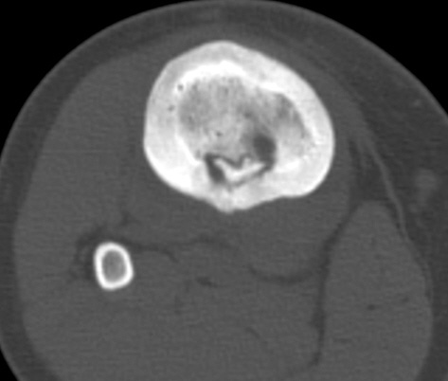
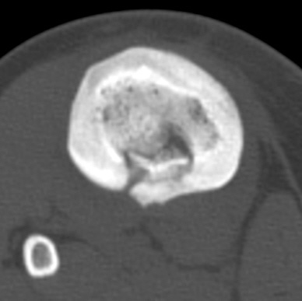
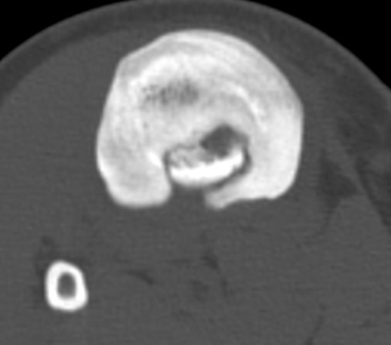

Slide 25
3 rules of Radiology
God Loves symmetry
God hates a straight line
The best film is an old film
Stephen I. Schabel

Slide 30
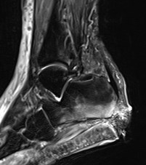

Slide 31
MRI of Pedal Osteomyelitis
Underlies ulcer
Usually at characteristic location
Confluent low T1 signal
Osteitis vs osteomyelitis
Medical vs Surgical treatment
Soft tissue debridement with ABX for “early osteo”
ABX for acute septic osteo

Slide 32
Location, Location, Location
Pedal Osteomyelitis
Tips of toes
1st and 5th MTP joints
Calcaneus
Base of 5th metatarsal

Slide 33
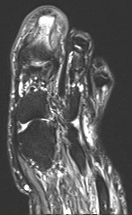
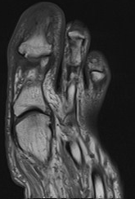

Slide 34
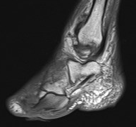

Slide 35
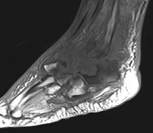
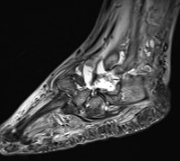

Slide 36
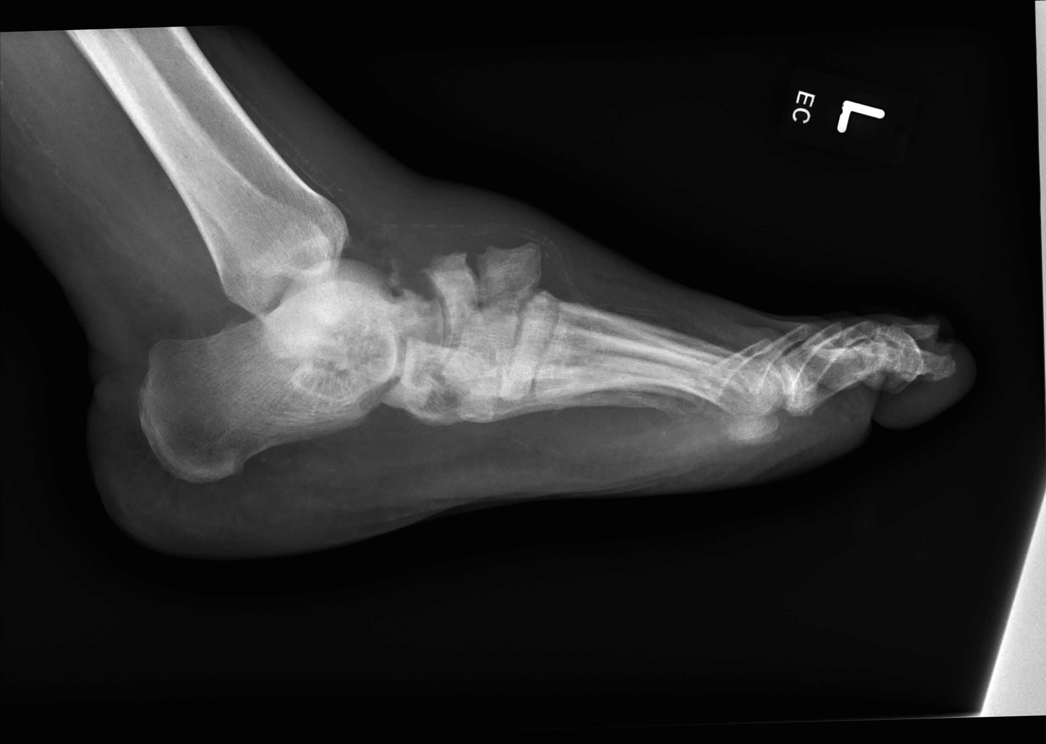

Slide 37
Neuropathic changes versus Osteo
MRI still preferred over Nuclear Medicine
IV contrast helps
Osteo almost exclusively due to spread from adjacent ulcer
Neuropathic joint shows bone fragmentation
Ghost sign whereby bone “reappears” between T1 images and post contrast images suggests osteo

Slide 38
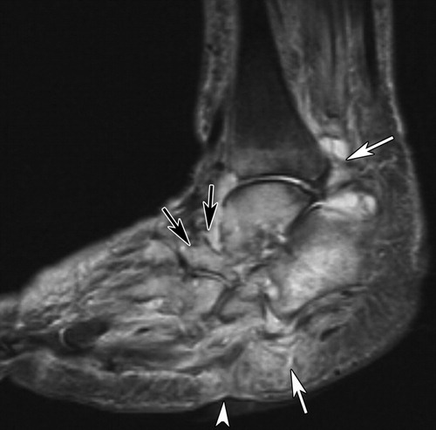
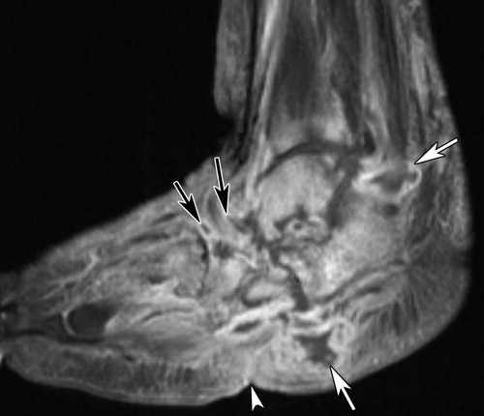
Donovan and Schweitzer Radiographics 2010

Slide 39
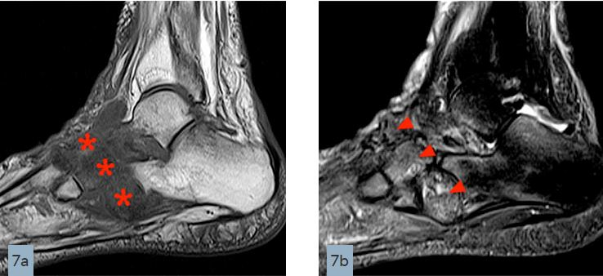
Ghost Sign – Should be Osteo
Radsource MRI Clinics

Slide 40
Soft Tissue Infection

Slide 41
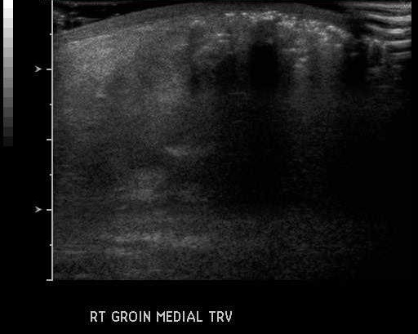

Slide 42
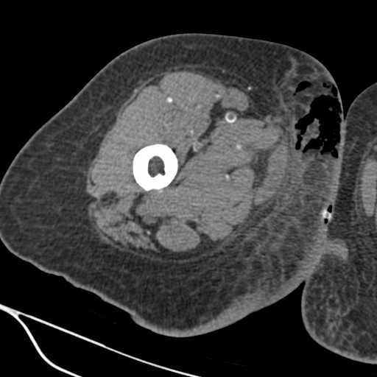
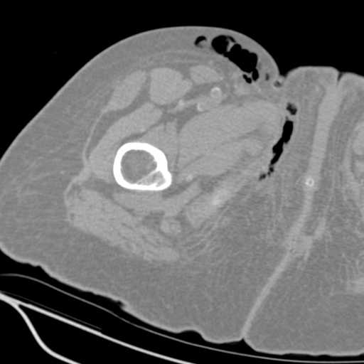

Slide 43
Necrotizing Fasciitis
Surgical emergency – Imaging should not delay surgery
20% mortality
Extremities, perineum, trunk
Polymicrobial – Group A Strep, Clostridium, Gram negatives
Clinical:
Diabetes/Obesity/Renal disease/Immunosuppresion
WBC INCR, Hg DECR, Acidosis, Renal failure
Soft tissue gas in 55%, [Estimated SN of MRI 70-80%]
May or may not involve deep tissue, yet this is most helpful imaging feature
May or may not enhance
Largest case series 10 pts
Uwash – “I have seen 2 cases in 5 years and am asked to evaluate for twice a month”

Slide 44
Necrotizing Fasciitis Kim Radiology 2012
High T2 signal is more common, but low T2 signal (eg gas) is more discriminatory
Deep fascia involvement that is extensive and not just continuous with superficial fascia
3 or more compartments
Fascial involvement > 3mm
Enhancement with nonenhancing areas
Muscle involvement is circumferential rather than patchy (patchy points to another diagnosis)
Abscess or myonecrosis: Unlikely to be NecFasc

Slide 45
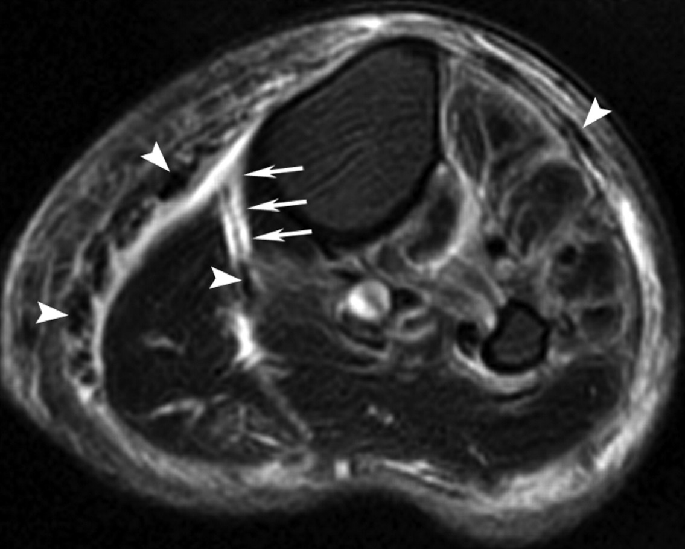
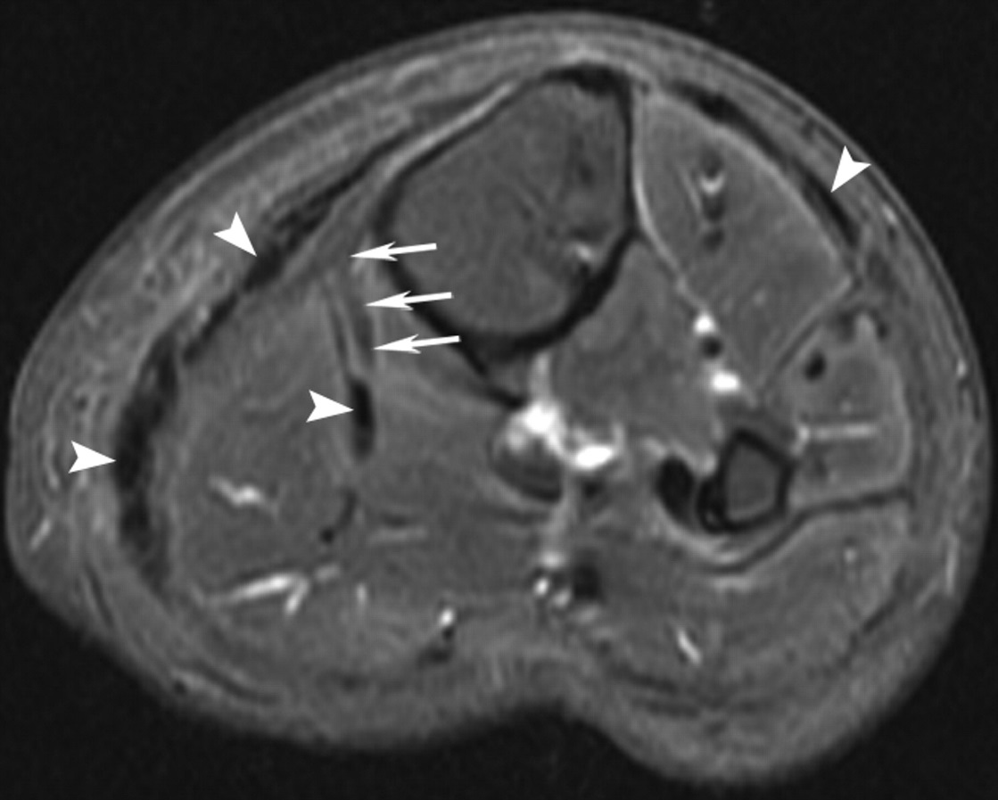
4 compartments of leg
Deep fascial involvement
> 3mm thick
Low signal T2 areas (gas)
Nonenhancing areas
Necrotizing Fasciitis!
Kim K et al. Radiology 2011;259(3):816-824

Slide 46
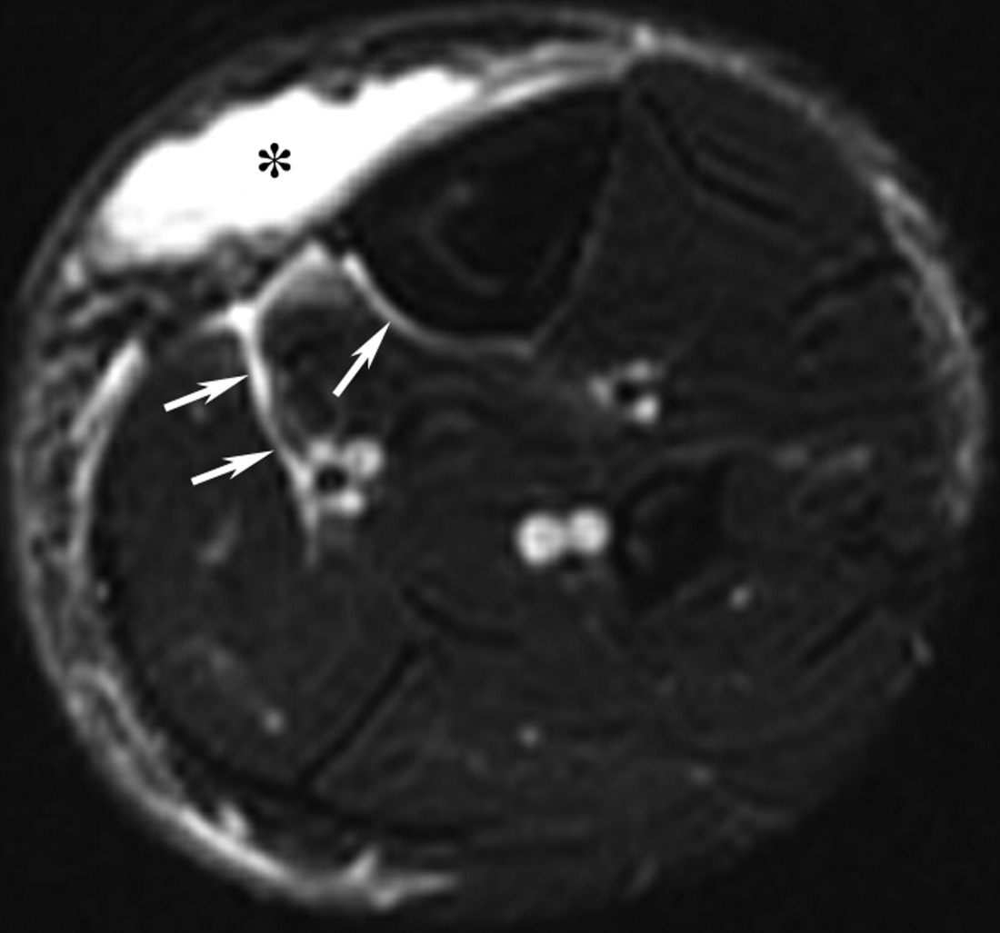
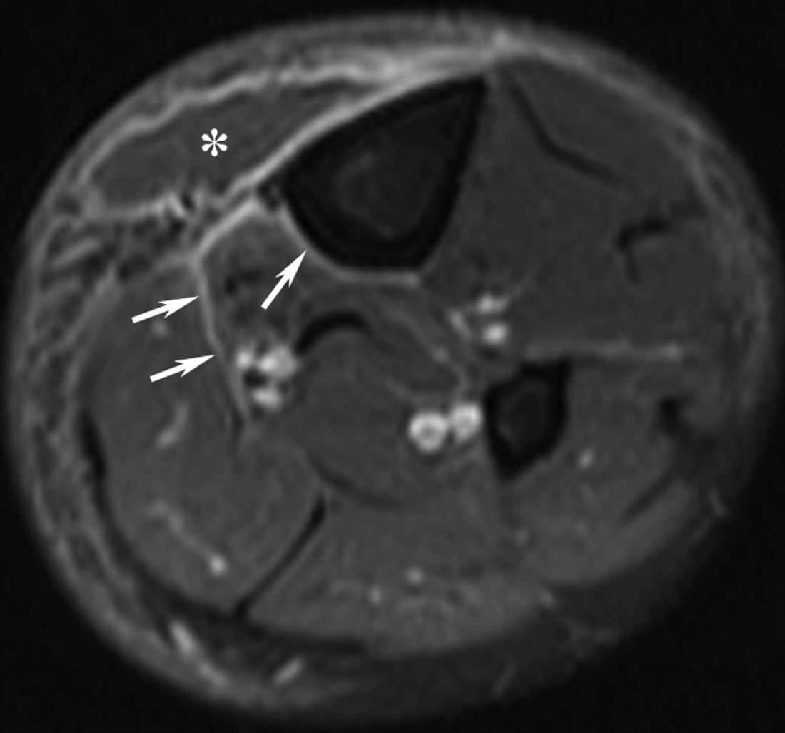
1-2 compartments of leg
Deep fascial involvement only continuous with superficial area
< 3mm thick
All enhancing
Abscess pointing to other diagnosis
NOT Necrotizing Fasciitis
Kim K et al. Radiology 2011;259(3):816-824
NOT Necrotizing Fasciitis

Slide 47
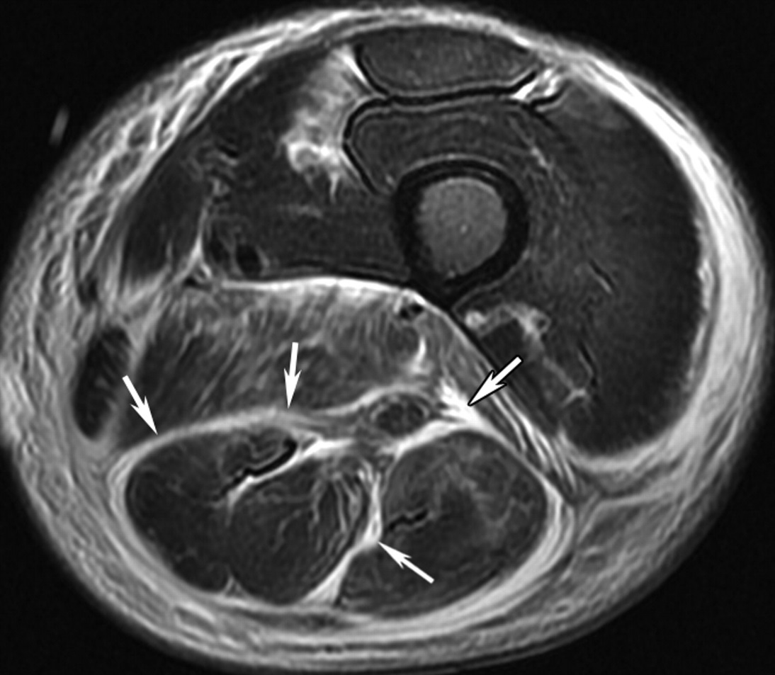
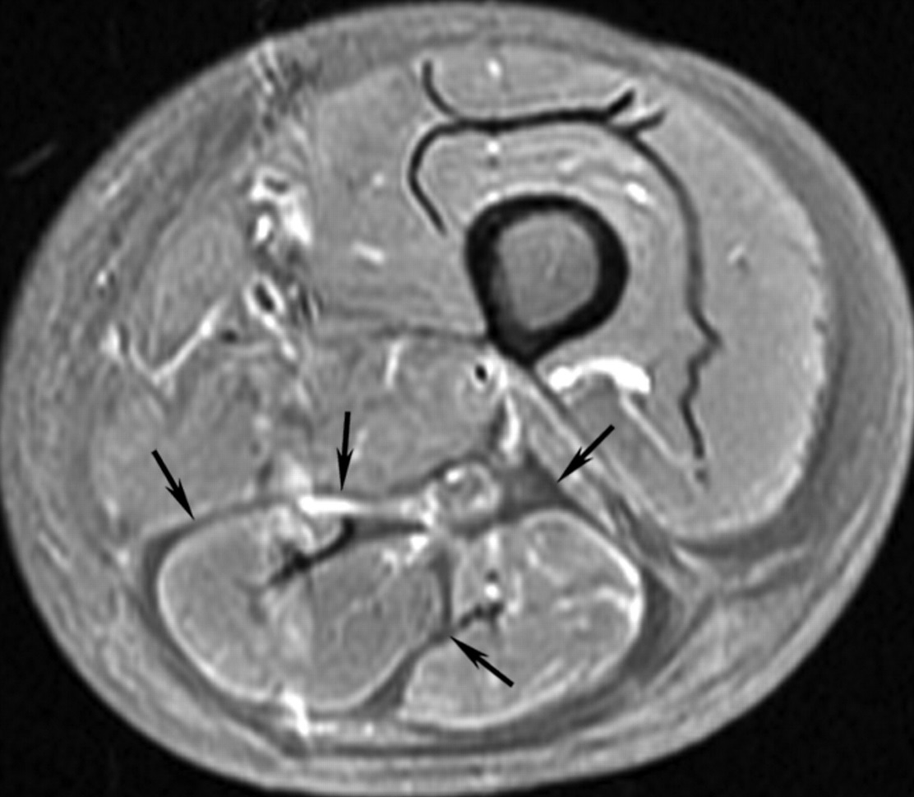
2-3 compartments of leg
Deep fascial involvement circumferentially
> 3mm thick
Non enhancing
Necrotizing Fasciitis!
Kim K et al. Radiology 2011;259(3):816-824

Slide 48
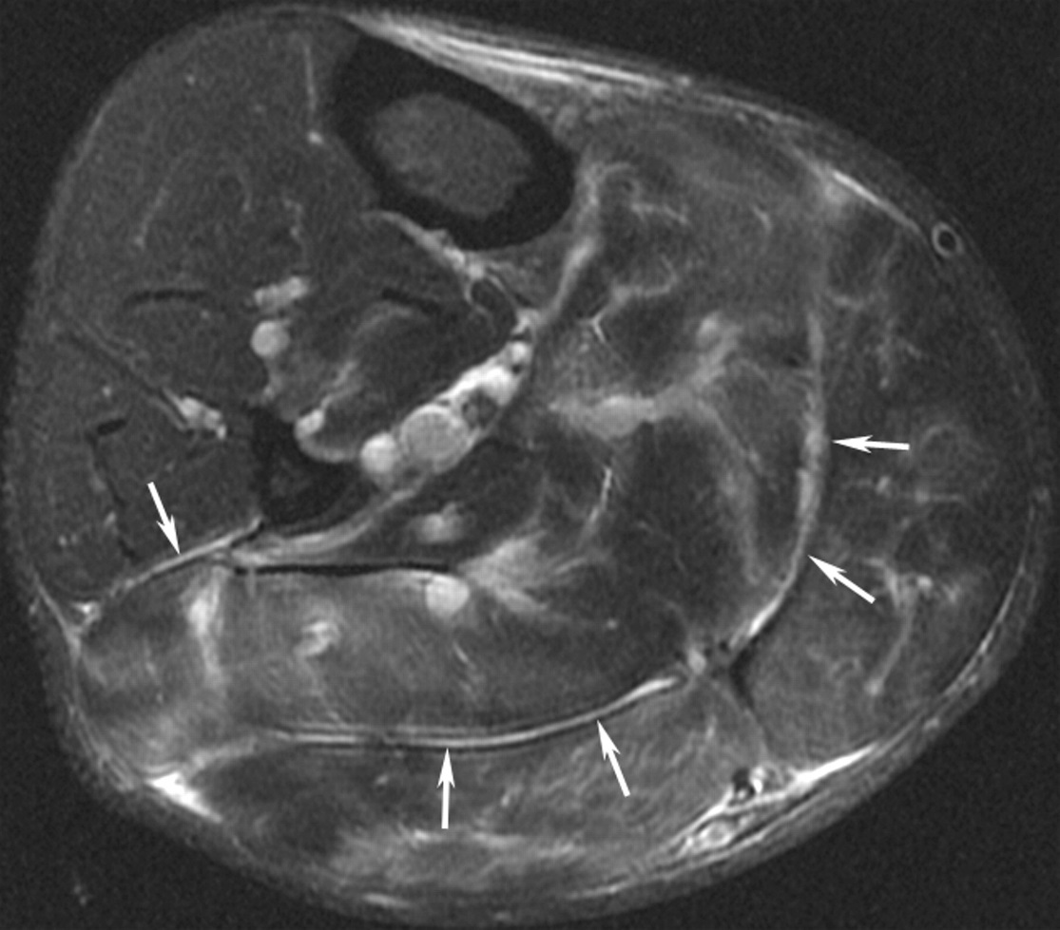
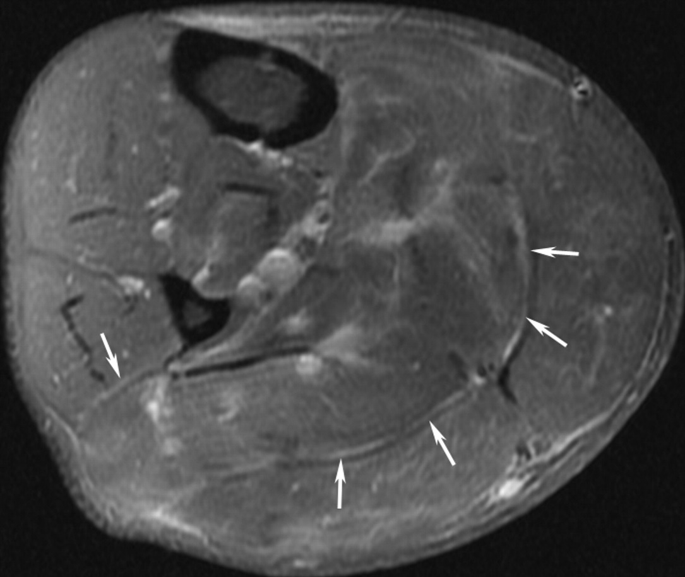
2 compartments of leg
Deep fascial involvement only continuous with superficial area
< 3mm thick
All enhancing
Patchy muscle signal abnl
NOT Necrotizing Fasciitis
Kim K et al. Radiology 2011;259(3):816-824

Slide 49
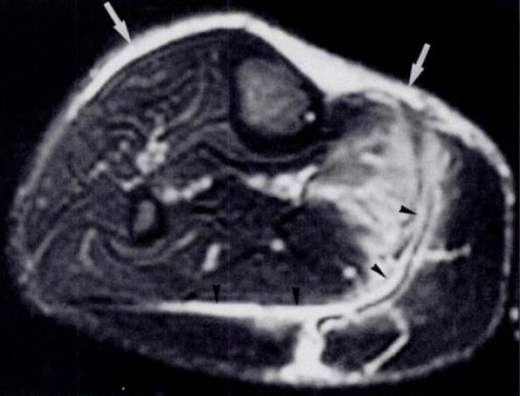
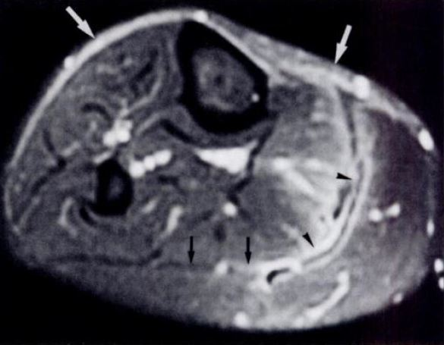
2 compartments of leg
Deep fascial involvement
> 3mm thick
Non enhancing areas
Necrotizing Fasciitis!
Schmid AJR 1998

Slide 50
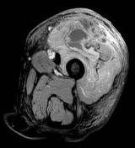
Pyogenic Myositis

Slide 51
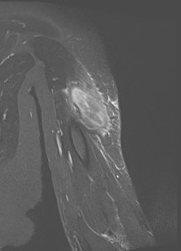

Slide 52
Diabetic Myonecrosis

Slide 53
Joint Infection

Slide 54
Periarticular osteopenia
JSN
Marginal erosions
-23 yo Lupus, Salmonella

Slide 55
9 months prior

Slide 56
Septic Arthritis
STS
Periarticular osteopenia
JSN
Marginal erosions
Rapid progression with Bacterial arthritis
Aspiration (> 50K/mm^3 and 75% NPs)
Aspiration ~ 90% accuracy, higher SP than SN

Slide 57
Aspiration Technique
18 g or larger
Cell count as important as culture
Prove in joint
Lavage if no return of fluid

Slide 58
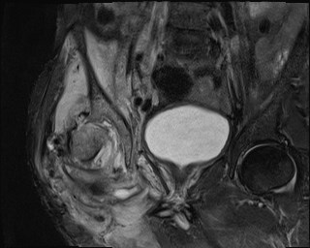
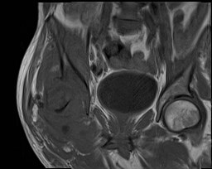
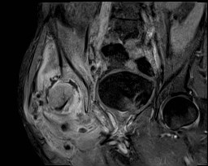
-Complex fluid with marrow changes early
-Low T1 and high T2
-Surrounding inflammatory change
-Contrast helpful though not a must

Slide 59
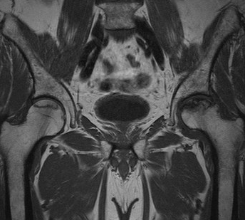
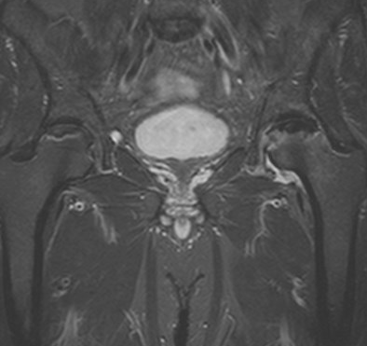
MRI of AVN
-Subchondral location
-Double line sign
-Anterior-superior
Notes:
With that same protocol, we can evaluate for AVN, a common clinical concern in our patient population at MUSC

Slide 60
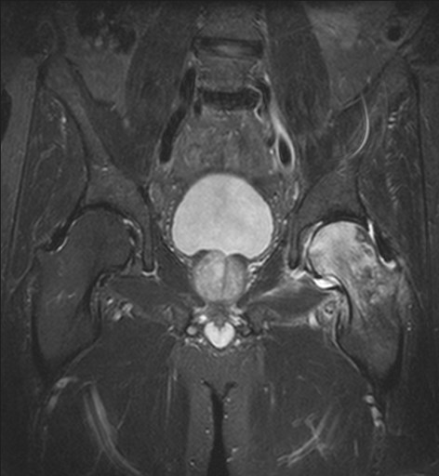
Transient Osteoporosis of Hip
- Absent double line sign
- One side of joint

Slide 61
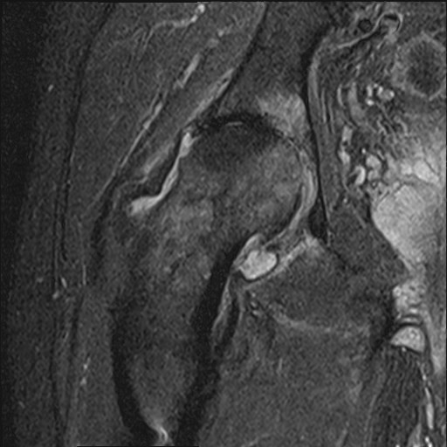
DJD
-No pericapsular inflammation
Notes:
Routine Osteoarhrtitis causes marrow edema signal spanning the joint

Slide 62
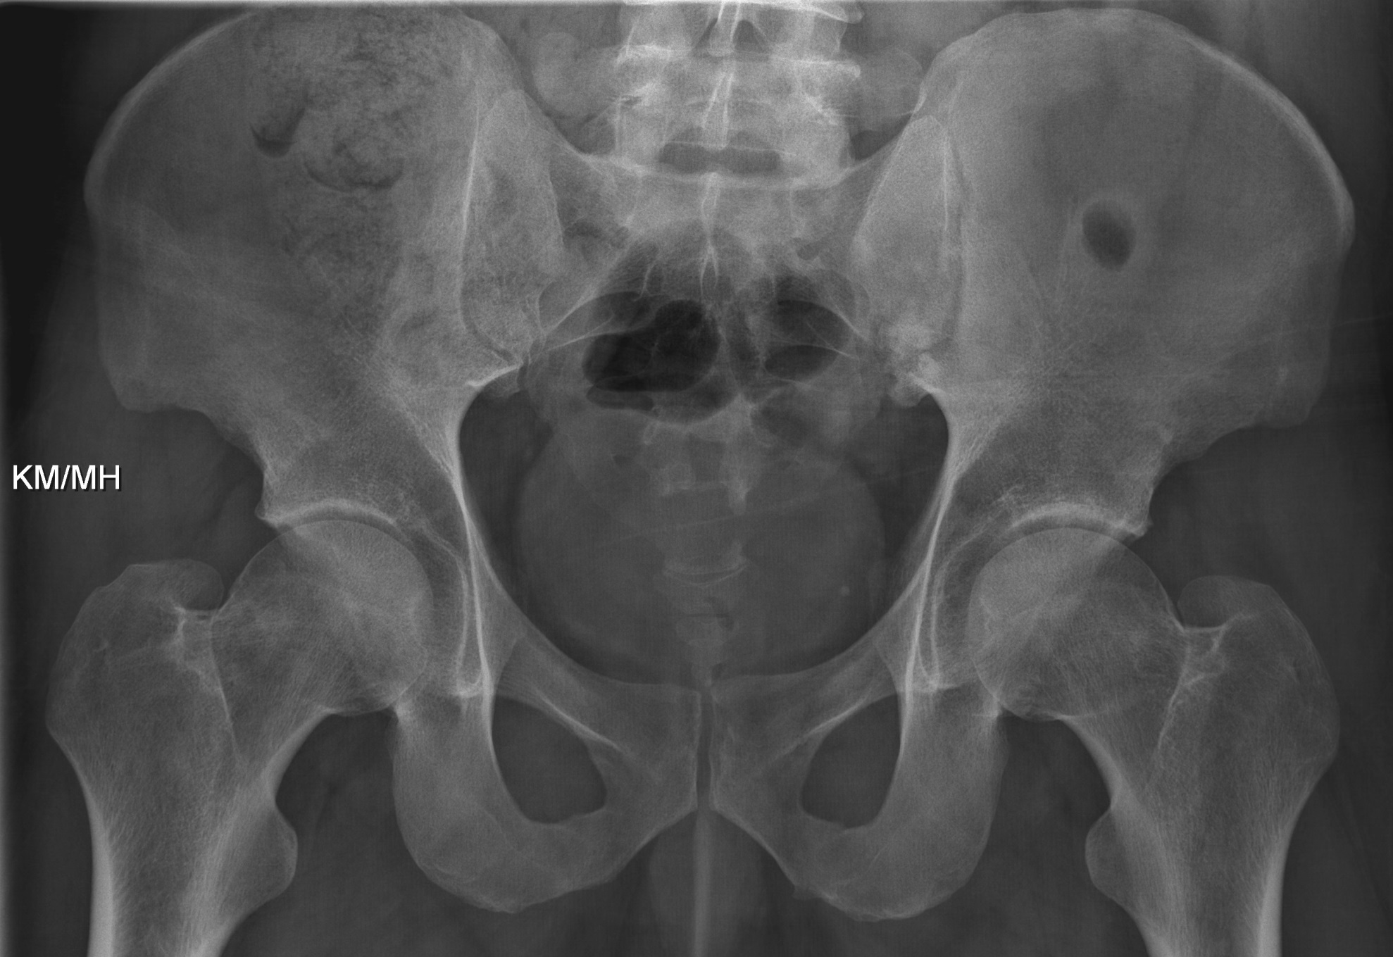
-34 yo IVDU with fevers

Slide 63
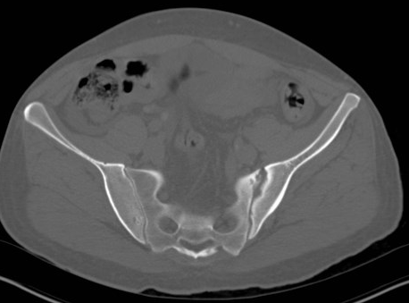
MRSA

Slide 64
“S” Joints
Sternoclavicular
Shoulder (AC)
SI
Symphysis pubis

Slide 65
Hardware Infection
5 months
prior
If infection is possibility, next step is aspiration
Infection with > 50K WBC/mL or > 60% neutrophils
Aspiration only ~70% SN But 95% SP

Slide 66
Dual isotope Leukocyte marrow imaging (LMI) 95% SN and SP
Rather than 3 phase
Normal symmetry of uptake

Slide 67
Not Infected

Slide 69
Infected

Slide 70
Outline
On x-ray and MRI changes of osteomyelitis are of permeative bone and soft tissue involvement including subperiosteal collections
In children and adolescents, osteomyelitis is more commonly blood-born and involves the long bone metaphyses
In adults, MSK infection is more commonly secondary to soft tissue ulcer or blood-born joint infection
Acute osteomyelitis progresses more rapidly than other MSK processes and may be seen with sequential radiographs
MRI is preferred to NM for potential diabetic foot infection, while NM is preferred when hardware is present
The sensitivity of MRI for necrotizing fasciitis is relatively low, while the presence of an alternative diagnosis including abscess or myositis is reassuring

