Slide 1
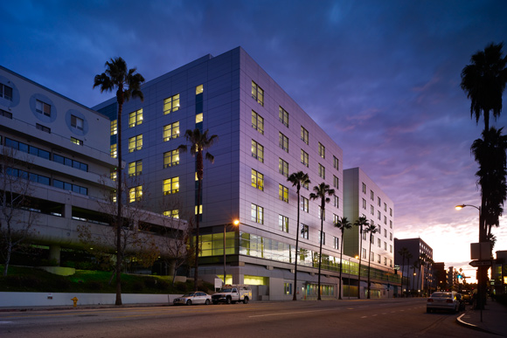
MRI of acute abdominal pain in pregnancy: Tips for success
Rex A. Parker, MD
Kaiser Los Angeles Medical Center

Slide 2
I have no disclosures

Slide 3
Goals
Briefly review the safety of MRI in imaging the pregnant patient with abdominal pain.
Review a basic protocol for MR imaging of the pregnant patient with abdominal pain.
Highlight a series of TIPS which will aid in performance and interpretation of MRI in pregnant patients.

Slide 4
MRI in pregnancy: Is it safe?
Probably
No known deleterious effects to the human fetus documented.
ACR approves of MR imaging of the pregnant patient in any trimester.
Although there is no ionizing radiation, radiofrequency energy used in MR does deposit energy in the patient as heat. The fetal temperature rise is felt to be less than those required for teratogenesis.
Other theoretic risks include noise exposure.
Potential risks versus benefits should be assessed on a case by case basis.
Gadolinium based contrast agents are known to cross the placenta and be taken up by fetus. They are classified as Category C in pregnancy and should be avoided.

Slide 5
MRI for RLQ Pain in Pregnancy: How I do it
T2 Single Shot Fast Spin Echo
Axial, Sagittal and Coronal
Balanced Steady State Free Precession (bSSFP, FIESTA, TruFISP, etc)
Axial and Coronal
Axial t1 gradient echo, dual echo, in and out of phase
Axial T2 SSFSE with fat suppression
Axial T1 fast spoiled gradient echo with fat suppression

Slide 6
Aortocaval compression and respiratory motion
Pregnant women, especially later in 2nd and 3rd trimesters can have limited breath hold capacity.
Compression of IVC can contribute to hypotension, tachycardia, even fainting.
Prone positioning or 10-20 degrees of left lateral tilt by placing a foam pillow under the patients right side can be helpful.

Slide 7
Use T2 Single Shot Fast Spin Echo Sequences
Single shot: entire matrix for an individual image obtained with one 90 degree excitation.
Half acquisition makes acquisition rapid, with each image typically obtained in under 1 second.
Images are relatively insensitive to fetal and maternal motion.
Acquire in transverse, coronal and sagittal planes.
Downside: The multiple 180 degree pulses mean that these sequences deposit more energy (higher SAR) than gradient echo or conventional spin echo/fast spin echo sequences.

Slide 8
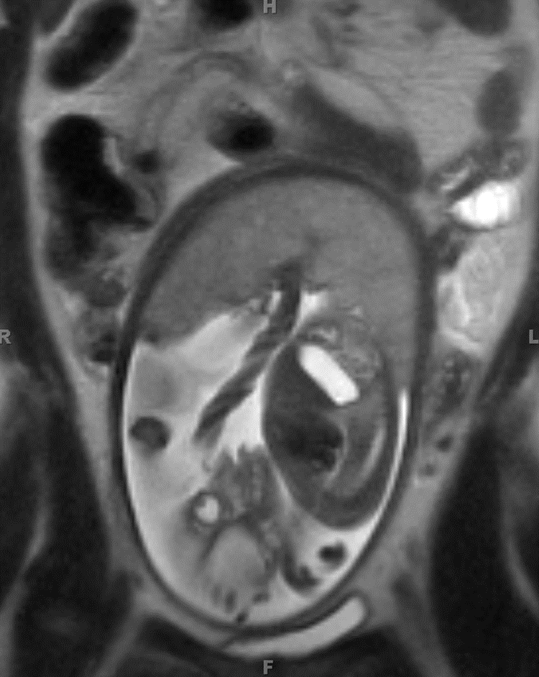
Fat stranding on T2 SSFSE can appear as hazy HYPOINTENSITY in the fat

Slide 9
Fat suppressed T2 SSFSE or STIR aid in identifying fluid and inflammation

Slide 10
Can’t find the appendix? Don’t worry
Nikolaidis, et al. and colleagues at PENN published a study in AJR in 2004 looking at the likelihood of acute appendicitis if the appendix was not seen and there were no secondary inflammatory findings in the RLQ.
Retrospective study. 366 CTs were reviewed by 2 experienced radiologists. The appendix could not be seen in 46 patients.
Only 1 of the 46 ended up with pathologically proven acute appendicitis, and that patient had a paucity of intra-abdominal fat.
Although a similar study has not been published on MRI, the overall sensitivity and specificity of MR and CT are similar and this experience could potentially be extrapolated to MR as well.
Take home: If there is a fair amount of fat in the belly, the appendix is not seen, and there are no right lower quadrant inflammatory findings, then the patient does not have appendicitis.
Nikolaidis P, Hwang CM, Miller FH, et al. The nonvisualized appendix: incidence of acute appendicitis when secondary inflammatory changes are absent. AJR Am J Roentgenol. 2004;183(4):889–92.

Slide 11
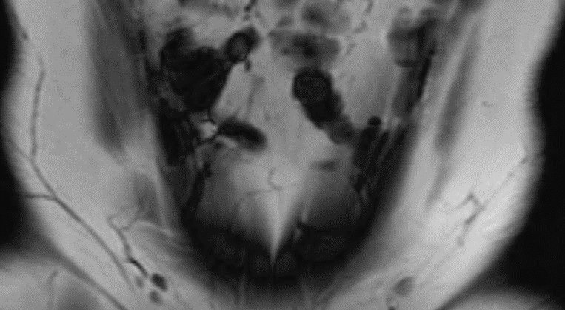
Identifying the normal appendix: Blooming on gradient echo (GRE) images
Normal appendix is frequently air-filled.
GRE images demonstrate a pronounced blooming effect due to magnetic susceptibility due to the lack of 180 refocusing pulses present on SSFSE.
Longer TE on gradient echo images results in more blooming effect. If dual echo T1 GRE (in and opposed phase) is used, blooming will be more evident on the in phase image.

Slide 12
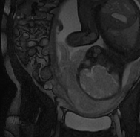
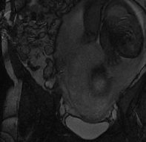
SSFSE
bSSFP
Balanced Steady State Free Precession (bSSFP, Fiesta, TruFISP) can aid in differentiating a normal appendix from dilated peri-uterine and peri-ovarian veins.
Both will be hypointense on SSFSE
The properties of bSSFP lead to hyperintense, or bright blood in veins.
bSSFP is a gradient echo sequence, meaning a normal gas filled appendix will demonstrate blooming related to magnetic susceptibility.

Slide 13
Blooming can aid in identifying appendicoliths and renal calculi
T2 SSFSE
Out of Phase GRE
In Phase GRE

Slide 14
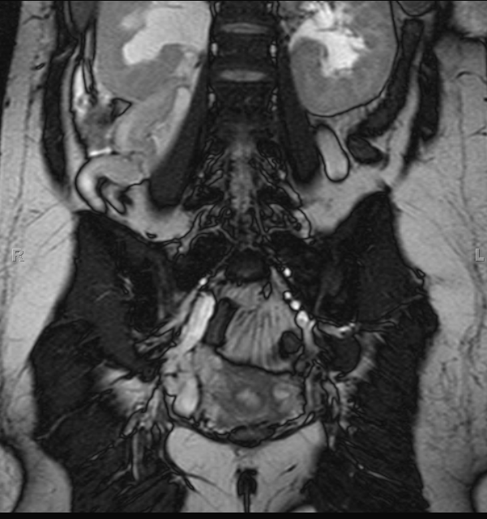
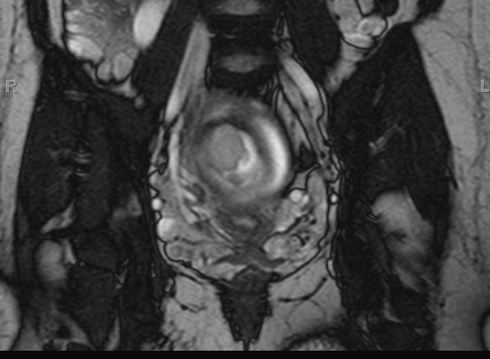

Slide 15
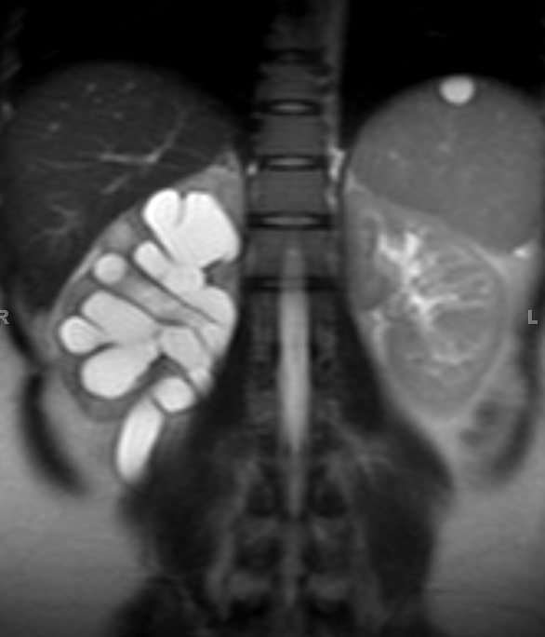
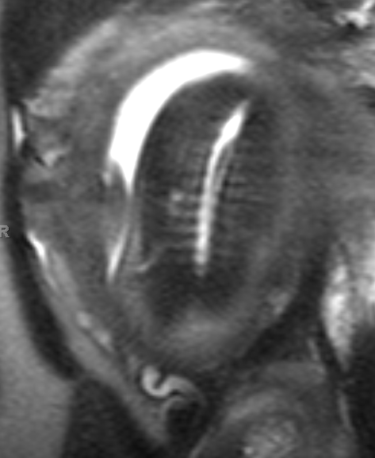
Hydronephrosis can be physiologic during pregnancy
Due to extrinsic compression of ureter by gravid uterus and hormonally induced ureteral smooth muscle relaxation.
Common, seen in up to 90% of pregnancies.
Usually right side.
Look for tapering of the ureter to the level of the sacral promontory.

Slide 16
Fat Suppressed T1 weighted gradient echo sequences can make identifying blood products easier.

Slide 17
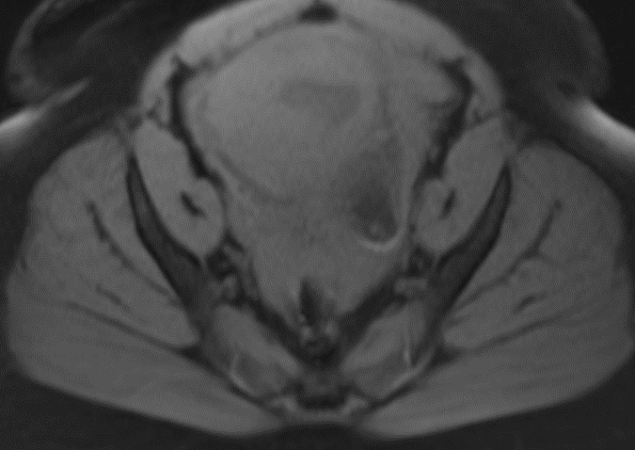
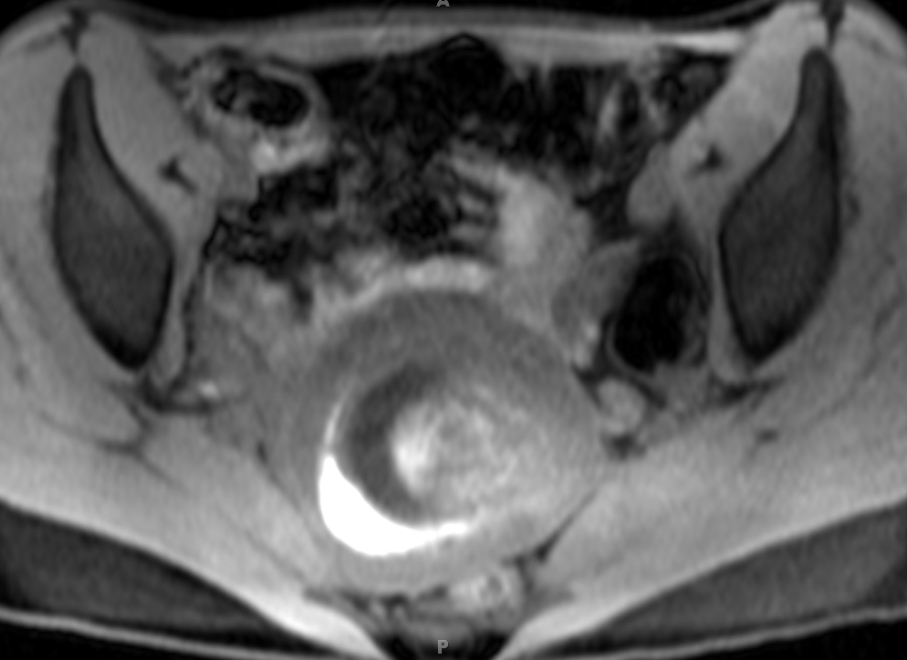
Hemorrhage
Free Fluid
Subchorionic Hemorrhage

Slide 18
Don’t assume the pregnancy is intrauterine
Findings of Ectopic Pregnancy on MRI
Lack of intrauterine gestational sac
Isolated hemoperitoneum
Tubal mass, frequently cystic
Cornual or Interstitial mass
Hematosalpinx

Slide 19
Don’t assume the pregnancy is intrauterine
Findings of Ectopic Pregnancy on MRI
Lack of intrauterine gestational sac
Isolated hemoperitoneum
Tubal mass, frequently cystic
Cornual or Interstitial mass
Hematosalpinx

Slide 20
Don’t assume the pregnancy is intrauterine
Findings of Ectopic Pregnancy on MRI
Lack of intrauterine gestational sac
Isolated hemoperitoneum
Tubal mass, frequently cystic
Cornual or Interstitial mass
Hematosalpinx

Slide 21
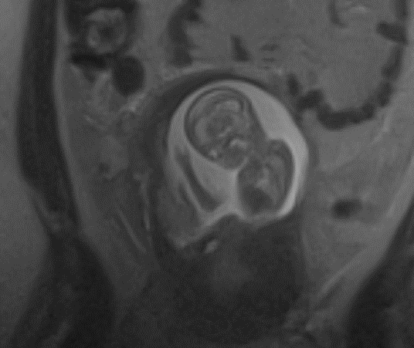
Don’t assume the pregnancy is intrauterine
Findings of Ectopic Pregnancy on MRI
Lack of intrauterine gestational sac
Isolated hemoperitoneum
Tubal mass, frequently cystic
Cornual or Interstitial mass
Hematosalpinx

Slide 22
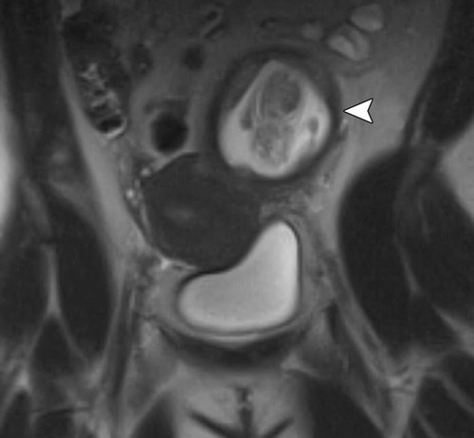
Cornual vs Interstitial vs Angular Pregnancy?
Some clinicians use the term cornual to describe interstitial and angular pregnancy
Others reserve cornual for implantation in one horn of a bicornuate uterus

Slide 23
Interstitial pregnancy
Implantation in the most proximal portion of the fallopian tube that traverses the myometrium
Important clinically because interstitial pregnancies have higher mortality than other ectopics
Surrounding myometrium can cause confusion for intrauterine pregnancy on US
Presence of surrounding myometrium has been postulated to allow for the pregnancies to be carried longer prior to presentation/rupture, although there is no good evidence to support this
Implantation is LATERAL to the uterine angle

Slide 24
Angular Pregnancy
Implantation in the lateral angle of the uterus, medial to the uterotubal junction
Completely surrounded by myometrium and can potentially be carried to term
However, high rates of rupture, placenta accreta and spontaneous loss
May present or rupture later in pregnancy

Slide 25
Don’t forget to look at the placenta
Normal Placenta
Placenta should have homogenous signal intensity
Uterus should have thin inner and outer bands of T2 hypointensity with middle band of relative T2 hyperintensity

Slide 26
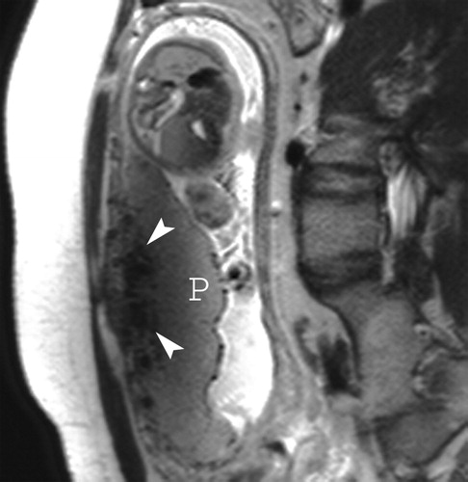
Normal Placenta
Tortuous subplacental T2 hypointense flow voids which represent subplacental vascularity
Can have thin T2 hypointense lines running through the placenta, likely corresponding with septae
RadioGraphics, http://pubs.rsna.org/doi/abs/10.1148/rg.287085060
Published in: W. Christopher Baughman; Jane E. Corteville; Rajiv R. Shah; RadioGraphics 2008, 28, 1905-1916.
DOI: 10.1148/rg.287085060
© RSNA, 2008

Slide 27
Don’t forget about the placenta
Placenta Previa
Placental implantation in lower uterine segment.
Can be partial, marginal or complete, based on degree to which placenta covers the internal os of the cervix.
Majority of marginal and partial previas resolve.
Complete previa less likely to resolve. Most are treated with Caesarean section.
May present with painless bleeding.

Slide 28
Don’t forget the placenta: Placenta Accreta
Term describing abnormal placentation wherein chorionic villi invade myometrium.
Accreta: Villi attached to myometrium but no muscular invasion.
Increta: Villi partially invade myometrium.
Percreta: Villi invade up to or beyond uterine serosa.

Slide 29
Placenta Accreta
MR Findings Include
Loss of normal T2 hypointense inner myometrial layer
Focal uterine bulge
Heterogeneous placental signal intensity
Dark, thick, intraplacental bands
Frank extension of placental tissue through the uterine wall

Slide 30
Placenta Accreta
MR Findings Include
Loss of normal T2 hypointense inner myometrial layer
Focal uterine bulge
Heterogeneous placental signal intensity
Dark, thick, intraplacental bands
Frank extension of placental tissue through the uterine wall

Slide 31
Placenta Percreta
MR Findings Include
Loss of normal T2 hypointense inner myometrial layer
Focal uterine bulge
Heterogeneous placental signal intensity
Dark, thick, intraplacental bands
Frank extension of placental tissue through the uterine wall

Slide 32
Think outside of the appendix
Like CT for appendicitis in the non-pregnant patient, part of the value of the MRI is in identifying mimics of appendicitis
Pathologic processes that affect reproductive age women occur at similar (or sometimes greater) rates during pregnancy
Look for adnexal, urinary tract, biliary and bowel pathology

Slide 33
Think outside of the appendix: SBO

Slide 34
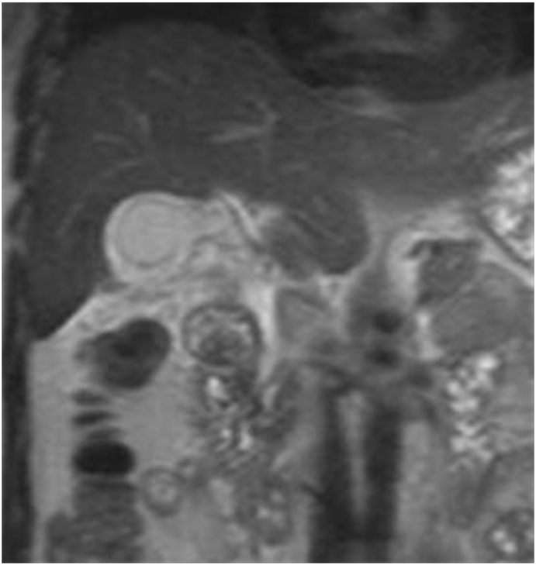
Think outside of the appendix: Cholecystitis
Findings similar to other imaging modalities
Distended gallbladder
Sludge or stones
Gallbladder wall thickening
Pericholecystic inflammation

Slide 35
Think outside of the appendix: Choledocholithiasis

Slide 36
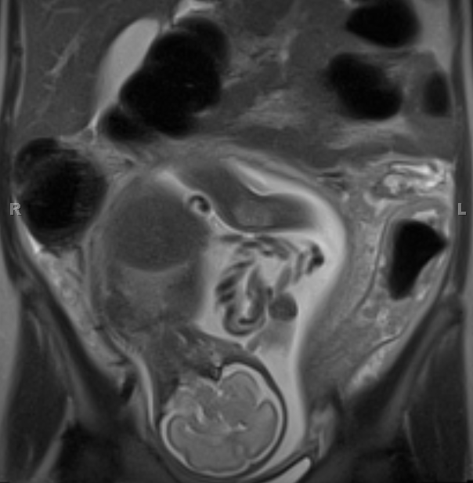
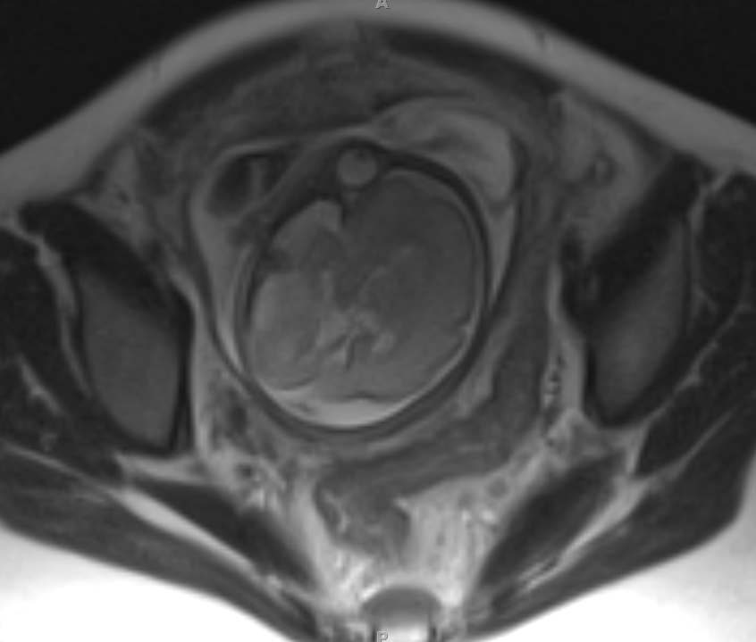
Think outside of the appendix: Colitis

Slide 37
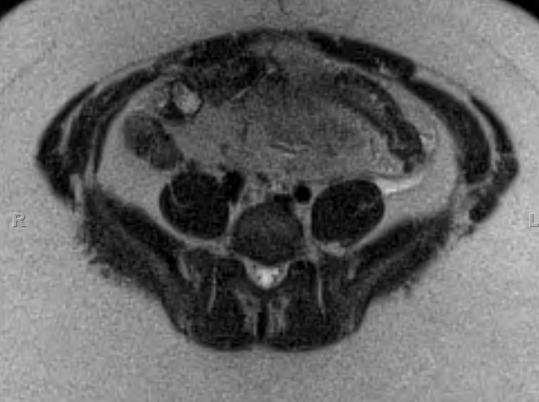
Think outside of the appendix: Diverticulitis

Slide 38
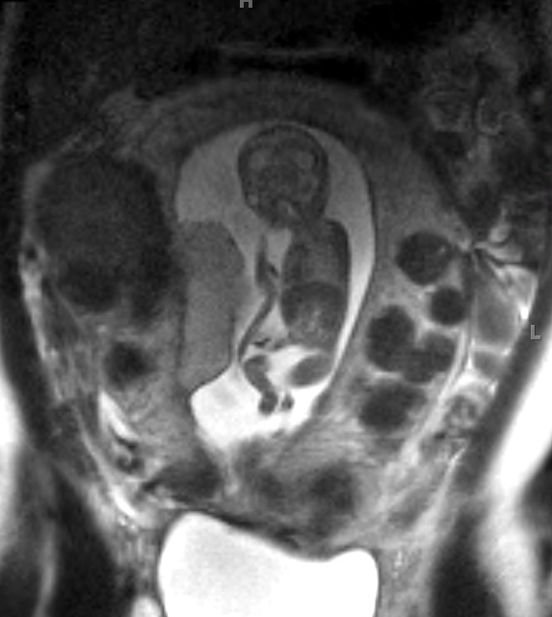
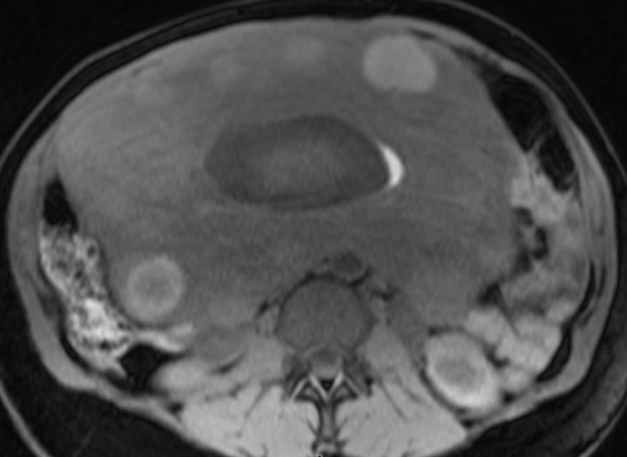
Think outside of the appendix: Degenerating Fibroids (and subchorionic hemorrhage)

Slide 39
Think outside of the appendix: Ovarian Torsion

Slide 40
Conclusion
MRI can be performed safely and quickly in the pregnant patient with abdominal pain
SSFSE sequences are the mainstay of the protocol, and are relatively insensitive to maternal and fetal motion
Blooming on gradient echo sequences can aid in identifying a normal, gas-filled appendix
Blooming can help to diagnose appendicoliths as well as urinary tract calculi
bSSFP images can aid in differentiating a gas-filled appendix from adjacent dilated veins
Adding fat suppression to T1 weighted spoiled gradient echo images can make identifying hemorrhage easier
Don’t assume the pregnancy is intrauterine
Don’t forget to look at the placenta
Think about other common pathologic processes besides appendicitis

