Slide 1


Primer on Interstitial Lung Disease
Jim Raptis
Cardiothoracic Fellow

Slide 2
I have no financial disclosures

Slide 3
Goals and Objectives
HRCT for Interstitial Lung Disease and approach to HRCT
Overview of Interstitial Lung Diseases
Usual Interstitial Pneumonia (ATS) Criteria
Making the diagnosis

Slide 4
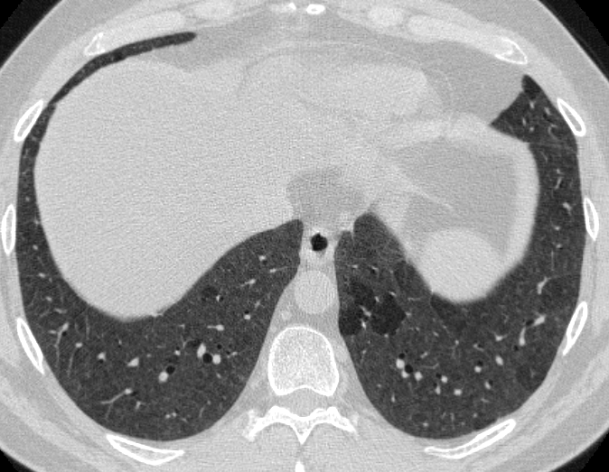
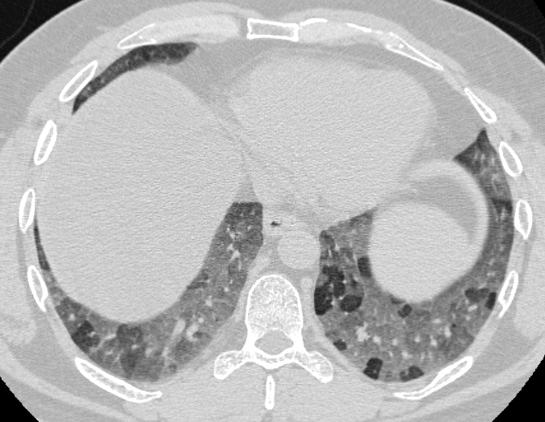
High resolution CT Protocol
Standard
  Slice thickness: 3 mm
  Reconstruction increment: 2 mm
  Coronal reconstructions
Inspiration
  Imaged supine
  Slice thickness: 1 mm
  Reconstruction increment: 10 mm
  used to reconstruct coronals
Expiration
  Imaged supine, sequential acquisition
  Slice thickness: 1mm
  Reconstruction increment: 10 mm
Notes:
Expiration images are performed sequential with acquisition
(step and shoot… in between individual axial scans the table is moved to the next z-position)
Inspiration used to reconstruct coronals
Scaheffer, William G 3/10/72, centrilobular nodules, and air trapping, CHP → history of pigeon exposure as he cleaned escalators at malls outside

Slide 5
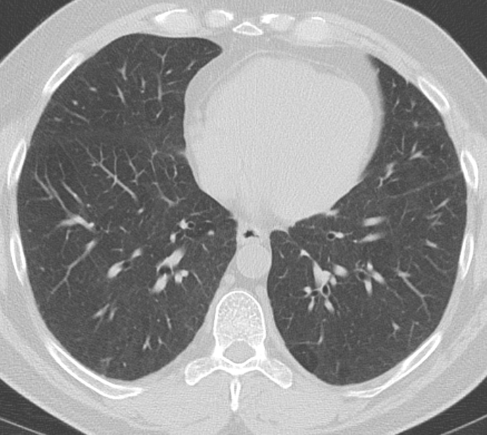
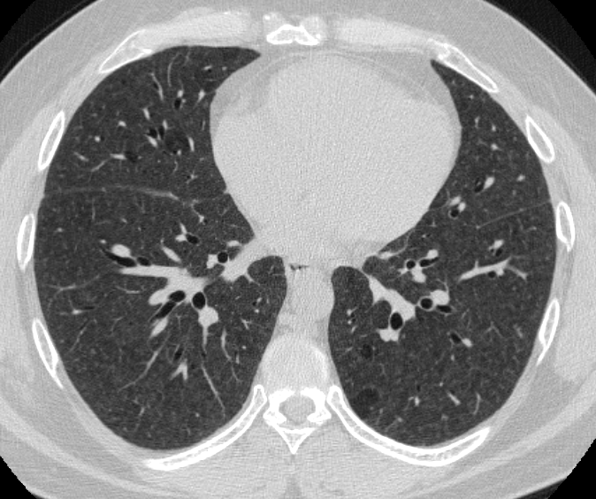
Parenchymal Findings: 5 questions
Demographics? Smoker, collagen vascular disease, immunocompromised, age
Acuity? Look at older studies
Location?
  Vertical (upper vs lower)
  Horizontal (central vs peripheral)
Pattern?
  Linear
  Nodular
  GGO
  Consolidation
  Mosaic
  Cystic
Other? effusions, lymphadenopathy
Notes:
Insert slide centrilobular nodules in somoker and non-smoker (how history helps us) RB-ILD or CHP
Knowing the hx of pigeon exposure allowed us to make diagnosis of HP; patient was treated with CellCept and Prednisone and the offending agent was removed. A year later his imaging findings are markedly improved.

Slide 6
2013 ATS/ERS IIP Classifications
Major
  Idiopathic pulmonary fibrosis (IPF)
  Nonspecific interstitial pneumonia (NSIP)
  Respiratory bronchiolitis –ILD (RB-ILD)
  Desquamative interstitial pneumonia (DIP)
  Cryptogenic organizing pneumonia (COP)
  Acute interstitial pneumonia (AIP)
Minor
  Lymphocytic interstitial pneumonia (LIP)
  Pleuroparenchymal pulmonary fibroelastosis
Chronic Fibrosing
Smoking related
Acute/subacute
Notes:
Revised classification in 2013; American Thoracic Society and European Respiratory Society
These are idiopathic pneumonias
Divided into two categories, will focus on major
Minor classification → they have pushed these two into those categories; LIP is rare to be idiopathic, commonly with sjogrens or HIV;
The ATS/ERS classifications emphasize interaction between clinicians, radiologists and, and pathologists → gold standard is a multidisciplinary approach
Other diseases are less common; also important to keep in mind that histologic patterns may be seen in association with various diseases (CVD), exposures (drugs), etc…
Inclusion of RB-ILD and DIP is controversial as typically not idiopathic but smoking related

Slide 7
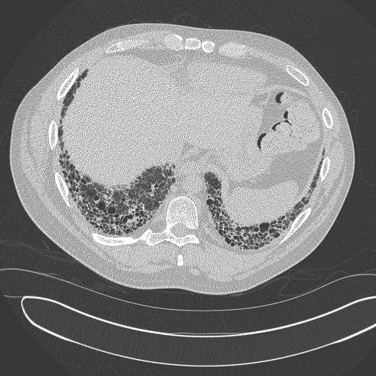
Disease | Clinical | Radiology | Pathology
Usual Interstitial Pneumonia (UIP)/Idiopathic Pulmonary Fibrosis(IPF) | 1° > 2° Idiopathic (IPF), Rheumatoid, Hypersensitivity, Asbestosis | Honeycombing, subpleural or basilar, reticulation | Temporal and spatial heterogeneity + Fibroblastic foci (pulmonary cirrhosis)
Notes:
Clinical:
most patients > 50 years old, gradual onset – of dry productive cough (also dyspnea, weight loss, clubbing),
more common in smokers;
IPF (no underlying cause) poor prognosis (2-5 years) with 5 year survival around 25 to 40%;
doesn’t respond to steroids;
patients with secondary forms have better prognosis;
when diagnosed at greater than 70 yr old almost always ipf;
Important to note that UIP is a histologic/pathologic diagnosis and it is classified as IPF when no etiology is found.
Restrive pattern on PFTs
Pathology:
heterogenous combination of fibroblastic foci, fibrosis, and honeycombing with normal intervening lung; temporal (different stages of fibrosis – both old and active lesions) and spatial heterogeneity (peripheral and basal lung with normal intervening lung).
Diagnosis is made by a lung biopsy (more than one lobe of lung); areas of normal lung next to areas of end stage lung next to areas of developing fibrosis
Fibroblastic foci (represents zones of acute lung injury in the back drop of chronic fibrosis) and deposition of collagen resulting in collagenous interstitial fibrous tissue
Lack of honeycombing at path should suggest an alternate diagnosis
Extent of honeycombing and reticulation has been shown to correlate with prognosis
Radiology:
Hallmark is honeycombing – cysts (actually dilated bronchioles) which range from 2 to 20 mm in size and enlarge slowly overtime
Reticular pattern with lower lung predominant and subpleural regions
Reticular pattern progresses to honeycombing
Decreased lung volumes because of fibrosis
Findings can be asymmetrical
When you see reticulation it represents findings of fine lung fibrosis
Consolidatin and GGO is indicative of acute exacerbation
CAN BE DIAGNOSED ON THE BASIS OF CT FEATURES

Slide 8
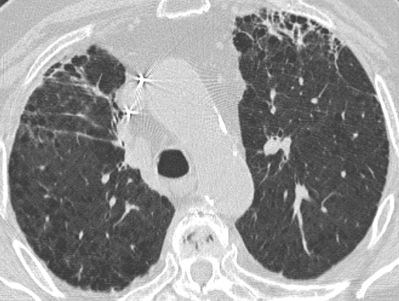
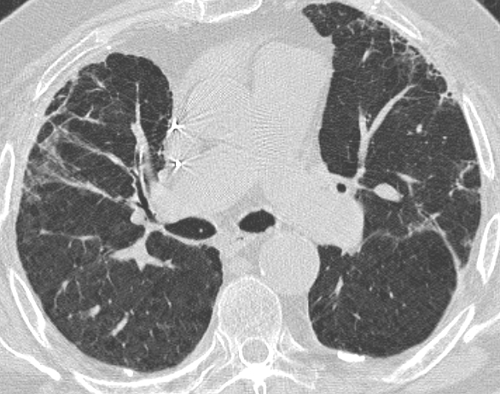
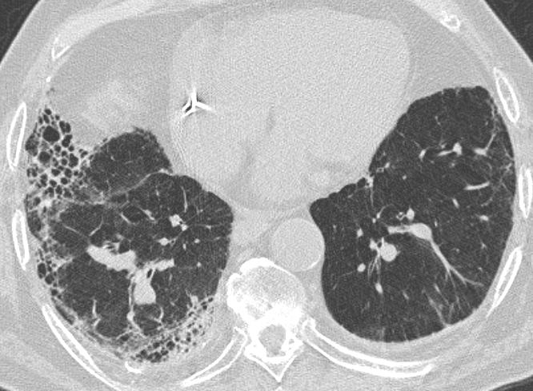
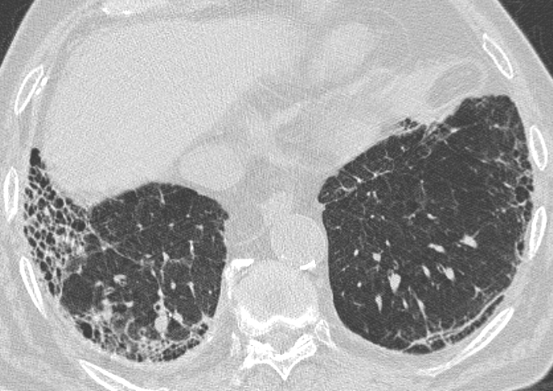
Notes:
Another case of UIP….
Radiology findings: honeycombing, traction bronchietasis, reticular opacities, architecterual distortion, and volume loss, with or without groundglass; peripheral and lower lobe predominance
Honeycombing in a basilar and subpleural distribution
Peripheral/subpleural reticulation (anteriorly and laterally in left lung)
Traction bronchiectasis occurs in areas of severe fibrosis
Subpleural lines can also be seen indicated fibrosis (bottom right image)
Note the patchy distribution marked by areas of fibrosis, reticulation, and normal intervening lung → different stages of fibrosis
Other findings to look for:
Subpleural and lower lobe predominant process; reticular opacities in the periphery

Slide 9
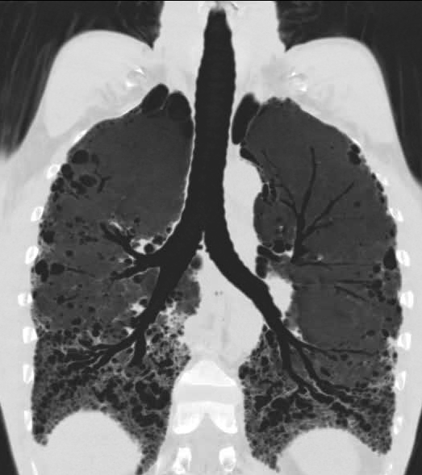
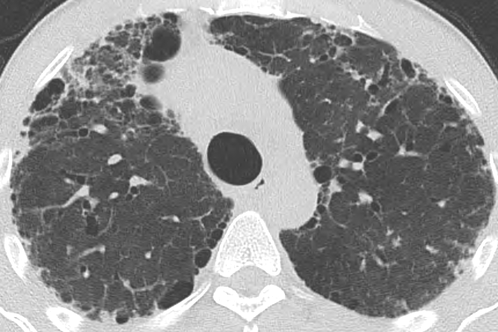
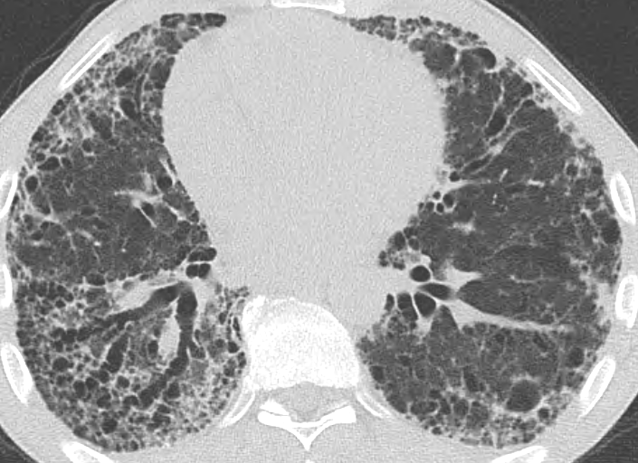
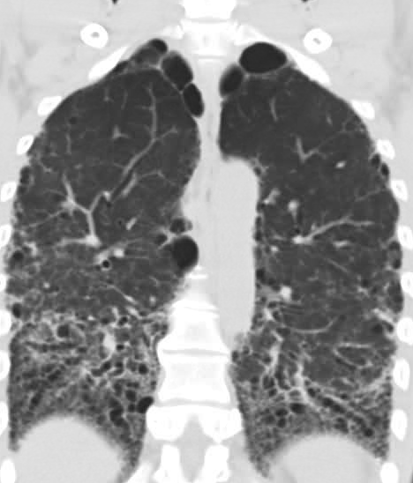
Notes:
Classic findings of honeycombing, irregular reticular opacities, and traction bronchiectasis
note the temporal and spatial heterogeneity as seen by the areas of reticulation (early fibrosis), honeycombing (end stage), and some more normal appearing lung
Traction bronchiectasis
Coronals very helpful for getting an overview of the distribution
Honeycombing can be variable in sizes
IPF has worse prognosis
Progression over time…. CT examinations are 1 year apart
Median survival 2-3.5 years; respiratory failure and cor pulmonale
2ndary forms have better prognosis.
Classic UIP pattern → peripheral and basilar predominant honeycombing; temporal and spatial heterogeneity → areas of severe fibrosis, some look normal …
Coronal views are helpful to appreciate the basilar distribution

Slide 10
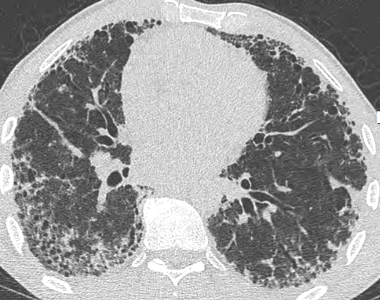
Honeycombing
Clustered air-cysts/dilated bronchioles
2-20 mm and homogeneous
Can enlarge over time
> 1 layer
Subpleural
Not the same as honeycombing on histopathology
When seen on HRCT with basilar distribution PPV UIP > 90%
Sundaram AJR 2008
Notes:
Lined by bronchiole epithelium so actually dilated bronchioles
Consistent with end stage fibrosis
In many cases of IPF/UIP honeycombing is predominant finding
Lined by bronchiole epithelium
Layers

Slide 11
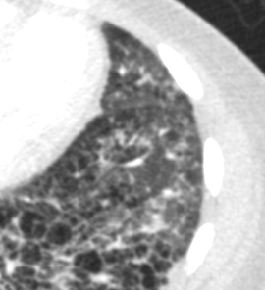
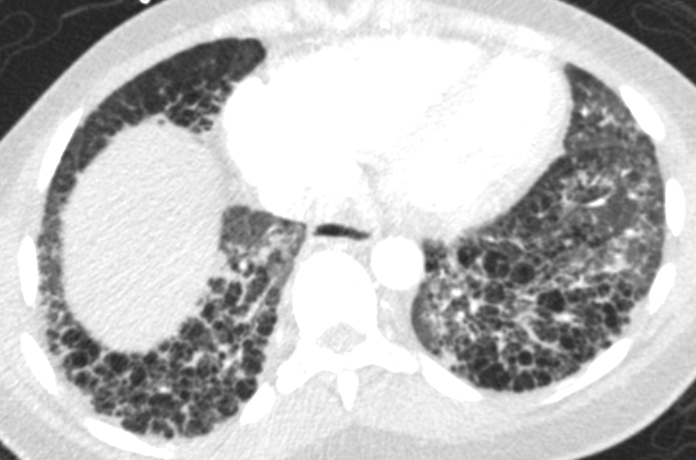
Reticulation
Intralobular
Irregular opacities from alveolar wall fibrosis
Notes:
Another pattern you can also see; these are individual alveolar walls that become fibrotic and you see coarse looking opacities.
Intralobular interstitial thickening results in reticular pattern;
Mainly subpleural and basilar
Reticulation + honeycombing
Maul, Holly 12/15/77

Slide 12
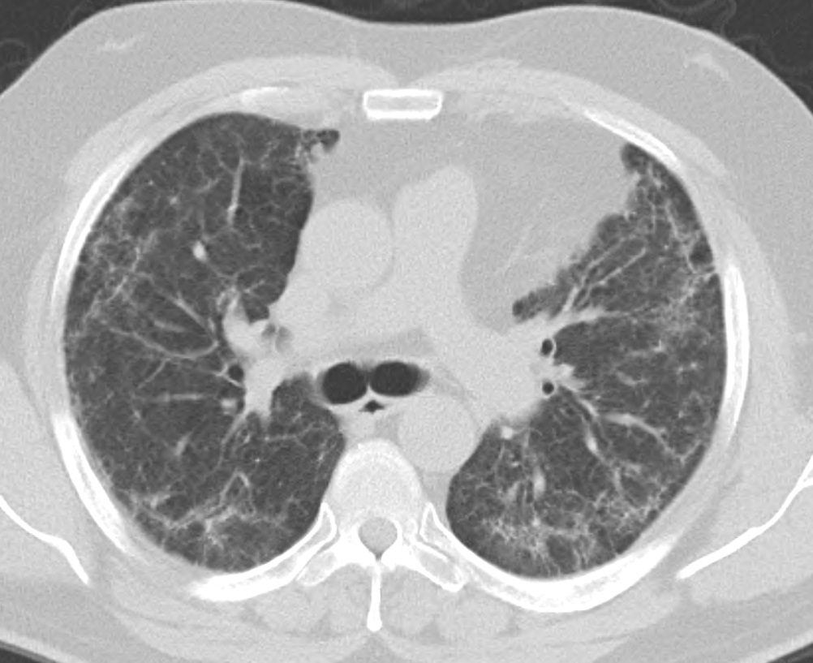
Disease | Clinical | Radiology | Pathology
Nonspecific Interstitial Pneumonia (better prognosis) | 2° > 1° Scleroderma, Hypersensitivity, Drugs | Reticulation, groundglass, lower lobe and peripheral predominance | Temporal homogeneity (fibrotic and cellular)
Notes:
Clinical:
Younger than IPF by several decades
Similar presentation – dyspnea, cough, 6 months to 3 year duration of symptoms
Equal male:female predominance
Idiopathic form a diagnosis of exclusion
Most common ILD in connective tissue disease (excluding RA which is usually UIP)
Drug Related
HP
Infection/acute lung injury
5 year mortality < 20%
Rx with many forms of immunosuppressive therapy
Pathology
Homogenous expansion of alveolar walls by active inflammation and/or fibrosis
Same stage of findings
Can range from predominantly inflammatory process (cellular form) to predominant fibrosis (fibrotic form) [difficult to distinguish on imaging]
Presence of fibrosis gives a worse prognosis; cellular NSIP better prognosis
Radiology
Lower lung predominance of groundglass and reticulation
Lower lobe predominant
Can have traction bronchiectasis and honeycombing (though less common)
Subpleral sparring
Patients with the predominant finding of GGO at presentation have been shown to have a better long term prognosis
Groundglass can be indicative of acute inflammation (DAD or OP) and represent an accelerated phase similar to UIP
Presence of GGO and reticulation will suggest NSIP rather than UIP and often warrant further investigation, possibly bx
HRCT usueful for follow-up of disease

Slide 13

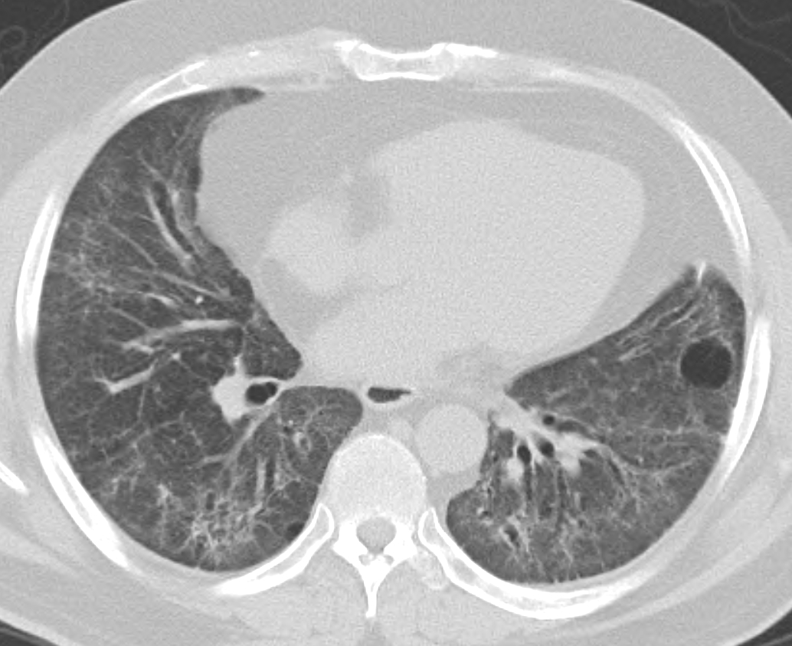
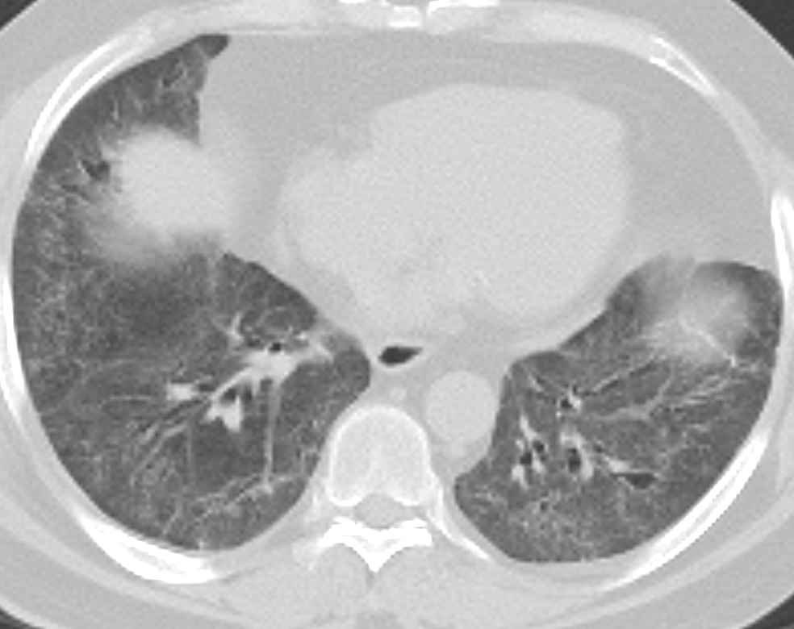
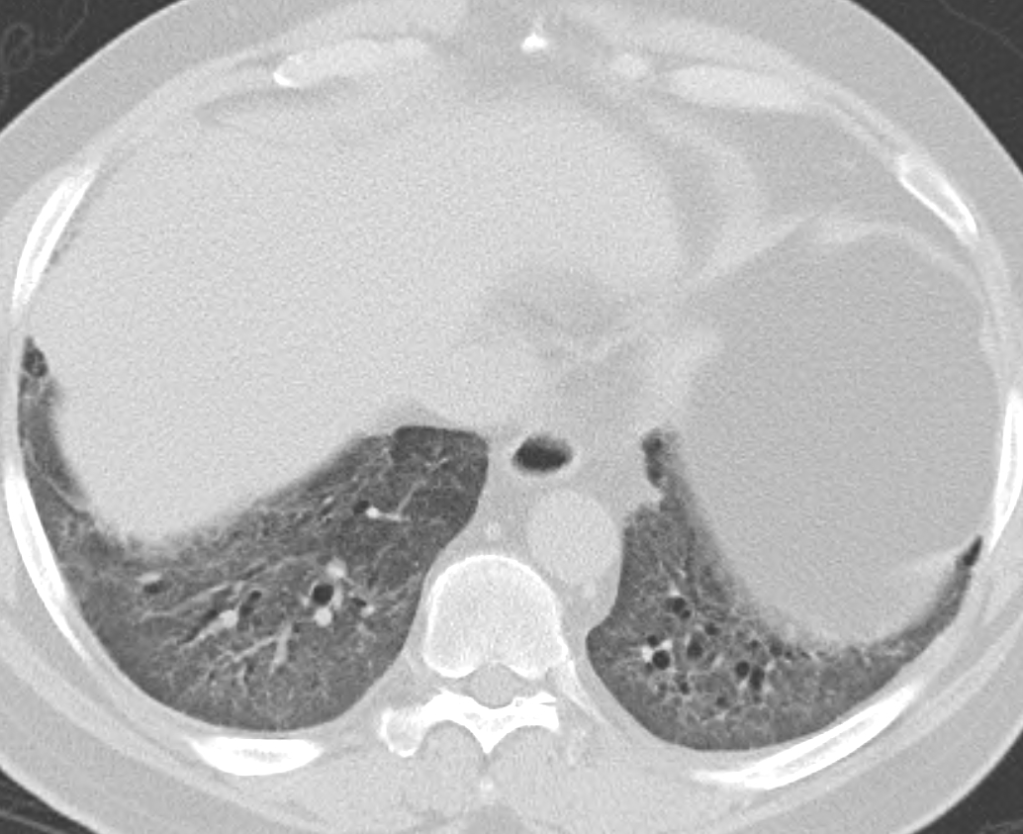
Notes:
Lower lobe
Diffuse or peribronchovascular
Subpleural sparring (about 20% of cases)
Ground glass, reticulation
Traction bronchiectasis
RARE honeycombing

Slide 14
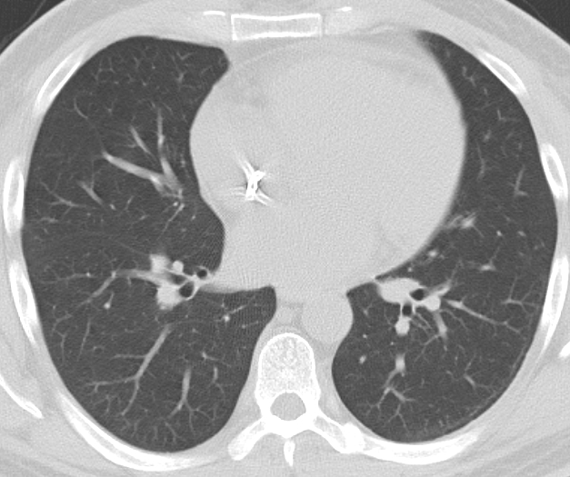
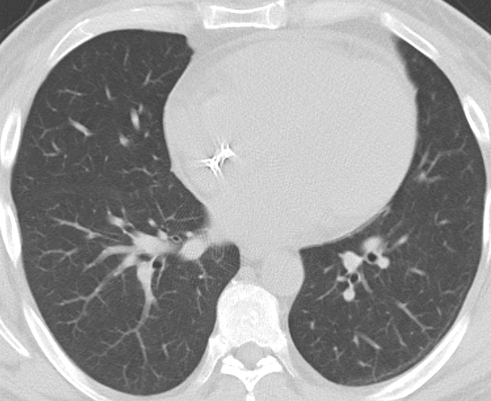
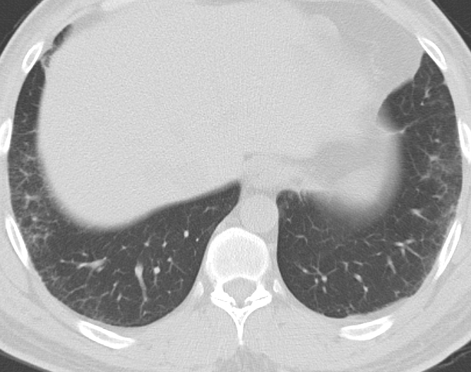
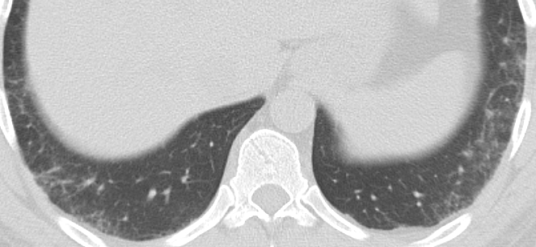
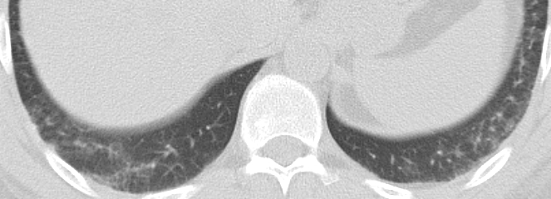
Notes:
Surgical lung biopsy if needed (wont need one if known CTD)
Cellular pattern:
Mild to moderate interstitial chronic inflammation
Type II pneumocyte hyperplasia
Fibrosing pattern
Temporally homogenous and often diffuse
loose interstitial fibrosis with preserved architecture

Slide 15
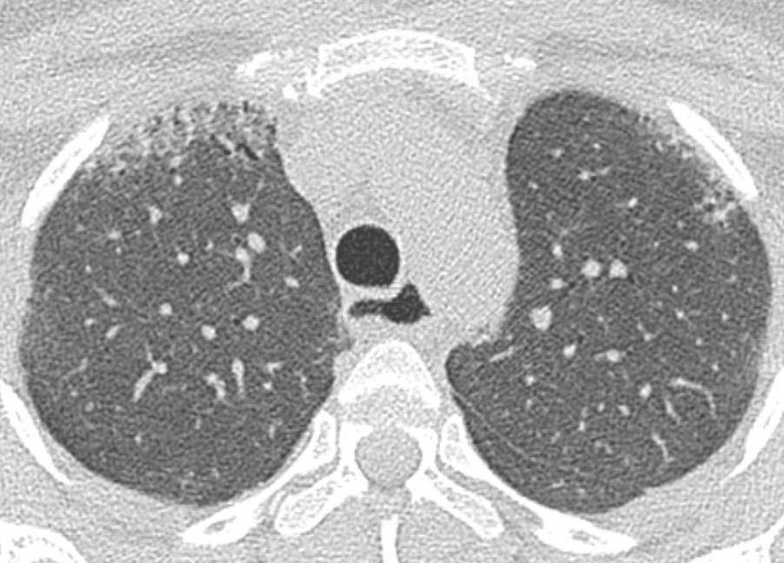
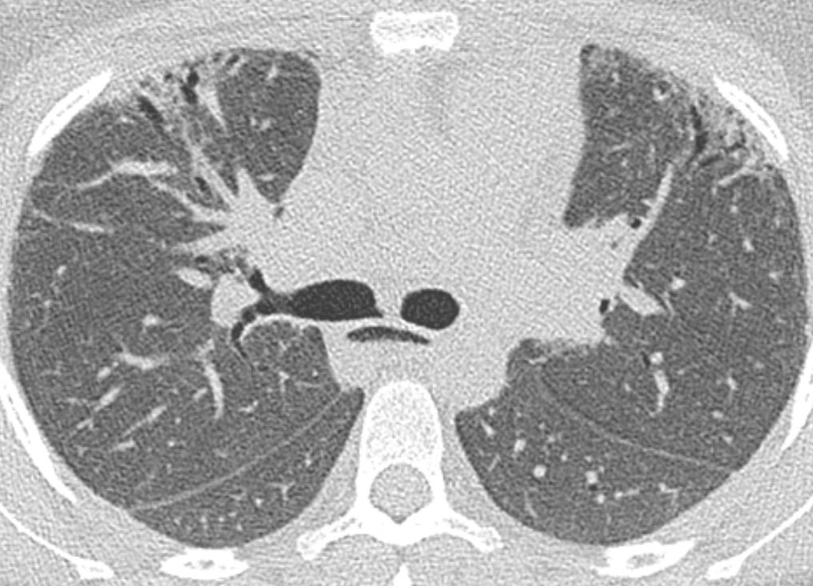
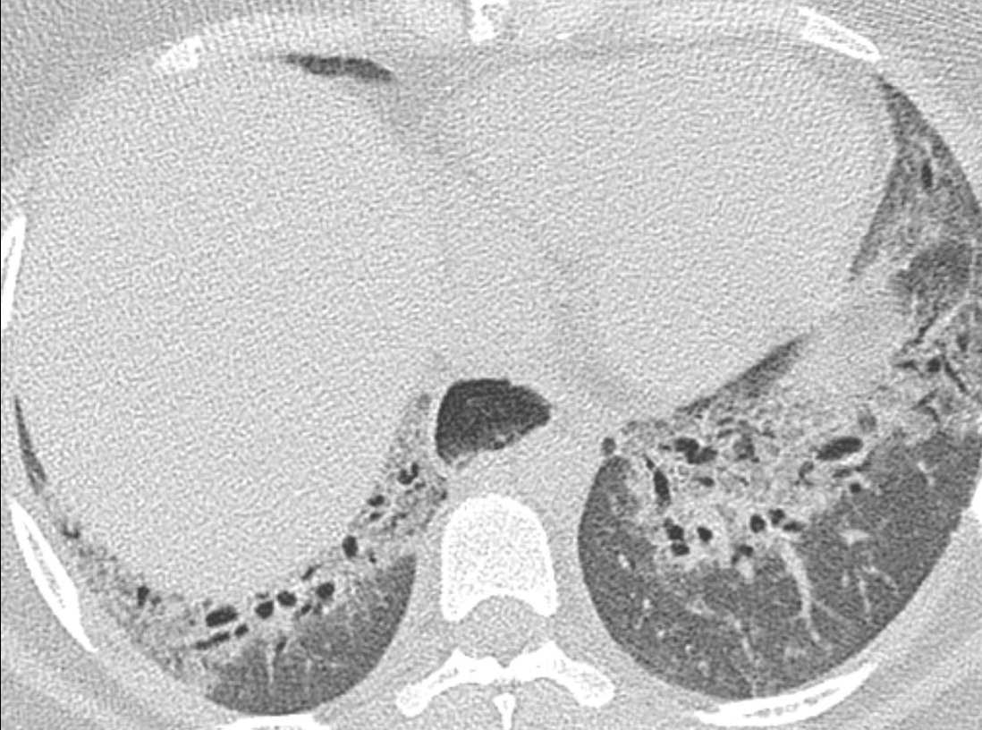
Notes:
Patient with scleroderma, patulous esophagus
More of a peribronchovascular distribution
Fibrotic form of NSIP [note the increase traction bronchiectasis]

Slide 16
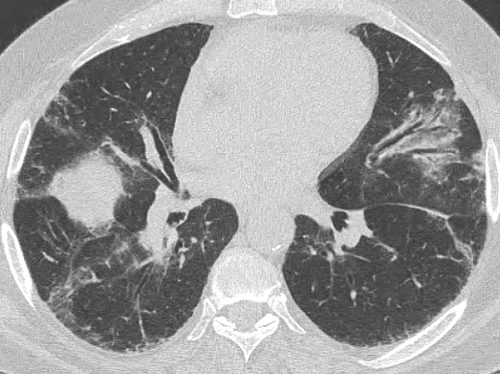
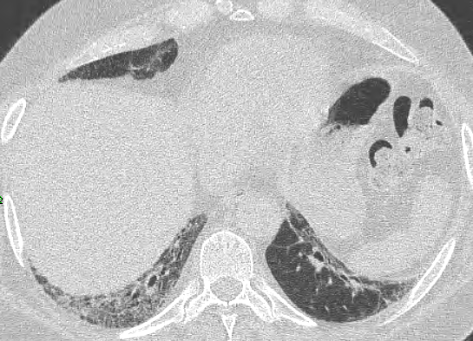
Connective Tissue Diseases
NSIP > UIP
  15 to 20% of ILD prior to systemic manifestations
  RA is exception
Systemic Sclerosis (Scleroderma)
  > 50% abnormal HRCT
  No Biopsy
Bad actors for ILD
  Amyopathic Dermatomyositis
  Antisynthetase syndrome
Undifferentiated CTD
  + serologies
  Few symptoms
  High % of idiopathic ILD
Notes:
Often will present initially with respiratory syndromes
A lot of people will have a few features of CTD and they fall into the undifferentiated CTD category; important because the prognosis is better
Patient on right with antiynthetase syndrome with reticulation and traction bronchiectasis; golfer (with antisynthetase syndrome)
Had characteristic mechanics hands
Weakenss
Myopathy
Positive anti-bodies

Slide 17
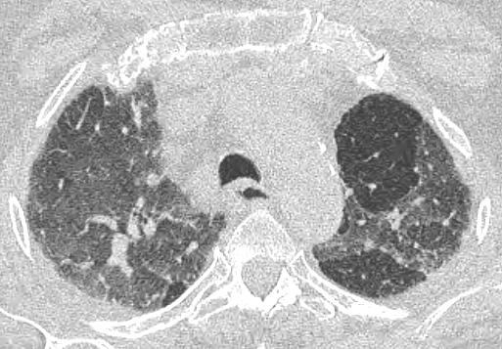
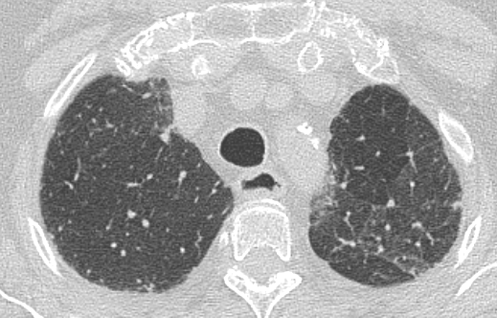
Disease | Clinical | Radiology | Pathology
Chronic Hypersensitivity | Exposure to antigen | Secondary lobular air trapping; centrilobular nodules, upper lobe | Fibrosis; centrilobular accentuation of peribronchiolar fibrosis
Notes:
Clinical
More than 200 different antigens
Many different HP syndromes are named after substance involved e.g. farmer’s lung, cheese workers lung, hot tub lung, etc…
Dry cough, dyspnea, fevers, chills
Symptoms improve when removed from offending agent (ACUTE)
Subacute form intermittent and continuous re-exposure
Chronic is from low level consistent exposure
Pathology
Chronic stage is characterized by presence of fibrosis which can mimic IPF and even include honeycombing on imaging and path
Radiology
Characterized by presence of reticulation, architectural distortion, traction bronchiectasis, and honeycombing
Air trapping – lobular areas of decreased attenuation on inspiratory images with air trapping seen on expiatory images*
Upper lobe involvement*

Slide 18
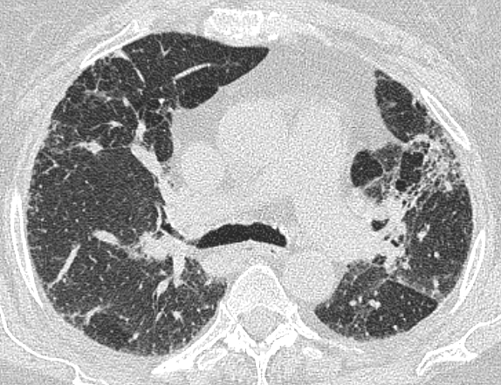
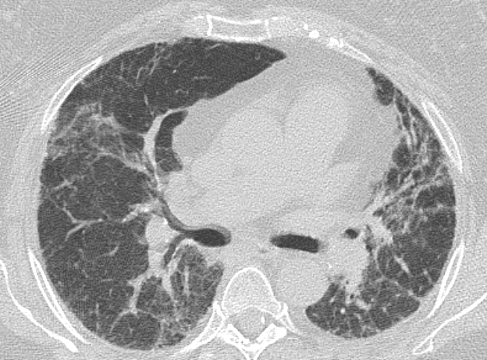
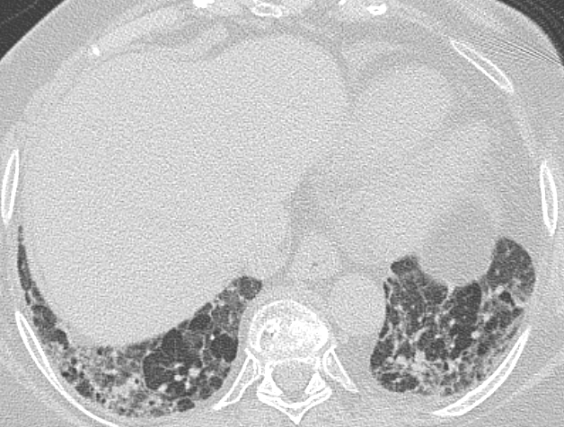
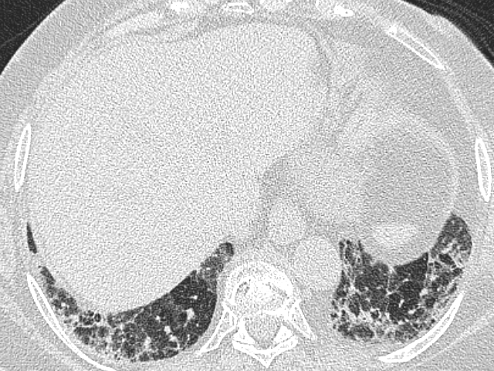
Notes:
Chronic HP
Characterized by presence of reticulation, architectural distortion, traction bronchiectasis, and honeycombing

Slide 19
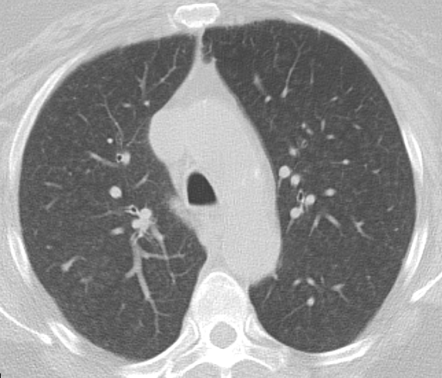
RB ILD
Disease | Clinical | Radiology | Pathology
Respiratory bronchiolitis (RB-ILD) | Smokers | Centrilobular nodules, upper lobes | Bronchiolecentric (peribronchiolar) distribution of macrophages
Notes:
Clinical
Young heavy smokers (age 30 to 40), greater than 30 pack year history
Dyspnea, cough
Usually unassociated with specific symptoms but when symptomatic get labeled with interstitial lung disease
Often mixed obstructive and restrictive lung disease
This is due to combo of RBILD and emphysema
Treat with smoking cessation
Good prognosis
Progression to fibrosis or respiratory failure not common
Can benefit from steroids
Radiology
Centrilobular nodules
Bronchiole wall thickening
tend to involve upper lung zones
Pathology
Pigmented macrophages, absence of lymphocytes
Macrophages fill bronchioles, alveolar ducts, and alveoli
Macrphages contain brown pigment which represents particulate matter unique to cigarette smoke
Results in peribronchiolar and alveolar wall inflammation

Slide 20
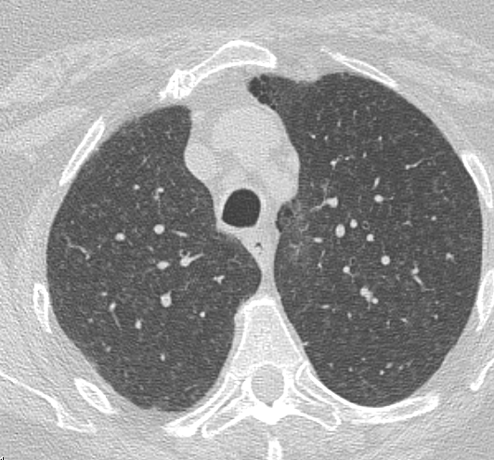
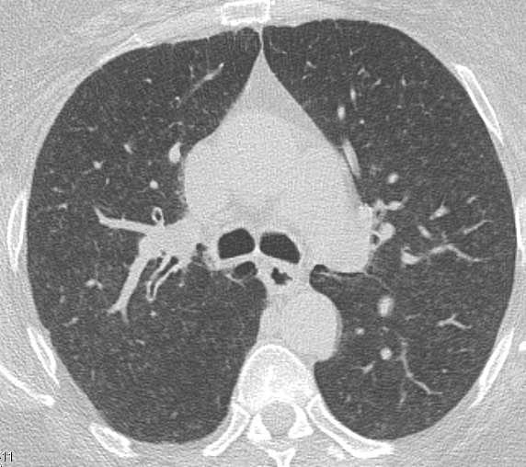
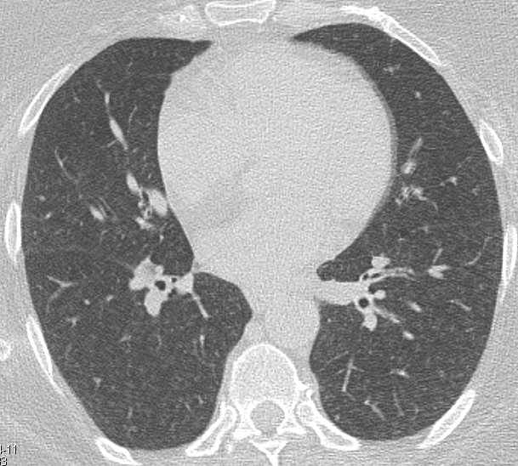
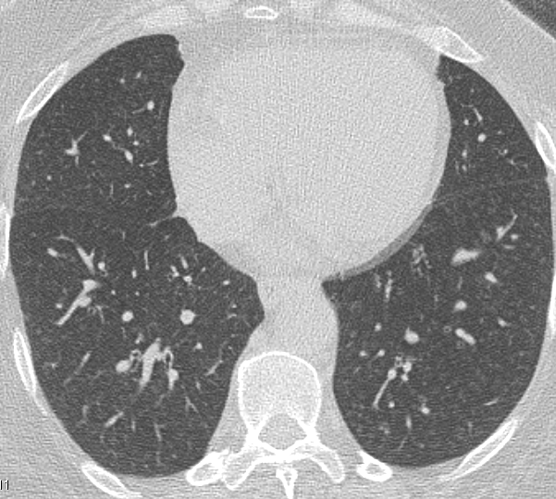
Notes:
RB-ILD
Diffuse centrilobular nodules with some predilection for the upper lungs
Bronchiole all thickening
Small percentage of patients will develop a reticular pattern form fibrosis (mild and rare)

Slide 21
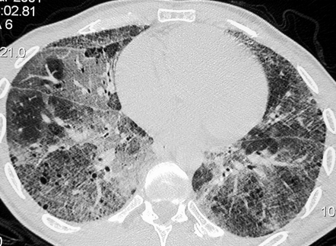
Disease | Clinical | Radiology | Pathology
Desquamative Interstitial Pneumonia (best prognosis) | Smoker | Ground Glass, (emphysema*), lower lobe | Macrophage filling alveolar spaces
Notes:
Clinical
Most smokers (90%)
Known environmental exposures, second hand smoke, drugs, gene mutations (much more rare)
30 to 50 years old
Dyspnea on exertion, hypoxia, dry cough
PFTs decreased diffuse capacity
Benefit from smoking cessation and roids
Findings will improve with treatment
Radiology
Predominant finding is groundglass
Subpleural and basilar predominance
Can have air filled cysts
Histologic
It is a misnomer → not desquamative, not interstitial; filling up of aveoli with dirty macrophages.
Distinguished from RB by presence of more diffuse involvement of the air spaces (on a continuum with RB-ILD)
Likely related conditions representing different degrees of small airway and parenchymal reaction to cigarette smoke
Often will get reclassified as RB-ILD
Surgical lung bx may be needed to differentiate from other entities.

Slide 22
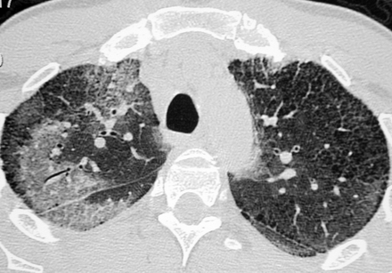
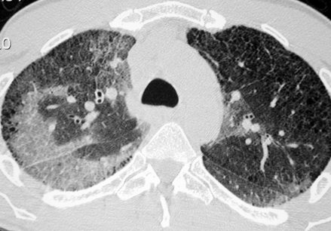
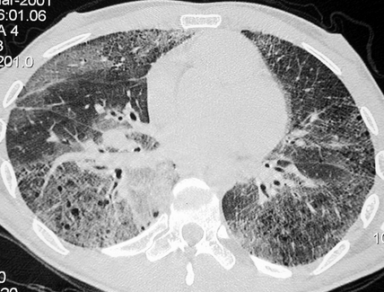
Notes:
DIP
Can have air filled cysts
Groundglass
Focal areas of lucency from mosaic perfusion related to bronchiolitis and airway obstruction
Subpleural predominance
Mild reticulation

Slide 23
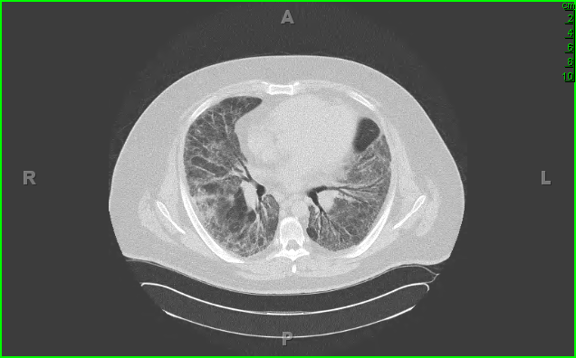
Disease | Clinical | Radiology | Pathology
Acute Interstitial Pneumonia | Idiopathic ARDS | GGO w/ secondary lobular sparring | Organizing stage of alveolar damage
Notes:
Clinical
50 to 60 years old
Prodromal of viral illness or respiratory infection
Dry cough and rapidly progressive dyspnea (symptoms less than a weak and then respiratory failure)
Die within 6 months
Radiology
Bilateral groundglass opacities that can be patchy or diffuse
Secondary lobular sparing (gives a geographic appearance)
Can have smooth septal line thickening and intralobular lines to give crazy paving look
Pathology
Histologic findings of diffuse alveolar damage /ARDs (has been referred to as idiopathic acute respiratory distress syndrome given histologic overlap)
Stages
Acute stage/exudative stage → edema, hyaline membranes, acute interstitial inflammation
Organizing/proliferative phase → fibroblast proliferation, type II pneumocyte hyperplasia,
Chronic → 2 weeks after injury → fibrosis with collagen deposition

Slide 24
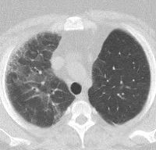
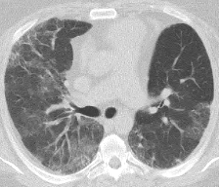
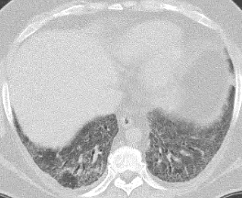
Notes:
AIP
Groundglass
Patchy or confluent
Can be subpleural
Secondary lobular sparing

Slide 25
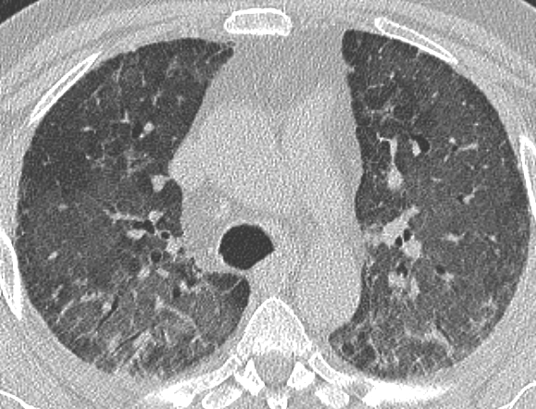



Notes:
AIP
As disease evolves get architectural distortion and traction bronchiectasis (fibrosis)
Typically after greater than seven days of onset
Note the reticular pattern (fibrosis)

Slide 26




Disease | Clinical | Radiology | Pathology
Organizing Pneumonia | 2° > 1°; REVERSIBLE Drugs, Infection, Vasculitis, Neoplasm, Immune (Graft vs Host) | Peripheral consolidation or GGO CT >> clinical; (subpleural, peribronchial, reverse halo) | Inflammatory plugs
Notes:
Clinical
Common reaction associated with infection, connective tissue disease, inflammatory bowel disease, inhalational injury, hypersensitivity, drug toxicity, radiation, aspiration
often no causes is found, hence the term cryptogenic organizing pneumonia
2 to 3 month history of a nonproductive cough, low grade ever, malaise, and shortness of breath
Respond well to steroids
Imaging findings typically will reverse as well
Imaging overlap (for example in chronic eosinophilic pneumonia); history and laboratory tests very helpful
Radiology
Patchy consolidation
Subpleural or peribronchial (image on left x2)
Can see bronchial wall thickening and dilatation
Perilobular pattern
Small ill defined nodules – peribronchial or peribrchiolar
Larger nodules or masses
Ill defined nodules of groundglass
Central areas of groundglass – Reverse Halo (3rd image) – corresponds to alveolar septal inflammation with ring shape or crescentic periphery corresponding to OP within alveolar duts
Can see crazy paving
Poorly defined, irregular linear opacities and groundglass (4th image)
Linear opacities typically don’t resolve and have worse prognosis
Bronchial wall thickening or dilatation
Pathology
Intraluminal plugs of granulation tissue within alveolar ducts and surrounding alveoli associated with chronic inflammation of surrounding lung parenchyma
Granulation tissue polyps may also be present within bronchioles

Slide 27


Disease | Clinical | Radiology | Pathology
Lymphocytic | Usually in Sjogrens (Hashimotos/HIV) | Interstitial + Cysts | Polymorphus lymphocytic infiltrate
Notes:
Clinical
LIP part of spectrum of pulmonary lymphoproliferative disorders ranging in severity from benign airway centered cellular aggregates (lymphoid hyperplasia) to malignant lymphomas
Average age 50 to 60 years
Cough and dyspnea
Can rarely be idiopathic
Usually associated with Sjogrens, Hashimotos, HIV (usually children)
Uncommon
Was included in ATS/ERS because can mimic NSIP
Respond to steroids but 33 to 50% die within 5 years
Radiology
Extensive groundglass opacities and poorly defined nodules
Cysts
Thickening of peribronchovascular bundles
Pathology
Diffuse interstitial lymphoid infiltrate

Slide 28
Disease | Clinical | Radiology | Pathology
Usual Interstitial Pneumonia/ Idiopathic Pulmonary Fibrosis (terrible prognosis) | 1 > 2 Clinical (Idiopathic Pulmonary Fibrosis) Rheumatoid, Hypersens, Asbestos | Honeycombing | Temporal and spatial heterogeneity + Fibroblastic foci (pulmonary cirrhosis)
Nonspecific Interstitial Pneum (better prognosis) | 2 > 1 Scleroderma, Hypersensitivity, Drugs | Reticulation | Temporal homogeneity (fibrotic and cellular)
Desquamative (best prognosis) | Usually from smoking | Ground glass (emphysema) | Macrophages filling in alveolar spaces
RB-ILD | Smokers | Centrilobular nodules | Macrophage infiltrate with peribronchiolar predominance
Organizing Pneumonia (reversible) | 2 > 1 Drugs, Infection Vasculitis, Neoplasm, Immune (Graft vs Host) | Peripheral consolidation or GGO CT >> clinical | Inflammatory plugs
Acute Interstitial Pneumonia | Idiopathic ARDS | GGO w secondary lobular sparing | Organizing stage of alveolar damage

Slide 29

IPF
IPF incidence in US
  7-20 per 100,000 women
  10-40 per 100,000 men
2/3 are patients > 60 years of age
Median survival time = 2 -3 years
Raghu et al, Am J Respir Crit Care, 2006
Notes:
Stevens, Robert
3/14/48
More common in men and older patients greater than 60;
UIP; very poor median survival; actually has much worse prognosis than lung cancer;
Very classic look for UIP; honeycombing → peripheral, more than one row. Very good look.
Want to be very specific, don’t want to be sensitive; don’t want to put someone on transplant list for UIP unless we are sure it is UIP.
Diagnostic HRCT findings of UIP/IPF allows for confident diagnosis without biopsy
Need to exclude other causes of UIP and have presence of all three criteria to make diagnosis

Slide 30
IPF
Diagnosis < 40 years old is unusual
Fibrosis > 70 years almost always IPF
Cigarette smoking moderately associated with IPF: 60% of patients with IPF are current or former smokers
5-20% have family history of interstitial lung disease or IPF
Gastroesophageal reflux

Slide 31

UIP is not IPF
Collagen vascular diseases (RA)
Drug toxicity
Chronic hypersensitivity
Asbestosis
Hermansky-Pudlak
Familial IPF
Notes:
When we talk about UIP, we will say it is a UIP pattern to emphasize that UIP is not synonymous with IPF
Amiodarone toxicity
In order to give someone the diagnosis of IPF you need to exclude other causes

Slide 32
Why does it Matter?
Diagnosis of IPF
  2 new medications approved by FDA for IPF (Pirfenidone and Nintendanib)
    Slow decline in pulmonary function
2011 criteria
  Designed to provide recommendations on diagnosis and management of IPF
  Discarded 2000 criteria
Notes:
2 drugs:
Pirfenidone – used for UIP, very expensive, will get paid for by insurance if HRCT is read for consistent with UIP; most UIP patients are too sick to get lung biopsy
Nintendanib
Slow decline of PFTs but no research showing decreased progression of CT findings or long term benefit.
Treatment is supportive and serves as a bridge to transplant.

Slide 33
2011 HRCT Criteria
UIP Pattern (all 4) | Possible UIP Pattern (all 3) | Inconsistent with UIP (only 1)
Subpleural, basal predominance | Subpleural, basal predominance | Upper or midlung predominance
Reticular abnormalities | Reticular abnormalities | Peribronchovascular predominance
Honeycombing | Absence of features in column 3 | Extensive GGO (> reticular)
Absence of features in column 3 |  | Profuse micronodules (bilateral, predominant upper lobes)
 |  | Discrete cysts
 |  | Consolidation
 |  | mosaic attenuation/air trapping (in 3 or more lobes)
Notes:
(away from honeycombing)
What we talk about are the following patterns:
UIP pattern – relies on good distribution, honeycombing, and reticulation – and absence of other findings on the right.
Possible UIP pattern → all of same features as UIP pattern but doesn’t have honeycombing; these patients pay go on to lung biopsy. CT helpful in directing lung biopsy.
Inconsistent with UIP pattern:
Upper – sarcoid
Peribronchovascular – OP
GGO – DP, nodules or cysts, consolidation, or mosaic (subacute hypersensitivity has strong association with air trapping)
If honeycombing is absence it can still be UIP; often times these are the patients who will go on to biopsy.
25 to 40% of patients with UIP can have an inconsistent with UIP
Our job is that if it has a UIP pattern they can avoid a lung biopsy; other two categories require further investigation.
To make a diagnosis of IPF you need to exclude other causes of UIP and have presence of all three criteria to make diagnosis

Slide 34

2011 HRCT Criteria
UIP Pattern (all 4)
Subpleural, basal predominance
Reticular abnormalities
Honeycombing
Absence of features in column 3
Notes:
(away from honeycombing)
This is a classic case of UIP

Slide 35




Notes:
Another example of honeycoming; not always of the same size; can be big, or small, or areas inbetween.
Another case of UIP, no need for biopsy

Slide 36


Notes:
UIP: Yet again another example of honeycombing varied in size with traction bronchiectasis.
Read as UIP pattern, no need for biopsy

Slide 37


2011 HRCT Criteria
Possible UIP Pattern (all 3)
Subpleural, basal predominance
Reticular abnormalities
Absence of features in column 3
Notes:
This is a case read as possible UIP; here we see reticulation, don’t see much in the way of honeycombing. Maybe on a good day would see the stuff in right lower lobe. Read as possible UIP and open lung biopsy went on to show a pathologic diagnosis of UIP.

Slide 38




Notes:
Another case of reticulation that was read as possible UIP; went on to biopsy and had UIP

Slide 39






2008
2014
2015
Notes:
This is why we talk about reticulation:
in 2008 the study would be read as possible UIP;
in 2014 we would read this as definite UIP.
In 2015 with worsening groundglass
groundglass to indicate active inflammation
Biopsy will show findings of diffuse alveolar damage pattern or superimposed organizing pneumonia
OP typically responds better than DAD
Bad sign when you see groundglass consolidation superimposed upon UIP/IPF
30% of patients will not have IPF at initial presentation.
Most patients evolve like this with progressive worsening of fibrosis over 5 to 10 years

Slide 40




2009
2011
2012
2014
Notes:
Similar case of reticulation which progresses to honeycombing and has a diagnosis of UIP;
2009, 2011 – possible UIP
2012, 2014 – UIP pattern
This is why honeycombing lets us make a confident diagnosis. But the lack of honeycombing doesn’t exclude UIP.

Slide 41


2011 HRCT Criteria
Inconsistent with UIP (only 1)
Upper or midlung predominance
Peribronchovascular predominance
Extensive GGO (> reticular)
Profuse micronodules (bilateral, predominant upper lobes)
Discrete cysts
Consolidation
mosaic attenuation/air trapping (in 3 or more lobes)
Combined pulmonary fibrosis and emphysema
Notes:
(away from honeycombing)
Emphysema upstairs, groundglasss and reticulation downstairs → this is combined pulmonary fibrosis and emphysema

Slide 42

2011 HRCT Criteria
Inconsistent with UIP (only 1)
Upper or midlung predominance
Peribronchovascular predominance
Extensive GGO (> reticular)
Profuse micronodules (bilateral, predominant upper lobes)
Discrete cysts
Consolidation
mosaic attenuation/air trapping (in 3 or more lobes)
Organizing pneumonia
Notes:
(away from honeycombing)
Inconsistent with UIP; preibronchovascular opacities → more consistent with organizing pneumonia

Slide 43


2011 HRCT Criteria
Inconsistent with UIP (only 1)
Upper or midlung predominance
Peribronchovascular predominance
Extensive GGO (> reticular)
Profuse micronodules (bilateral, predominant upper lobes)
Discrete cysts
Consolidation
mosaic attenuation/air trapping (in 3 or more lobes)
Desquamative Interstitial Pneumonia
Notes:
(away from honeycombing)
Here is another patient with diffuse groundglass, emphysema/cysts; read as inconsistent with UIP; read as DIP.

Slide 44


2011 HRCT Criteria
Inconsistent with UIP (only 1)
Upper or midlung predominance
Peribronchovascular predominance
Extensive GGO (> reticular)
Profuse micronodules (bilateral, predominant upper lobes)
Discrete cysts
Consolidation
mosaic attenuation/air trapping (in 3 or more lobes)
Lymphangioleiomyomatosis (LAM)
Notes:
(away from honeycombing)
Also read as inconsistent; read as LAM; multiple cysts in a patient.

Slide 45


2011 HRCT Criteria
Inconsistent with UIP (only 1)
Upper or midlung predominance
Peribronchovascular predominance
Extensive GGO (> reticular)
Profuse micronodules (bilateral, predominant upper lobes)
Discrete cysts
Consolidation
mosaic attenuation/air trapping (in 3 or more lobes)
Chronic Hypersensitivity Pneumonitis
Notes:
(away from honeycombing)
This is a patient with multiple small centrilobular nodules and air trapping – hypersensitivity pneumonia.
Chronic hypersensitivity
Often no identifiable exposure (30% of time)
Secondary lobular air trapping
Centrilobular nodules
Upper/preibronchovbascular
Path: bronchiolocentric, poorly formed granulomas, lymphocytic BAL

Slide 46
Histopathology criteria for UIP
UIP Pattern (all 4) | Probable UIP Pattern | Possible UIP Pattern (all 3) | Non UIP Pattern
Evidence of marked fibrosis/architectural distortion +/- Honeycombing in a peripheral, subpleural location | Evidence of marked fibrosis/architectural distortion +/- Honeycombing in a peripheral, subpleural location | Patchy or diffuse involvement of lung by fibrosis | Hyaline membranes
Presence of patchy lung fibrosis | Absence of EITHER fibroblastic foci or patchy fibrosis (but not both) | Absence of features against a diagnosis of UIP | OP
Presence of fibroblastic foci | Absence of features against a diagnosis of UIP | Absence of other features of UIP | Granulomas
Absence of features against a diagnosis of UIP | OR Honeycombing only |  | Marked interstitial inflammation away from honeycombing
 |  |  | Predominant airway centered changes
 |  |  | Other features of alternative diagnoses
Notes:
Be aware as we have now moved to grading our cases as
UIP, possible, inconsistent
Pathologists are grading there cases with 4 categories.

Slide 47
Multidisciplinary approach suggested
If clinical history is appropriate and UIP pattern on HRCT, then biopsy avoided
Possible UIP and inconsistent with UIP may prompt surgical biopsy*
No minimum requirements
  At MIR, we aim
    2 pulmonary staff
    1-3 Radiology staff
    1 Pulmonary Pathologist
    1 Rheumatologist
Flaherty KR Am J Respir Crit Care Med 2004;

Slide 48
Multidisciplinary approach suggested
The pathologic diagnosis changed by in approximately 20% of cases
In 50%, radiologists changed their diagnosis
In 33% pulmonologists changed their diagnoses
Flaherty KR Am J Respir Crit Care Med 2004;
Notes:
In some of the studies it has been shown that path diagnosis can be changed in MD approach
Radiologists are all over the place.

Slide 49



Notes:
Robert M Bolter 2-11-53 UIP CT 5-10-10
Example at first glance we thought was UIP

Slide 50




Inspiration Expiration
Notes:
Robert M Bolter 2-11-53 UIP CT 5-10-10
Expiration images showed air trapping → turned out the patient had been chronic hypersesnsitivity.

Slide 51
Any underlying condition/cause for ILD?
Not IPF
YES
NO
IPF
Possible UIP
Inconsistent with UIP
Lung Biopsy
HRCT
UIP
UIP, probable, possible
NOT UIP
Not IPF
Multidisciplinary Conference
Not IPF
IPF
Notes:
Flow chart recommended → underlying cause not IPF
Do HRCT if read as UIP → IPF
If inconsistent goes to biopsy.

Slide 52
Any underlying condition/cause for ILD?
Not IPF
YES
NO
HRCT
Lung Biopsy
IPF
Multidisciplinary Conference
Not IPF
Notes:
Suspected IPF
We do it differently. Unless it is a slam dunk most get HRCT and get discussed at conference. We try to be a little bit more sparring with biopsy as biopsy is challenging and there is a good chance if you biopsy them they can get stuck on a ventilator and be difficult to get them off.
We can have an impact as a radiologist in helping direct biopsy.
You don’t want to just biopsy the most severe portions of the lung where end stage fibrosis is. Want to guide the surgeons where areas of end stage fibrosis are not. Want to be able to see some normal lung, developing fibrosis, and end stage fibrosis. Usually biopsying 2 or more lobes.

Slide 53
Management guidance issues
HRCT Pattern | Surgical Biopsy | Diagnosis of IPF?
UIP | UIP Probable UIP Possible UIP nonclassifiable fibrosis | YES
UIP | Not UIP | NO
Possible UIP | UIP, Probable UIP | YES
Possible UIP | Possible UIP nonclassifiable fibrosis | Probable
Possible UIP | Not UIP | NO
Inconsistent with UIP | UIP | Possible
Inconsistent with UIP | Probable UIP Nonclassifiable fibrosis Not UIP | NO
Notes:
Some controversies
Some UIP just looks inconsistent on CT
Suspected clinical and clinical IPF are viewed the same
Radiology and pathology patterns;
Realize that we can still can get a UIP diagnosis if we have a UIP pattern, a possible, and inconsistent; → we know there are cases where we may still get UIP on pathology where we don’t see the findings on CT.

Slide 54




Notes:
This was one of those cases where the patient didn’t have classic findings of UIP and read as possible UIP; discussed at conference and pathology showed UIP diagnosis and those received diagnosis of probable UIP

Slide 55
% of IPF based on HRCT?
HRCT Pattern | What percentage UIP/IPF?
Definite (with honeycombing) | 95 %
Possible | 85 %
Inconsistent with UIP | 25 %
What % of UIP had HRCT?
HRCT Pattern | 55 patients
High prob of UIP | 27 %
Intermediate prob of UIP | 11 %
Low prob of UIP | 62 %
Sverzellati, Radiology 2010
Notes:
If read as inconsistent with UIP, still 25% of patients have IPF (first study)
Just because you don’t have findings of UIP on HRC doesn’t mean you don’t have UIP (62% of the patients with known UIP had low probability UIP findings on HRCT)

Slide 56



Idiopathic Pneumonias
SMOKING-
RELATED
FIBROSING
INJURY
UIP
NSIP
AIP
COP
DIP
RBILD
Notes:
Attempt to standardize all of this with ATS criteria as this does guide some of the therapies;
Idiopathic pneumonias can be grouped into three categories → fibrosing, injury, smoking related; 6 big players;
Knowing the 6 major players in idiopathic pneumonia and having an understanding of how to use the HRCT criteria to bin the patients into a UIP pattern, possible UIP pattern, or inconsistent with UIP pattern can help us narrow a differential diagnosis. This can be beneficial and when evaluated with a multidisciplinary approach we can help make an accurate diagnosis and affect patient care.

Slide 57
Thank You

