Slide 1
MACRA: Is History Repeating Itself?
Zeke Silva III, MD, FACR, FSIR, RCC
Chairman, ACR Commission on Economics
Eastern Radiological Society Meeting
San Antonio, TX
April 24, 2017

Slide 2
Topic #1
Value fatigue

Slide 3
Government 101

Slide 4
Some payment history

Slide 5
Some quality history

Slide 6
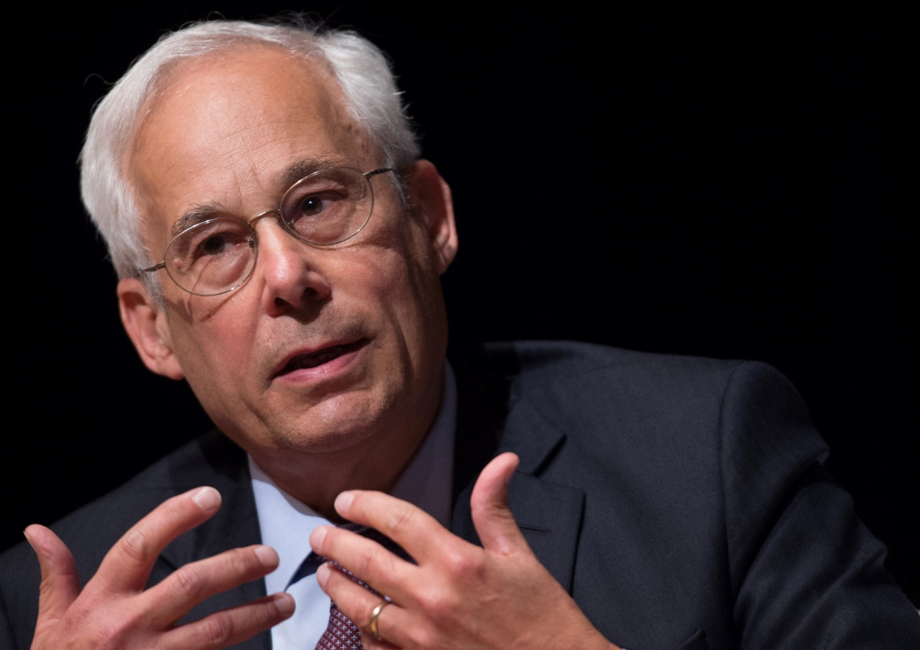
“not a day went by without an error”
“On at least three occasions, I know of, she waited, alone, for over an hour cold and frightened in a waiting area outside an MRI unit in the sub-basement in the middle of the night”.
Don Berwick, MD, MPP
President & CEO Institute for Healthcare Improvement

Slide 7
Topic #3
Who are we?

Slide 8
patient facing versus non-patient facing

Slide 9
Continuous
Episodic
Broad
Primary Care
Hospitalist
Focused
Rheumatology
Orthopedic surgeon
“Only as ordered by another physician” - Radiology

Slide 10
Claims
Episode Identification
Assignment
Association
Risk Adjustment
Trigger Rules and Codes
Relevant Services
Sequelae
Output
Combinations
Relevant Diagnoses
Indications

Slide 12
Topic #3
MACRA the basics

Slide 13
M
A
C
R
A
Medicare Access and Chip Reauthorization Act

Slide 14
Quality Payment Program
QPP
MACRA
MIPS
APMs
Merit-Based Incentive Payment System
Alternative Payment Models

Slide 15
2017 Affects 2019
2016
2017
2018
2019
Adjustment
2014
2015
2016
2017
Performance Year

Slide 16
Performance Categories
PATIENT FACING
Quality
Cost
Advancing Care Information
Improvement Activities

Slide 17
Weighting of MIPS Factors – 2019
PATIENT FACING
Quality
Cost
Advancing Care Information
Improvement Activities
60pts
15pts
25pts
0pts

Slide 18
Performance Categories
NON-PATIENT FACING
1/2
Quality
Cost
Advancing Care Information
Improvement Activities

Slide 19
Weighting of MIPS Factors - 2019
NON-PATIENT FACING
Quality
Improvement Activities
15 pts
85pts

Slide 20
non-patient facing

Slide 21
patient facing
INDIVIDUAL
Bill more than 100 “Patient Facing Encounters” per year
GROUP
More than 25% of individuals are “Patient Facing”

Slide 22
So, what are the “patient facing encounters?”
E/M
FOR SURE
Procedure Codes
MANY OF THEM

Slide 23
Final Score: Around 4 to 9% in play
Max
Negative
Zero Adjustment
Positive Adjustment
Max Adjustment
0
100
Performance Threshold

Slide 24
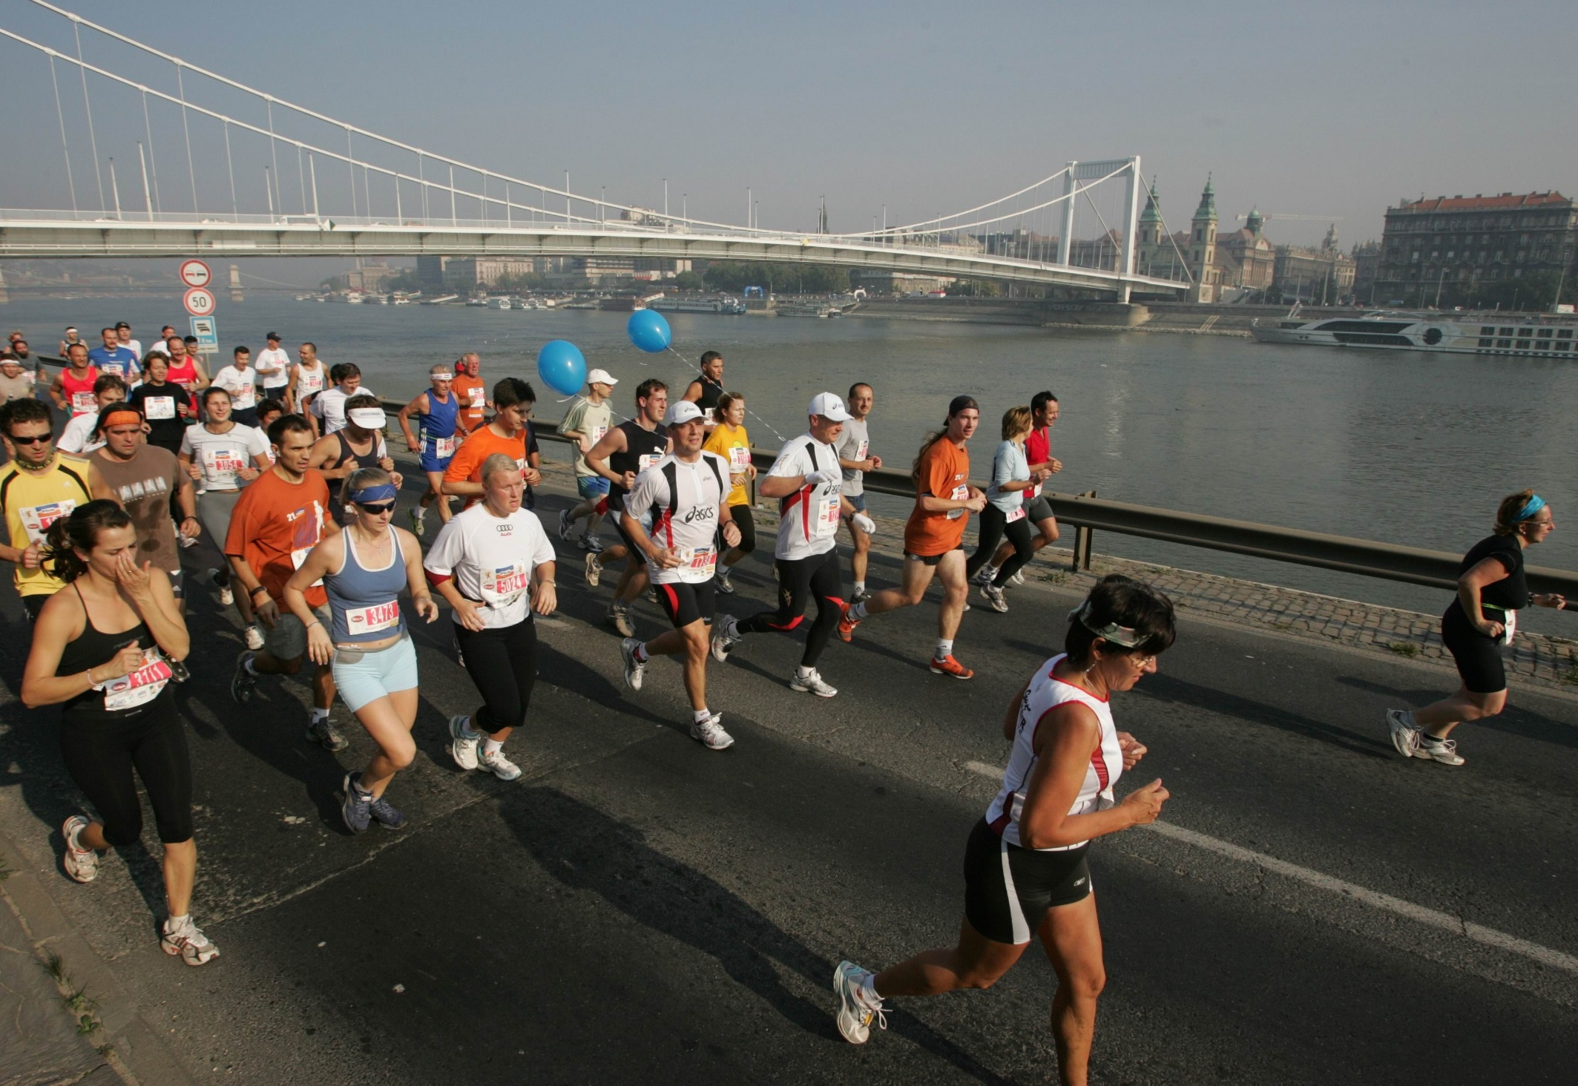
Pick Your Pace
I ain’t doin’ nothin’
I’ll do the bare minimum
I’ll go in, but not all in
GO FOR IT!

Slide 25
Final Score: Around 4 to 9% in play
Max
Negative
Zero Adjustment
Positive Adjustment
Max Adjustment
0
100
Performance Threshold

Slide 26
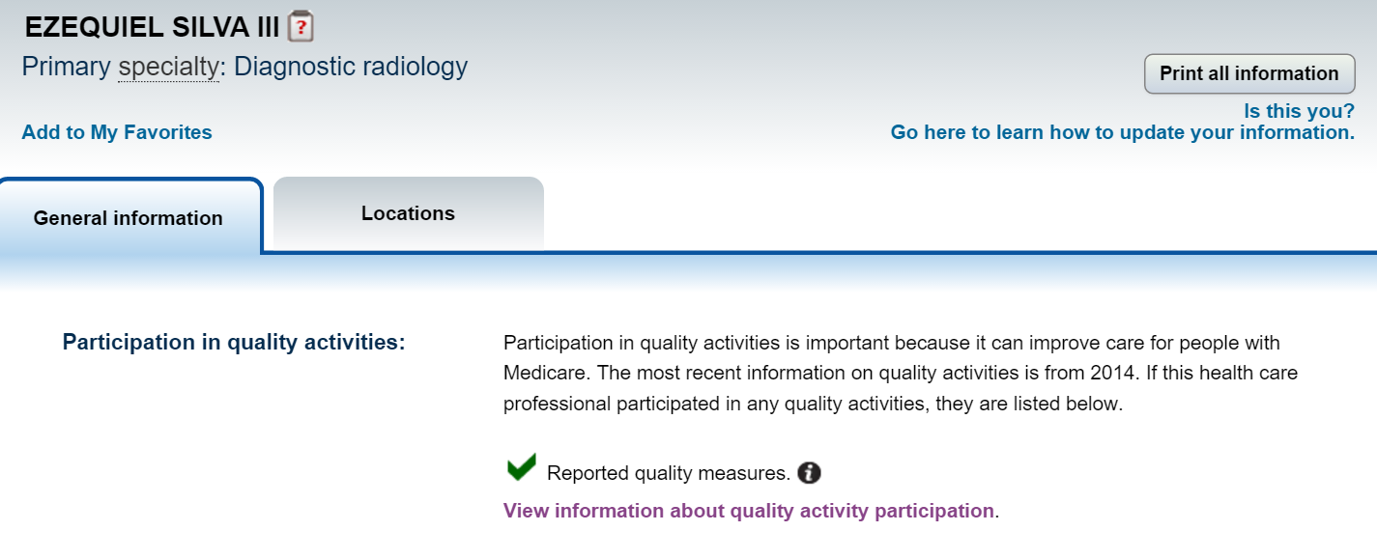
Reported quality measures.

Slide 27
Topic #4
MACRA deeper dive

Slide 28
Performance Categories
Quality
Quality
Cost
Advancing Care Information
Improvement Activities

Slide 29
6
1
50%
MEASURES
OUTCOME (PRIORITY) MEASURE
THRESHOLD

Slide 30
Claim
Based
Registry
Based
vs.

Slide 31
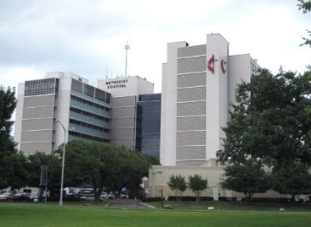
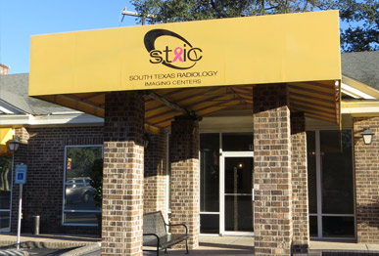
QCDR
145
195
359
360
362
363
364
405
406
Claims
145
195
405
406
436
ACRad 18
ACRad 19
ACRad 20
ACRad 21
ACRad 22
ACRad 23
QCDR
195
359
360
362
363
364
405
406
Claims
195
405
406
436
ACRad 9
ACRad 10
ACRad 11
ACRad 12
ACRad 13
ACRad 14
ACRad 15
ACRad 16
ACRad 17
ACRad 9
ACRad 10
ACRad 11
ACRad 12
ACRad 13
ACRad 14
ACRad 15
ACRad 16
ACRad 17
ACRad 18
ACRad 19
ACRad 20
ACRad 21
ACRad 22
ACRad 23
TIN/NPI #1
TIN/NPI #2
Thank you: Greg Nicola, MD

Slide 32
Performance Categories
Improvement Activities
Quality
Cost
Advancing Care Information
Improvement Activities

Slide 33
2 MEDIUM WEIGHTED ACTIVITY
1 HIGH WEIGHTED ACTIVITY
or
Simple attestation

Slide 34
Implementation of improvements that contribute to more timely communication of test results
Use of QCDR data, for ongoing practice assessment and improvement in patient safety
Use of mammo reminder system
MOC

Slide 35
High or Medium Weight Measure?

Slide 36
R-SCAN
Care Coordination
Beneficiary Engagement
Reduction of unnecessary studies
Population Health Manageent
Patient Safety and Practice Assessment

Slide 37
Topic #5
Alternative payment models

Slide 38
Eligible APM Participants (MIPS Exempt)
PAYMENTS
2021
and
2022
2023
and
on
2019
and
2020

Slide 39
Payments for APMs
.75%
Annual Update*
5% of aggregate Part B payments
APM
bonus
each
year
* .25% for MIPS

Slide 40
Radiology Advanced APMs – Year 1
MEDICARE SHARED SAVINGS PROGRAM – TRACKS 2 AND 3
NEXT GENERATION ACO

Slide 41
Radiology Advanced APMs – Year 2
???
MEDICARE SHARED SAVINGS PROGRAM – TRACKS 2 AND 3
NEXT GENERATION ACO

Slide 45
Bundled Payments
Comprehensive Care for Joint Replacement Model (CJR)

Slide 47
DRG and Cost/Shares | DRG No. 470 | DRG No. 470 (1)
Cost Type | Imaging Share of Cost | Imaging Cost
Medicare | Part B | Part B
Year | 2013 | 2013
Mean | 1.39% | $39.86
1.39%
$39.86

Slide 48
Thank You!
Zeke Silva III, MD, FACR, FSIR, RCC
Chairman, ACR Commission on Economics
South Texas Radiology Group
University of Texas Health Science Center
San Antonio, TX
zekesilva3@gmail.com
@zekesilva3

