Slide 1
The National Lung Screening Trial: How Research Expands Radiologic Practice
Bruce J. Hillman, MD
University of Virginia Department of Radiology and Medical Imaging
December 2013

Slide 2
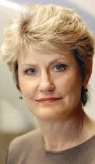
My thanks to Dr. Denise Aberle, Professor of Radiology, University of California Los Angeles, for her many insights as Principal Investigator of the NLST and for her collaboration in writing the manuscript* on which much of this lecture is based.
*Aberle and Hillman, International
Day of Radiology, 2013,
http://www.internationaldayofradiology.com/publications/. Pp. 65-84.

Slide 3
Research to Practice
The basics of screening
Observational studies of lung cancer screening
The National Lung Screening Trial
Why a randomized controlled trial?
The process and outcomes
What the NLST means to stakeholders
Research and clinical practice

Slide 4
Definition of Screening
Systematic population-based testing of individuals who are asymptomatic with respect to some target disease
Prevent, interrupt, or delay the development of advanced disease in individuals with a pre-clinical form of the target condition
Treatment for early disease must have better outcome than for later disease
Benefit to the population must outweigh the harm
- Methods Task Force of the ACR Committee on Screening Technologies

Slide 5
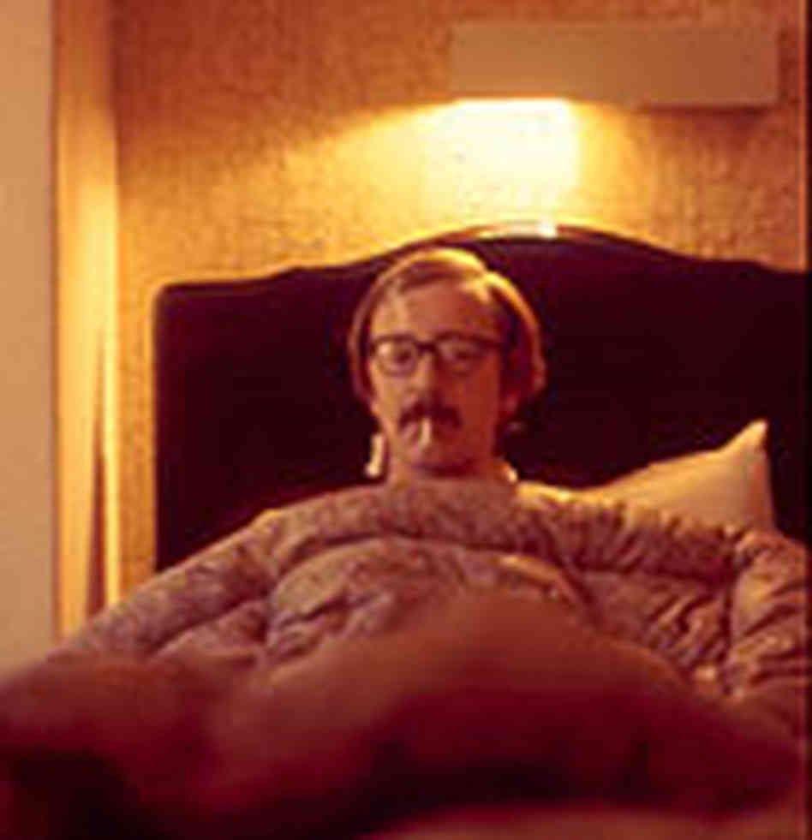
Factors Promoting Imaging Screening
Makes sense to “catch” disease early
Public demand – 87% say screening always good*
Public fear of key target conditions
Patients’ growing involvement in health care
Direct-to-patient advertising
The Internet
Striking anecdotes of screening success and positive media reports
Well publicized observational research reporting benefit
*Schwartz, JAMA 2004
The doc says he got it all
- Anonymous and ubiquitous

Slide 6
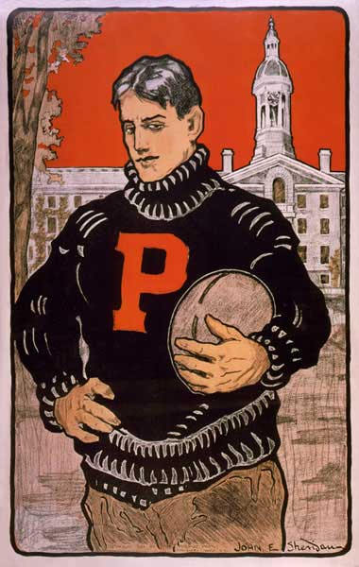
Screening is More Complicated
Three things can happen when you pass the football and two of them are bad
- Woody Hayes

Slide 7
Outcomes of Imaging Screening
True Negative – The individual is healthy and reassured
Improved quality of life
Benefit outweighs cost

Slide 8
Outcomes of Imaging Screening
False Negative – Incorrect assurance that a person with disease is healthy
False security
May ignore later signs and symptoms
Later diagnosis and treatment
Cost without benefit

Slide 9
Outcomes of Imaging Screening
False Positive – imaging identifies “disease” that does not exist
Follow-on diagnostic and therapeutic procedures
Inappropriate treatments
Associated morbidity, mortality, and cost
Screening, Dx, Rx is all cost; no benefit
Depending on the application:
- Individual or society pays screening costs
- Follow-on costs fall to society

Slide 10
Outcomes of Imaging Screening
True Positive – The individual has a finding that truly represents “disease”
Disease found earlier than if symptomatic and individual incurs less morbidity/mortality
Benefit outweighs cost

Slide 11
TPs that Produce no Benefit
Disease found earlier but no impact on health outcome
Incidentalomas
Pseudodisease (Overdiagnosis)
I: Slow growing disease
II: The patient dies of some other cause
III: Fast growing disease – the patient dies at the same time as he would if he had not undergone screening
Screening, Dx, Rx is all cost; no benefit

Slide 12
Lung Cancer as a Target for Screening
Most common cause (27%) of U.S. cancer death in both men and women
Identifiable high-risk population
Potentially amenable to early stage imaging detection
Up to 70% five year survival with surgical resection
Treatment at an early stage more effective than treatment at advanced stages
High sensitivity imaging screening test (CT) widely available

Slide 13
1960-1980 Screening Studies
Four RCTs employing CxR and/or sputum cytology
_________________
Increased survival*
BUT
No decrease in the death rate (mortality)
*Survival = average time from diagnosis to death
Mortality rate = deaths/thousand/year

Slide 14
1995-2002 Single Arm Studies of CT
Variety in:
Eligibility by risk
Imaging protocols
Threshold size to be considered positive
Results - 3X nodule detection and more early stage cancers by CT vs. historical controls but no change in the number of late stage cancers
Pseudodisease
Extended survival but mortality rate not testable

Slide 15
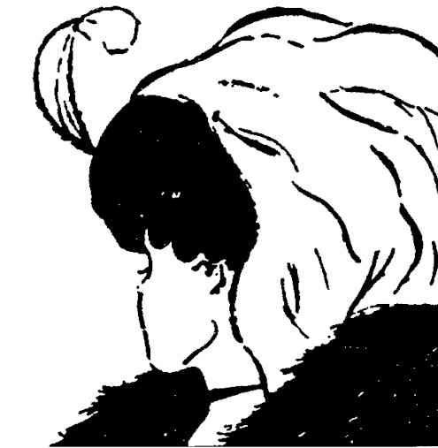
Biases of Survival as Screening Endpoint
All biases systematically make screening appear to work better than it actually does
Lead time bias
Length bias
Overdiagnosis
Optimism is the madness of insisting that all is well when we are miserable
- Voltaire

Slide 16
Lead Time Bias
onset
death
pre-clinical disease
signs/symptoms
survival
screen (+)

Slide 17
Length Bias
Rapidly Progressive Disease
screen
onset
death
Indolent Disease

Slide 18
Early Lung Cancer Action Project
International registry - Cases submitted by participating institutions
Led by Claudia Henschke, MD
Funded by grants from NCI, industry (GE), and tobacco companies
1999: Lancet article first of a number of I-ELCAP publications showing lengthened survival;
Modeled an 80% mortality benefit
Projected $6,000 per year of life saved
Other modeling unable to show similar outcomes*
* e.g. Bach, JAMA, 2003

Slide 19
ACRIN and the NLST
Need for a trial with endpoint = change in mortality
Randomized controlled trial
Lung cancer rare even in a high risk population
Large sample size
Sizable number of sites
Accomplished research team with varied expertise
Organizational and IT infrastructure to handle massive amounts of data
__________________
Very Expensive!

Slide 20
Serendipity
1999 – NCI intramural Lung Screening Study (LSS) showed proof of concept
March 2001 – ACRIN proposal for 7,000 subject study and LSS for 12,000 subjects presented to NCI Board of Scientific Advisors
What the organizations could afford
Both studies underpowered to show a reasonably expected mortality benefit
_______________
BSA: Do it right or do nothing at all!

Slide 21
Shotgun Wedding
November 2001 - BSA approved a joint ACRIN/LSS trial of 50,000 subjects powered for 18% mortality reduction
Expected cost: $200 million
Early stopping rules for strongly negative/positive results
Harmonized imaging, interpretation, and follow-up
ACRIN to additionally gather data on:
Cost
Effect on smoking cessation
Quality of life
Specimen (blood, sputum, urine) archive on 10,000 subjects for future biomarker research

Slide 22
The Principals
NLST Executive Committee co-chaired by
ACRIN PI: Denise Aberle, MD
LSS PI: John Gohagen, PhD; later Christine Berg, PhD
32 accrual sites
A cadre of expert physicians, physicists, economists, sociometricians
A dedicated organizational and technical infrastructure
NCI Oversight Committee chaired by BSA Chair, Robert Young, MD
Regular meetings and reporting to NCI Director

Slide 23
NLST Protocol – The Basics
Eligibility:
Asymptomatic for lung cancer
55-74 years of age
>30 pack years smoking history
Still smoking or quit< 15 years previously
Randomization on accrual to:
3 years annual CT and 7 years follow-up; or
3 years annual CxR and 7 years follow-up
Positive scan: non-calcified nodule of 4mm or more

Slide 24
Why Chest Radiography as the Control?
Previous trials had shown no benefit
BUT
Many physicians still ordering annual CxR for smokers
AND
Concerns that potential subjects might decline to participate if offered nothing
AND
Powerful pro-screening interests attacking the trial as unnecessary and unethical

Slide 25
Politics
Henschke claimed that I-ELCAP had “proven” the value of screening – NLST “unethical”
The Lung Cancer Alliance, unsuccessfully petitioned to stop the trial:
NIH Director, Elias Zerhouni
NCI Director, Andrew von Eschenbach
Anonymous tip accusing ACRIN PI of bias based on court testimony on behalf of tobacco interests
Congressional investigation but no sanctions

Slide 26
The Outcomes
53,454 subjects enrolled in 18 months
Trial closed 4 months ahead of schedule
Gender and ethnic distribution similar to US smokers
>90% of subjects with nodules received f/u care
24.2% of CTs (39% on initial screen)
6.9% of CXRs
CT vs CxR
2X Stage 1A cancers
1/3 the number of interval cancers
Fewer Stage 4 cancers
___________________
20% lung cancer-specific mortality reduction
6.7% all causes mortality reduction

Slide 27
The Denouement
2011 – Primary result of NLST published in NEJM
2011-2013 – Imaging providers plan for and some initiate lung cancer screening programs
Lahey Clinic experiments with free screening*
*Wald, JACR, 2013

Slide 28
The Denouement
2004 – U.S. Preventative Services Task Force denies the value of CT lung cancer screening based on single-arm trials
August 2013 – Based on NLST, USPTF categorizes CT lung cancer screening as a grade ‘B’ technology
Insurers to pay for the screening exam*
Applicable to:
55-74 years old
>30 pack years smoking
Still smoking or quit within the last 15 years
*PPACA mandates CMS and private payers pay for USPSTF grades A and B procedures without cost sharing

Slide 29
Key Concerns for Future Research
False positives
Improve risk stratification
Change definition of positive to 5mm
Watchful waiting on less concerning nodules
Pseudodisease
Molecular methods to better determine which lesions need treatment
Value and cost of a national screening program
Cost-effectiveness analysis due soon
Tens of billions of dollars in added public and private costs

Slide 30
Ad Astra per Aspira
11 years from conceptualization to publication
Secondary aims published over time
@ $250 million
Difficulties overcome
Scientific
Ethical
Political
Financial
Students achieving Oneness will move on to Twoness
- Woody Allen

Slide 31
Ad Astra per Aspira
The ups and downs of a lifetime…but worth it!
The winners
Asymptomatic individuals at high risk for lung cancer
ACRIN
NIH and NCI
The leaders of the trial
Radiologists
Expansion of clinical services
Screening plus downstream imaging
Opportunity to collaborate with pulmonologists and surgeons to develop and operate a CT lung cancer screening service
Validation of radiology as an intellectually legitimate and inquiring specialty based on evidence development

Slide 32
The NLST as Metaphor
Typifies how research has advanced radiologic practice over the past four decades
Dramatic imaging innovations paired with IT and connectivity technologies
US
CT
MRI
PET
Image-guided interventions
Continuous improvement in temporal, spatial, and contrast resolution leading to new clinical capabilities

Slide 33
Additional Recent Examples
National Oncologic PET Registry (NOPR)
Collaboration with CMS under coverage with evidence development (CED) program
Sponsored by a coalition of societies
Administered by ACRIN
Therapeutic impact of PET interpretation on cancer care
PET interpretation changed a third of treatment plans
_________________
Broad expansion of PET coverage for
nearly all cancers and applications

Slide 34
Additional Recent Examples
Digital Mammographic Imaging Screening Trial (DMIST)
ACRIN screening trial
50,000 women with paired film-screen and full-field digital mammography
FFDM equivalent overall and superior for:
Dense breasts
Peri-menopausal women
______________
FDA down-classification of FFDM
CMS decision to pay extra for FFDM
Nearly complete U.S. replacement of FS with FFDM

Slide 35
Additional Recent Examples
National CT Colonography Trial
ACRIN screening trial
CTC equivalent to colonoscopy
________________
CMS denied initial submission (2010) for coverage
Sample not representative of Medicare enrollees
Additional analysis ongoing

Slide 36
The Value of Research to Practice
The 40-year transition of radiology from a medical backwater to a premier specialty is almost entirely attributable to continuous innovation
The engine of innovation is research
Radiologists’ future success depends on continued research leading to important innovation
The scientist does not study nature because it is useful. He studies it because he delights in it, and he delights in it because it is beautiful
- Henri Poincare

Slide 37
The Challenges to Research
The next decade presents critical challenges
An antagonistic environment bent on cost-reduction
Industry leery of investing in developing new products
Declining grant moneys
Tightening academic department budgets
The folding of ACRIN into ECOG-ACRIN

Slide 38
The Challenges to Research
Rank and file radiologists’ views about the value of research
Consistently rated among the least valued of all ACR activities in ACR member surveys
Research is the funny old uncle of radiology who the family mostly keeps hidden. We trot him out for family reunions and sit him in a corner where people can stop by and visit if they want
- Charles Putman, MD

Slide 39
The Challenges to Research
Commonly heard biases:
Researchers don’t work as hard as clinicians
When researchers must access equipment after hours or its grants submission time, work hours are longer and harder
Researchers’ work is less stressful
Stressful?…try to keep your grants going with falling federal funding and your livelihood on the line
Researchers get paid too much for what they do
Consider the demand for trained, potentially fundable researchers in elite academic departments, industry, and on Wall Street
Too much of clinician-generated revenue is used to support researchers
Every department needs to decide whether it wishes to be in ‘the game’ – it costs departments 25 cents for every extramural dollar
I don’t get any benefit from what they do
Enhanced reputation from research achievement is essential to compete for outstanding new faculty, fellows, and residents

Slide 40
…But Most of All
If all the biases were true, why wouldn’t
everybody choose to be a researcher?

Slide 41
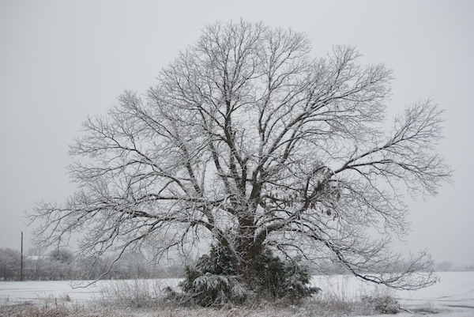
Research is a ‘Good” of the Specialty
Individuals and organizations must spread recognition that without research leading to innovation, the specialty will enter a ‘nuclear winter’ that it will not long survive
Riches do not so much exhilarate us by their possession as they torment us with their loss
- Epicurus

Slide 42
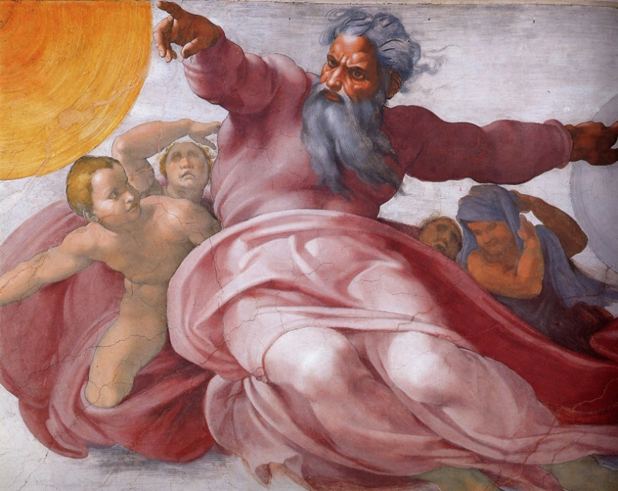
Research is a ‘Good’ of the Specialty
Recast research as ‘economics’ and ‘government relations’
with the understanding that no successes in these areas are possible without the supporting data from research
In God we trust. All others bring data

Slide 43
Research is a ‘Good’ of the Specialty
All radiologists should:
Recognize, appreciate, and support research
Realize that both excellent clinicians and competitive researchers are essential to a successful department
Bow their necks, get to work, and stop carping
Learn to critically read the research literature
Teach others
Mentor young researchers
Attend research sessions at major meetings
Participate in multi-center clinical trials trial
ECOG-ACRIN
Industry
Contribute 1% of income to an organizational research fund*
* William Thorwarth, Private practice radiologist; RSNA Board of Directors; ACR Past President

Slide 44
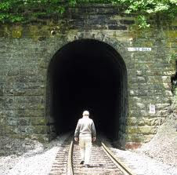
Everyone has talent. What is rare is the courage to follow that talent to the dark places where it leads
- Erica Jong

