Slide 1
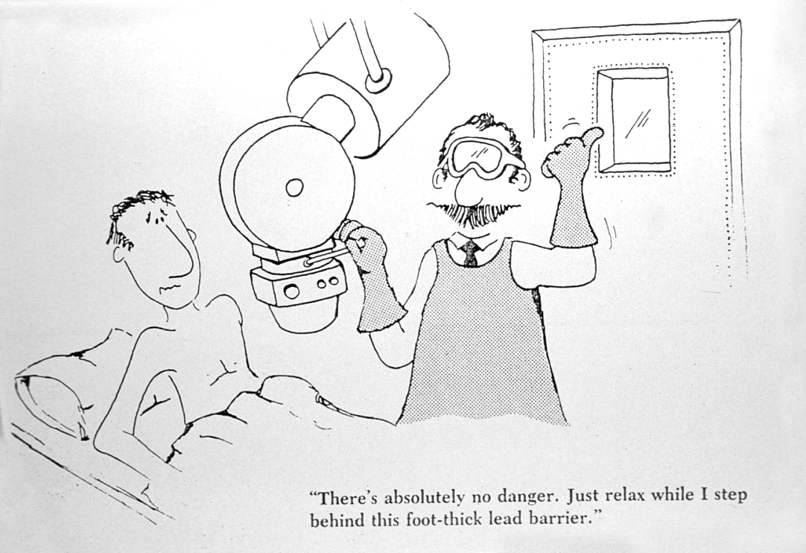
Interventional Radiology “Doses”
Walter Huda PhD
Radiology and Radiological Science

Slide 2
Financial Disclosures
Research Support (Siemens)
Consultant/Contractor (Siemens)
Book Royalties (LWW, MPP)
President (Huda Physics in Medicine)

Slide 3
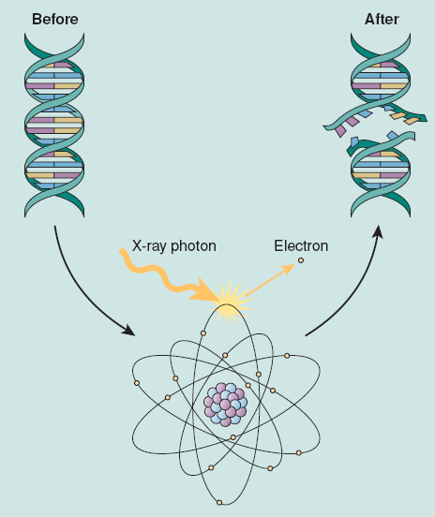
Cell Death & Carcinogenesis

Slide 4
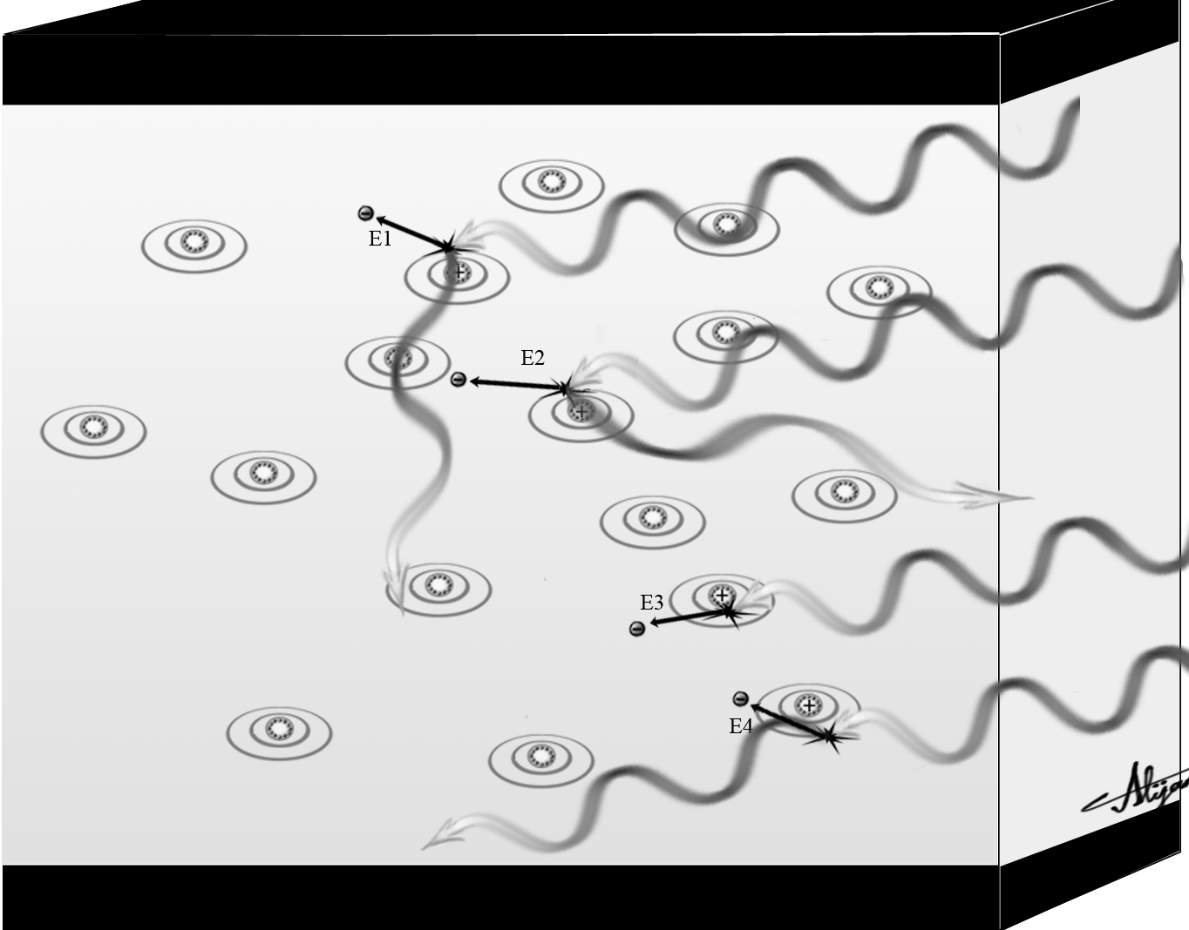

Energy transferred to electrons E
Mass of air M
Air Kerma = E/M

Slide 5
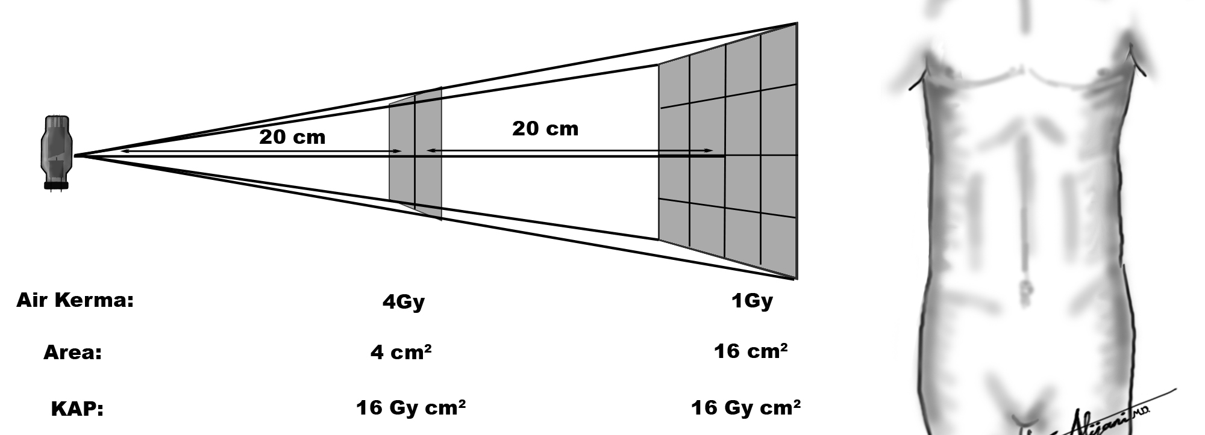
Air Kerma ⇒ Skin Dose ⇒ “Burn”
Kerma Area Product ⇒ “Cancer Risk”

Slide 6
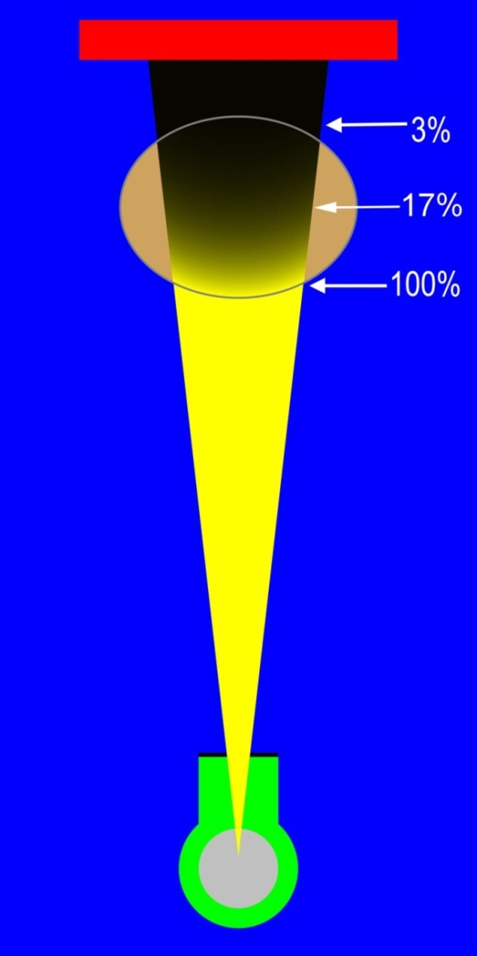
Skin Doses
One half dose delivered
first 3-5 cm of tissue
Why entrance skin dose
important in IR

Slide 7
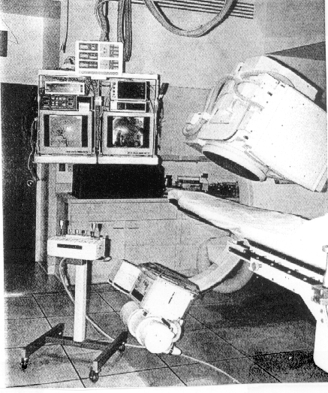
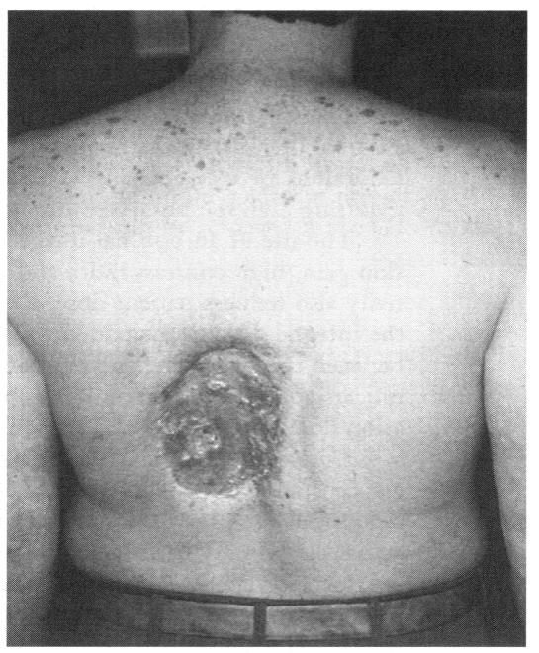
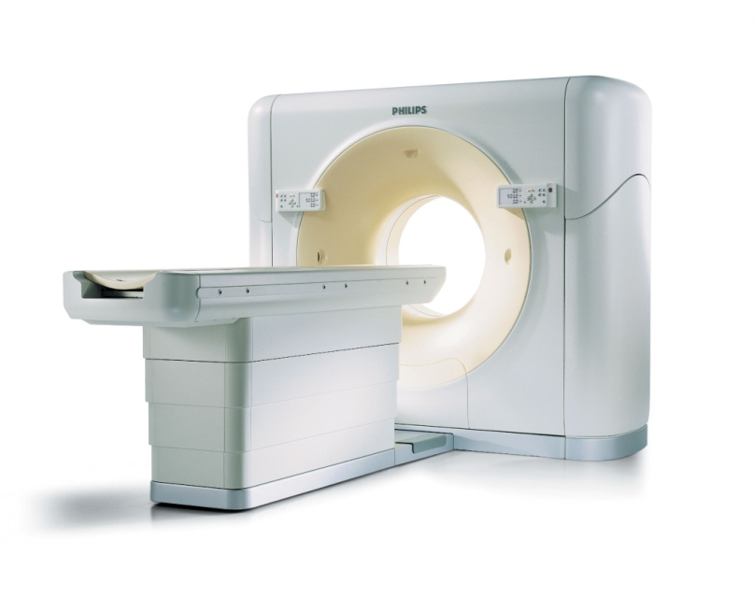
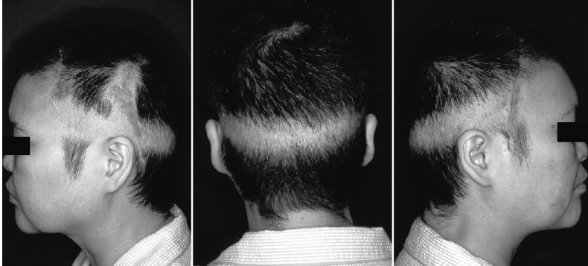
Harmful Tissue Reactions

Slide 8
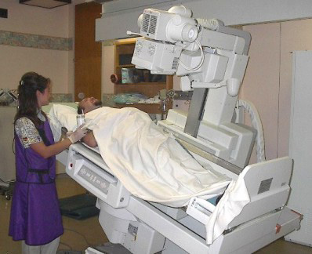
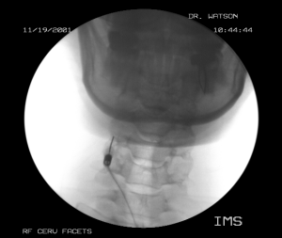
Fluoroscopy skin doses
EAK rate ~ 10 mGy/min
↑ 3 to 4 cm of tissue; ↑ 100% dose

Slide 9
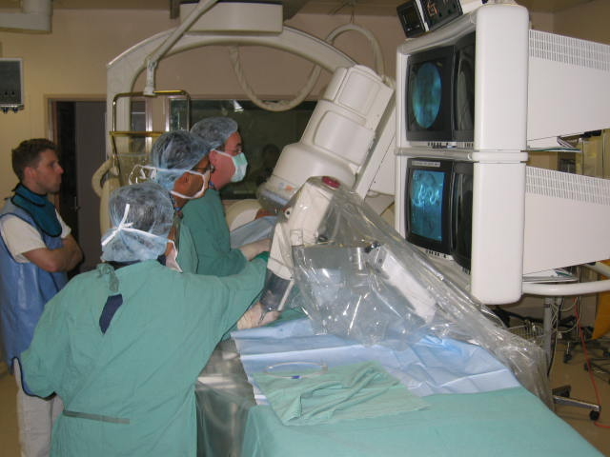
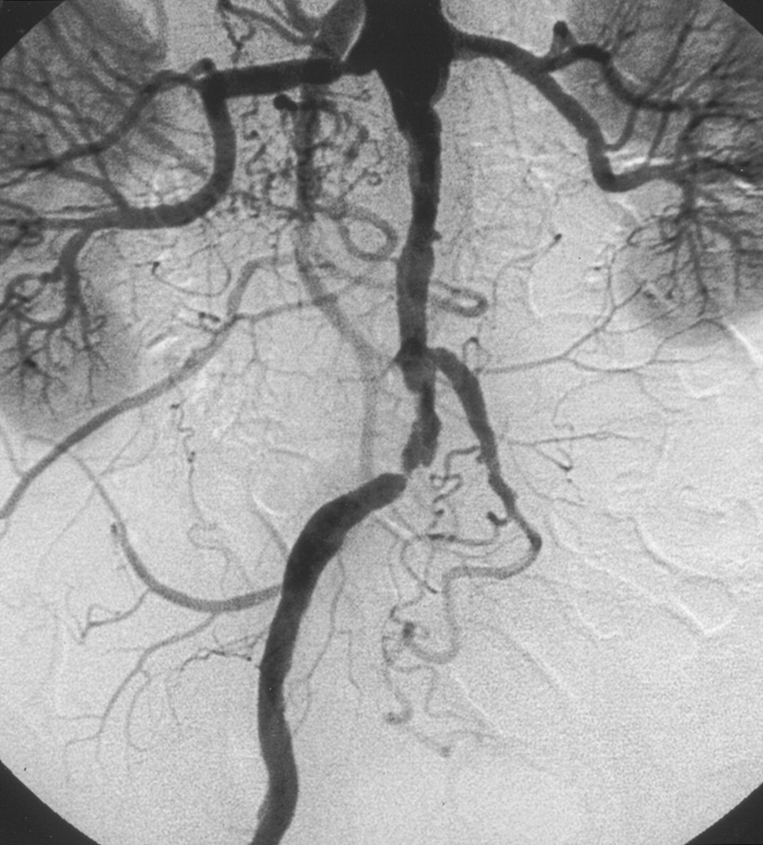
Digital Photospot
EAK ~ 3 mGy / film
↑ Electronic Magnification

Slide 10
Typical Skin Doses
6 frames per second (5 sec)
10 runs ⇒ Skin Dose 650 mGy
35 min Fluoro ⇒ 350 mGy
Total Skin Dose ~ 1 Gy
(1/3rd Fluoroscopy + 2/3rd DSA)

Slide 11
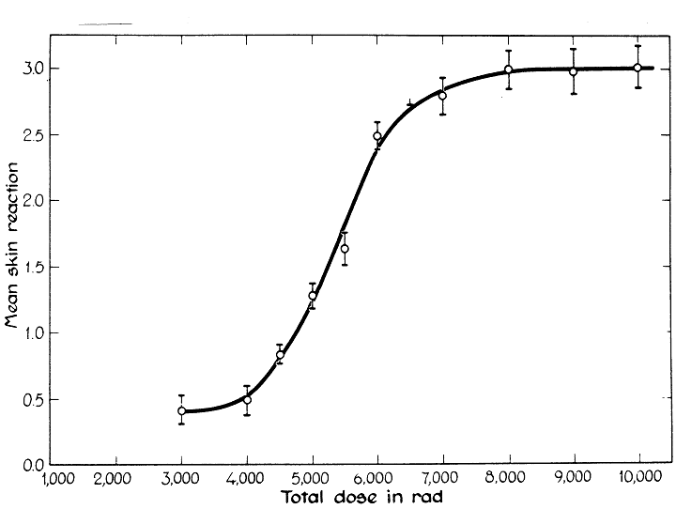
Threshold Dose ~ 2,000 mGy
Probability
Dose (Gy)

Slide 12
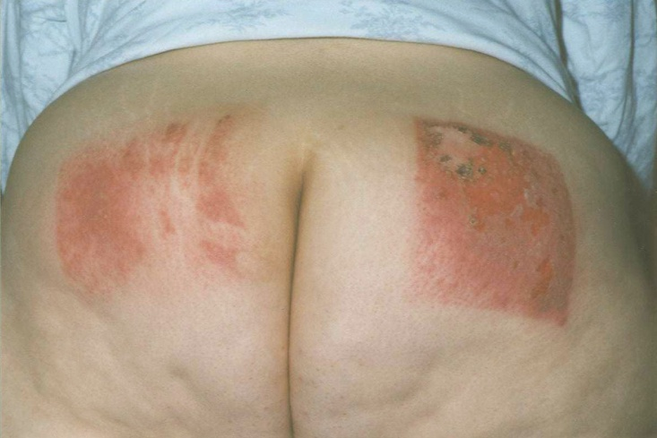
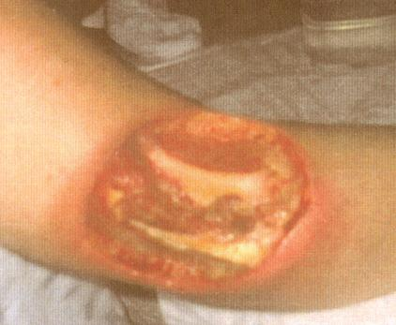
Erythema
~ 5 Gy
Moist Desquamation
~ 10 Gy
Dry Desquamation
~ 15 Gy

Slide 13
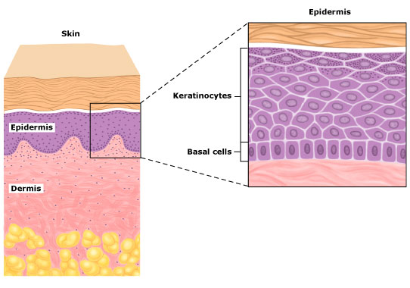
Radiation burns appear
~ 10 days after radiation exposure

Slide 14
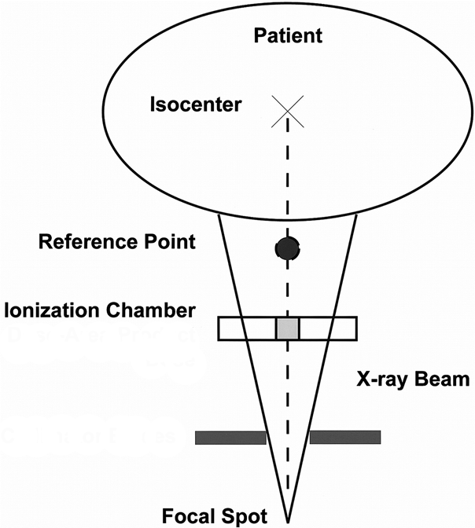
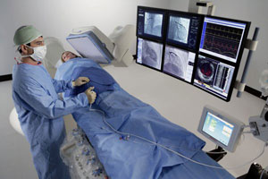
Interventional Reference Point (IRP)
15 cm
Cumulative Dose (Gy)

Slide 15
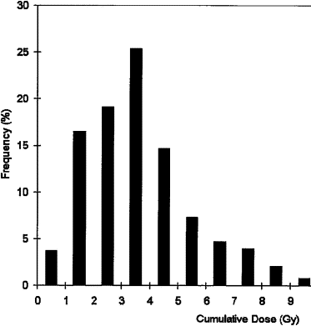
IR Cumulative (IRP) Doses
Dose Operator “Sees”

Slide 16
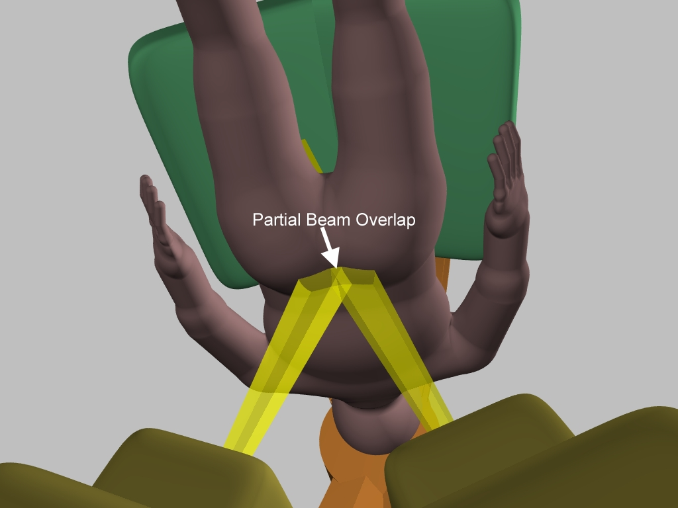
Dose Index [DI] = Peak Skin Dose/IRP
Peak Skin Dose

Slide 17
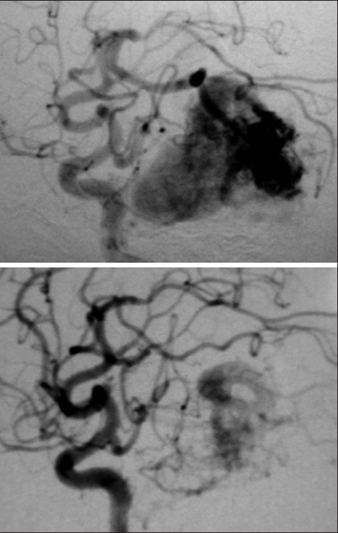
Head Neuro-Embolization
356 Patients
Average_{Peak Skin Dose} 2 Gy [Range 0.002 to 6.7 Gy]
Average_{Dose Index} 0.5
[Range 0.05 to 1.7]

Slide 18
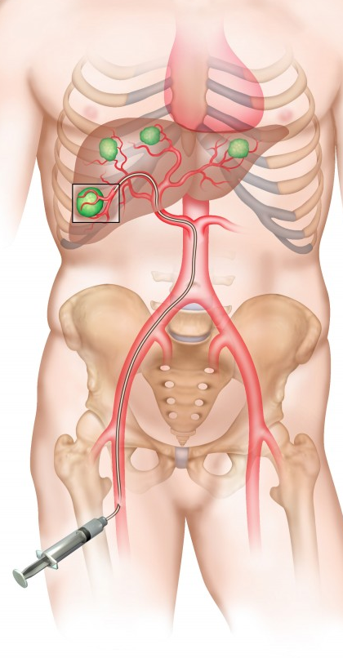
Hepatic Embolization
26 Patients
Average_{Peak Skin Dose} 1.4 Gy [Range 0.07 to 5.5 Gy]
Average_{Dose Index} 1.0
[Range 0.6 to 1.2]

Slide 19
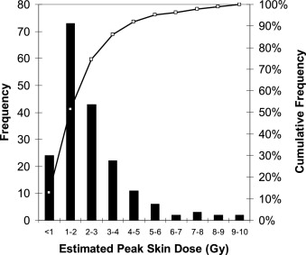

Slide 20
IRP (Skin Dose)
IRP (Total Skin Dose)
Skin Dose ~ IRP Dose
Conservative/Best Option

Slide 21
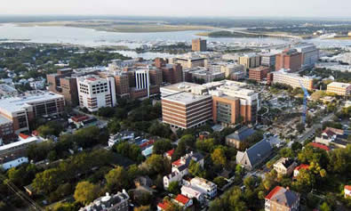
MUSC
Policy Principle
IR Patients
< 2 Gy ⇒ “No Action”
> 2 Gy ⇒ “Warn Patient”
> 5 Gy ⇒ “Physics Review”
+ “Contact Patient”

Slide 22
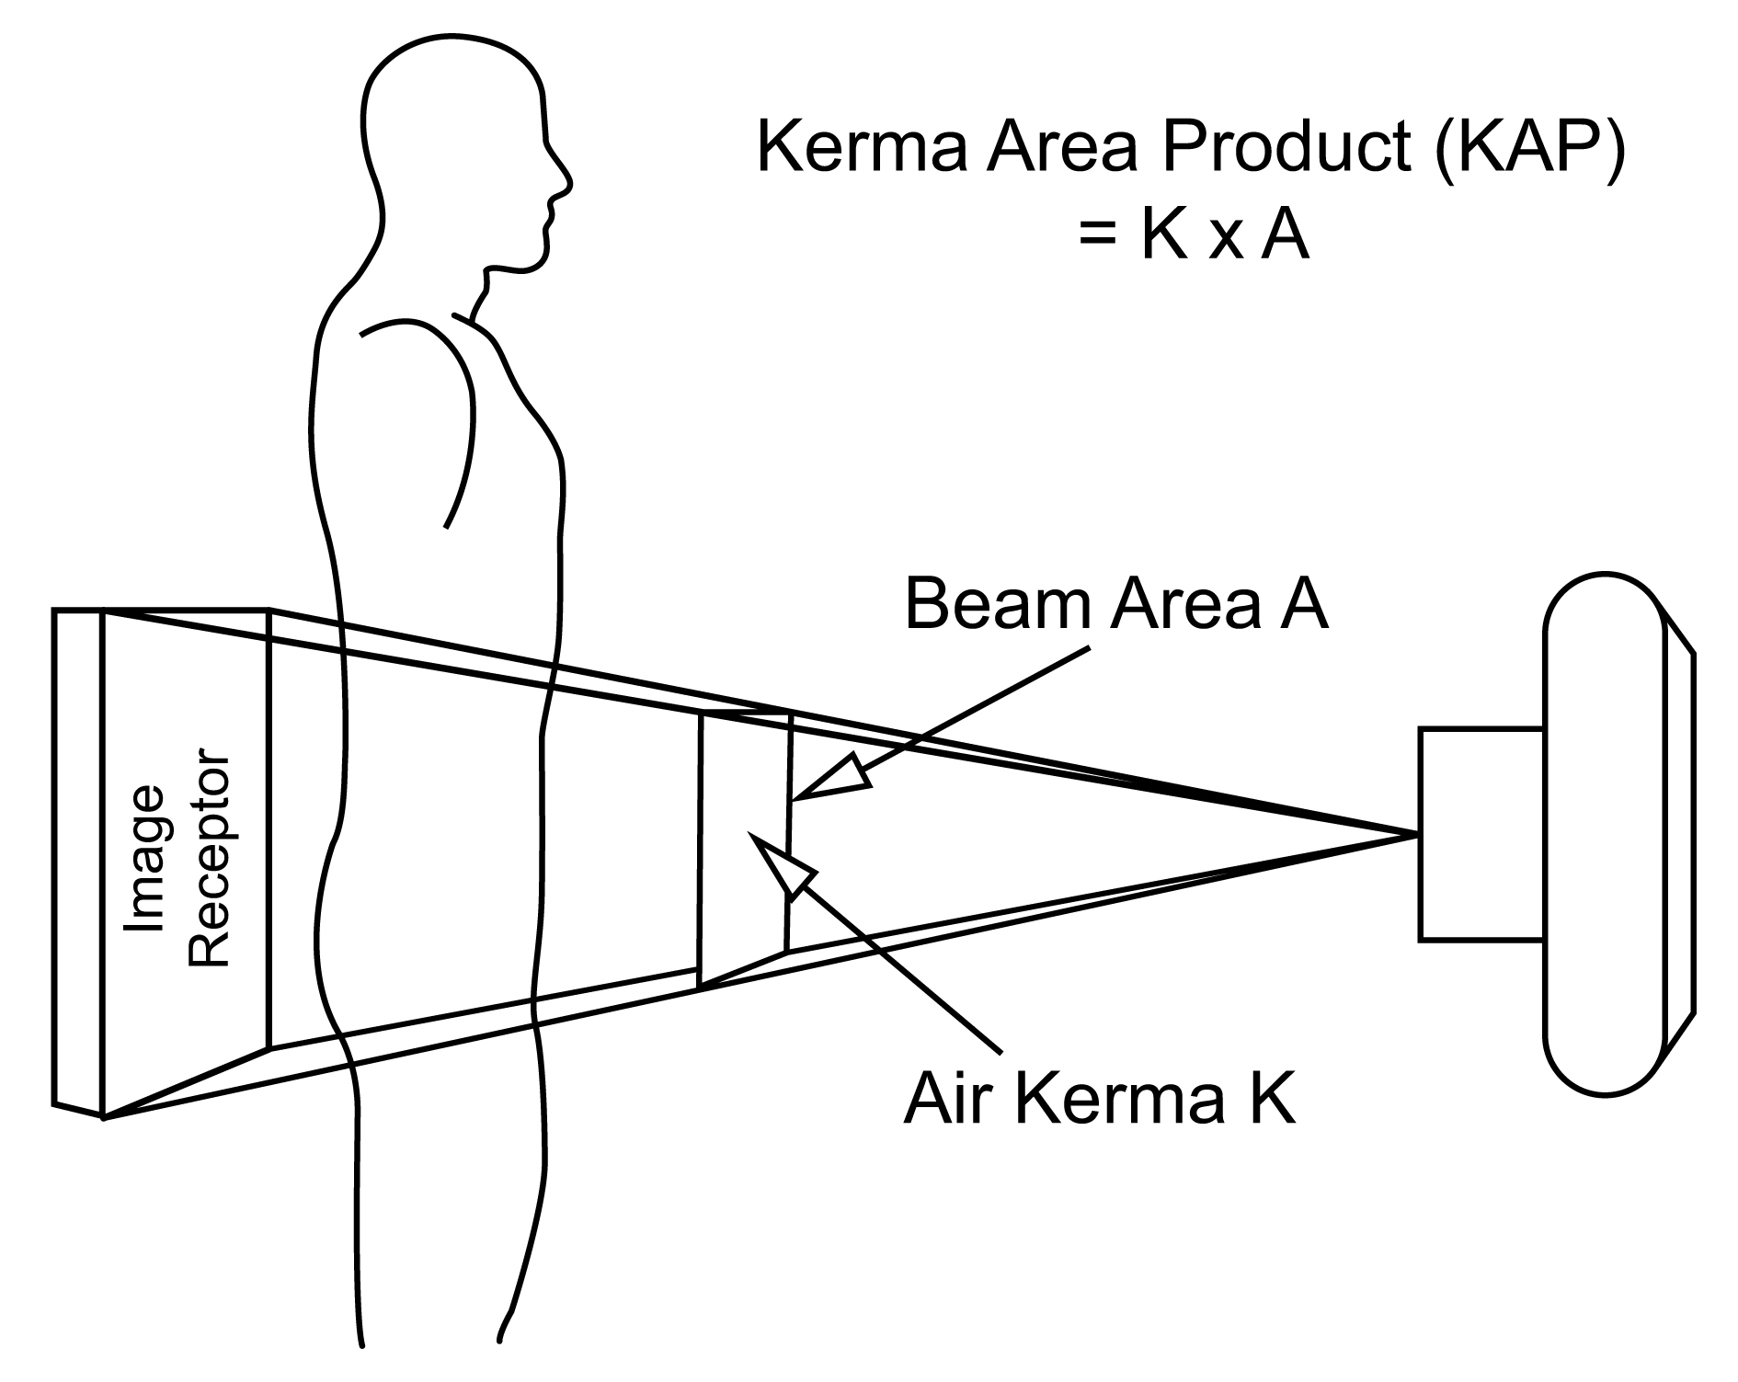
AKA Dose Area Product (DAP)

Slide 23
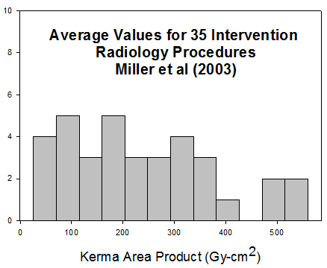
~ 60 per category
Total # ~ 2,000

Slide 24
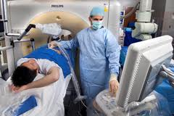
Low of 26 Gy-cm²
(Nephrostomy Obstruction)
High of 560 Gy-cm²
(Spine AVM Embolization)

Slide 25
Average KAP
~ 340 Gy-cm²
177 head
AVM embolization
Low ⇒ 4 Gy-cm²
High ⇒ 1,350 Gy-cm²

Slide 26
25th %
~ 100 Gy-cm²
Mean Patient KAP
~ 200 Gy-cm²
75th %
~ 300 Gy-cm²

Slide 27
100 µGy-m² = 1 Gy-cm²
Exam Protocol

Slide 28
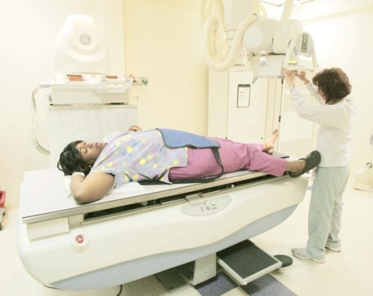
Kerma Area Product (Gy-cm²)
Body Region/Projection
+Patient Size

Slide 29
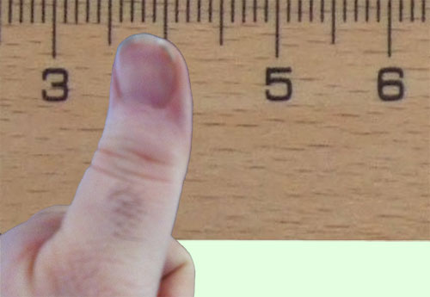
Converting KAP
Effective Dose (ED)
ED = 0.1 mSv / Gy-cm²

Slide 30
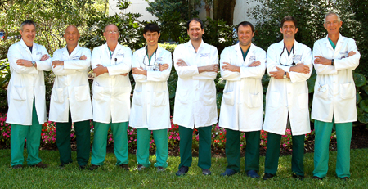
IR Effective Doses ~ 10 to 30 mSv

Slide 31
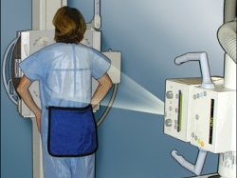
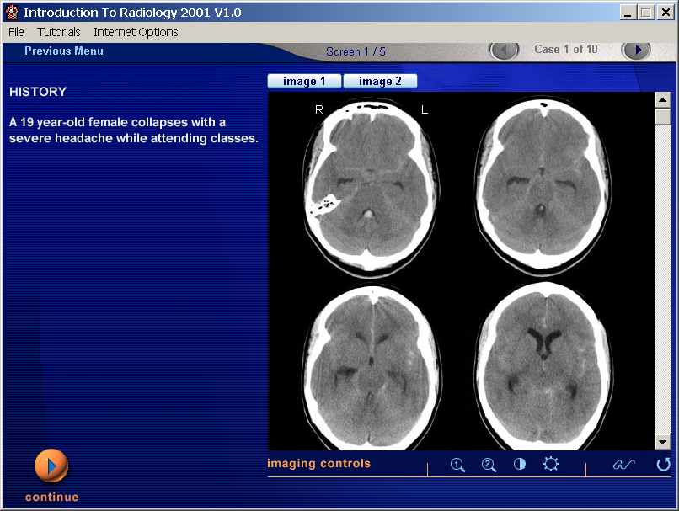
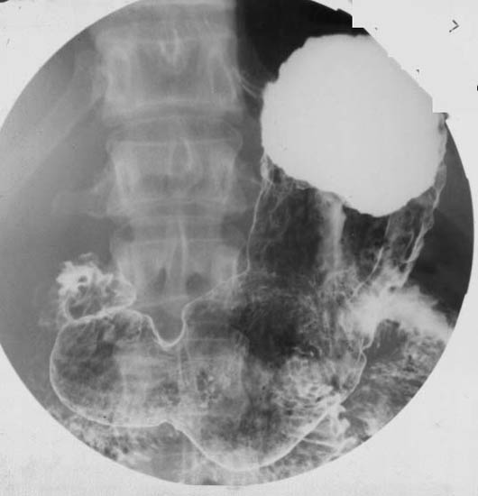
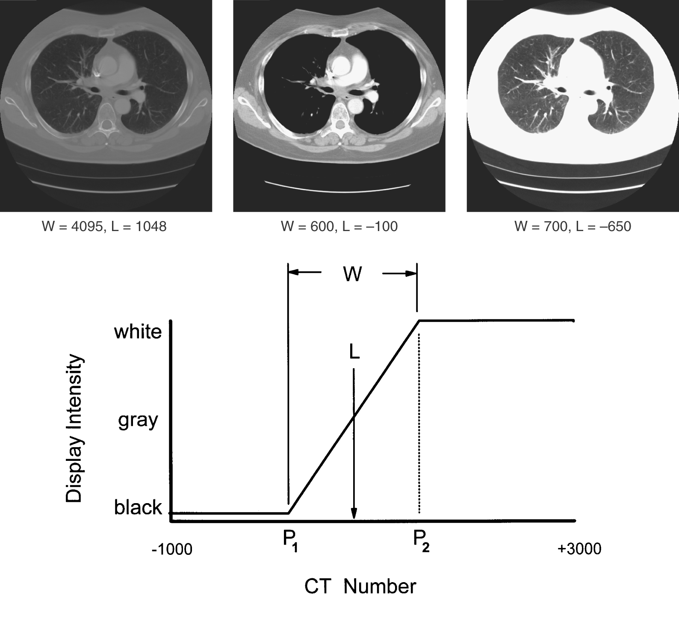
Typical ED’s in Radiology
Body x-ray
~ 0.2 mSv
Head CT
~ 2 mSv
Barium Meal
~ 5 mSv
Chest CT
~ 6 mSv

Slide 32
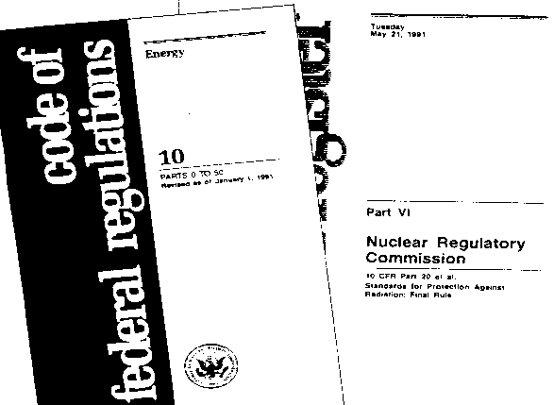
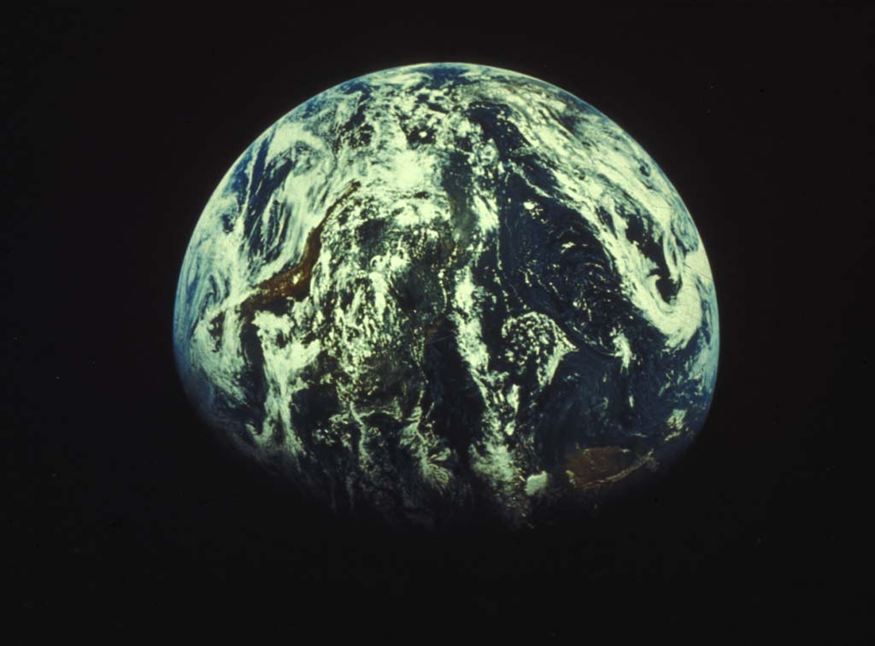
Occupational: Legal Limit
50 mSv / yr
Occupational: Typical
~ 5 mSv / yr
Natural Background
~ 3 mSv / yr

Slide 33
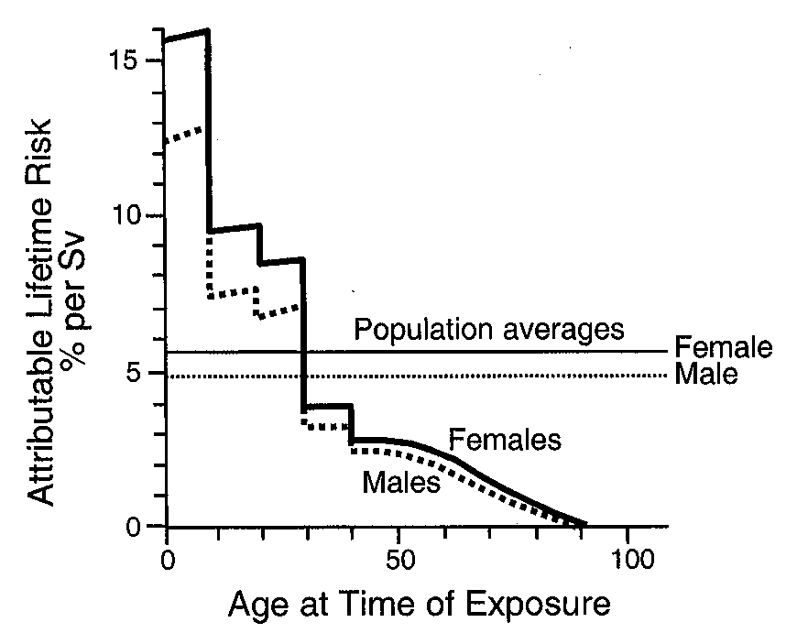
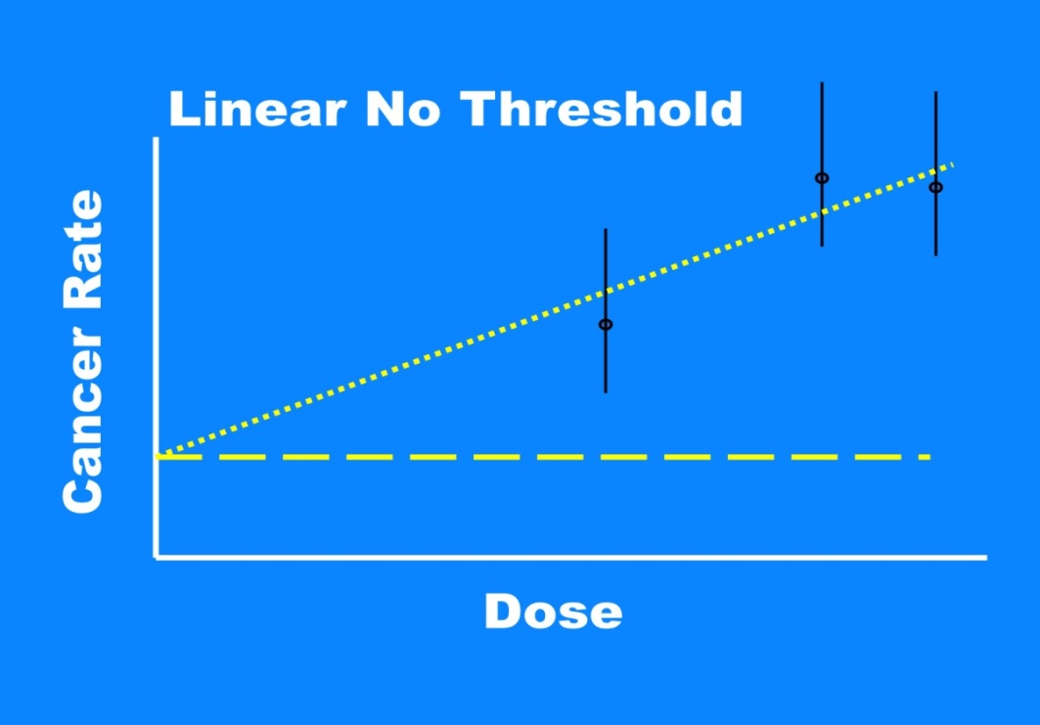
Cancer Risk (in Radiology) Uncertain
Depend on Dose, Sex and Age
10 mSv (30 year old) ~ 0.1%

Slide 34
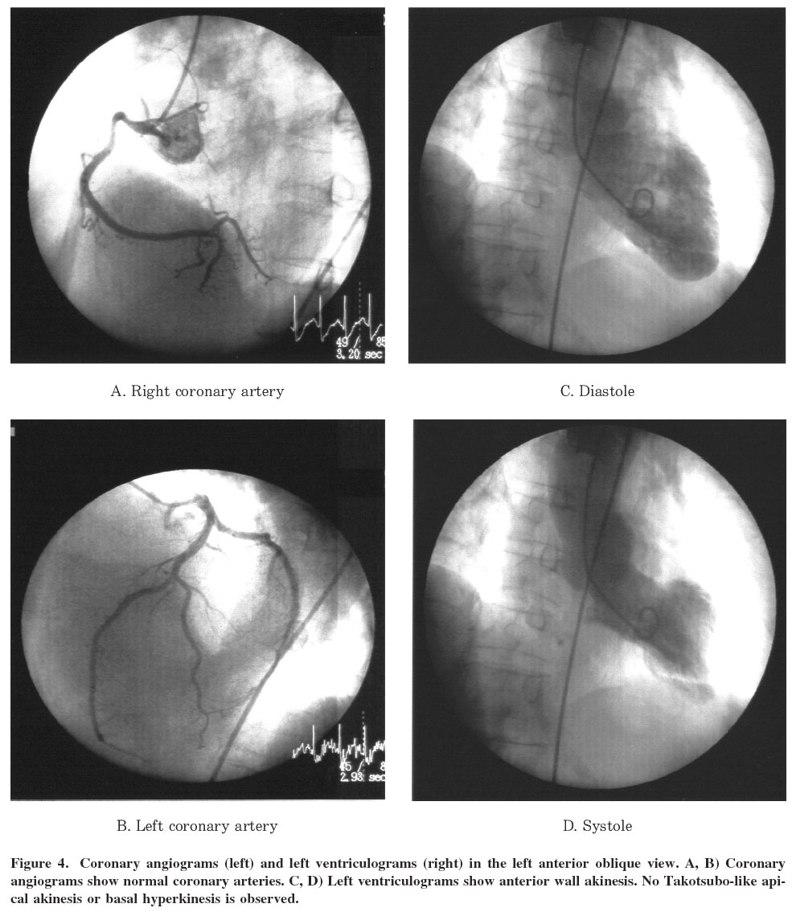
No maximum for “diagnostic imaging”

Slide 35

huda@musc.edu

