Slide 1

ADVOCACY IN RADIOLOGY
Eastern Radiological Society
Charleston, SC
April 10, 2014
Howard B. Fleishon, MD, FACR, MMM
hbf@cox.net
Vice Chair, Government Relations Commission
American College of Radiology

Slide 2
Disclosure
Howard B. Fleishon, MD does not have any financial interests in relation to this activity.

Slide 3
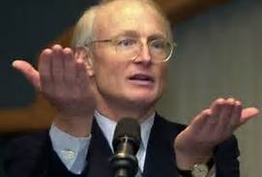


Slide 4
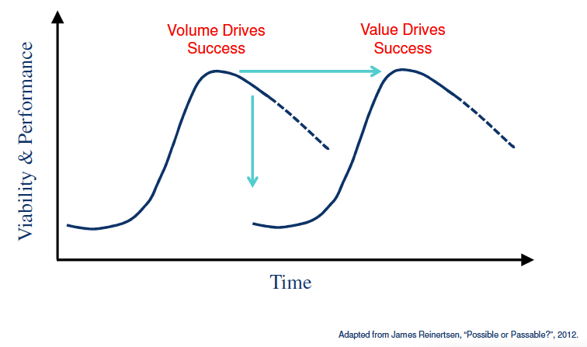
Imaging 2.0
Imaging 3.0

Slide 5
Definitions
The word “advocate” comes from the Latin “ad, to + vocare, to call.”
Lobbying: activity which is focused on specific legislation. Well defined rules and regulations.
  Direct lobbying
  Grassroots or indirect lobbying
  Call to Action

Slide 6
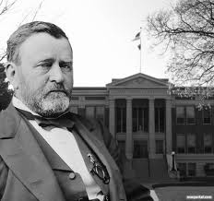

Slide 7
Early Lobbying in America
As early as 1792, William Hull was hired by the Virginia veterans of the Continental army to lobby for additional compensation for their war services. Hull wrote to other veterans' groups, recommending that they have their "agent or agents" cooperate with him during the next session to pass a compensation bill.

Slide 8
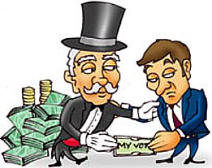

Slide 9
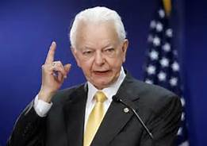
“We could not adequately consider our work load without them. We listen to representatives from the broadest number of groups: large and small; single-issue and multi-purposed; citizens groups; corporate and labor representatives; the public spirited and the privately inspired. They all have a service to fulfill.”
Senator Robert C. Byrd
Sept. 28, 1987

Slide 10
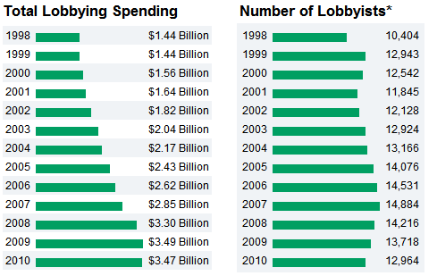
Growth of Lobbying Industry

Slide 11
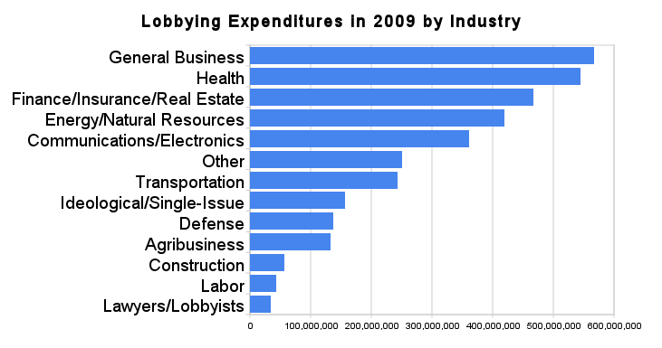

Slide 12
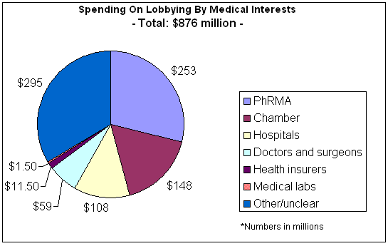

Slide 13
Value of Lobbying
Strategas demonstrated that large corporations with disproportionate investments in lobbying outperformed the S&P index by an average of 11% from 2001 to 2011
Bloomberg News (2006): lobbying was a "sound … strategy" for the 20 largest federal contractors. ROI up to 2,517%
2011 meta-analysis of previous research found a positive correlation between corporate political activity and firm performance.

Slide 14
Physicians as Lobbyists
90% of legislative assistants rated physicians either effective or somewhat effective lobbyists.
The most common suggestions were to focus less on reimbursement and to address a broader range of health care issues.
Landers SH, Sehgal AR. How do physicians lobby their members of Congress? Arch Intern Med. 2000 Nov 27;160(21):3248-51.

Slide 15
ACR Government Relations
ACR is recognized by congressional representatives and industry as the largest and most influential advocacy organization for the profession.
The ACR maintains 11 full time staff and engages consultants for advocacy.
Other organizations in Radiology defer to the ACR for advocacy.

Slide 16
Other Radiology Advocacy Organizations
Medical Imaging and Technical Alliance (MITA)
E-ordering Coalition
ASTRO
Access to Medical Imaging Coalition (AMIC)
Society of Interventional Radiologists
Academy of Radiology Research.

Slide 17
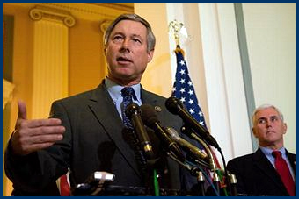

Slide 18
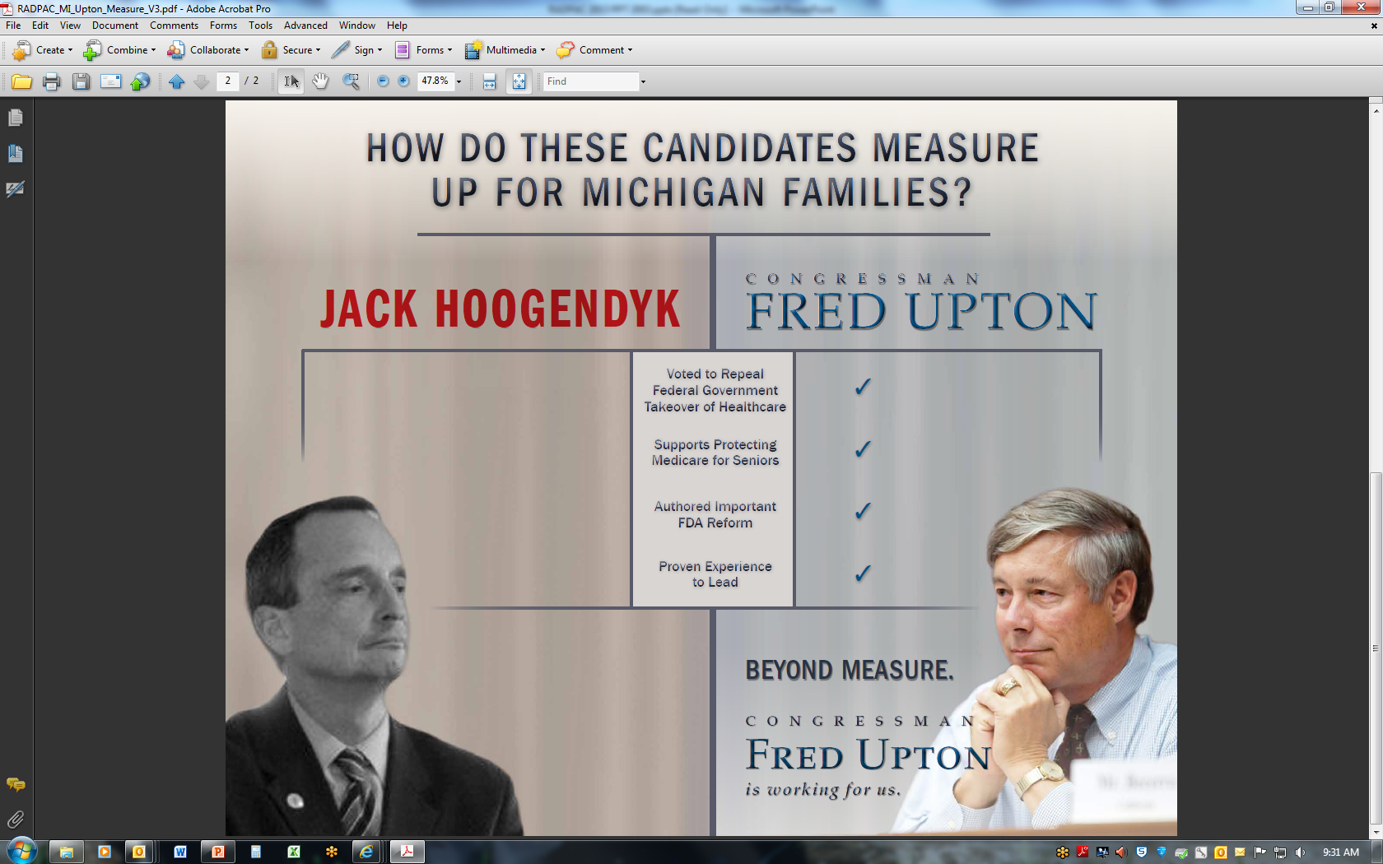
2012 Independent Expenditures

Slide 19
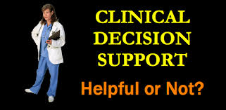

Slide 20
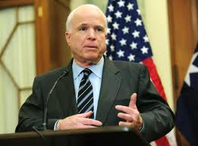

Slide 21
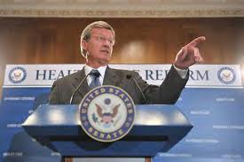

Slide 22
Recent Events
SGR reform bill was passed by House with attachment to repeal ACA “Individual Mandate”
3/27/2014: HR 4302: “Protection Access to Medicare Act of 2014” passed by House
4/1/2014: Senate passed HR 4302
4/2/2014: President signs HR 4302

Slide 23
Specific provisions of HR 4302
  Requires ordering providers to consult physician-developed appropriateness criteria when prescribing advanced imaging procedures for Medicare patients.
  Maintains the current overall provider reimbursement for the next 12 months (avoiding a 24 percent across the board cut to provider payments statutorily mandated by the SGR formula).
  Mandates that cuts to medical services greater than 20 percent (in comparison to the previous year) are phased in over a two-year period.
  Requires the CMS to produce data used to justify a 25 percent multiple procedure payment reduction, instituted in 2012, to certain imaging procedures provided to the same patient, on the same day, in the same session.

Slide 24
State Issues
Radiologist assistant
Scope of practice
Self-referral ― IL, PA and OR
DENSE — breast density notifications & insurance mandates
      13 states with mandatory disclosure of breast density notification:
Medicaid: CDS in Wisconsin
Colorado Clean Claims Task Force
Notes:
RA in states: ACR staff continues to work with states to help propose legislation regarding RAs — currently 29 states recognize RAs in state law or regulation. RA bill in TX died in 2013 due to a procedural hindrance.
SCOPE OF PRACTICE: CRNAs and interventional pain management, use of fluoroscopy, supervision of fluoroscopy, removal of collaborative practice agreements -- nursing, ability to order/interpret diagnostic imaging by ancillary personnel. Much to the dismay of the physician community, the Supreme Court of Iowa ruling published on May 2013 overturned earlier decision of the lower Iowa District Court on ARNP Supervision of Fluoroscopy.
SELF REFERRAL: In 2013 legislative session there is self-referral bill activity in Illinois, Oregon (SB 683—disclosure bill, passed) and Pennsylvania.
DENSE: There are now a total of thirteen states with mandatory disclosure of breast density notification: AL, CA, CT, HI, IN, MD, NC, NV, NY, OR, TN, TX, and VA. In UT the notification is optional and IL—reimburses for US upon physician recommendation. In Maine, following the recommendations of the Work Group the physician community voluntarily agreed to the recommendation of including breast density information in the letters to patients without a legislative mandate.
Medicaid WI Prior authorization vs. Computerized Decision Support—Wisconsin successfully completed a major initiative to have the State Medicaid agency accept point of service decision support as an alternative to Radiology Benefit Management (RBM) preauthorization process administered through MedSolutions. Beginning May 1, 2013, health systems, groups, and individual providers that order computed tomography (CT) and magnetic resonance (MR) imaging services and have implemented advanced imaging decision support tools may request an exemption from the prior authorization (PA) requirements for these services. This initiative was a multi-year collaborative effort between Wisconsin Medical Society, a consortium of Wisconsin medical centers currently using decision support, and the Wisconsin Radiological Society. Find more information here.

Slide 25


Slide 26
Culture of Advocacy
  Advocacy should be a standing agenda item for meetings in every practice, department, society and chapter.
  Make advocacy a requisite for “citizenship” in your practice.
  Have your practice sponsor facility visits with local or federal politicians.
  Professional societies should create opportunities in their periodicals and annual meetings to discuss advocacy and legislative updates.
  Early engagement of advocacy in the next generation of radiologists is essential. Incorporate presentations and updates into residency programs.
  Basic elements of advocacy can be included in the professionalism module of MOC.

Slide 27
“Ten people who speak make more noise than ten thousand who are silent."
Napoleon Bonaparte

Slide 28
Thank You
hbf@cox.net

