Slide 1
Prostate Embolization: New Treatment Option for BPH
Howard M. Richard, III, MD

Slide 2
Disclosures
None
Off label discussion > yup

Slide 3
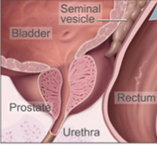
Prostate
From Greek προστάτης, prostates, literally "one who stands before", "protector", “guardian"
Sited at the base of bladder
Notes:
(from Greek προστάτης, prostates, literally "one who stands before", "protector", "guardian"[1]

Slide 4
Prostate Function
Secrete fluid that constitutes 30% of semen volume
Prostate secretions protect sperm
Contains smooth muscle
Helps expel semen during ejaculation
Notes:
The function of the prostate is to secrete a slightly alkaline fluid, milky or white in appearance, that in humans usually constitutes roughly 30% of the volume of the semen along with spermatozoa and seminal vesicle fluid.[4] Semen is made alkaline overall with the secretions from the other contributing glands, including, at least, the seminal vesicle fluid.[5] The alkalinity of semen helps neutralize the acidity of the vaginal tract, prolonging the lifespan of sperm. The prostatic fluid is expelled in the first ejaculate fractions, together with most of the spermatozoa. In comparison with the few spermatozoa expelled together with mainly seminal vesicular fluid, those expelled in prostatic fluid have better motility, longer survival and better protection of the genetic material.
The prostate also contains some smooth muscles that help expel semen during ejaculation.

Slide 5
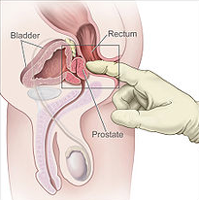
Prostate Structure
In healthy state > Walnut
11 grams > 7-11 grams
Just below the bladder
Surrounds urethra
Can be felt during a rectal exam
Notes:
healthy human male prostate is classically said to be slightly larger than a walnut. The mean weight of the normal prostate in adult males is about 11 grams, usually ranging between 7 and 16 grams.[6] It surrounds the urethra just below the urinary bladder and can be felt during a rectal exam.
The secretory epithelium is mainly pseudostratified, comprising tall columnar cells and basal cells which are supported by a fibroelastic stroma containing randomly oriented smooth muscle bundles that's continuous with the bladder. The epithelium is highly variable and areas of low cuboidal or squamous epithelium are also present, with transitional epithelium in the distal regions of the longer ducts.[7] Within the prostate, the urethra coming from the bladder is called the prostatic urethra and merges with the two ejaculatory ducts.[8]
The prostate can be divided in two ways: by zone, or by lobe.[9] It does not have a capsule; rather an integral fibromuscular band surrounds it.[10] It is sheathed in the muscles of the pelvic floor, which contract during the ejaculatory process.

Slide 6
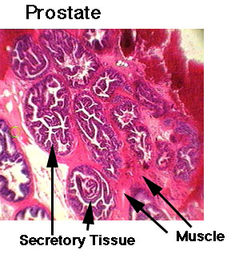
Prostate Histology
Glandular cells
secrete prostatic fluid
Myoepithelial cells
contractile function
Subepithelial interstitial cells
suport matrix

Slide 7
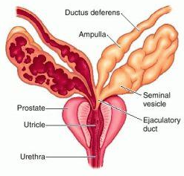
Prostate Structure
Secretory epithelium
Prostatic secretion
Fibro-elastic stroma
Smooth muscle
Surrounds prostatic urethra
Urethra merges with two ejaculatory ducts
Notes:
The secretory epithelium is mainly pseudostratified, comprising tall columnar cells and basal cells which are supported by a fibroelastic stroma containing randomly oriented smooth muscle bundles that's continuous with the bladder. The epithelium is highly variable and areas of low cuboidal or squamous epithelium are also present, with transitional epithelium in the distal regions of the longer ducts.[7] Within the prostate, the urethra coming from the bladder is called the prostatic urethra and merges with the two ejaculatory ducts.[8]
The prostate can be divided in two ways: by zone, or by lobe.[9] It does not have a capsule; rather an integral fibromuscular band surrounds it.[10] It is sheathed in the muscles of the pelvic floor, which contract during the ejaculatory process.

Slide 8
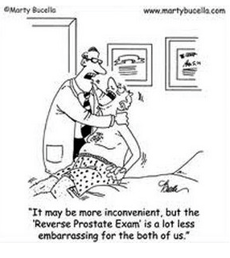
Prostate Function
Male sexual response
ejaculation
Secretions
acidic, proteins, PSA, zinc
Regulation
Testosterone > produced in testes

Slide 9
Prostate Pathology > Prostatitis
Inflammation > prostatitis
Four categories
I Acute prostatitis > ABX
II Chronic prostatitis > ABX
III Chronic non-bacterial prostatitis
male chronic pelvic pain syndrome
RX with alpha blockers, PT, psychotherapy, anxiolytics, nerve modulation…
IV Leukocytosis > Rare

Slide 10
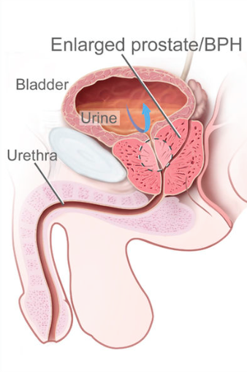
BPH
Benign prostatic hyperplasia
hyperplasia of stromal and epithelial cells
increase in the number of cells
Impinge on urethra
Increase resistance to voiding

Slide 11
BPH
Increasing resistance to urine flow
Bladder has to work harder
Hypertrophy of bladder
Bladder instability
Eventually, bladder enlarges, bladder thins and becomes atonic

Slide 12
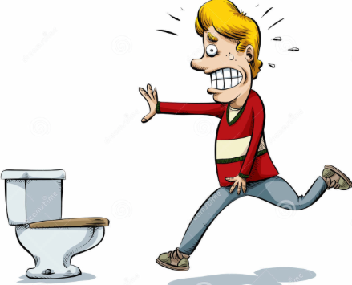
BPH symptoms
Lower urinary tract symptoms (LUTS)
Storage or Voiding
Storage
Urgency
Frequency
Urge incontinence
Nocturnal Incontinence
Nocturia

Slide 13
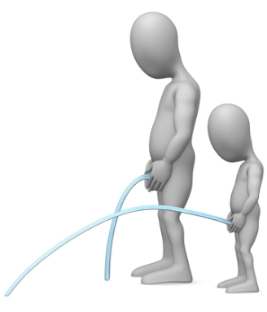
BPH symptoms
Voiding symptoms
Hesitancy
Poor Flow
Intermittent stream
Dribbling
Poor bladder emptying
Urinary retention

Slide 14
Bladder Outlet Obstruction (BOO)
Acute urine retention
Can not pass urine
Pelvic pain
Chronic retention
Straining > overflow incontinence, hernia, hemorrhoids
Urine stasis > Bladder stones

Slide 15
Causes of BPH
Androgens
Testosterone
Dihydrotestosterone (DHT), a metabolite of testosterone
Product of prostate enzyme 5α-reductase, type 2
Estrogens > no link identified
Failure in the spermatic venous drainage system*
* 2008 Andrologia 40 (5): 273–281

Slide 16
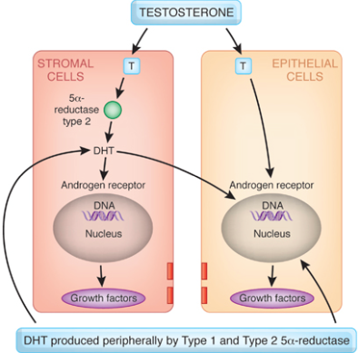
Causes of BPH
Androgens
Testosterone
Dihydrotestosterone (DHT), a metabolite of testosterone
Product of prostate enzyme 5α-reductase, type 2

Slide 17
Causes of BPH
Failure in the spermatic venous drainage system????
Increased hydrostatic pressure and local testosterone levels 100 fold over serum
Dietary considerations
High protein diet > Chinese study
Alcohol intake> Japanese American study
Metabolic syndrome
Obesity, diabetes, hypertension, inc. cholesterol

Slide 18
Pathophysiology of BPH
Glandular epithelial hypertrophy
Stromal cells w/ muscular fibers hypertrophy
Predominate component
Ratio is unclear
Purpose of growth is unclear
May represent “re-awakening” in adulthood of embryonic induction process??

Slide 19
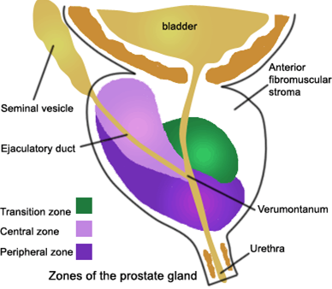
Anatomic BPH
Posterior urethral glands
earliest growth between 30-50
Transitional zone
Majority of late growth
Peripheral Zone
Minimal growth
Majority of prostate cancer

Slide 20
BOO
Static component
Increased prostate volume
Glandular proliferation
Dynamic component
Increase in Smooth Muscle tone
Impinge on urethra

Slide 21
BOO > LUTS
Lower urinary tract symptoms
frequency
urgency
nocturia
difficulty initiating urination
incomplete bladder emptying
decreased urinary stream

Slide 22
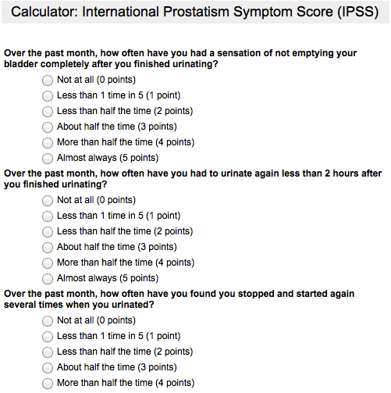
BOO > LUTS
International Prostate Symptom Score (IPSS)
Questionnaire for symptom measurement
7 questions

Slide 23
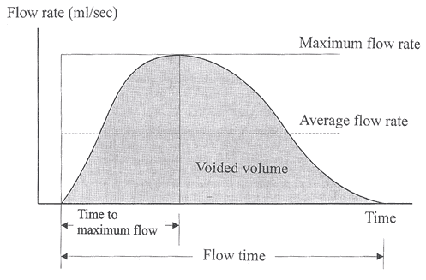
LUTS
Urodynamics
Decreased peak urine flow rate Qmax
Increase in post-void residual PVR

Slide 24
LUTS
Severity of symptoms > IPSS > 7 (Moderate)
Incidence based on IPSS up to 40% over 50yr
90% of men between 50 and 80 suffer with some degree of LUTS
Progression to acute urine retention
6.8 episodes per 1000 general population
34.7 episodes per 1000 in men older than 70

Slide 25
LUTS
Treatment options
Active surveillance
Drug therapy
Mechanical devices
Surgical options
Prostate embolization

Slide 26
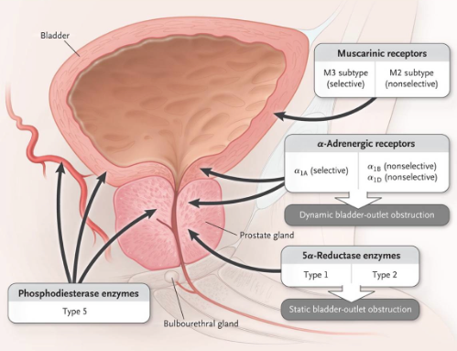
LUTS
Drug Therapy
Alpha Blockers
5-Alpha reductase inhibitors
Anti-cholinergics
Phyto-therapeutics

Slide 27
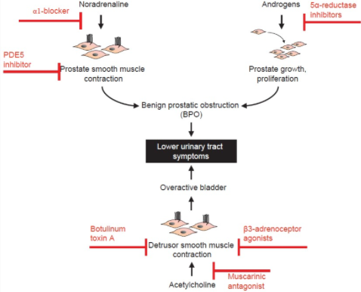

Slide 28
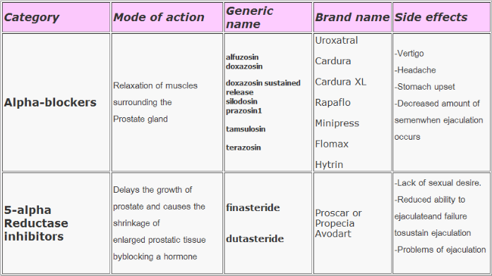

Slide 29
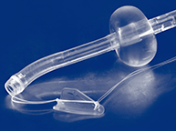
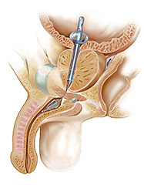
LUTS
Mechanical devices
stents
indwelling catheters
“The Spanner”
Pain
Required removal in 63%
CAUTI

Slide 30
LUTS
Surgical options
Trans Urethral Resection Prostate (TURP)
Gold standard
Transurethral Laser Ablation Prostate
Open prostatectomy
Larger prostates

Slide 31
TURP
Trans Urethral Resection of Prostate
Gold standard
Prostates less than 80-100 gm
Overnight hospital stay

Slide 32
TURP
Complications
Urinary incontinence
Decline in sexual function
Erectile dysfunction
Irritative voiding symptoms
Bladder neck contracture
Transfusion
UTI
Hematuria
Notes:
The VA Cooperative Study found a 1% risk of urinary incontinence
(which was similar to the incidence in the watchful waiting group) and an overall decline in sexual
function that was identical to the watchful waiting treatment group. Usually performed under general or
spinal anesthesia, TURP requires a hospital stay. One unique complication of TURP is TUR syndrome, a
dilutional hyponatremia that occurs when irrigant solution is absorbed into the bloodstream. Other
complications that have been reported in more than 5% of patients include (in order of frequency):
erectile dysfunction (which may not in all cases be attributable to the surgery); irritative voiding
symptoms; bladder neck contracture; the need for blood transfusion; UTI; and hematuria.

Slide 33
Open Prostatectomy
Reserved for prostate glands > 80-100 gm
Major surgery
Weeks to recover
Complications include erectile dysfunction
Transfusions
Stricture

Slide 34
BPH > BOO > LUTS
Initial symptoms are managed medically
Invasive options reserved for patients whose symptoms worsen on medical management
Surgical Indications

Slide 35
LUTS > Invasive RX
Indication for surgery
Renal insufficiency secondary to hydronephrosis
Recurrent acute urine retention
Intractable hematuria
Repeated urinary tract infections
Bladder stones

Slide 36
LUTS > Invasive RX
Average prostate volume at presentation with surgical indications
<30 gm 1987-1992
>60 gm 2003-2006
Improving medical management allows surgical indication symptoms to be put off while prostate continues to grow

Slide 37
Pelvic Embolization
Prostatic embolization for hemorrhage
Malignancy
After TURP
Trauma
Reported from mid 1970’s
In 2000, Dr. Demerit* reported relief of BOO related to BPH following prostate embolization
*J Vasc Interv Radiol 2000;11(6):767–770.

Slide 38
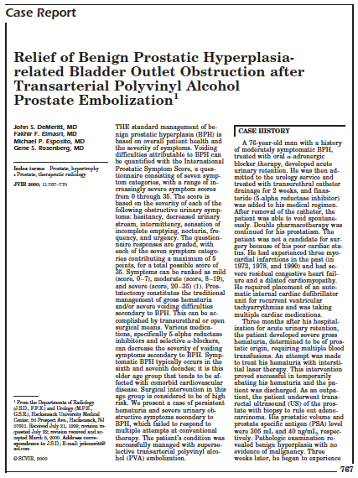
BPH Improves after embo
76 yo Patient with BPH embolized for prostate bleeding
Symptoms of BPH improve

Slide 39
BPH Improves after Embo
Urinary symptoms score improved
24 before embolization decreased to 15 after four days and 13 at five and 12 months
Prostate volume decreased
305 mL before embolization decreased to 190ml at 12 months ( 40% decrease)
PSA decreased
40 ng/ml before embolization to 5 ng/ml at five months ( 90% decrease)

Slide 40
Animal Experiments
Dogs were given hormones to induce prostate hypertrophy*
Half of the dogs were embolized
Embolized dogs prostates shrank
Histologically
Gland atrophy, fibrosis, inflammatory cell infiltration
*J Vasc Interv Radiol 2009; 20:384–390

Slide 41
Animal Experiments
1/2 of the pigs underwent prostate embo*
Embolized prostates decreased in volume
Histologic evaluation
Fibrosis and gland atrophy
Pigs were evaluated for sexual function after embolization
No difference between groups i.e., no change in sexual function after embolization
*Radiology 2008: 246:783-789

Slide 42
Embolic agents
Polyvinyl alcohol particles 200um
Old school non-spherical
Pisco et al
Embospheres
Tris-acryl gelatin microspheres 300-500 um (Embospheres, Angiodymanics)
Carnevale et al
Embozene
Notes:
Three materials have been used and reported in published studies of prostate artery innovation humans. Tris-acryl gelatin microspheres 300-500 um (Embospheres, Angiodymanics) were used in trials performed by Carnevale. Non-spherical polyvinyl alcohol particles 200 um were used in the studies reported by Pisco . hydrogel microspheres 100 to 400 um (Embozene microspheres; CeloNova We feel that the tightly calibrated Embozene® Microspheres will be safe and effective.

Slide 43
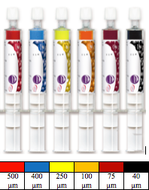
Embolic agents
Embozene® Microspheres
Spherical, tightly calibrated, biocompatible, non-resorbable, hydrogel beads coated with an inorganic perfluorinated polymer (Polyzene®-F) coating

Slide 44
Outcome Measures
Prostatism > LUTS > IPSS & QOL scores
Change in erectile function
International Index of Erectile Function (IIEF-5)
BOO > Q max & PVR
Prostate volume
PSA reflects prostate volume

Slide 45
IPSS
Seven symptom categories
hesitancy
decreased urinary stream
intermittency
sensation of incomplete emptying
nocturia
frequency
urgency
Notes:
Voiding symptoms can be quantified based on the IPSS. This validated questionnaire consists of seven symptom categories. The scores range from 0 to 35. Scores are based on degree of severity of several symptom groups: hesitancy, decreased urinary stream, intermittency, sensation of incomplete emptying, nocturia, frequency, and urgency. There is a maximum of five points per category. Symptom scores are ranked from mild (0-7), Moderate (8-19) and severe (20-35) .

Slide 46
IPSS
Seven symptom categories
0 - 5 points per category
0-7 mild
8-19 moderate
20-35 severe
Quality of Life (QOL) score 0-6
How would it feel to spend rest of your life like this > 0 delighted to 6 terrible
Notes:
There is a maximum of five points per category. Symptom scores are ranked from mild (0-7), Moderate (8-19) and severe (20-35) . 8-19
One additional question gives a QOL score. This asks patients to rate how they would feel if they had to spend the rest of their life with their current symptoms. This is scored on a range from 0 delighted to 6 terrible

Slide 47
Complications
Post procedure pain
Non target embolization
Colon
Bladder
Radiation injury
Non reported so far

Slide 48
Complication
Post embolization pain
Bagla
No pain after PAE
Carnavale
Mild burning in urethra & retro-pubic area
Responded to non-opiate non-steroidal anti-inflammatory medications
Resolved within first week

Slide 49
Complication
Bladder ischemia
One patient developed pain during PAE
He required surgical removal of ischemic are of bladder*
One patient developed hematuria after PAE
MRI demonstrated region of hypo perfusion of bladder
Reperfusion seen of 3 month MRI

Slide 50
Complication
Colon ischemia
Rectal bleeding and /or diarrhea post UAE
Symptoms resolve by third post embo day
Colonoscopy day 4 demonstrated rectal ulcers
Repeat colonoscopy day 16
Ulcers disappeared without treatment

Slide 51
Complication
Radiation injury
Average fluoro times 85 minutes
No serious skin injuries
One year follow up

Slide 52
Prostate Embolization
Extended overnight observation basis
Pre procedure
Non-steroidal anti-inflammatory medication
Anti-emetics
Antibiotics
Intravenous moderate conscious sedation and local anesthesia

Slide 53
Prostate Embolization
Femoral artery access
Selective catheterization of the bilateral internal iliac arteries
Super selective catheterization of the prostatic arteries
Angiography to verify location of prostate

Slide 54
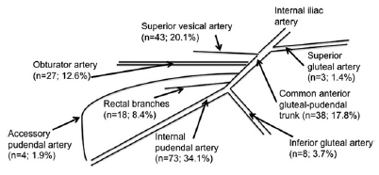
Prostate Embolization
Prostate arteries anatomy*
Single PA in 57% of sides, 43% had two PAs
*J Vasc Interv Radiol 2012; 23:1403–1415

Slide 55
Prostate Embolization
Prostate artery can arise from*
Internal pudendal artery 73 (34.1)
Superior vesical artery 43 (20.1)
Anterior common gluteal-pudendal trunk 38 (17.8)
Obturator artery 27 (12.6)
Prostatorectal trunk 18 (8.4)
Inferior gluteal artery 8 (3.7)
Accessory pudendal artery 4 (1.9)
Superior gluteal artery 3 (1.4)

Slide 56
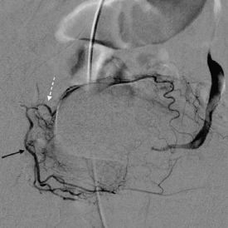
Prostate Embolization
Prostate DSA
Superior vesical artery
Right anterior lateral prostate artery
Notes:
DSA of the right anterior lateral PA (black arrow), arising from a common trunk with the superior vesical artery (white dotted arrow).

Slide 57
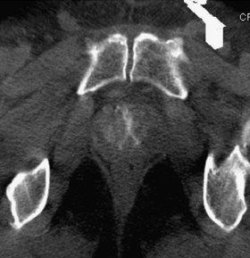
Prostate Embolization
Verification of prostate
Minimize risk of non target embolization
Colon or Bladder
Cone Beam CT
Notes:
Axial cone-beam CT pattern of central/superior gland perfusion without capsule or inferior lateral perfusion, which suggests a duplicated PA. This image was obtained after selective angiography of the anterior lateral PA.

Slide 58
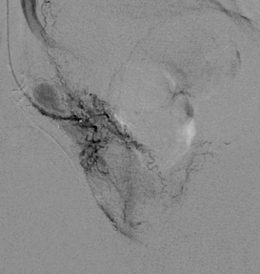
Prostate Embolization
Angiogram and cone beam CT demonstrate only partial filling of prostate consistent with two PAs
Right posterior lateral PA arising from internal pudendal artery
Notes:
DSA of the right posterior lateral PA, which originated from the internal pudendal artery, vascularizing much of the peripheral gland.

Slide 59
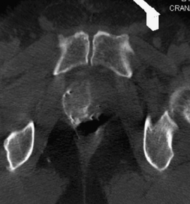
Prostate Embolization
Cone beam CT verifies opacification of the capsular and inferior lateral prostate gland
Notes:
Axial cone-beam CT in the same patient after selection of the posterior lateral PA. Capsular and inferior lateral perfusion, a complementary pattern to that shown in a, is noted.

Slide 60
Prostate Embolization
Embolization performed with Embozene
Monitor for adequate embolization
Monitor for non target embolization
Monitor for collaterals that supply the prostate

Slide 61
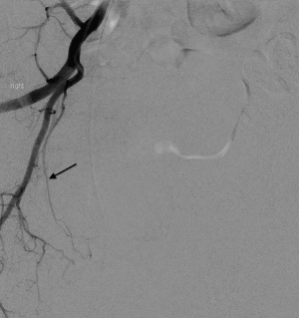
Prostate Embolization
DSA is used to identify the vascular bed
Foley catheter in bladder marks the top of prostate
Perfusing caudal tissue???

Slide 62
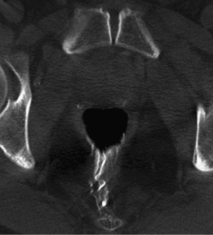
Prostate Embolization
DSA is used to identify the vascular bed
Foley catheter in bladder marks the top of prostate
Perfusing RECTUM

Slide 63
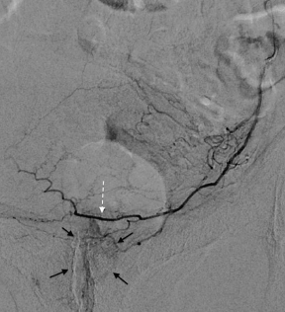
Prostate Embolization
DSA is used to identify the vascular bed
Foley catheter in bladder marks the top of prostate
Perfusing cephalad tissue???

Slide 64
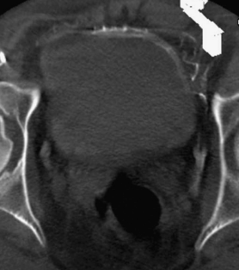
Prostate Embolization
DSA is used to identify the vascular bed
Foley catheter in bladder marks the top of prostate
Perfusing BLADDER

Slide 65
Prostate Embolization
Post embolization
Monitor for post embolization syndrome
Pain
Fever
Monitor for complications
Hematuria > Cystoscopy
Hematochezia > Endoscopy

Slide 66
Prostate Embolization
Follow up
2 week post op check
Hematuria or hematochezia referral to
Cystoscopy or proctoscopy
3 and 12 month follow up
Repeat MRI, PSA, Urodymanics (Qmax and PVR), IPSS/QOL and IIEF-5

Slide 67
Results
IPSS and QOL
3 point decrease is significant
Pisco reported 10 point ave decrease in IPSS
IIEF-5 erectile function
Expect no change
Pisco reported an improvement post UAE

Slide 68
Results
Urodynamics
Qmax increases from 4.2 to 10.8 ml/sec
PVR decreased from 103 to 58 at one year follow up
Prostate Volume
40% decrease in volume at five months
PSA
Decrease from average 10.1 to 4.3

Slide 69
Discussion
Number of procedures for LUTS has decreased with advances in Medical therapy
Allows prostates to grow even larger before a surgical event occurs
TURP remains the durable and effective GOLD standard

Slide 70
Discussion
TURP
Requires general or spinal anesthesia
Significant complication
Durability
Ejaculatory disorders
UAE > Opportunity
Moderate sedation
Fewer ejaculatory complications
Jury is still out….

Slide 71
