Slide 1
MRgFUS – MR Guided Focused US for Uterine Fibroid Therapy

Slide 2
David P. Zadvinskis, M.D.
Medical Director
Department of Radiology
Dublin Methodist Hospital
Riverside Radiology and
Interventional Associates

Slide 3
MRgFUS
MR guided Focused Ultrasound
High Hz US delivers heat to ablate the fibroid
MR imaging guides the procedure and measures temp
FDA approved for uterine leiomyomas since October 2004

Slide 4
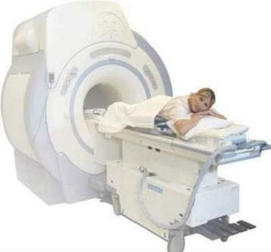
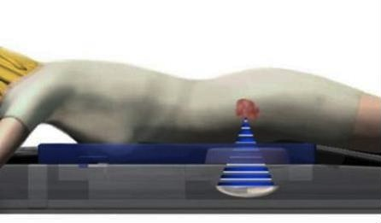
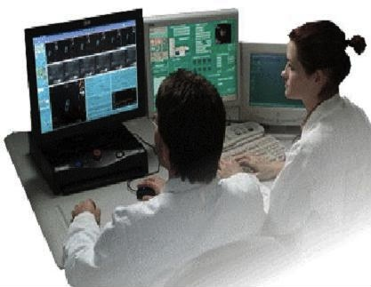
:
Patient lies prone
Able to communicate with MD
A “stop sonication” button is available if there is any discomfort.
Notes:
The ExAblate 2000 provides non-invasive surgery using MR guided Focused ultrasound and has the potential to change the face of surgery in the coming years.
You can see the different elements of the system: the patient lying on ExAblate bed (a GE MR bed adapted with electronics and transducer) and operator outside scan room sitting in front of workstation to handle all treatment aspects.
The equipment cabinet and optional chiller are in the equipment room.

Slide 5
Patient Preparation
Shave the skin anteriorly
Remove any creams/ointments
Foley catheter to control the bladder and move the uterus or bowel
Rectal gel
Fentanyl and Versed

Slide 6
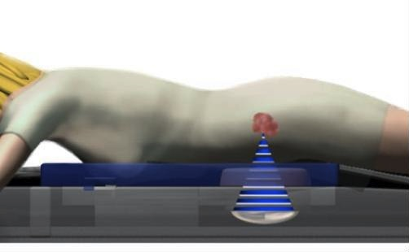
How does MRgFUS Work?
Focused US generates heat, ablating fibroid tissue only at the focal point to 65-85ºC for 20 seconds. This is similar to a magnifying glass focusing the sun’s energy on a single point.
Fibroid
Focused Ultrasound Beam
Water Bath
Transducer
Notes:
The focused ultrasound beam is generated by a phased array transducer which is located in the patient table and passes through a water bath and gel pad which create acoustic coupling with the patient.
The effect of focusing ultrasound energy is similar to that of using a magnifying glass to focus the sun’s energy on a single point. However, unlike light, ultrasound energy can easily pass through the skin and propagate through tissue to converge to a focal point inside the body.
The focal point has the shape of a small bean. In few seconds, the tissue at the focus reaches a temperature level that causes cell destruction. The system then moves to another spot to ablate it,until all the planned spots are treated.
The size of the sonications can be varied, depending on the size and depth of the focal volume to be treated, ranging from 1x2mm to 10x30 mm.

Slide 7
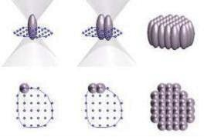
Length: 10-45 mm
Diameter: 2-10 mm
Spots or “sonications” range in shape and size to accommodate treatment plan.
Fibroid
Focused Ultrasound Beam
Water Bath
Transducer
Multiple sonications are needed to ablate the entire fibroid.
Notes:
The focused ultrasound beam is generated by a phased array transducer which is located in the patient table and passes through a water bath and gel pad which create acoustic coupling with the patient.
The effect of focusing ultrasound energy is similar to that of using a magnifying glass to focus the sun’s energy on a single point. However, unlike light, ultrasound energy can easily pass through the skin and propagate through tissue to converge to a focal point inside the body.
The focal point has the shape of a small bean. In few seconds, the tissue at the focus reaches a temperature level that causes cell destruction. The system then moves to another spot to ablate it,until all the planned spots are treated.
The size of the sonications can be varied, depending on the size and depth of the focal volume to be treated, ranging from 1x2mm to 10x30 mm.

Slide 8
MRgFUS: MRI
MR is used for imaging guidance
MR thermography measures temperature
Heat causes Brownian motion, shifts resonant Hz of H2O
65-85 degrees celsius (>60)
Usually 20 seconds per sonication
3 hour limit from 1st sonication
Notes:
8

Slide 9
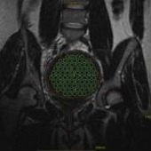
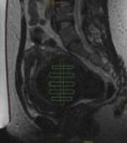
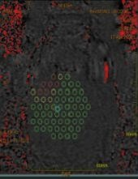
Treatment Plan

Slide 10
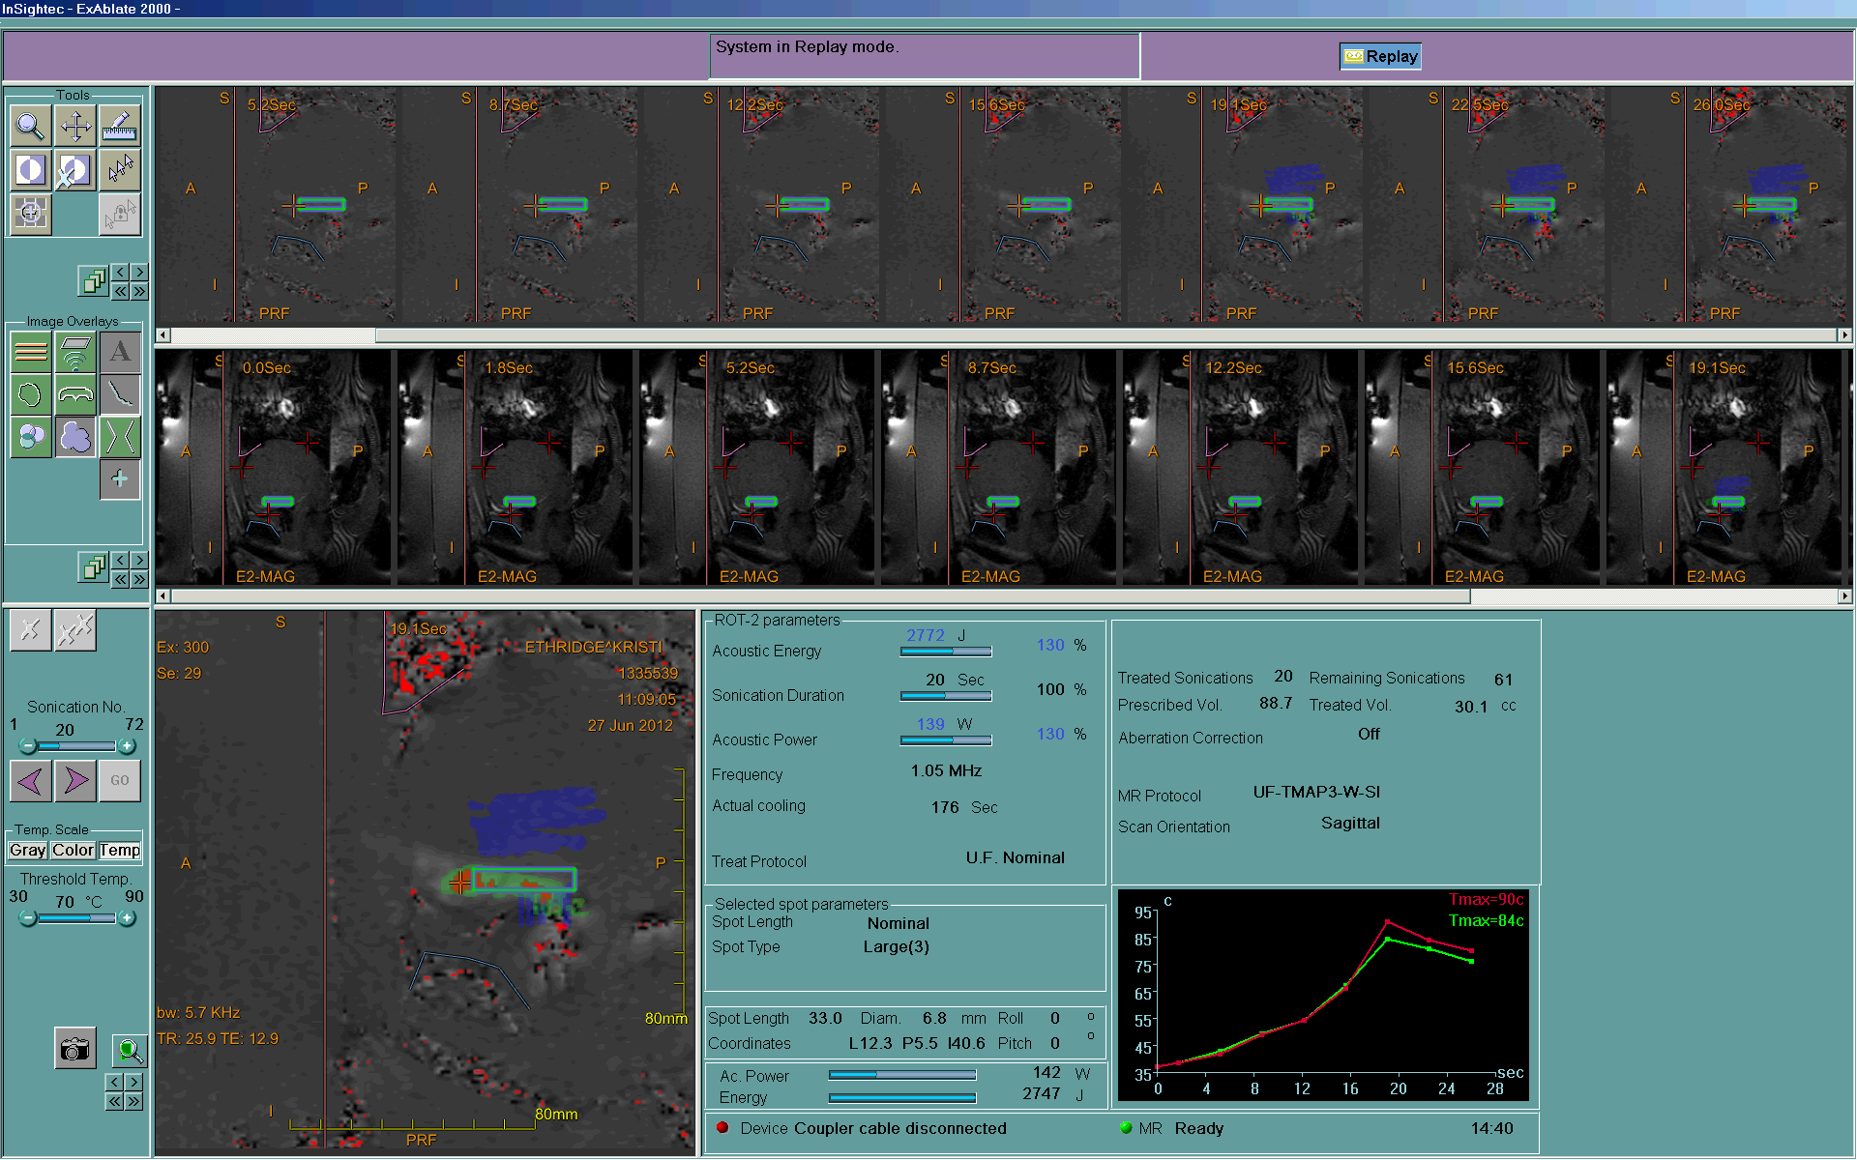

Slide 11
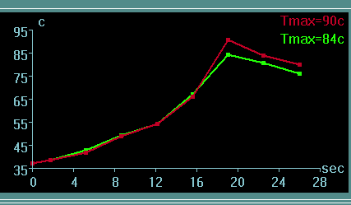
Thermography

Slide 12
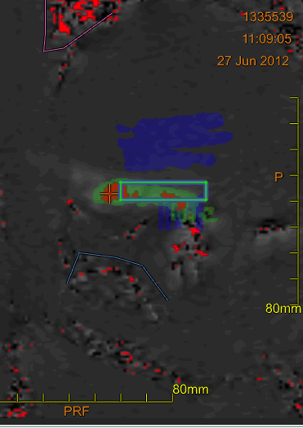
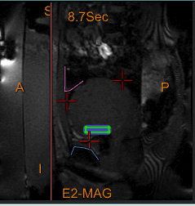
MRgFUS Tx Images

Slide 13
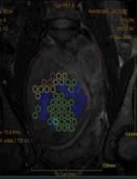
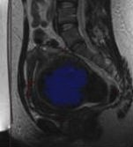
Tx in progress, thermal dose
Thermal Dose Map: Often underestimates non-perfused volume as shown on post Tx MRI T1 post contrast

Slide 14
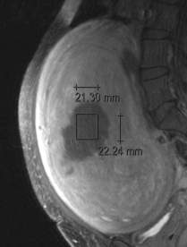
Treated region on MR = coagulative necrosis
A: Thermal Dose Volume C: Undamaged Fibroid
B: Non-perfused Volume D: Normal Uterine Muscle
A
A
D
C
B
B
C

Slide 15
Advantages of MRgFUS
Essentially noninvasive
No hospitalization
Limited conscious sedation
No ionizing radiation
Return to normal activity next day
Low rate of complications
Reduced cost

Slide 16
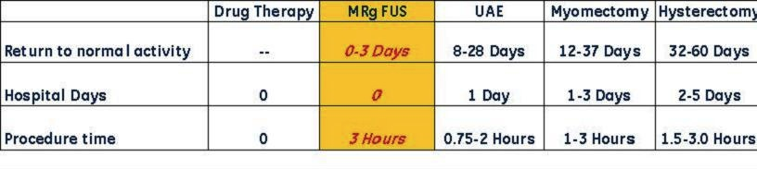
Comparison of Treatment Options
Spectrum of Invasiveness
Expectant
Management
Hysterectomy
MRgFUS
Notes:
In viewing the spectrum of treatment options, aside from watch and see and drug therapy which is limited to 3 month treatment regimen, MRgFUS is the least invasive, has no hospital stay and return to normal activity within one day

Slide 17
MRGFUS vs other Uterine Preserving Treatments
Need for Alternative Tx | @ 12 mo | @ 24 mo | References
Myomectomy | 10.6% | 13% - 16.5% | 1,2,3,4
UAE (Uterine Artery Embolization) | 7% - 10% | 12.7% - 23.7% | 5,6,7
MRgFUS NPV >60% | 6% (NPV=60%) Using current version | 13% (NPV=60%) Using current version | 8
References
Subramanian S, Clark MA, Isaacson K. Outcome and resource use associated with myomectomy.
Obs & Gyn.2001; 98: 583-587
Nezhat FR, Roemisch M, et al. Recurrence rate after laparoscopic myomectomy. Am Assoc Gynecol Laparosc. 1998;5: 237-240
Rossseti et al. Long term results of laparoscopic myomectomy: recurrence rate in comparison with abdominal myomectomy. Hum Reprod. 2001:16:770-774
Doridot et al. Recurrence of leiomyomata after laparoscopic myomectomy. J Am Assoc Gynecol Laparosc. 2001;8: 495-500
Spies JB, Bruno J, et al. Long-term outcome of uterine artery embolization of leiomyomata. Obstet Gynecol. 2005; 106: 933-939
Goodwin SC, Spies JB, et al. Uterine artery embolization for treatment of leiomyomata: long-term outcomes from FIBROID registry. Obstet & Gynecol. 2008; 111: 22-32
Sharp HT. Assessment of new technology in the treatment of idiopathic menorrhagia and uterine leiomyomata. Obstet Gynecol. 2006;108: 990–1003
Stewart EA, Gostout B, Rabinovici J, et at. Sustained relief of leiomyoma symptoms by using focused ultrasound surgery. Obstet & Gynecol. 2007;110: 279-287
Notes:
17

Slide 18
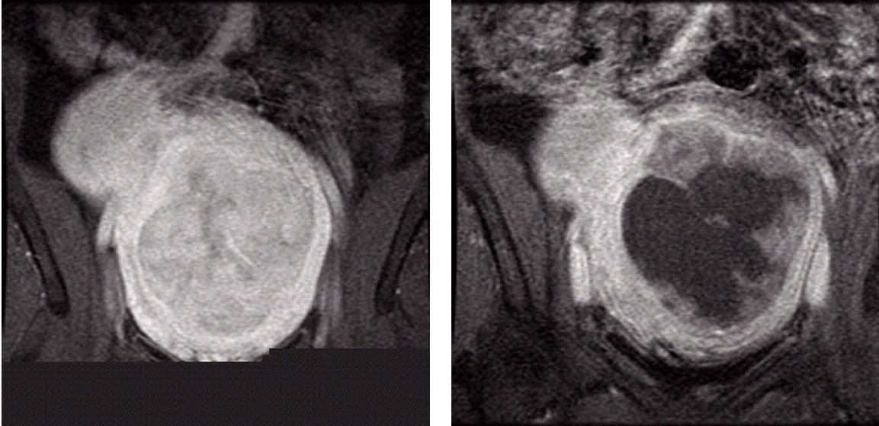
Post-Treatment NPV
Most important predicting factor for treatment response is immediate post-treatment non-perfused volume (NPV)
Enhanced T1w
NPV
Notes:
18

Slide 19
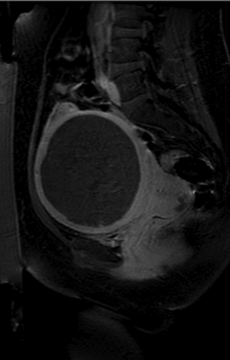
Sagittal T1+c Post treatment
Fibroid volume: 600cc
Symptoms: Heavy menstrual bleeding and pain
NPV
Treatment time:
2 hours 22 minutes
Results: 98% NPV with no adverse events
Courtesy of KNI, Kalamazoo, MI

Slide 20
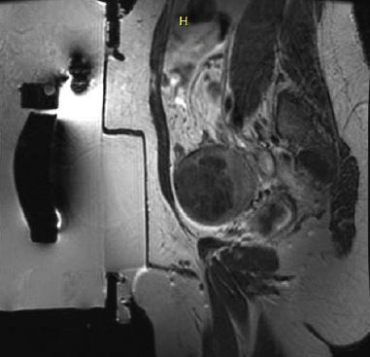
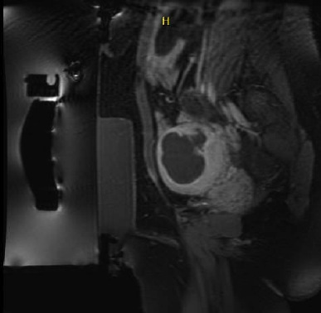
Fibroid volume: 116cc Symptoms: Heavy bleeding
Treatment time: 3 hours, 19 minutes Results: 80% NPV with no adverse events
Fibroid
NPV
Sagittal T2w
Sagittal T1+c Post Tx
Courtesy of UVA, Charlottesville, VA

Slide 21
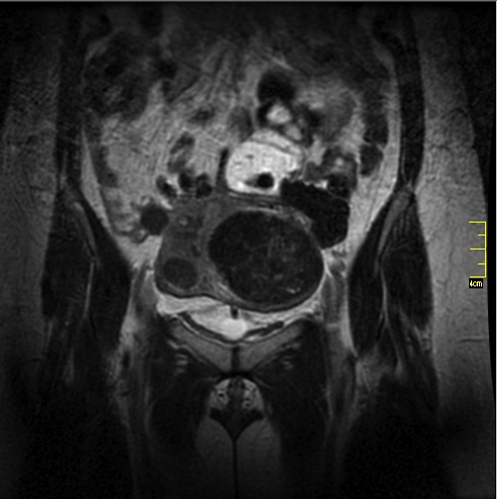
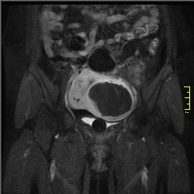
Fibroid volume: 139.6cc Symptoms: Heavy bleeding, pain and urinary frequency
Treatment time: 3 hours, 24 minutes
Results: 90% NPV with no adverse events
Fibroid
NPV
Coronal T2w
Coronal T1+c Post Tx
Courtesy of UCLA, Los Angeles, CA

Slide 22
Predictors of Tx Success
NPV (60 vs 80%)
Lower T2 signal
Older patient
Confluence of ablated volume

Slide 23
MRgFUS Inclusion Criteria: Age
Women age 18 or older
Pre or peri-menopausal (within 12 months of last menstrual period).
Patient should be family complete
Notes:
92% of patients of symptom relieve

Slide 24
MRgFUS Inclusion Criteria
Fibroids visible on non-contrast MRI
Fibroid enhances with MR contrast
Fibroids are device accessible
< 12 cm from skin anteriorly
< 20 cm from transducer
> 4 cm from anterior spine/sacrum
Notes:
92% of patients of symptom relieve

Slide 25
MRgFUS Inclusion Criteria
Symptomatic uterine fibroids:
Symptom severity scores of 21 or higher based on the Uterine Fibroid Symptom and Health-Related Quality of Life Questionnaire
Notes:
92% of patients of symptom relieve

Slide 26
Ideal Patient: 1 to 3 anterior fibroids of moderate size (4 to 6 cm) with low T2 signal

Slide 27
MRgFUS Exclusion Criteria
Uterine size >24 weeks
More than 4-5 fibroids
Pedunculated fibroids
Infarcting/calcified fibroids
Extensive adenomyosis
? Bright T2W– Enhancing fibroids

Slide 28
Gonadotropin Releasing Hormone Agonists (Lupron)
Symptomatic fibroids > 10cm
3 months of treatment to decrease size
Vascular/cellular fibroids: Tx also decreases vascularity which can act as a heat sump

Slide 29
MRgFUS Exclusion Criteria/MRI
  Implanted ferromagnetic materials and/or devices contraindicated for MR scan
  Allergy to MRI contrast agent
  Weight greater than 250 lbs (113Kg)
  Severe claustrophobia (not controlled with mild sedation)
  Unable to communicate pain/sensations during the procedure
Notes:
92% of patients of symptom relieve

Slide 30
MRgFUS Exclusion Criteria
Pregnancy
Patients with active PID
Local or systemic infection
Known/suspected pelvic carcinoma or pre-malignant conditions
Undiagnosed vaginal bleeding
Notes:
92% of patients of symptom relieve

Slide 31
MRgFUS Exclusion Criteria
Extensive abdominal scarring that cannot be avoided by redirection of the beam
Bowel in the treatment path
Dermoid cyst of the ovary in the treatment path
Intrauterine device (IUD) in the treatment path

Slide 32
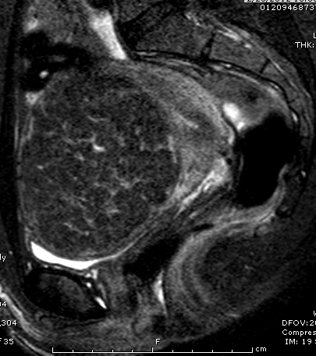
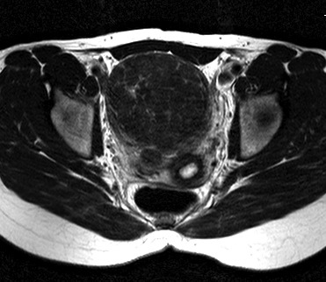
First OH MRgFUS Tx: T2 Sag/Ax

Slide 33
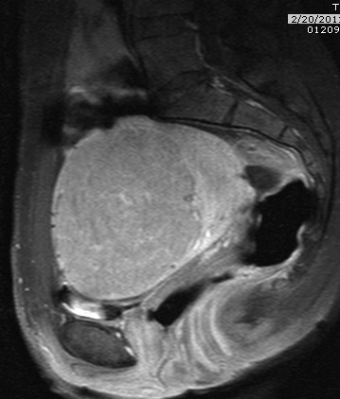
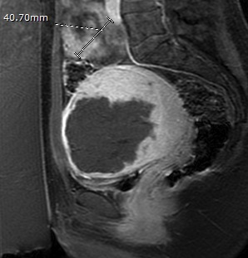
T1 C+ Pre and Post Tx
72 Sonications

Slide 34
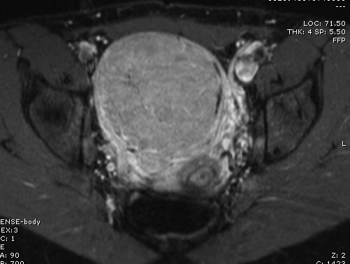
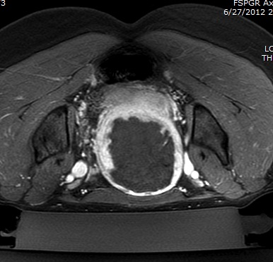
T1 C + Axial Pre and Post Tx
NPV > 70%

Slide 35
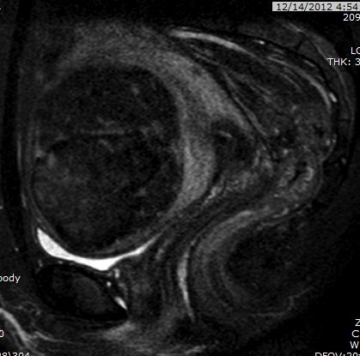
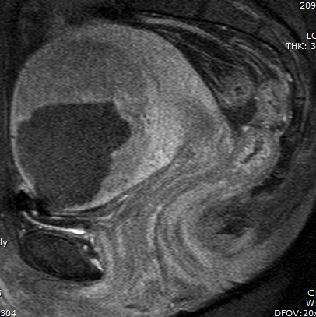
6 Months Post Tx

Slide 36
6 Months Post Tx
Virtually complete resolution of bulk symptoms - urinary frequency, dyspareunia
Decreased fibroid size 8.6 x 8.0 x 6.7 cm was 9.6 x 8.3 x 7.7 cm
No complications

Slide 37
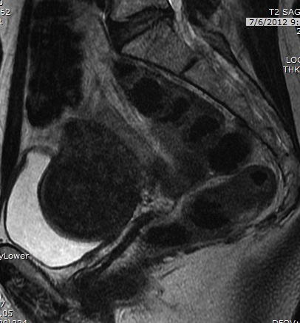
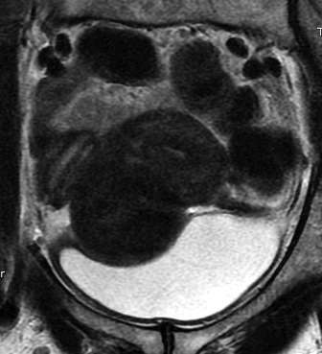
2nd OH MRgFUS Tx: T2 Sag/Cor

Slide 38
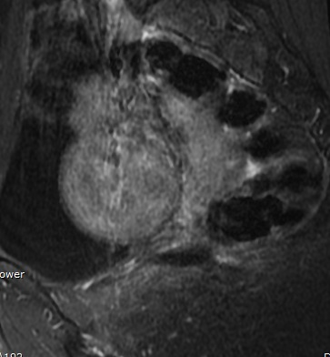
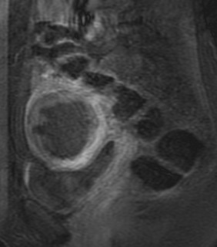
T1 C+ Pre and Post Tx

Slide 39
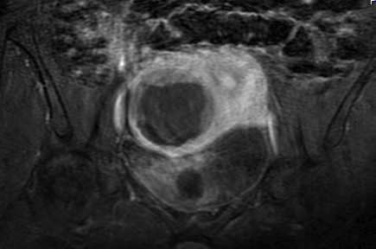
T1 C+ Post Tx: NPV = 81%

Slide 40
6 Weeks Post Tx
Reports slight improvement of bulk symptoms
No complications

Slide 41
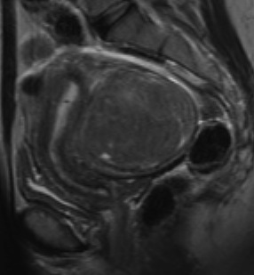
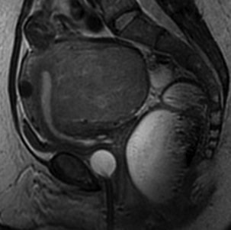
3rd OH MRgFUS Tx: T2 Sag/Ax

Slide 42
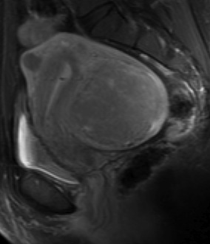
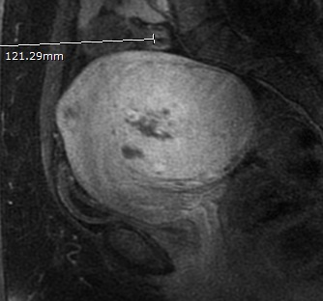
T1 C+ Pre and Post Tx

Slide 43
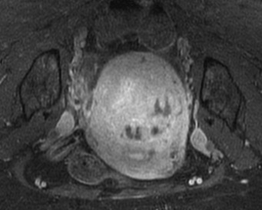

Slide 44
2 Weeks Post Tx
No change in bulk symptoms
Virtually no cramping post procedure
Small focus of skin erythema 5mm in size - resolving

Slide 45
Side Effects/Complications
Transient abdominal pain
Positional discomfort from 3-4 hour procedure (shoulder/back pain)
Thermal injury to skin
1 Bowel perforation
1 Sciatic nerve palsy – spontaneous resolution

Slide 46
Skin Burn – Case 1
• Although many of the sonications were done through an old surgical scar, the patient did not report any pain (maybe due to local dermal sensory loss from previous surgery)
• Following treatment patient had a third degree skin burn which required surgical intervention

Slide 47
T1w+C post treatment sagittal images. Arrow marks the hyperemia and NPV in skin/muscle after 73 sonications

Slide 48
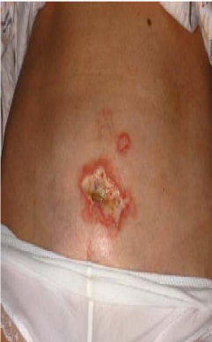

Slide 49
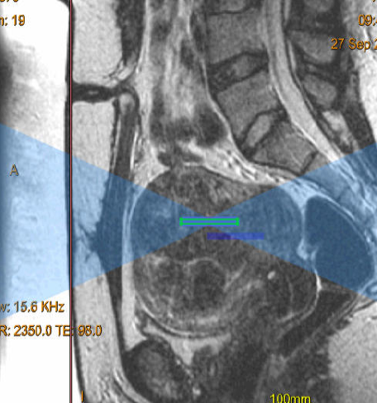
Skin Burn Case 2

Slide 50
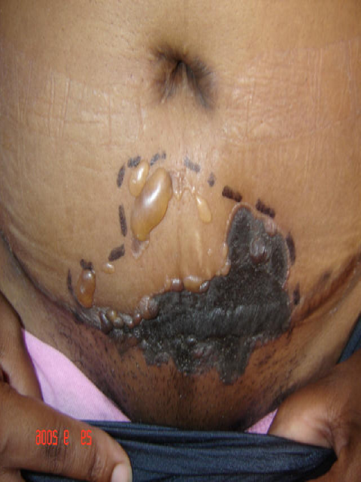

Slide 51
Nerve Injury
During treatment, the patient (who refused sedation) felt radiating leg pain which she did not report.
Following treatment, the patient reported leg pain and weakness.
Patient refused to accept anti inflammatory medication.
Pain persisted close to a year before disappearing.

Slide 52
Failure to keep an adequate margins between sonications and sacral nerves

Slide 54
Bowel perforation
During treatment, the patient did not report any specific complaint.
Several days later she was admitted to the ER with acute abdominal pain.
She was diagnosed as having bowel perforation, and had a surgical repair.
Following surgery, pt recovered and was released from the hospital in a few days.

Slide 55
Failing to note intestinal loop wedged between the fibroid and rectus muscle

Slide 56
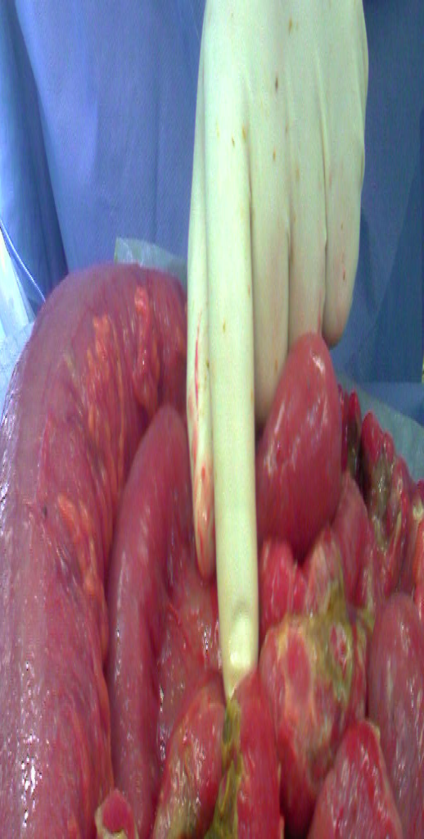
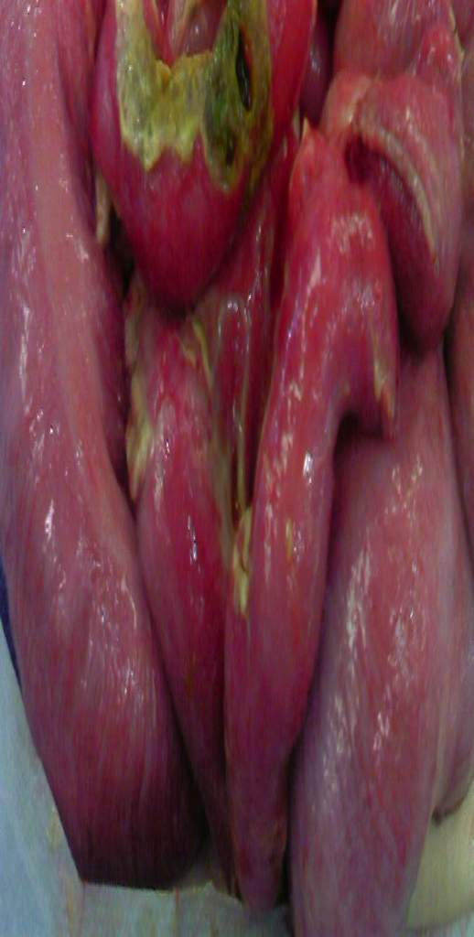

Slide 57
Hysterectomy Complications
Blood transfusion 2.5%
Bowel injury 1%
Bladder injury 1%
PE 1%
Hematoma 1%
At least one complication 6%

Slide 58
MRgFUS Experience
First FDA approved treatment in Oct 2004
More than 9,500 treated in 100 countries
>2600 women in the US treated
85% or more = sustained-effective relief
Most symptomatic patients improve in 3 months, near normal after 6 months
117 anecdotal pregnancies
Notes:
Uterine Fibroids are a very prevalent condition and occur in up to 80%, with 25% of women requiring some form of treatment to alleviate symptoms. UF are the leading cause of hysterectomy, with up to 1/3 of all hysterectomies performed for UF. Hyst. and Myomectomy, the leading treatment alternatives are both surgical treatments which require hospitalization and extensive recovery time. UAE, generally requires an overnight stay in the hospital and if often accompanied by significant pain and post-embolization syndrome. Drug therapy is a temporary measure, which is often a prelude to hysterectomy or myomectomy.
Over 2200 women have been treated with ExAblate with close to 92% experiencing symptom relief.improvem

Slide 59
Post-MRgFUS pregnancies
117 Pregnancies
Mean Age = 36 years (27-49)
Mean time to conception = 9 months
Live births in 64 (55%), 38 were vaginal (59%)
22 Spontaneous Ab (19%)
10 Elective termination (9%)
9 Currently pregnant (8%)
12 Lost to follow up (10%)
Jaron Rabinovici. 3rd International Focused Ultrasound Symposium. 10-15-2012

Slide 60
Post-MRgFUS pregnancies
The following risks were not seen in any of the cases:
Uterine rupture
Preterm labor
Placental abruption
Abnormal placentation leading to fetal growth restriction

Slide 61
RELIEF Registry
REgistry for Leiomyoma, International Efficacy of Focused US
Collaboration of the Focused Ultrasound Foundation with support from InSightec and Philips
Baseline and f/u data up to 3 years for 1000 patients
20 sites worldwide including Ohio Health
Data endpoints include safety, patient satisfaction, need of alternative therapy, and clinical improvement as measured by the symptom severity score (SSS) of the Uterine Fibroid Quality-of-Life Instrument

Slide 62
Growth in Related Procedural Volume
Itabashi Chuo Medical Center in Tokyo, Japan reported an increase in patients treated for fibroids by 550% in one year
Patients not eligible for MRgFUS were referred to alternative treatments
MRgFUS positive impact on other uterine fibroid treatment methods has been realized at other sites

Slide 63
MRgFUS Future Applications
Palliative Tx osseous metastases: FDA approved 10/2012
Essential tremors
Prostate: Ca or BPH
Breast Ca
Brain tumors
Clot lysis
Targeted drug delivery: Microbubbles, nanoparticles

Slide 64
Palliative Tx Osseous Mets
Indications:
  EBRT failure (~35% of patients fail)
  EBRT contraindicated or refused
Single session treatment
Results in few days
Improvement of quality of life
Excellent safety profile
  Minimal risk for skin injuries or fracture
Doesn’t exclude future treatments

Slide 65
MRgFUS Fibroid Tx Summary
Efficacy similar to UAE and myomectomy
Similar cost to UAE, cheaper than myomectomy and hysterectomy
Much better safety profile
Nearly non invasive

Slide 66
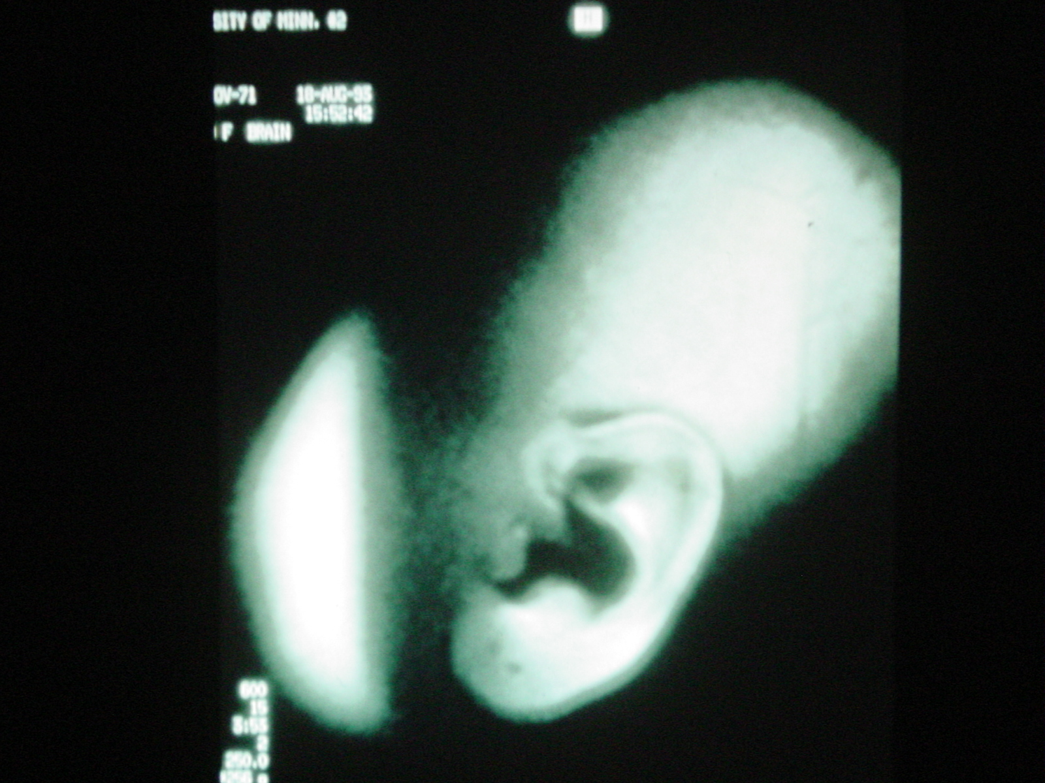

Slide 67
