Slide 1
The Sorcerer’s Apprentice How Medical Imaging is Changing Health Care
Eastern Radiological Society
Southern Pines, North Carolina
April 2013

Slide 2
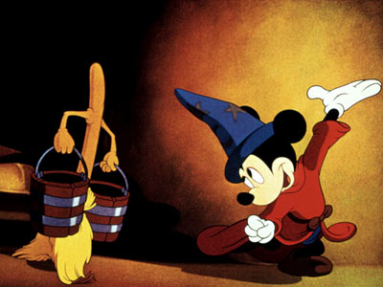
A perfect metaphor…

Slide 3
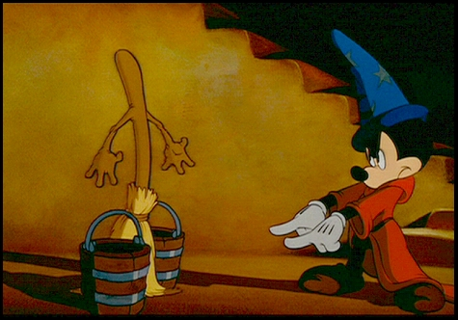
The Sorcerer’s Apprentice
Changing health care and imaging innovation
An antagonistic milieu
Barriers to innovation
The demands of an industry focused on cost
Changes in the payment environment and their impact on innovation
The needs of imaging providers

Slide 4
Key Premises
The success of medical imaging (almost wholly) due to important continuing innovation
Imaging companies and providers have prospered
The future success of medical imaging requires similar or greater innovation
Robust innovation pipeline
Antagonistic milieu threatens realization of the promise of future imaging innovation
Future success requires innovation that conforms to our societal needs for beneficial technologies that provide good value at an affordable cost
Innovators and their customers must think strategically about which innovations to pursue or to implement in their practices

Slide 5
The Golden Age of Medical Imaging
1970-present:
Consistent stream of new and valuable technologies:
US
CT
MR
PET
Interventional advances
New applications of existing technologies
Increased computing power and connectivity technologies

Slide 6
The Benefits of Imaging
Improved and more reliable patient care
Less invasiveness
No/minimal discomfort
No/little recuperation period
Capacity to repeat over time
Replacement of old and outmoded procedures
Diagnosis
Staging
Screening
Treatment
Response
Marker

Slide 7
Imaging Innovation Progressing Rapidly
Major shifts in imaging innovation already underway:
Gross anatomy/pathology to cellular and subcellular imaging
Anatomic to functional imaging
General functional imaging to imaging specific targeted receptors
Qualitative to quantitative
The linking of diagnostics to therapeutics

Slide 8
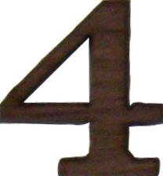
P4 Medicine Promoting Imaging Innovation*
Predictive of individual patient risks to support better disease surveillance
Preemptive diagnosis and treatment to improve outcomes
Personalized diagnosis and treatment based on history and the genome
Participatory care in consideration of patient preferences
*aka precision medicine, aka personalized medicine aka molecular medicine

Slide 9
Imaging and P4 Medicine - Examples
Predict susceptibility to specific diseases
Genome-informed surveillance to earlier disease
Predict biological aggressiveness/treatability
Discern the best treatment and dose before beginning therapy
Predict toxic effects
Monitor response to treatment early and accurately
Link surveillance, diagnosis, staging, and treatment in an efficient, convenient, patient friendly paradigm

Slide 10
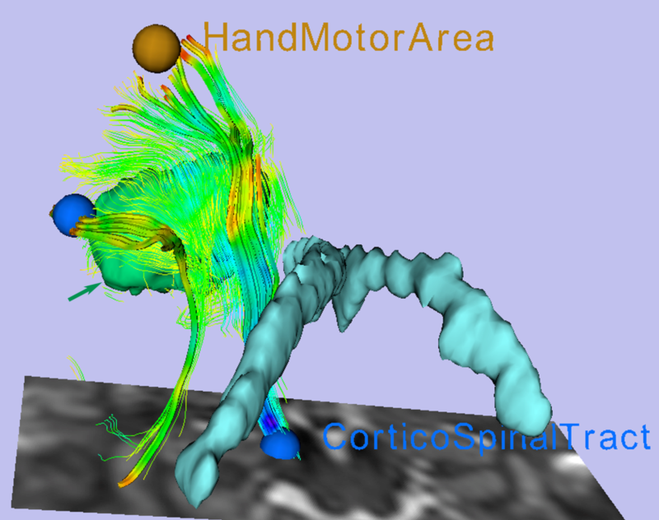
Example P4 Innovation
Advanced pre- and intra-operative visualization

Slide 11
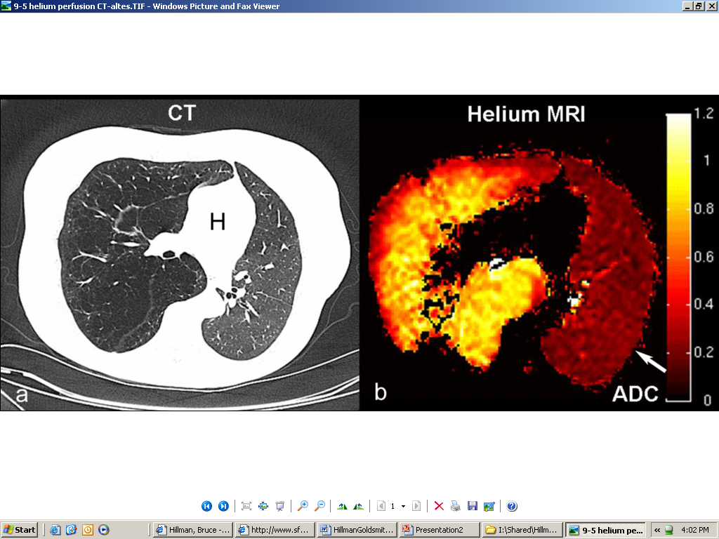
Example P4 Innovation
Hyperpolarized noble gas MRI lung imaging for anatomic detail and pulmonary function

Slide 12
Example P4 Innovation
64-CU ATSM PET to guide intensity modulated radiation therapy of hypoxic tumor regions
18-FDG
64-Cu ATSM

Slide 13
Imaging Phenotype to Predict Genotype
Integrated databases
Genomics
Proteinomics
Immunohistochemistry
Demographics
Clinical data
Imaging phenotypes to predict key diagnostic and therapeutic events

Slide 14
Smart Systems
Detection and characterization
CADe to CADx
Future IT systems may operate independently or with radiologist oversight of selected cases
Radiologist focuses on:
More complex and novel imaging
Consultation and direct patient care
Or switches the paradigm
Value to the health system
Consultation with physicians and patients
Leadership and participation

Slide 15
The Anti-Imaging Bias
The financial success of imaging has led to an anti-imaging bias among other physicians and policy-makers
Imaging has replaced others’ procedures
Radiologists’ incomes have risen faster then others
Complaints that imaging procedures are overpaid
More money for imaging providers means less for everyone else
Whenever a friend succeeds, a little something in me dies.
- Gore Vidal

Slide 16
Imaging is the “Tall Poppy”
Concern that much of imaging use is “marginal” - does not improve health
Marginal use: cost without benefit
Index exam
High cost, low benefit downstream imaging due to:
False positive results
Incidentalomas
Pseudodisease
Policies to halt the rate of rise in imaging utilization and cost

Slide 17
CT & MR UNIT SALES – U.S. MARKETS
Units
2000
DRA
1750
CT
MR
1500
1250
DRGs
1000
Clinton
750
CON
500
250
0
‘73
‘75
‘77
‘79
‘81
‘83
‘85
‘87
‘89
‘91
‘93
‘95
‘97
‘99
‘01
‘03
‘05
‘07
‘09*
Source: NEMA 2010
*Annualized

Slide 18
MD-Directed Services – 2000-2005
70
Imaging
Tests
60
Other procedures
All physician services
Major procedure
50
Evaluation & management
40
Cumulative Percent Change
30
20
10
0
2000
2001
2002
2003
2004
2005
Source: MedPAC

Slide 19
MD-Directed Services – 2000-2008
70
Imaging
Tests
60
Other procedures
All physician services
Major procedure
50
Evaluation & management
40
Cumulative Percent Change
30
20
10
0
2003
2004
2005
2006
2007
2008
Source: MedPAC

Slide 20
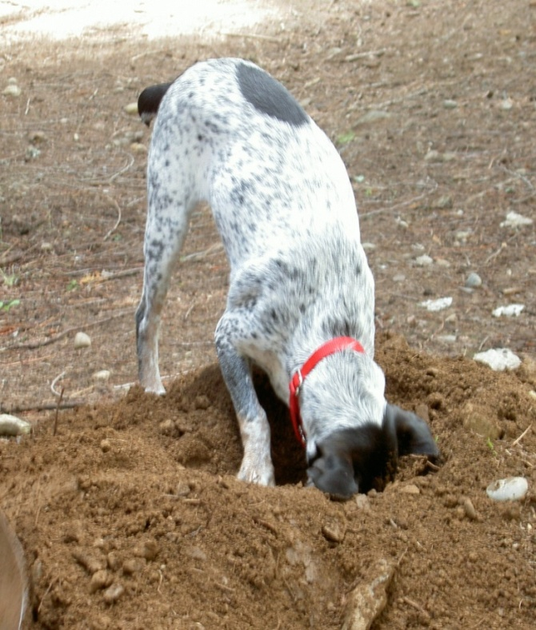
It Worked Once, So…
2010 Patient Protection & Affordable Care Act
Further and more severe technical fee reductions
Targeted in-office imaging and non-hospital testing facilities
Concern that there is still another “bone” to be found in the same whole…perhaps a whole carcass
The sun don’t shine on the same dog’s tail all the time.
- Sam Snead

Slide 21
Industry’s Perfect Storm
Legislation and regulation to reduce payments
2005 Deficit Reduction Act
2010 Patient Protection and Affordable Care Act
Worldwide recession
Lost jobs and health insurance
Employers shift of financial responsibility to patients
RBMs and pre-authorization
Concerns over diagnostic radiation
ALL LEADING TO
Reduced imaging utilization
Fewer new imaging providers
Less reinvestment by current providers
DIMINISHED SALES OF DEVICES
and
GREATER CAUTION IN PURSUING INNOVATION

Slide 22
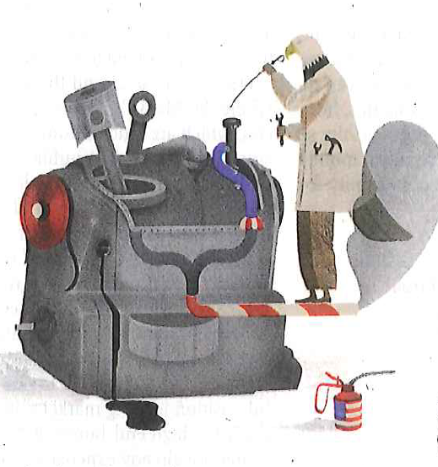
Innovation in the U.S.
Declining capital markets
Reduced venture capitalist spending due to recent losses
Especially affects “more adventurous firms”
Major implications for job growth
Tightened immigration policies
1995-2005: 40% of new companies started by immigrants or their children
Immigrants with 2X the patent rate of people born in the U.S
Heavy-handed university patent policies
Diminished commercialization of grant-funded discoveries
- Schumpeter – Fixing the Capitalist
Machine, The Economist, Sept. 29, 2012

Slide 23
Era of Caution in Imaging Innovation
Static grant funding for idea generation
Fear over new reimbursement attacks
Uncertainty over world financial markets
Uncertainty about how medical services might be paid for in the future
The strategic question is:
Be a real innovator with mission to improve patients’ health
versus
A “me too” company with diminished expectations

Slide 24
Barriers to Successful Innovation
Research and development
The fish ladders
FDA approval
CMS and private coverage
Demonstration to patients, providers, and society of:
Benefit
Value
Affordability

Slide 25
The Costs of Innovation
Innovation development and assessment translates to time and money
Direct costs of development and testing
Opportunity costs
3-7 years typical for important new devices
>$100M
>10 years for new drug, contrast agent, radiopharmaceutical
>1B
“Dry holes”

Slide 26
Fish Ladders - FDA
Considerations of “safety and efficacy”
Underfunded - FDA actions taking longer than regulatory rules allow
Insufficient guidance on what is required for new types of technology
Political disarray
Whistle blowers
Fear of approving advanced technologies with possible hidden risks

Slide 27
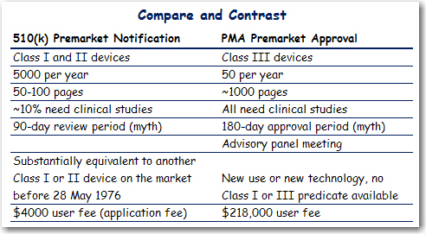
Fish Ladders - FDA
Jae Choi; Janus Head Consulting
Source: Clinical Device Group, Inc.

Slide 28
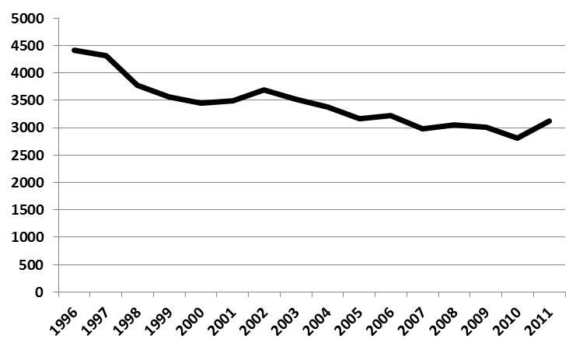
Medical Devices: Minor Innovations
Number of 510k clearances vs. time
From 1996 to 2011
Jae Choi; Janus Head Consulting
Choi et al; Source: Data from FDA

Slide 29
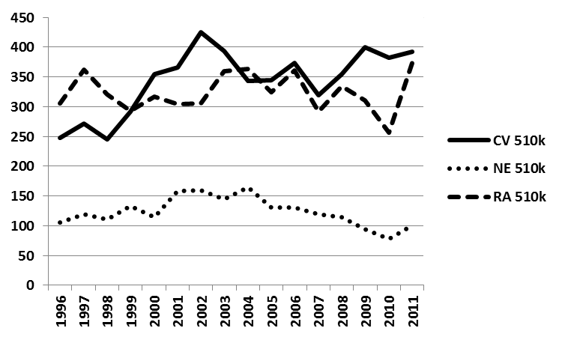
Minor Innovations: Specific Types of Devices
Number of 510k clearances vs. time for Cardiovascular, CNS, and Radiology
From 1996 to 2011
Jae Choi; Janus Head Consulting
Choi et al; Source: Data from FDA

Slide 30
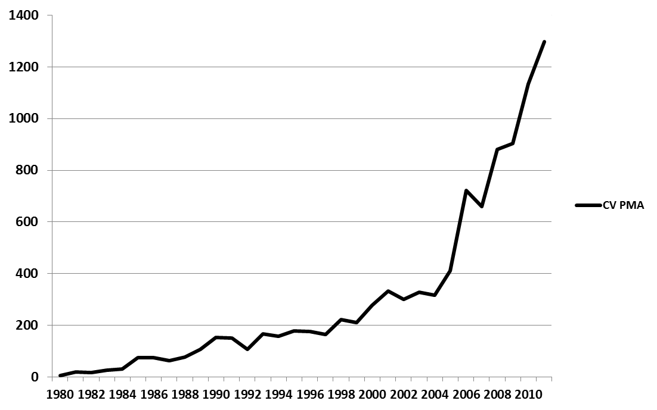
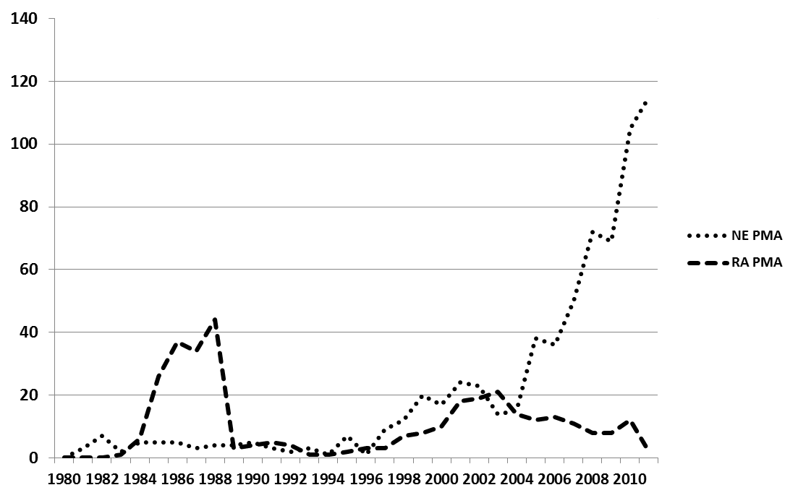
Medical Devices: Major Innovations
Number of PMA approvals vs. time for Cardiovascular, CNS, and Radiology
From 1980 to 2011
Jae Choi; Janus Head Consulting
Choi et al; Source: Data from FDA

Slide 31
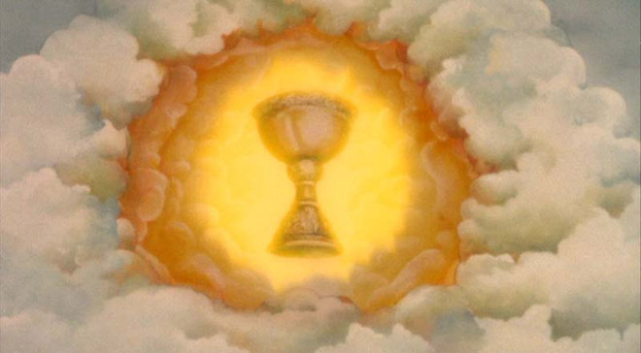
Fish Ladders - CMS
The boys all took a flier at the Holy Grail now and then. though none of them had any idea where the Holy Grail really was, and I don't think any of them actually expected to find it, or would have known what to do with it if he had run across it.
- Mark Twain
Medicare coverage essential to success
Private payers follow Medicare
Coverage for “medical necessity”
Innovation provides a benefit to patients
Evidence that the innovation is finding a niche in practice
Local vs. national coverage decisions
Coverage with evidence development
Limited coverage for sites collecting data in deemed trials/registries

Slide 32
Measuring Benefit
Improved health a difficult task for imaging innovations
Imaging a single link in the Dx/Rx chain
The organizational structure for rigorous trials is overwhelmed
Attributing a health benefit to a diagnostic test takes:
Big numbers
Big time
Big money

Slide 33
Acceptance and Dissemination
Future innovations must overcome
4 hurdles
Benefits to patients
Improved care and/or health
Less discomfort/invasiveness
Higher efficiency/convenience/painless
Attractiveness to providers
Efficient
Fits into the context of their practices
Easily learned
Profitable
Value: a reasonable ratio of cost/benefit in the context of existing options
Affordability to society

Slide 34
Out with the Old, In with the Old
Accountable care organizations (ACOs)
Managed care light from your friendly managed care provider
Deemed providers assume responsibility for a regional population
Provide inpatient and outpatient care, as well as preventative and early detection services
ACOs assume risk - fixed payment per beneficiary plus profit-sharing
Competition over cost and quality
ACOs alter incentives to restrict care
Services like medical imaging become cost centers
Rationed resource overseen by:
RBMs or decision support software
Utilization review
Metrics to assess completeness and quality of care
Correct aberrant incentives to provide “the right amount of care”

Slide 35
The Future of Fee-for-Service Payment
Shift to bundled payments won’t happen overnight
Continued attacks to make imaging less profitable
Future attacks on technical fees
The anti-imaging bias
Persistent erroneous belief that imaging use and cost continues to rise
Undocumented belief that imaging codes are overpaid
Need for federal cost savings
It worked before!
Professional fees - Congressional and private insurance efforts to achieve savings from “efficiencies” in interpreting contiguous exams on the same patient performed on the same day
Progressive empowerment of radiology benefits management (RBMs) firms

Slide 36
The Transition Period - A Foot in Both Camps
Fee-for-service incentives: Volume is king
Streamline workflows to increase capacity for new work
ACO incentives: Value is king
Streamline workflows to:*
Focus on outcomes
Redefine productivity beyond RVU production
Become leaders on medical staffs and in the community
Become “visible” to patients and referring physicians
Establish the role of imaging in new delivery systems
Inefficiencies in workflow put practices at risk
*From ACR’s Imaging 3.0

Slide 37
Summary
Innovators
Providers
Think strategically about which technologies can cross “the 4 hurdles”
Stage research to maximize information at the lowest cost
Consult customers early and often
Track secular changes that may impact the value of future technologies
Be ruthless in go/no go decisions
Track technologies during development and testing
Weigh the potential of implementation for improving efficiency
Evaluate the relative advantages of early versus later adoption
Consider local payment approaches and ACO trajectory
Assess the impact of an innovation on perceptions of patients, physicians, and the health system

Slide 38
bjh8a@virginia.edu
Golf appeals to the idiot in us and the child. Just how child-like golf players become is proven by their frequent inability to count past five
- John Updike

