Slide 1
Controversies and Current Role of Cardiac CT in the ER
James Ravenel MD
Medical University of South Carolina

Slide 2
What the %#$*@! do I do with all those Damn Nodules

Slide 4
Controversies and Current Role of Cardiac CT in the ER
James Ravenel MD
Medical University of South Carolina

Slide 5
Acute Chest Pain
>6 Million pts in US annually
5 – 8 % of these is STEMI or ACS
No well defined criteria for non-ST elevation ACS
Wide differential diagnosis
Schlett et al. 2011 JACC, Hoffmann et al. NEJM 2012

Slide 6
Acute Coronary Syndrome
Unstable angina (1.7% 30 day mortality)
Non-ST elevation MI (7.4%)
ST elevation MI (11.1%)
Acute myocardial ischemia

Slide 7
ACS Risk Scores
PURSUIT
TIMI
GRACE
FRISC
Validated on patients with ACS
Limited sensitivity in acute chest pain

Slide 8
TIMI
Age ≥ 65 years?
> 3 CAD risk factors?
Known CAD (stenosis ≥ 50%)?
ASA Use in Past 7d?
Severe angina (≥ 2 episodes w/in 24 hrs)?
ST changes ≥ 0.5mm?
+ Cardiac Marker?
Predicts mortality in ACS
< 2 may be appropriate for imaging to manage chest pain in ED

Slide 9
HEART Score
HEART Score for Chest Pain Patients
History | Highly suspicious | 2
 | Moderately suspicious | 1
 | Slightly suspicious | 0
ECG | Significant ST-depression | 2
 | Non specific repolarisation disturbance | 1
 | Normal | 0
Age | ≥ 65 year | 2
 | 45 – 65 year | 1
 | ≤ 45 year | 0
Riskfactors | ≥ 3 risk factors or history of atherosclerotic disease | 2
 | 1 or 2 risk factors | 1
 | No risk factors known | 0
Troponin | ≥ 3x normal limit | 2
 | 1-3x normal limit | 1
 | ≤ normal limit | 0
 |  | Total

Slide 10
HEART Score
Endpoint: Major Acute Cardiac Events
Low: 0-3—0.9%
Int: 4-6– 12%
High: 7-10– 65%

Slide 11
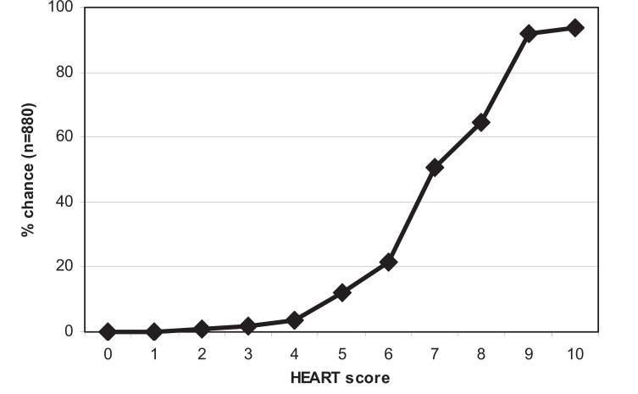
HEART Score

Slide 12
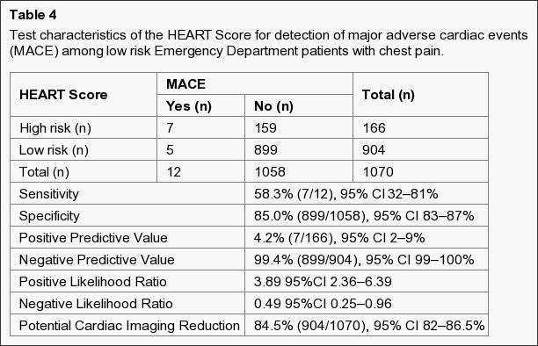
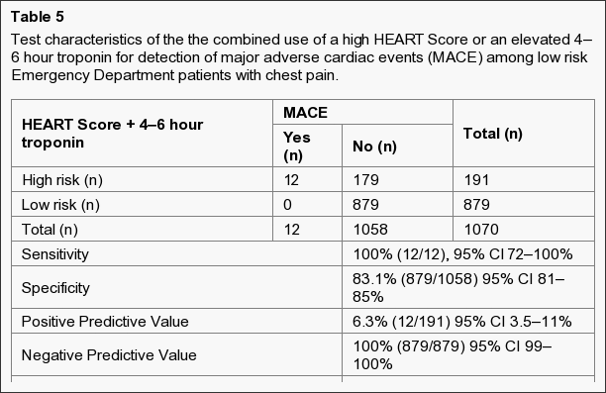
Crit Pathw Cardiol. 2011 September; 10(3): 128–133.

Slide 13
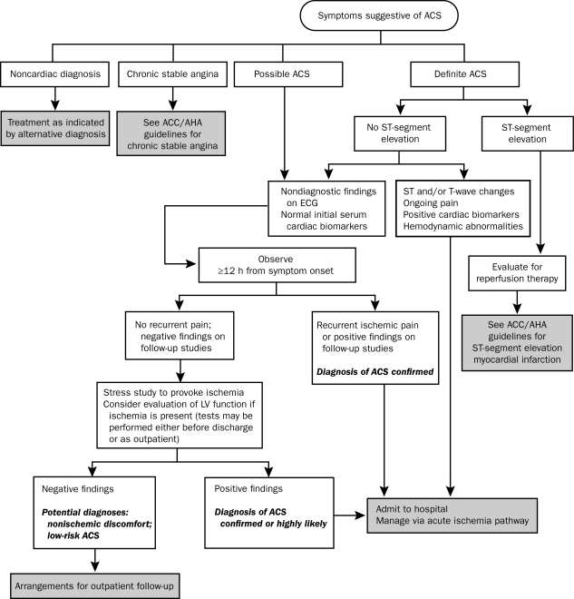
Historical Pathways

Slide 14
ED Pathway
Triage Nurse
CT
Admit
Send Home

Slide 15
Not all chest pain Requires CT

Slide 16
Stabbing left chest pain…

Slide 18
“Triple Rule Out”
ECG-gated CT Angiography of the chest

Slide 19
Technique
Calcium Score if older than 40
High iodine concentration (Ultravist 370)
Dual flow injection
Test bolus-Time to peak = scan delay
6 cc x scan delay= volume of Ultravist 370
50 cc 30 % Ultravist/ 70% saline
50 cc saline chaser

Slide 20
Technique
Retrospective gating
Functional analysis
Prospective/Flash
Single acquisition usually diastole
Lower dose
No function
? Suspected dissection

Slide 21
Reconstructions
Standard
2 chamber/3 chamber MIPs
3D VR
On the fly
Curved reformat
Function

Slide 23
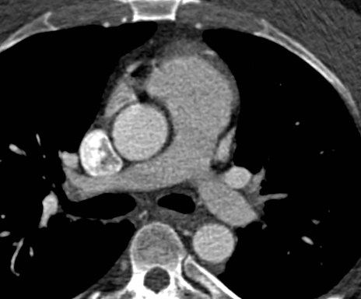

Slide 25
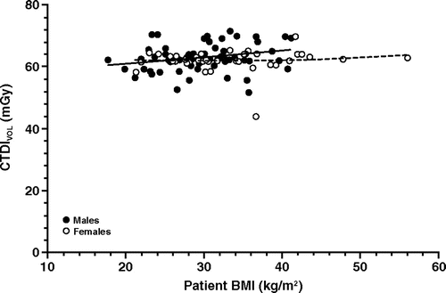
Radiation Dose
Effective doses: 20-31 mSv

Slide 26
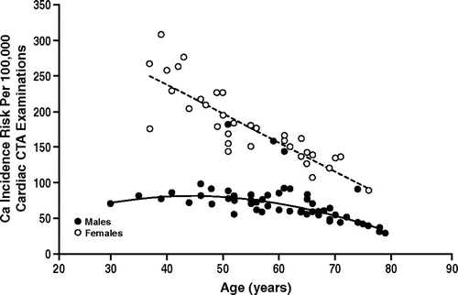
Radiation Dose

Slide 27
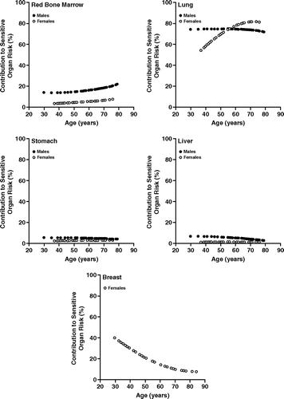

Slide 28
Cardiac Imaging in the ED

Slide 30
Why not just calcium score?
In Asymptomatic patient CAC of zero
Low 10 year events and all-cause mortality
Can this be applied to symptomatic patients?
3 studies -99% npv for ACS
7 studies -1.8% event rate over 4 years
Jacc: Cardiovascular Imaging. 2009;2(6):675-88

Slide 31
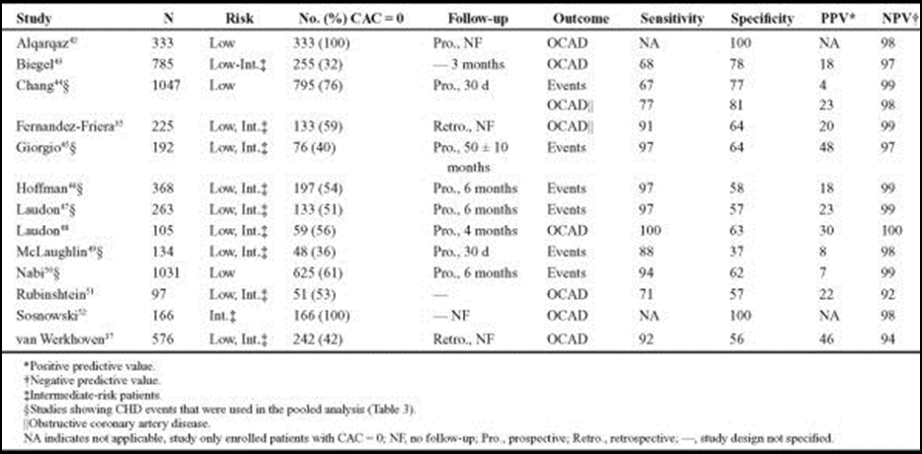
TABLE 3
Utility of Coronary Artery Calcium Scoring in the Evaluation of Patients With Chest Pain.
Tota-Maharaj, Rajesh; McEvoy, John; MB BCh, BAO; Blaha, Michael; MD, MPH; Silverman, Michael; Nasir, Khurram; MD, MPH; Blumenthal, Roger
Critical Pathways in Cardiology: A Journal of Evidence-Based Medicine. 11(3):99-106, September 2012.
DOI: 10.1097/HPC.0b013e31825b1429
TABLE 3 . 2 x 2 Table of Pooled Analysis of Low-Intermediate Risk Patients Evaluated for Chest Pain in the Emergency Department
© 2012 Lippincott Williams & Wilkins, Inc. Published by Lippincott Williams & Wilkins, Inc.
2

Slide 32
263 low/moderate risk
Blinded to outcome of calcium score
133 calcium score zero
1 cardiac related chest pain
Remaining no cardiac events out to 5 years
Mayo Clinic Proceedings2010;85:314-322

Slide 33
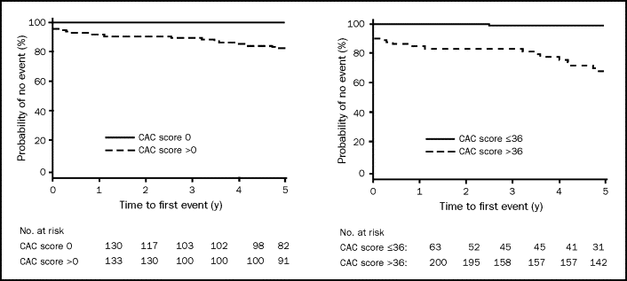

Slide 34
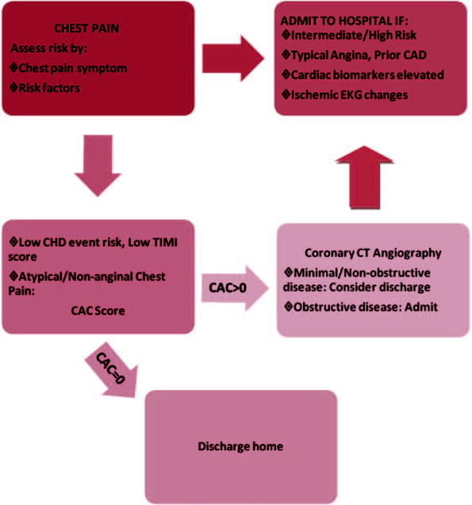
FIGURE 2
Utility of Coronary Artery Calcium Scoring in the Evaluation of Patients With Chest Pain.
Tota-Maharaj, Rajesh; McEvoy, John; MB BCh, BAO; Blaha, Michael; MD, MPH; Silverman, Michael; Nasir, Khurram; MD, MPH; Blumenthal, Roger
Critical Pathways in Cardiology: A Journal of Evidence-Based Medicine. 11(3):99-106, September 2012.
DOI: 10.1097/HPC.0b013e31825b1429
FIGURE 2 . Proposed chest pain algorithm based on pertinent studies.
© 2012 Lippincott Williams & Wilkins, Inc. Published by Lippincott Williams & Wilkins, Inc.
2

Slide 35
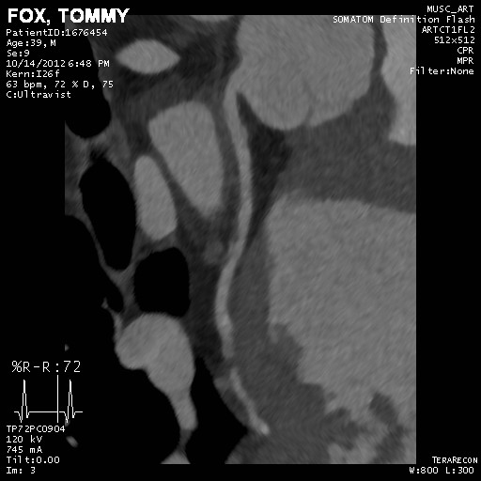
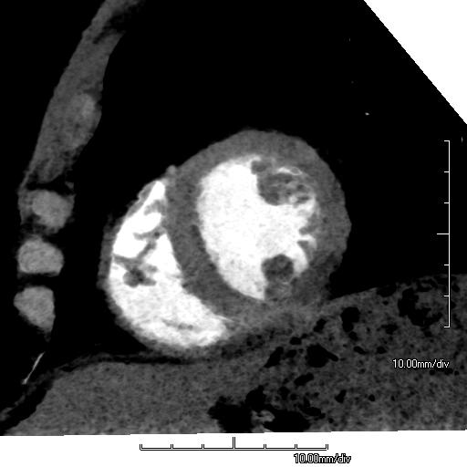
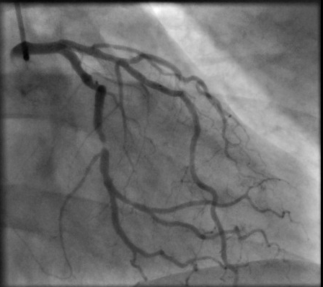
ACS possible with Ca-score of zero

Slide 36
ROMICAT I
368 subjects
Chest pain, negative troponin, no ECG ischemia
8.4% ACS
AT 2 years 25/333 (6.8%) had a Major cardiac event (MACE)
No disease-0%
< 50% stenosis-4.6%
> 50% stenosis-30.3%

Slide 37
ROMICAT I
Sensitivity of > 50% stenosis
ACS: 24/31 77% (59-90%)
MI: 5/8 63% (24-91%
NPV: 98% (Of course NPV would be 91.6% if everyone called negative and discharged without CT)

Slide 38
ROMICAT II
Do sequels help?

Slide 39
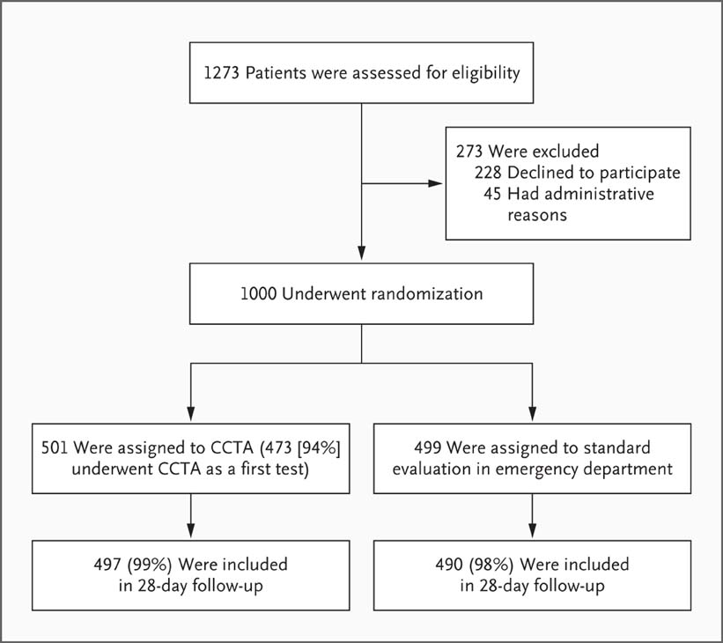
Screening, Randomization, and Follow-up of the Study Patients.
Hoffmann U et al. N Engl J Med 2012;367:299-308
Notes:
Figure 1 Screening, Randomization, and Follow-up of the Study Patients. CCTA denotes coronary computed tomographic angiography.

Slide 40
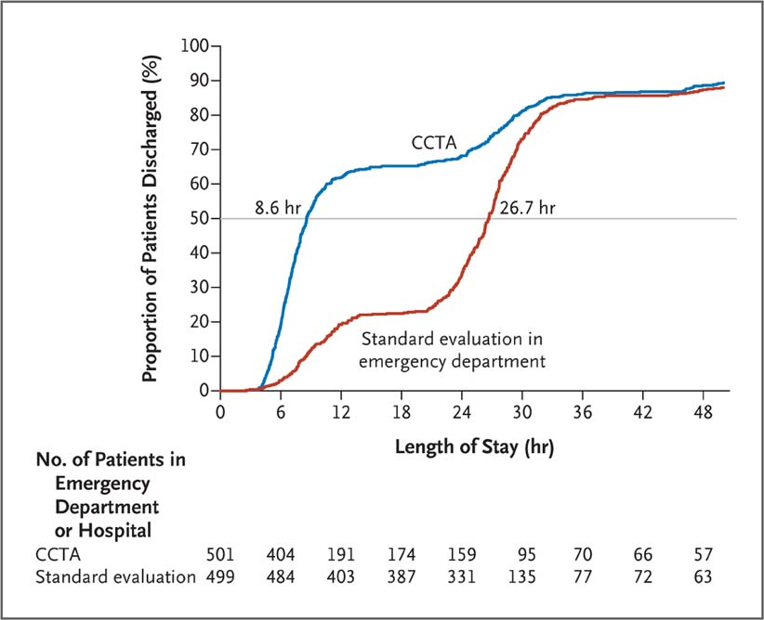
Length of Stay in the Hospital and Proportion of Patients Discharged.
Hoffmann U et al. N Engl J Med 2012;367:299-308
Notes:
Figure 2 Length of Stay in the Hospital and Proportion of Patients Discharged. The cumulative frequency of discharge from the index visit according to the length of stay is shown. The horizontal line indicates the median length of stay in the two study groups, which was significantly different (8.6 hours in the CCTA group vs. 26.7 hours in the standard-evaluation group, P<0.001).

Slide 41
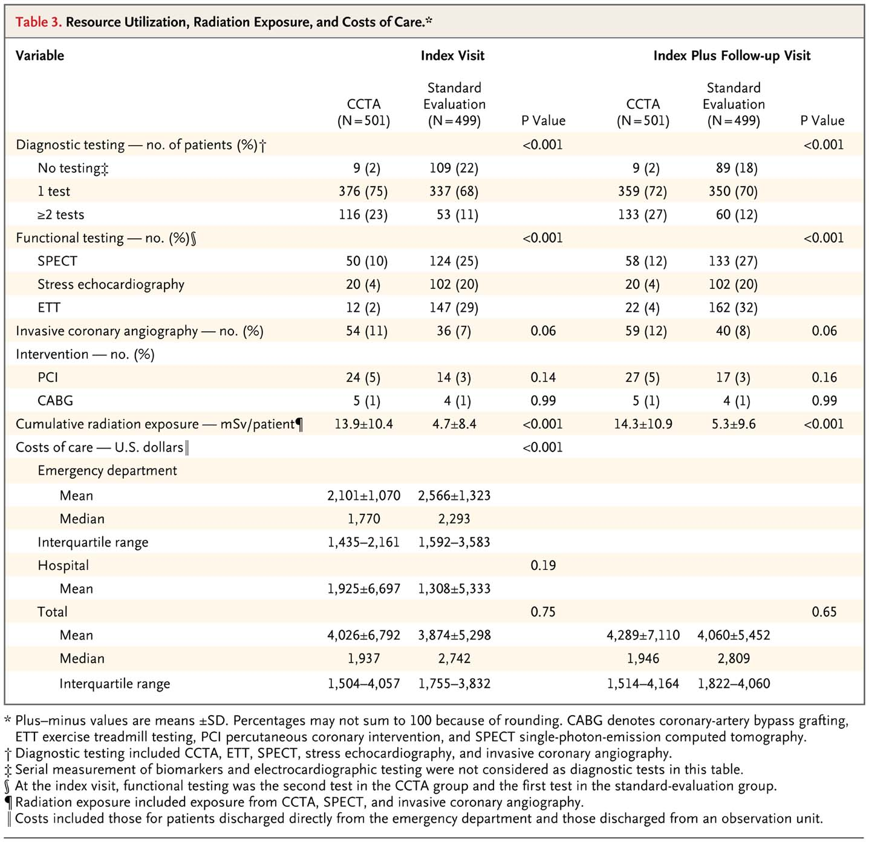
Resource Utilization, Radiation Exposure, and Costs of Care.
Hoffmann U et al. N Engl J Med 2012;367:299-308
Notes:
Table 3 Resource Utilization, Radiation Exposure, and Costs of Care.

Slide 42
Conclusions
In patients in the emergency department with symptoms suggestive of acute coronary syndromes, incorporating CCTA into a triage strategy improved the efficiency of clinical decision making, as compared with a standard evaluation in the emergency department, but it resulted in an increase in downstream testing and radiation exposure with no decrease in the overall costs of care.

Slide 43
ACRIN-PA

Slide 44
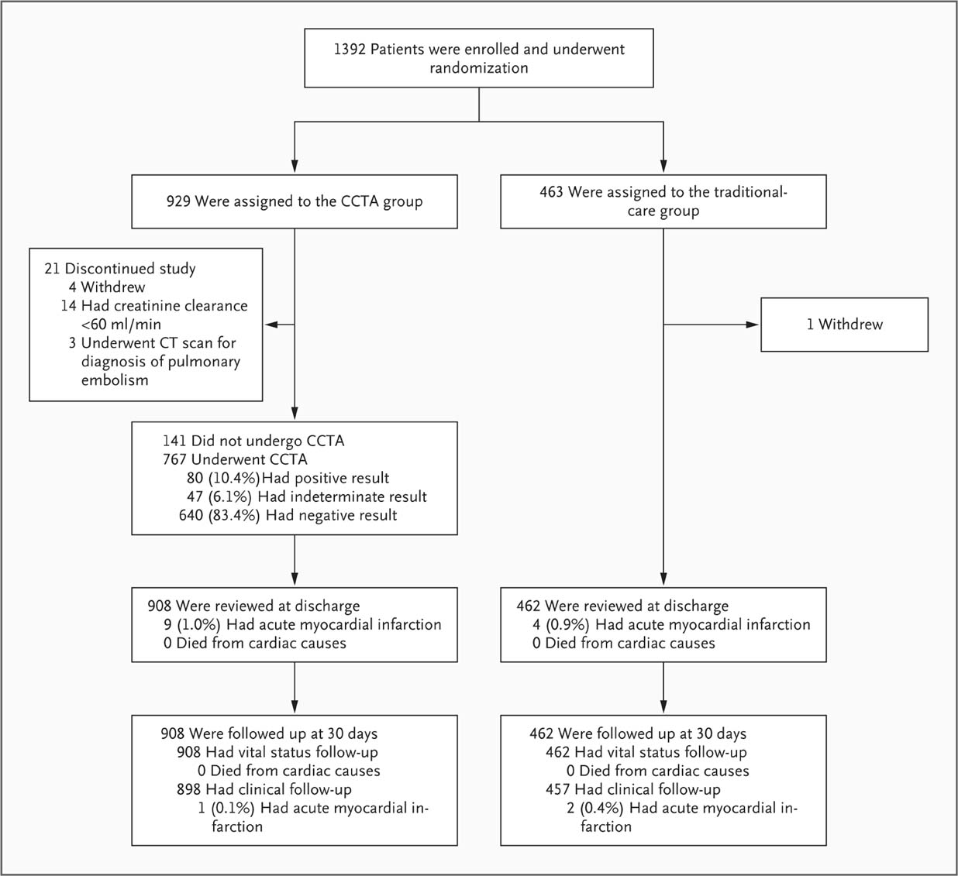
Enrollment, Randomization, Treatment, and Follow-up of the Study Patients.
Litt HI et al. N Engl J Med 2012;366:1393-1403
Notes:
Figure 1 Enrollment, Randomization, Treatment, and Follow-up of the Study Patients.

Slide 45
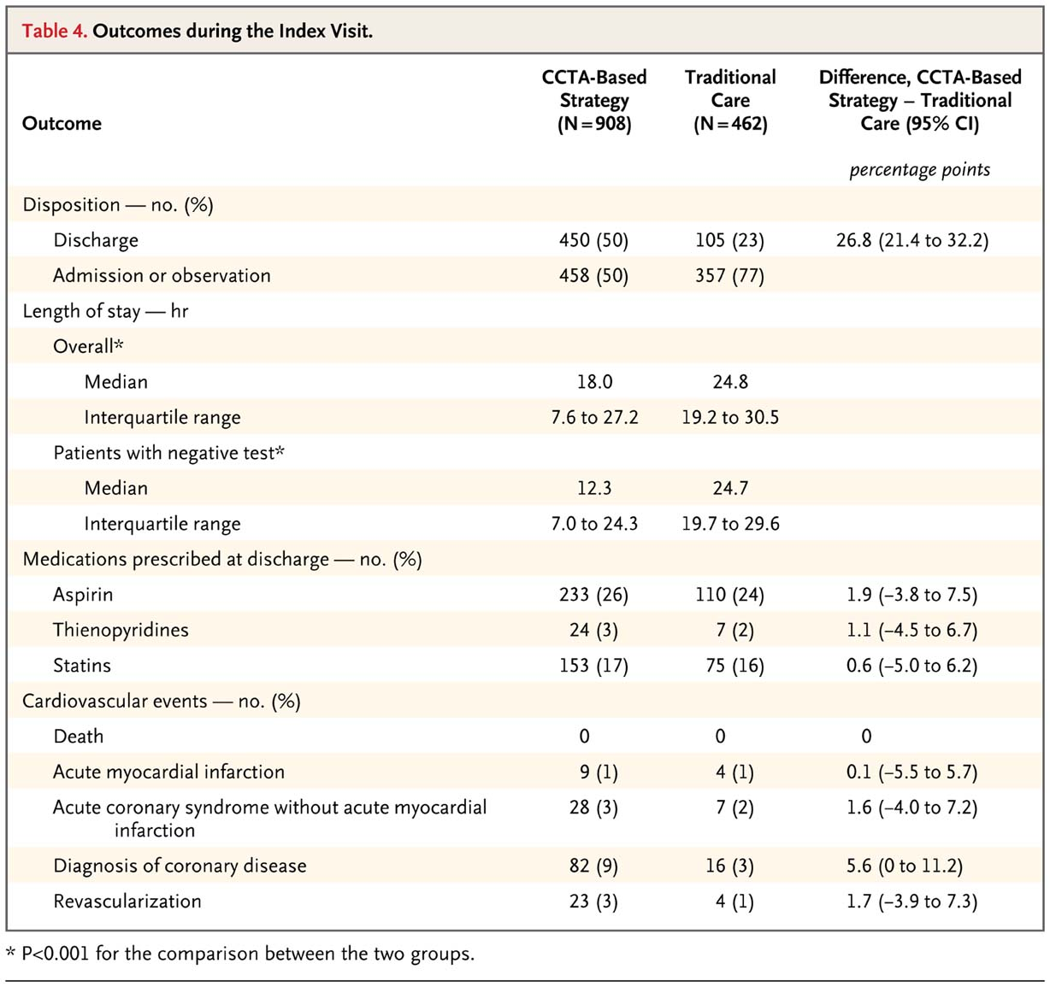
Outcomes during the Index Visit.
Litt HI et al. N Engl J Med 2012;366:1393-1403
Notes:
Table 4 Outcomes during the Index Visit.

Slide 46
Conclusions
A CCTA-based strategy for low-to-intermediate-risk patients presenting with a possible acute coronary syndrome appears to allow the safe, expedited discharge from the emergency department of many patients who would otherwise be admitted.

Slide 47
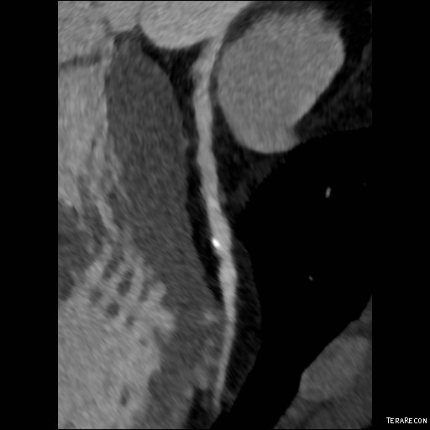
EfficienT & Safe DISCHARGE NPV ~99%
Safe to discharge if CTA is clean or stenosis is MILD (<50%?)
Length of hospital stay reduced
More direct discharge from ED
No increase in MACE for 30 days
Negative CTA good for 2yrs
Mild stenosis with
Positive vascular remodeling
Budoff et al 2008 JACC; Cury et al. 2013 AJR

Slide 48
Or not….
Both studies confirm the somewhat unremarkable fact that CCTA provides faster diagnostic results than standard evaluation
The underlying assumption …is that some diagnostic test must be performed before discharging these low-to-intermediate-risk patients from the emergency department. This assumption is unproven and probably unwarranted.
In short, the question is not which test leads to faster discharge of patients from the emergency department, but whether a test is needed at all.
Rita Redberg

Slide 49
Cost Implications
Romicat II –only cardiac f/u over 28 days
Other Incidental findings?
Up to 20% small pulmonary nodule

Slide 50
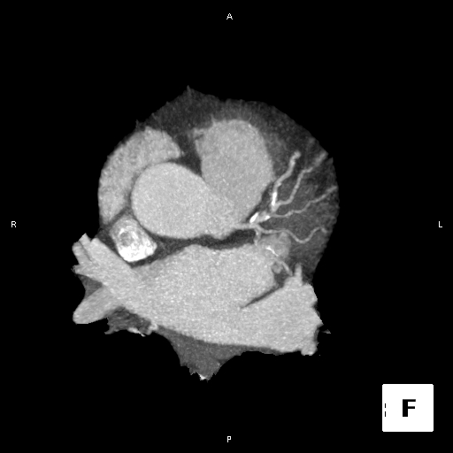
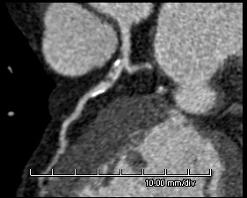
NPV - Excellent – BuT…

Slide 51
TRO vs. Cardiac CT
Z-axis coverage
Contrast dynamics
Alternate diagnosis in ED
CTA not an “emergency” modality

Slide 52
TRO vs. Myocardial Perfusion
Am J Cardiol 2009;103:1481–1486)

Slide 53
TRO vs. Myocardial Perfusion
Am J Cardiol 2009;103:1481–1486)

Slide 54
MPS generally older, diabetes, HTN, prior CAD
Similar rates of discharge (90 v 89%)
21% TRO group incidentaloma
24 nodules (10%)
Overall little difference in intermediate outcomes

Slide 55
Triple Rule Out-What is found?
197 subjects over 1 year
65% no CAD/ 23% mild/ 12% mod/severe
5 pneumonia
3 pulmonary emboli
1 Aortic dissection
1 Anomalous coronary

Slide 56
MUSC experience
1/1/13-3/31/13
163 exams (70M/93 F)
Age range 21-80 (65%- 5th and 6th decade)

Slide 57
MUSC experience Non-Coronary
2 PE
1 Lung Cancer
4 anomalous coronaries (3 “malignant”)
3 miscellaneous (pneumomediastinum, pericarditis, NICM)

Slide 58
MUSC experience Coronary
95 (58%) normal
36 (22%) mild
26 (16%) moderate
6 (4%) severe

Slide 59
MUSC experience Coronary

Slide 61
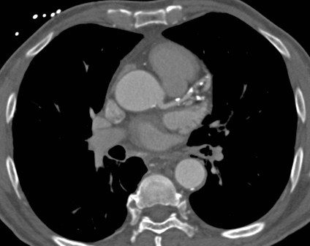
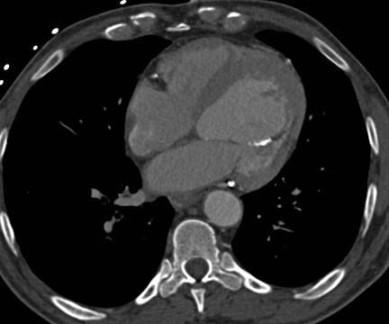

Slide 62
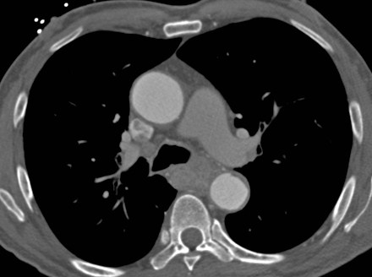

Slide 69
Interpretation
Is test diagnostic? All segments visualized?
Normal exam (no atherosclerotic disease)
Calcium score <100?
Mild Stenosis (<30%)
Moderate Stenosis (30-70%)
?Calcium score >400
Severe Stenosis (>70%)

Slide 70
Mild

Slide 71
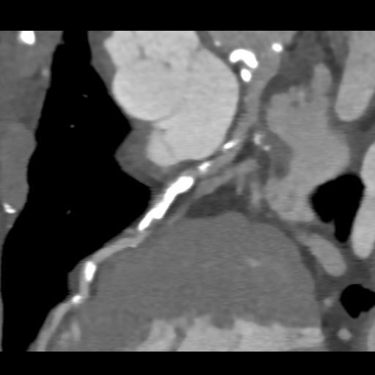
Moderate

Slide 72
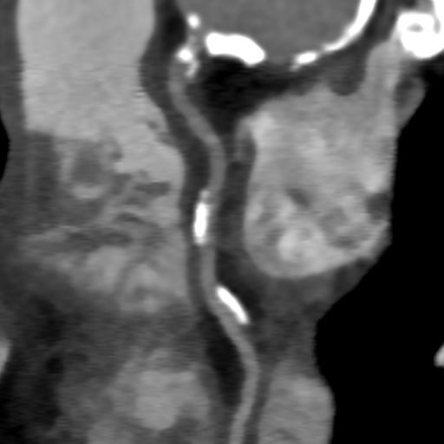
Severe

Slide 74
Should there be only one cut-off?
Binary decision at 50%?

Slide 75
Can Anyone Read?
ROMICAT I/II business hours studies
Univ of MD still business hour shop
Expert cardiac readers
Cardiac CTs are REALLY fancy!

Slide 76
Can Anyone Read?
On call residents after 1 cardiac rotation (100-150 cardiac CTs)
88.5% concur
10.4% minor discrepancy
1.1% major discrepancy
Comparison to Chest CT
89.8% concur
7.2% minor discrepancy
3.0 % major discrepancy

Slide 77
Cocaine and Chest Pain
Cohort matched control
44 subjects/132 controls
6-fold higher incidence of ACS
Not associated with higher presence of:
Plaque
Calcification
Stenosis
Am J Cardiol. 2009 Mar 1;103(5):620-5

Slide 78
Cocaine and Chest Pain
59 Subjects
79% non-specific ECG
85% TIMI score <2
55/59 immediate discharge or “brief” observation
6 stenosis > 50%
No coronary events at 30 days
Safe to discharge TIMI < 2 and (– ) coronary CTA
J Med Toxicol. 2009 Sep ;5(3):111-9.

Slide 79
Cocaine and chest pain
With low and intermediate risk for ACS…
Cocaine not associated with increased CAD when controlled for age, race, sex, and other risk factors for coronary disease
Cocaine use per se not reason to deny study either…

Slide 83
Conclusions
Negative CTA >99% NPV for MACE at 30 days
May be safe to discharge anyone with < 50% stenosis (low 30 day MACE)
Pre-test probability of disease (ACS) is 8%
Great test but…Is it really necessary?
Off load ED
Patient peace of mind
Limit repeat presentations?

