Slide 1
HRCT
The Basics

Slide 8
HRCT
Thin Collimation (1mm)
High Spatial Frequency Reconstruction
512x512 matrix
Lung Window (-600/1500 HU)

Slide 9
HRCT
Volumetric Scan
Expiration-Air Trapping
Prone- Differentiate Atelectasis

Slide 10
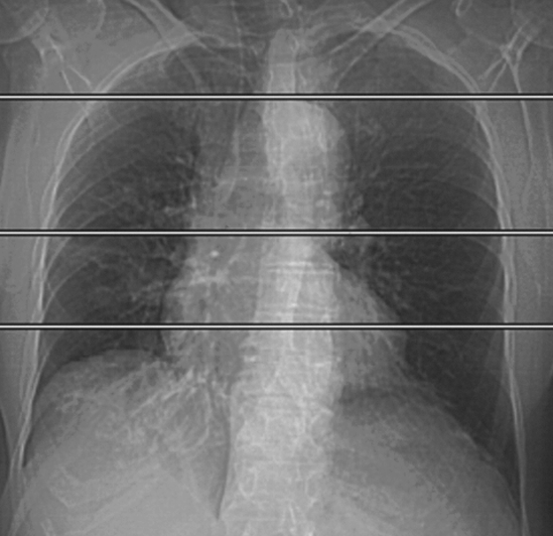

Slide 11
Basic Anatomy
Secondary Pulmonary Lobule
Pulmonary Acinus
Lobular Core

Slide 12
Secondary Pulmonary Lobule
Smallest unit of lung structure
Connective Tissue Septa
Polyhedral shape 1-2.5 cm
Single Small bronchiole

Slide 13
Pulmonary Acinus
Largest Gas Exchanging Unit of Lung
Distal to terminal bronchiole
Supplied by one (or more) respiratory bronchioles
6-10 mm
3-25 acini per secondary pulmonary lobule

Slide 14
Lobular Core
Central portion of secondary pulmonary lobule containing pulmonary artery and bronchiolar branches

Slide 15
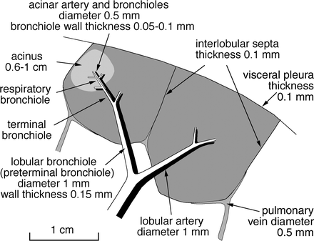
Basic Anatomy

Slide 16
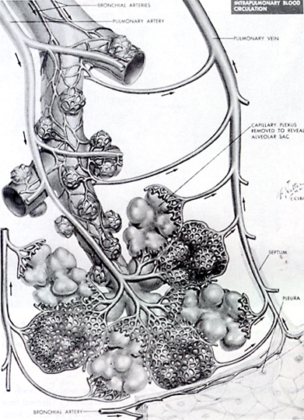

Slide 17
HRCT Terms
Interlobular Septa
Intralobular Septa
Sub-pleural Bands
Architectural Distortion
Honeycomb Lung
Ground Glass Opacity
Consolidation
Mosaic Attenuation
Centrilobular Nodules
Tree-in-bud Nodules
Perilymphatic Nodules
Cystic Air Space
Emphysema

Slide 18
Interlobular Septa
Connective tissue septa that marginate part of a secondary pulmonary lobule and contain pulmonary veins and lymphatics
10-20 mm long
0.1 mm thick
Best seen perpendicular to visceral pleura when thickened

Slide 19
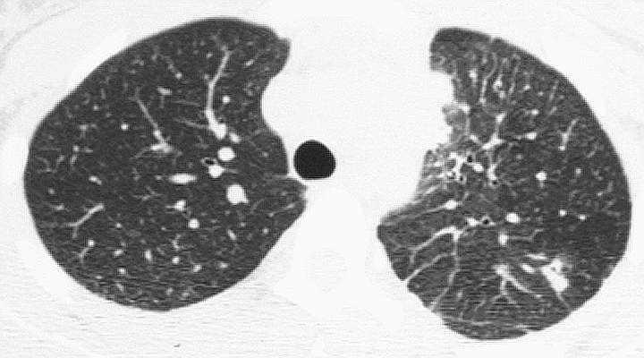

Slide 20
Intralobular Septa
Internal interstitial network which supports the secondary pulmonary lobule.
Contains connective tissue fibers of the alveolar walls and bronchovascular strucures leading to the alveolar ducts
Not visualized in normal subjects

Slide 21
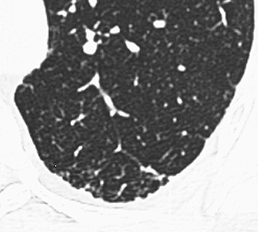

Slide 22
Subpleural Bands
Thin curvilinear line parallel to and within 1 cm from the visceral pleura
May represent subpleural fibrosis or dependent atelectasis
Labile engorgement of a leash of subpleural lymphatic vessels

Slide 23
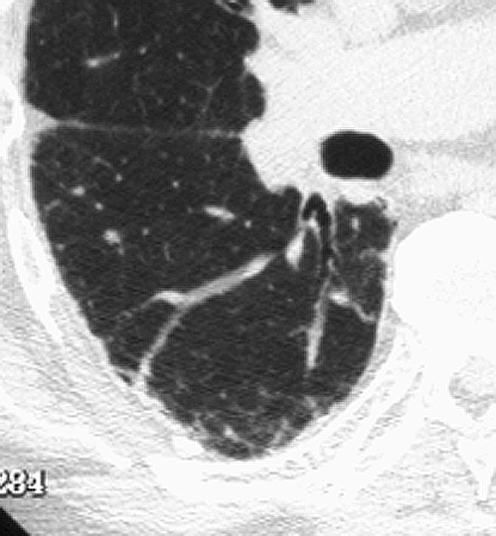

Slide 24
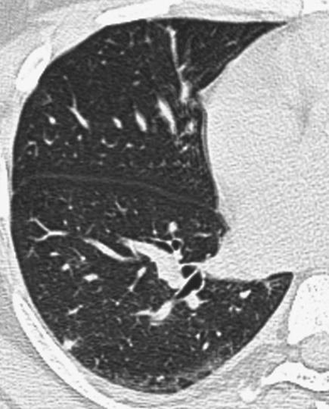
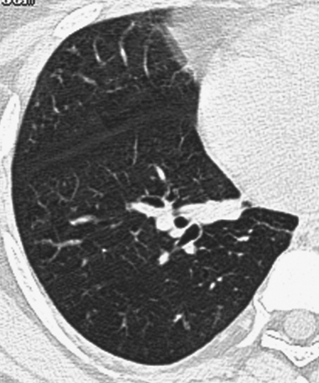
Supine
Prone

Slide 25
Architectural Distortion
Abnormal displacement of bronchi, vessels, fissures or septa
Usually associated with fibrosis

Slide 27
Honeycomb
Cystic air spaces characterized by clearly defined walls which may be thick
Destroyed and fibrotic lung tissue
Loss of acinar structure

Slide 28
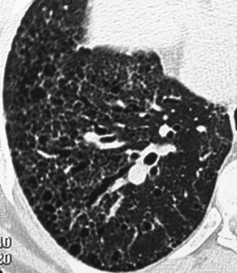

Slide 29
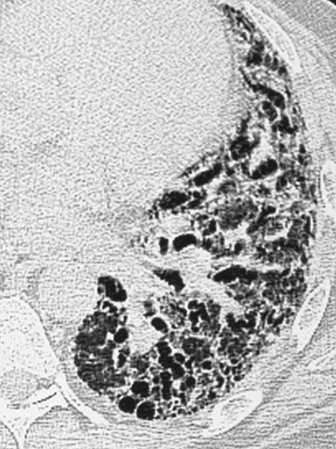
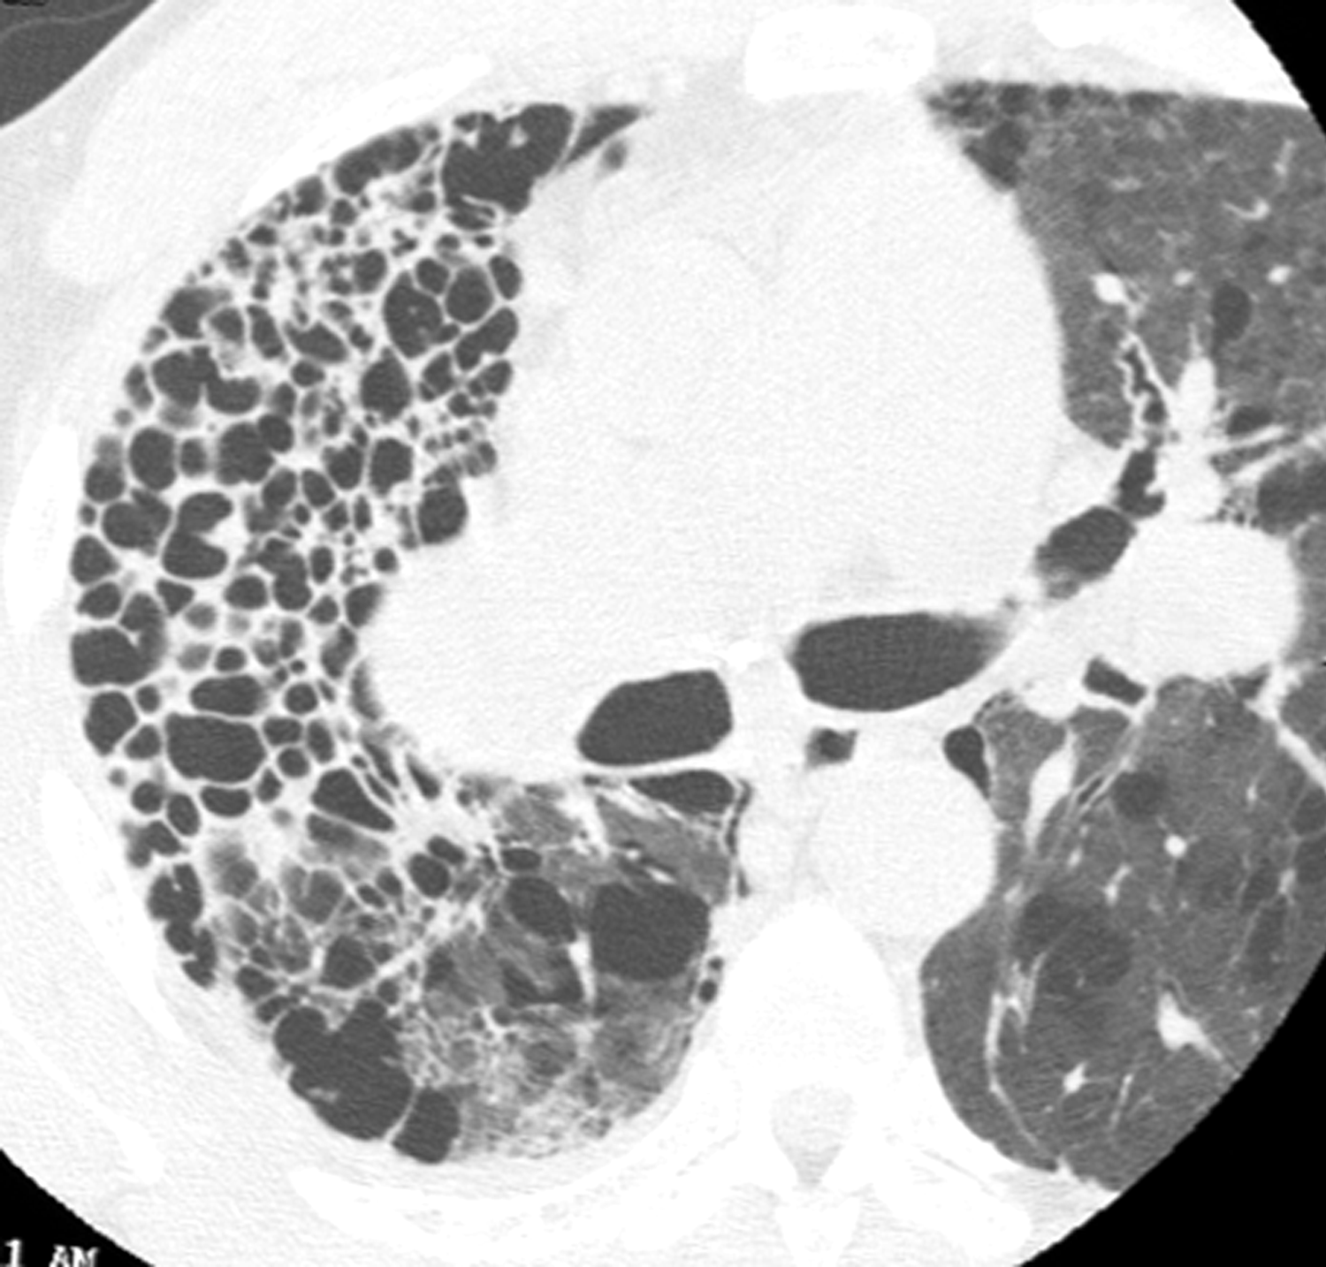

Slide 30
Ground Glass
Hazy increase in lung opacity which does not result in obscuration of the underlying pulmonary vessels.
May be due to air-space filling or minimal interstitial thickening

Slide 31
Consolidation
Exudative product displacing air from alveoli
Obscures margins of vessels, airway walls and septa
Solid/opaque
Air bronchogram

Slide 33
Mosaic Attenuation
Regional differences in lung perfusion resulting in attenuation differences
May reflect vascular obstruction or ventilation abnormalities

Slide 34
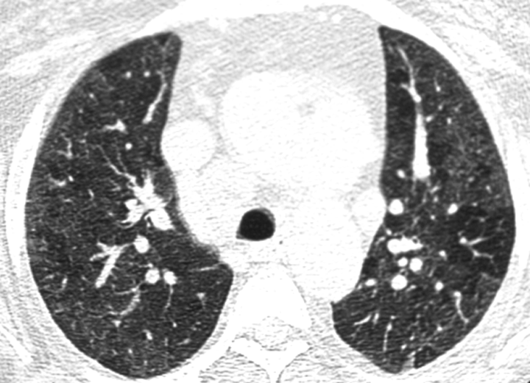
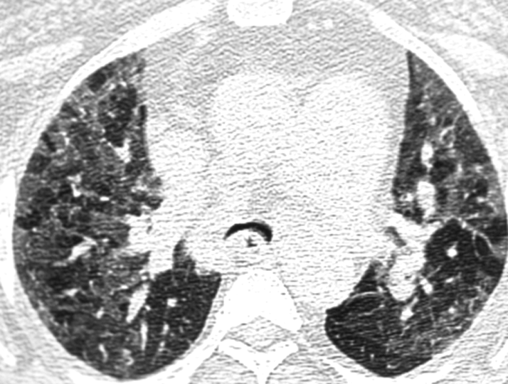
INSPIRATION
EXPIRATION

Slide 35
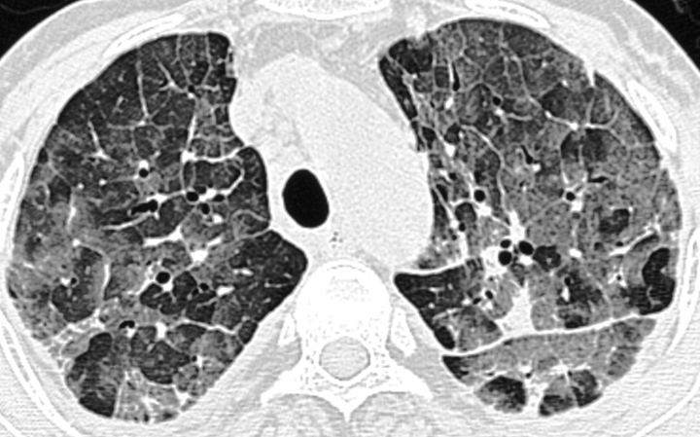
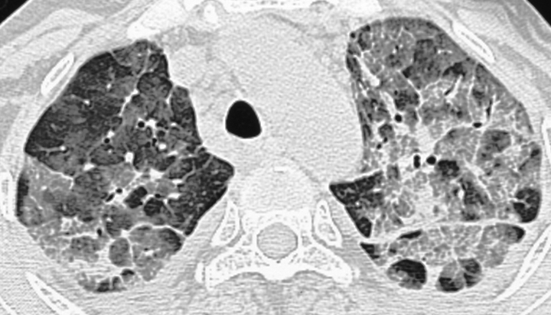
Inspiration
Expiration

Slide 36
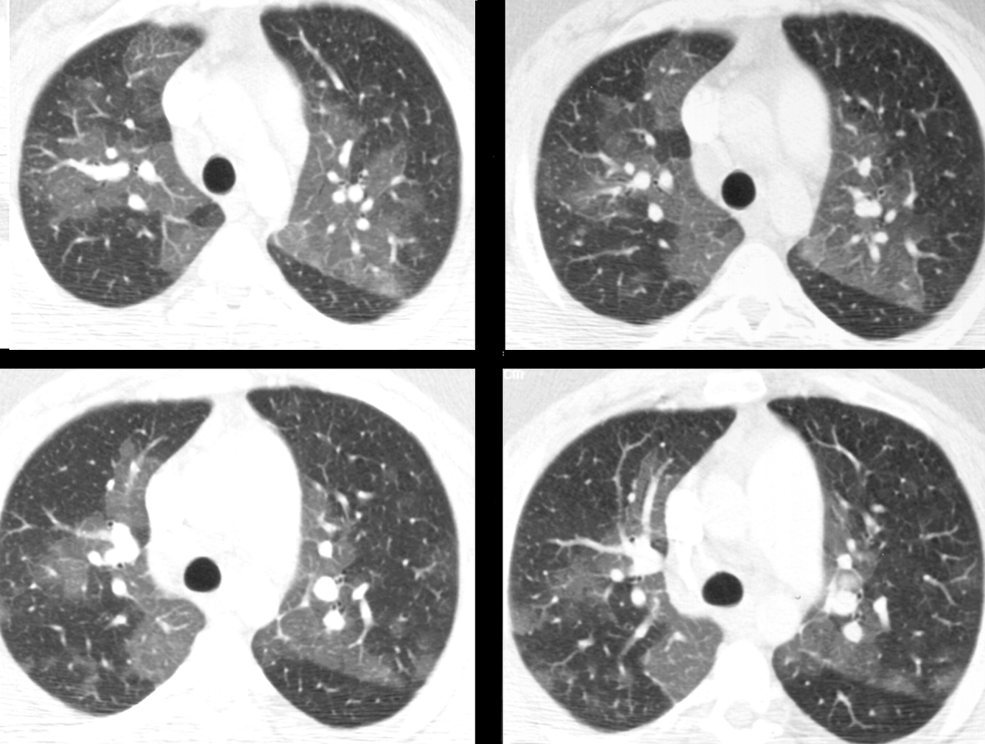

Slide 37
“Crazy-Paving” Pattern
Network of reticular opacities (inter- or intralobular septa) superimposed upon ground glass opacity

Slide 38
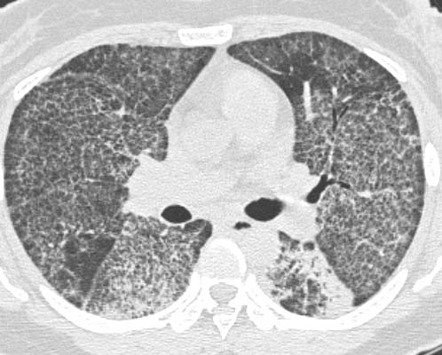

Slide 39
Nodular Disease
Centrilobular Nodules
-Hypersensitivity pneumonitis
-Panbronchiolitis
Peribronchovascular Nodules
-Sarcoidosis
-Lymphangitic Tumor
Tree-in-bud
-Atypical Mycobacterium and Tuberculosis
-Bronchopneumonia

Slide 40
Centrilobular Nodule
Abnormality involving the center of the secondary pulmonary lobule
Separated from pleural surface by several mm
Usually ill-defined; up to 1 cm in size (most several mm)

Slide 41
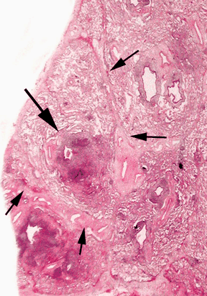

Slide 42
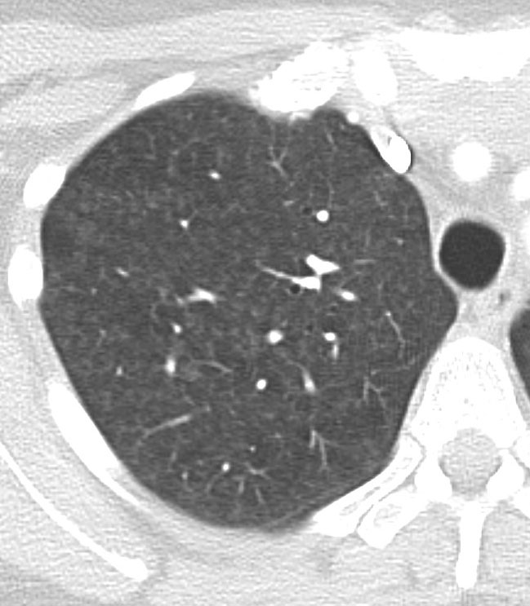

Slide 43
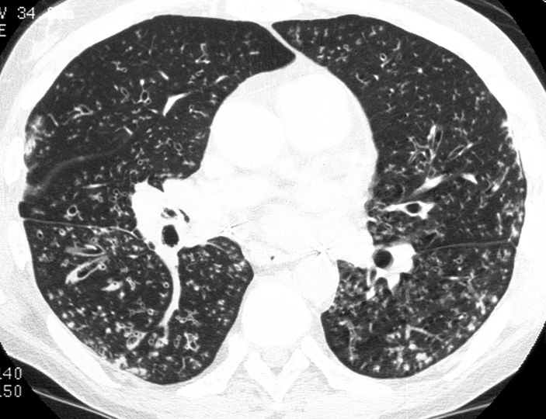
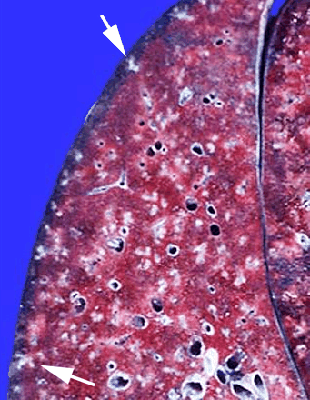
Tree-in-bud

Slide 44
Perilymphatic Nodules
Distribution along lymphatic vessels
Interlobular septa
Bronchovascular bundles
Subpleural

Slide 45
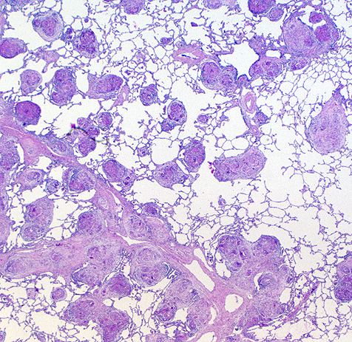
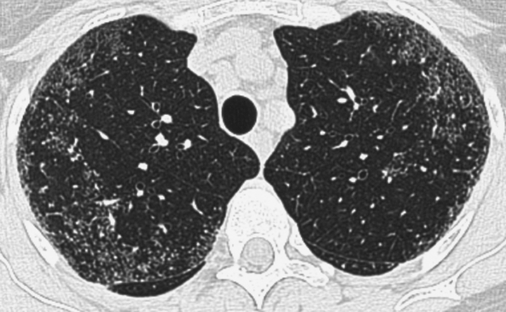
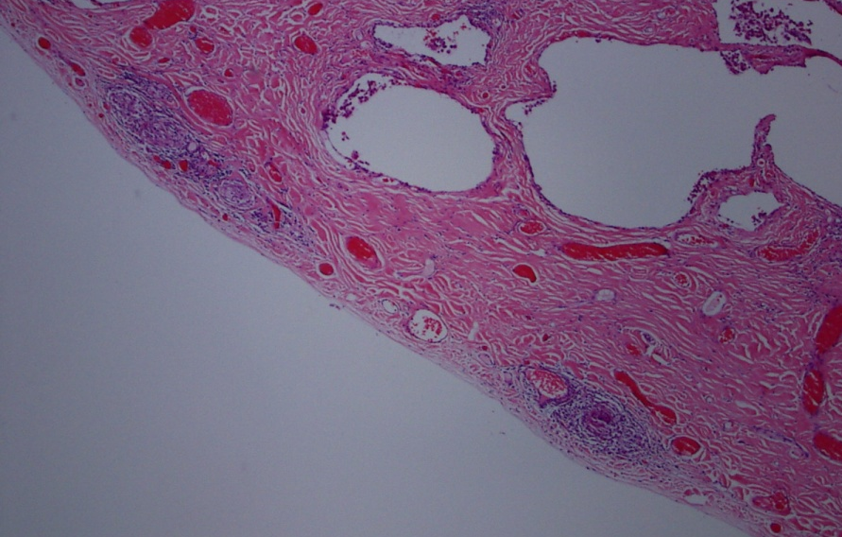
Sarcoidosis

Slide 46
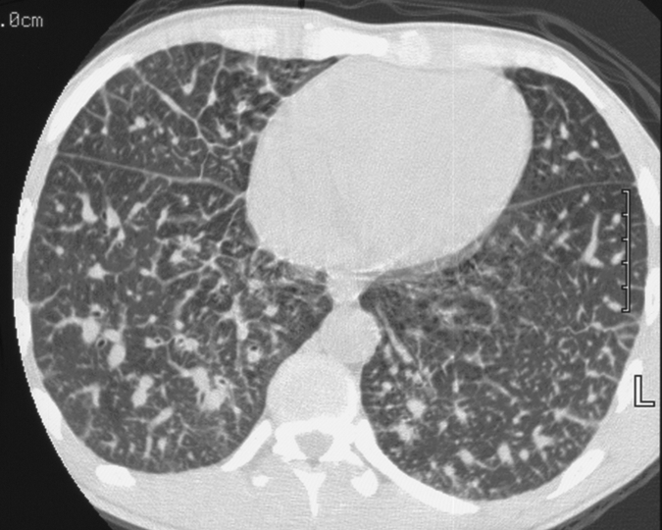
Lymphangitic Tumor

Slide 47
Cystic Air Space
Thin walled, well-defined, circumscribed air containing lesion with visible fibrous or epithelial wall

Slide 49
Emphysema
Permanent, abnormal enlargement of air spaces distal to the terminal bronchiole
Destruction of alveolar walls and air spaces without associated fibrosis
Regions of low attenuation without visible walls

Slide 50
Emphysema
Centrilobular- Mainly affects respiratory bronchioles and therefore the central region of the secondary lobule; ex. Smokers
Panacinar- Destruction of all components of the secondary lobule with paucity of vascular structures; ex. Alpha-1-antitrypsin
Paraseptal- Peripheral, distended sub-pleural air-spaces, usually 1 row thick

Slide 51
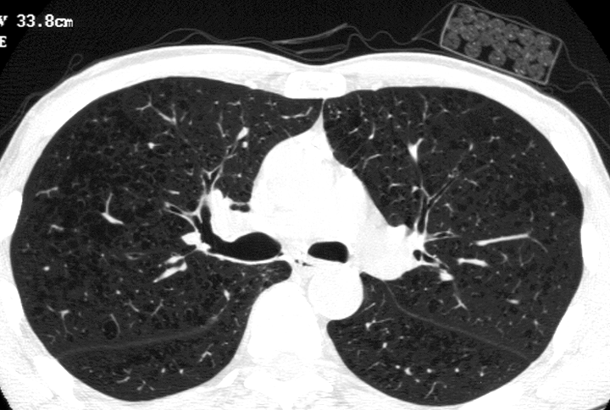

Slide 52
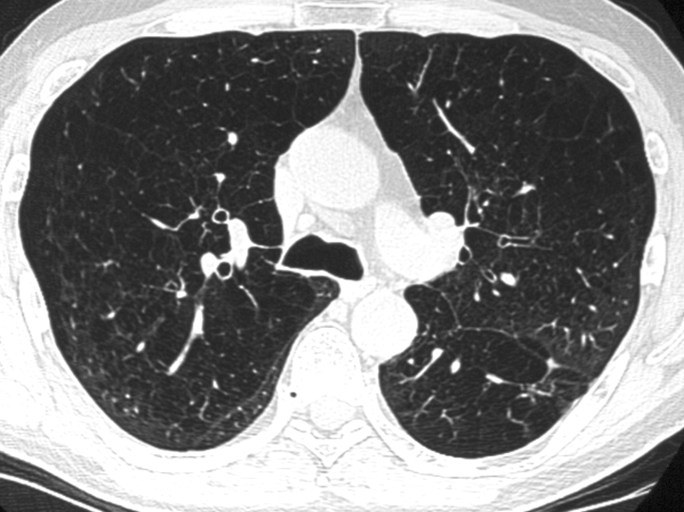
Centrilobular Emphysema

Slide 53
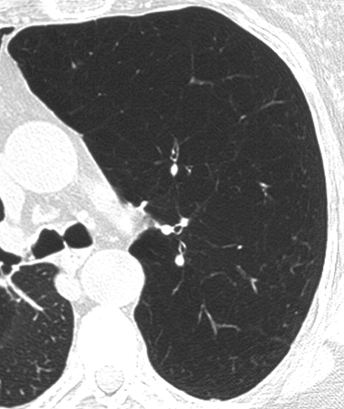
Panacinar Emphysema

Slide 54
HRCT
The Alphabet Soup

Slide 55
Interstitial Disease
BOOP-79%
UIP-71%
DIP-63%
AIP-65%
NSIP-9%

Slide 56
UIP
Idiopathic
Idiopathic Pulmonary Fibrosis
Associated with Collagen Vascular Disease
Scleroderma
Rheumatoid Arthritis
Polymyositis
Familial
Hermasky-Pudlak
Medications
Bleomycin
Occupational
Asbestos

Slide 57
UIP Pathology
Fibroblastic foci
“Spatial heterogeniety”-varying degrees of fibrosis
“Temporal heterogeniety”-admixed mature and immature collagen

Slide 58
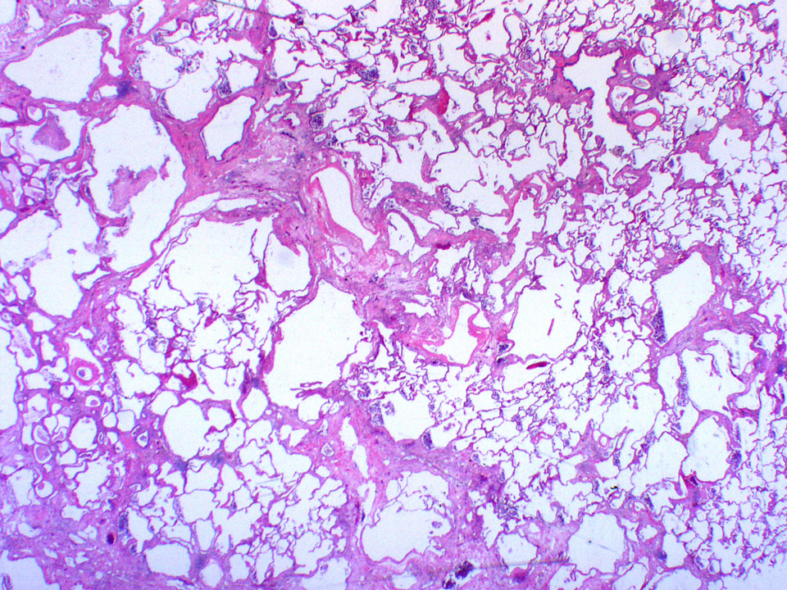

Slide 59
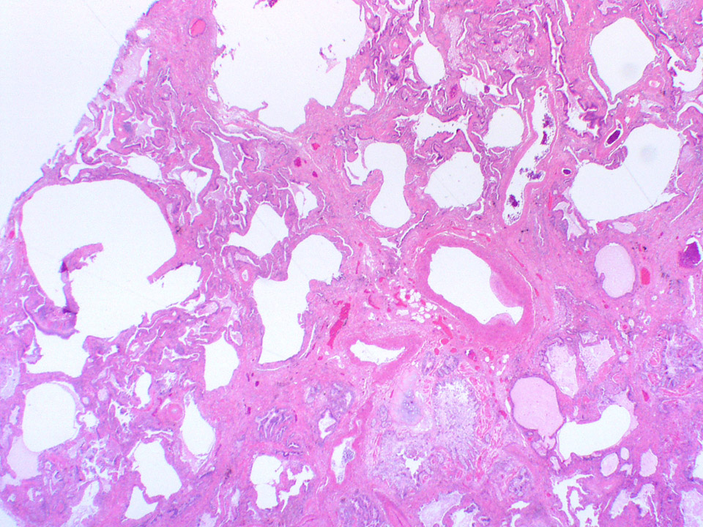

Slide 60
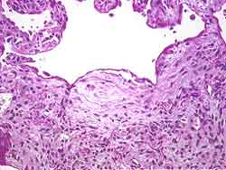

Slide 61
UIP CT/HRCT
Irregular Interlobular Septal Thickening
Subpleural Bands
Intralobular Septal Thickening
Traction Bronchiectasis
Honeycomb/Cystic Changes
Ground Glass Disease

Slide 62
CT Criteria for diagnosis of IPF
Definite IPF :
Peripheral, basal predominance
Reticular abnormality
Honeycombing
Absence of:
Extensive ground glass abnormality (extent > reticular abnormality)
Micronodules
Discrete cysts
Multilobular mosaic attenuation/air trapping
Consolidation
Notes:
62

Slide 63
CT Criteria for diagnosis of IPF
Consistent with IPF :
Peripheral, basal predominance
Reticular abnormality
Absence of:
Extensive ground glass abnormality (extent > reticular abnormality)
Micronodules
Discrete cysts
Multilobular mosaic attenuation/air trapping
Consolidation
Notes:
63

Slide 64
CT Criteria for diagnosis of IPF
Inconsistent with IPF :
Upper/mid-lung predominant
Peribronchovascular predominance
Extensive ground glass abnormality (extent > reticular abnormality)
Presence of any of the following:
Micronodules
Discrete cysts
Mosaic attenuation/air trapping
Consolidation
Notes:
64

Slide 65
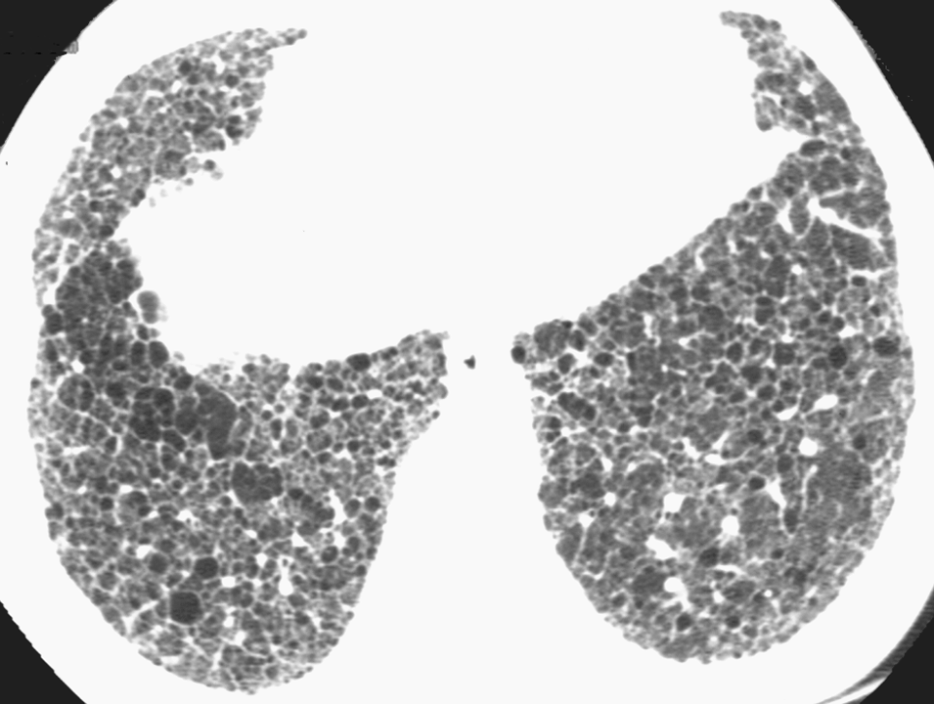

Slide 66
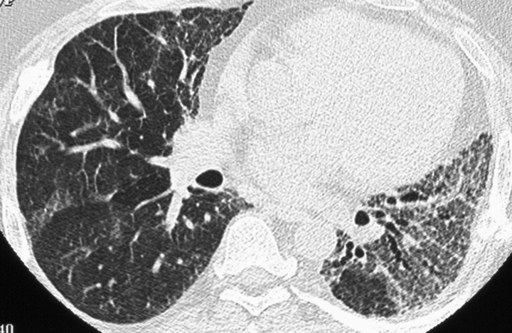

Slide 67
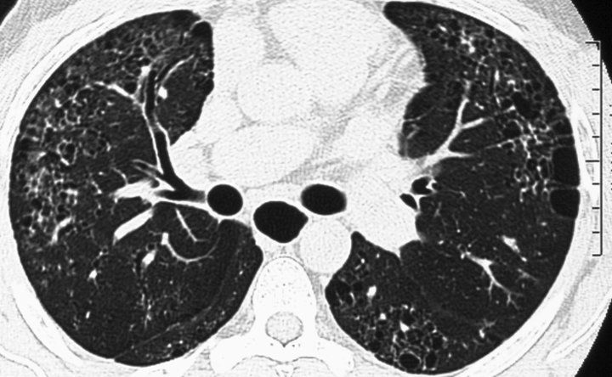
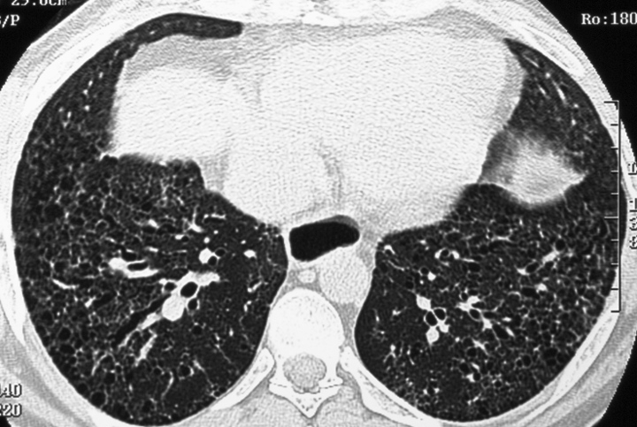

Slide 68
UIP Are CT Findings Diagnostic?
71% correct diagnosis; moderate degree of agreement
Ddx:NSIP
End-stage fibrosis from HP/sarcoid
Radiologic/Pathologic correlation

Slide 69
NSIP Non-Specific Interstitial Pneumonitis
Similar presentation to UIP
Avg. age 50
Dyspnea
Diagnosis of exclusion
May be seen with connective tissue disease/drug toxicity

Slide 70
NSIP Pathology
Characteristics of other IPs
Temporally and spatially homogeneous
Cellular and fibrotic patterns

Slide 71
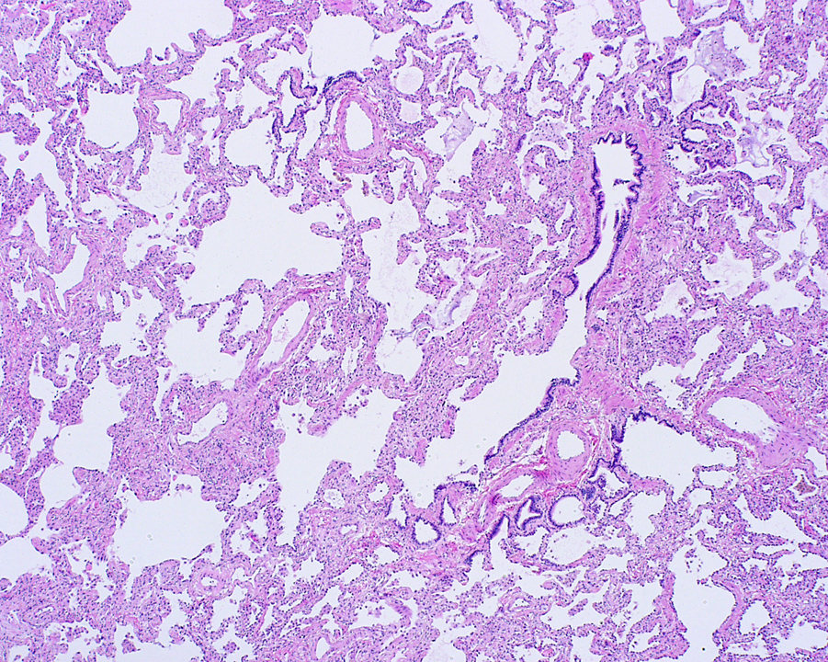

Slide 72
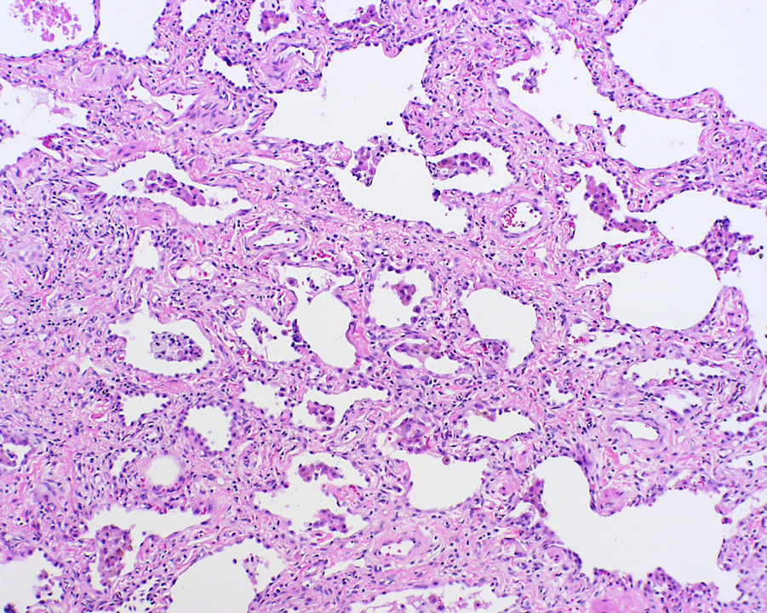

Slide 73
NSIP CT
Patchy peripheral ground glass opacity
Focal consolidation
Irregular linear opacities
Bronchial wall thickening/dilation

Slide 74
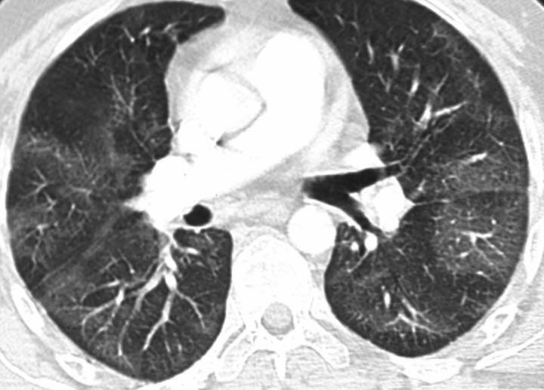
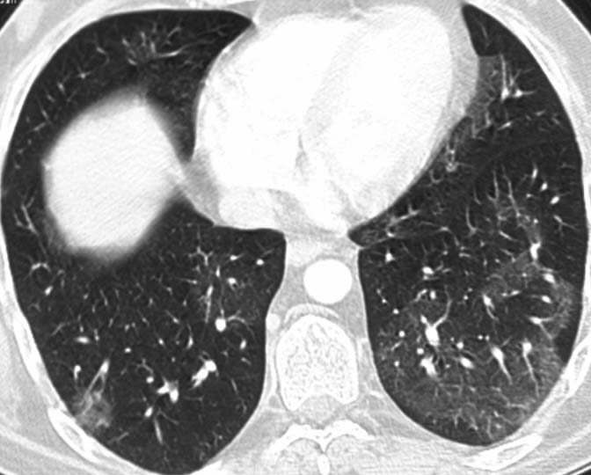

Slide 75
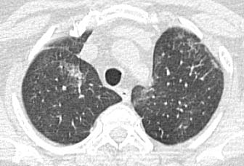
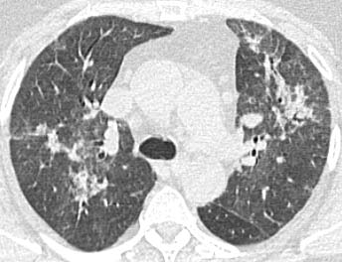

Slide 76
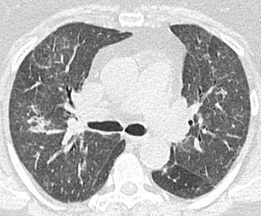
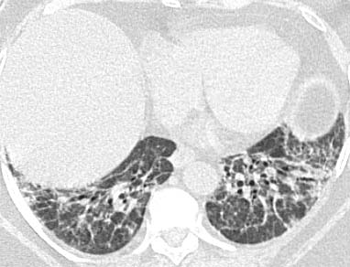

Slide 77
COP Cryptogenic Organizing Pneumonia
Non-productive cough
Low grade fever
Malaise
May be seen with connective tissue disease, drug reaction, infection, inhalational disease

Slide 78
COP Pathology
Fibroblastic tissue in air spaces and respiratory bronchioles
Variable degree of fibrosis
Variable distribution

Slide 79
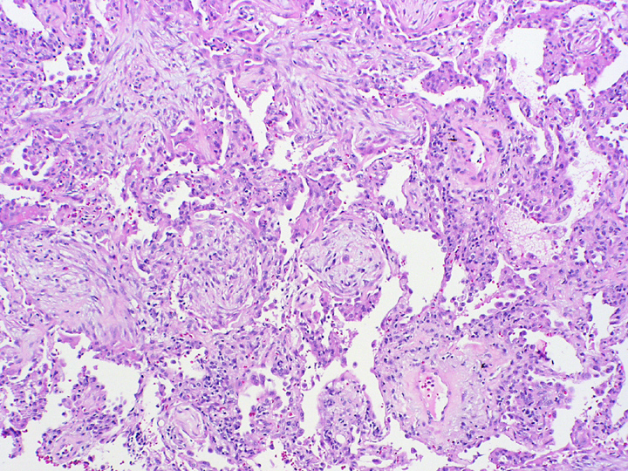

Slide 80
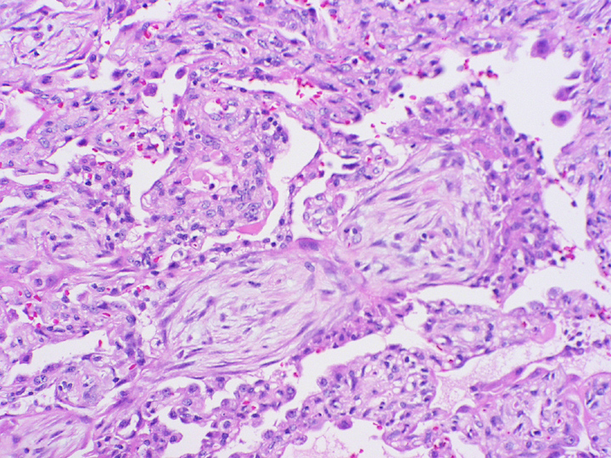

Slide 81
COP CT
Unilateral or bilateral patchy consolidation
Sub-pleural/peri-bronchiolar
Ground glass opacities
Minimal interstitial inflammation fibrosis
Bronchial wall thickening/dilation

Slide 82
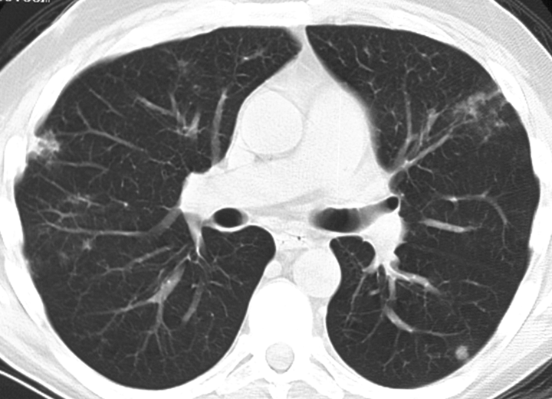

Slide 83
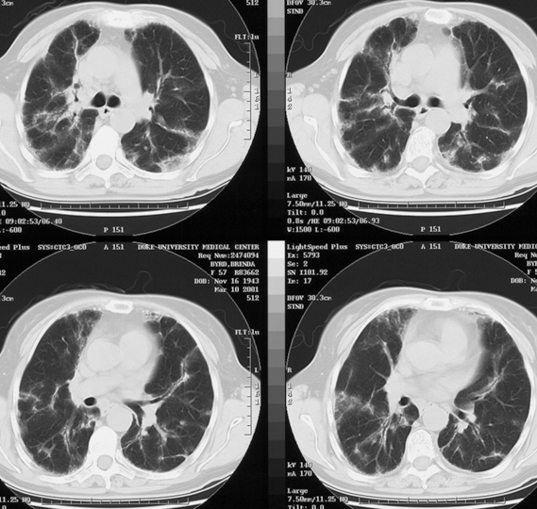

Slide 84
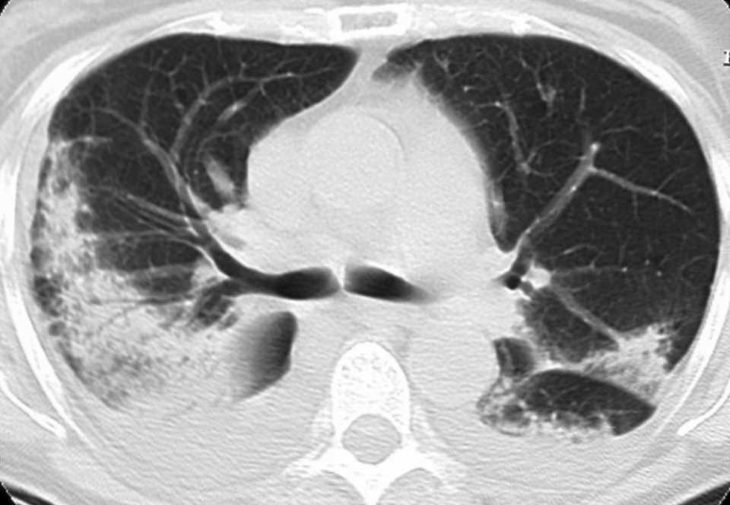

Slide 85
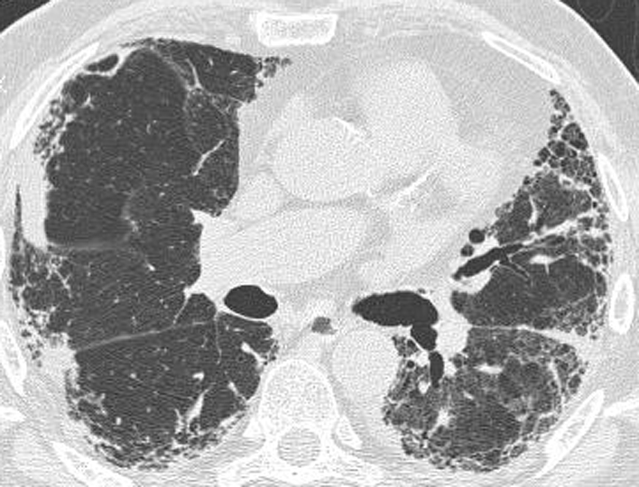
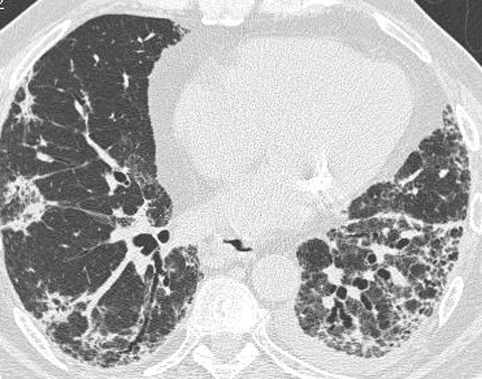

Slide 86
AIP Pathology
“Diffuse alveolar damage”
Alveolar wall thickening
Proteinacious exudate
Fibroblast proliferation
25-30% exudative pattern
70-75% fibroblastic pattern

Slide 88
AIP CT
Extensive mixed ground glass and consolidation
Interlobular septal thickening
Thickened bronchovascular bundles
Late fibrosis/honeycomb
No zonal predominance

Slide 89
9/12
9/24

Slide 91
Smoking Related-ILD
Respiratory Bronchiolitis
Respiratory Bronchiolitis-ILD
Desquamative Interstitial Pneumonitis
Pulmonary Langerhans Cell Histiocytosis
(UIP)

Slide 92
Galvin, Jeffrey R. MD; Franks, Teri J. MD
Journal of Thoracic Imaging: November 2009 ;24:274-284

Slide 93
Respiratory Bronchiolitis
Ubiquitous in smokers
Histologic Finding
Centrilobular Nodules without ILD

Slide 94
Respiratory Bronchiolitis

Slide 95
RB-ILD Pathology
Macrophages in respiratory bronchioles and alveoli
Bronchiolocentric

Slide 98
RB-ILD CT
Ground glass opacities
Centrilobular nodules
Bronchial wall thickening
Reticular opacities
Upper lobe predominance

Slide 101
DIP Pathology
Numerous macrophages within alveoli
Interstitial inflammation
Uniform distribution
May be seen in Langerhans Cell Histiocytosis

Slide 104
DIP CT
Mid/lower lung zones
ground glass opacities
Reticular changes in 50%
Mild honeycomb
Emphysema may co-exist

Slide 107
PLCH Pathology
Stellate bronchiolocentric nodules
Langerhans cells
S-100 positive

Slide 109
PLCH CT
Upper lung zone predominance
Thin walled cysts with irregular shapes
1-5 mm nodules
Centrilobular
Peribronchiole
+/- cavitation “cheerios”

Slide 114
UIP and smoking
Relative risk of 1.6
Fibrosis as a manifestation of lung injury
May have preserved lung volumes (coexisting emphysema)
Reduced diffusing capacity

Slide 116
Conclusions
Appropriate Descriptive Terms
Diagnosis/Differential Diagnosis
Level of Confidence
Pick up Phone and Discuss if Necessary

